Slide 1
Outskirts of Galaxy Clusters beyond a Self-similar Picture
Congyao Zhang (张从尧, Masaryk U.)
E. Churazov (MPA), K. Dolag (USM), W. Forman (CfA),
A. Kravtsov (UChicago), N. Lyskova (IKI), I. Zhuravleva (UChicago),
and many others
2025/05/26 @SJTU

Slide 2
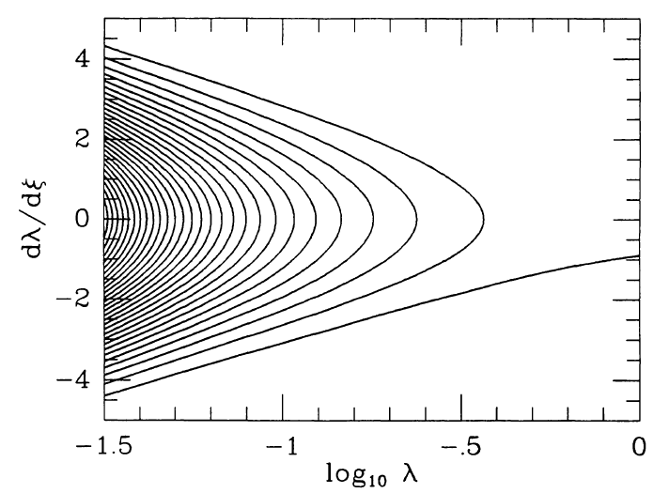
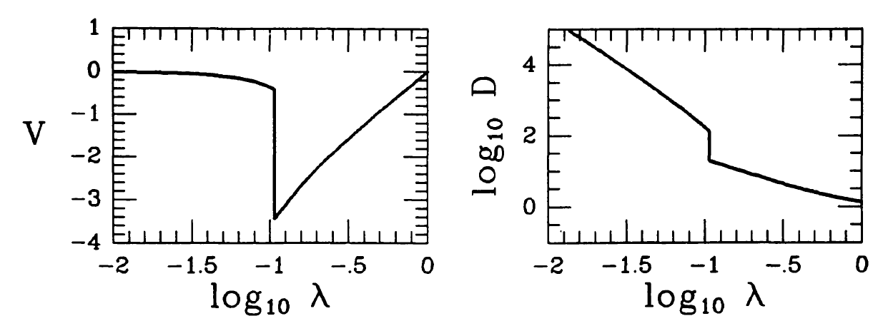
Self-similar spherical collapse model
Einstein–de Sitter universe
$$λ= \frac{r}{r_{ta}}$$
$r_{ta }∝ t^{δ}$
$M∝ a^{Γ_{s}}$
$$Γ_{s}= \frac{dlog⁡(M)}{dlog⁡(a)}$$
Fillmore 1984, Bertschinger 1985

Slide 3
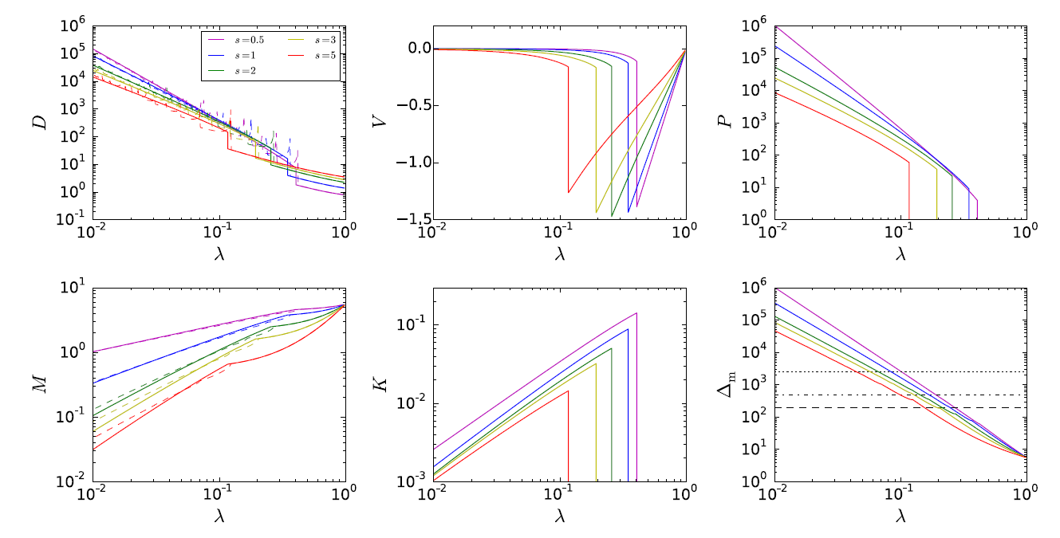
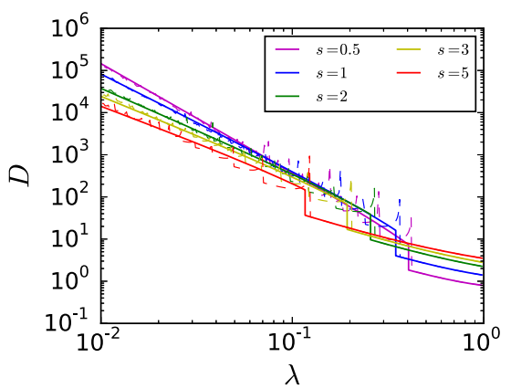
Γ_{s}
Γ_{s}
Accretion shock
Γ_{s}
Γ_{s}
Γ_{s}
Splashback boundary
Shi 2014
Entropy profile
Spherical symmetry
Evolving smoothly
Shi 2016

Slide 4
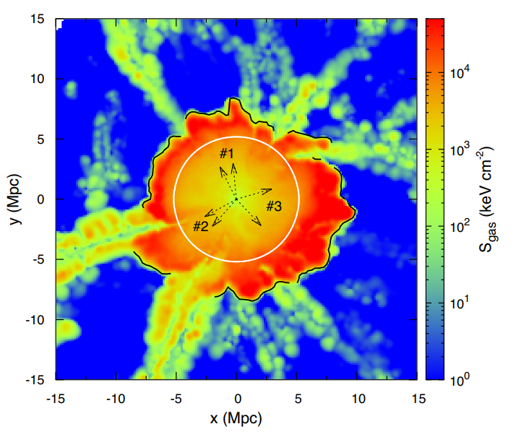
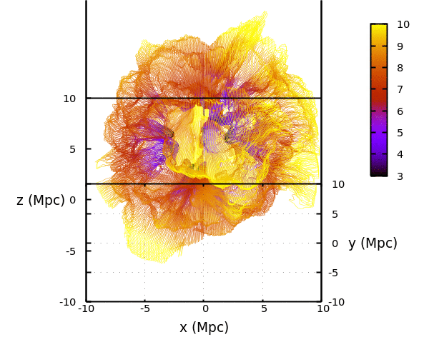
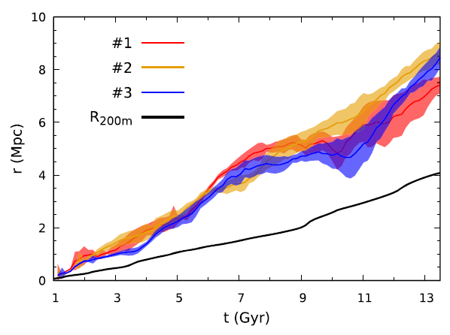
Zhang+2020

Slide 5
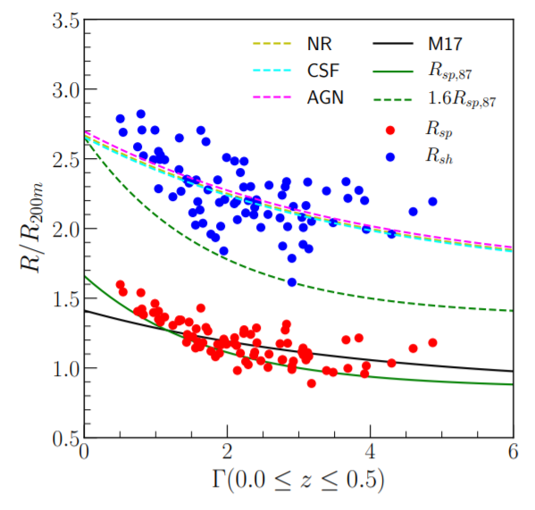
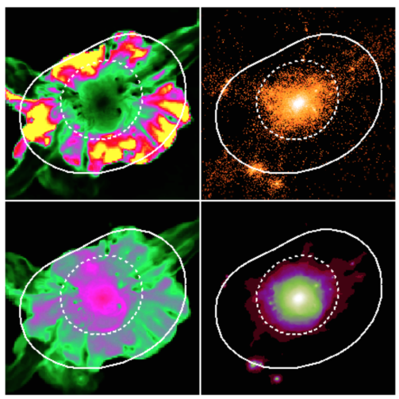
Aung+2021
Diemer+2014, Mansfield+2017

Slide 6
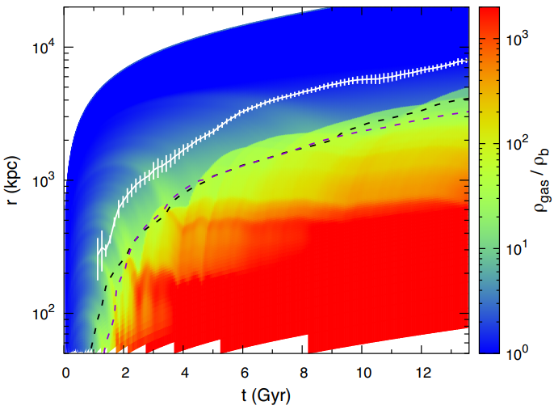
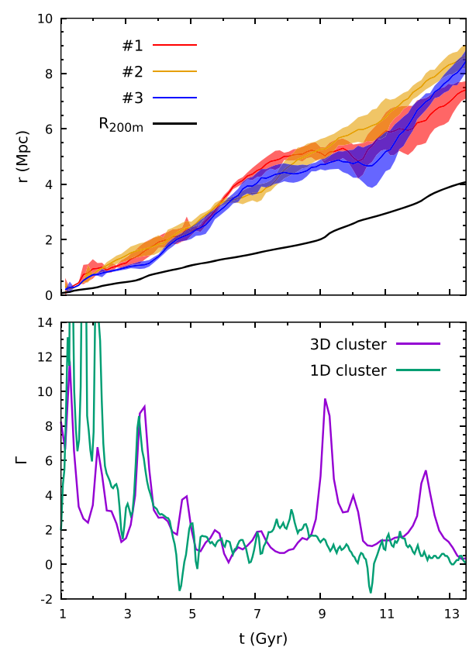
$$Γ= \frac{∆log⁡(M)}{∆log⁡(a)}$$
Γ_{s}
Zhang+2020

Slide 7
Total mass accretion rate
Merger shock
$$Γ_{vir}=\frac{ⅆlnM_{vir}}{ⅆlna}≠Γ_{s}$$
Smooth mass accretion rate
Accretion shock

Slide 8
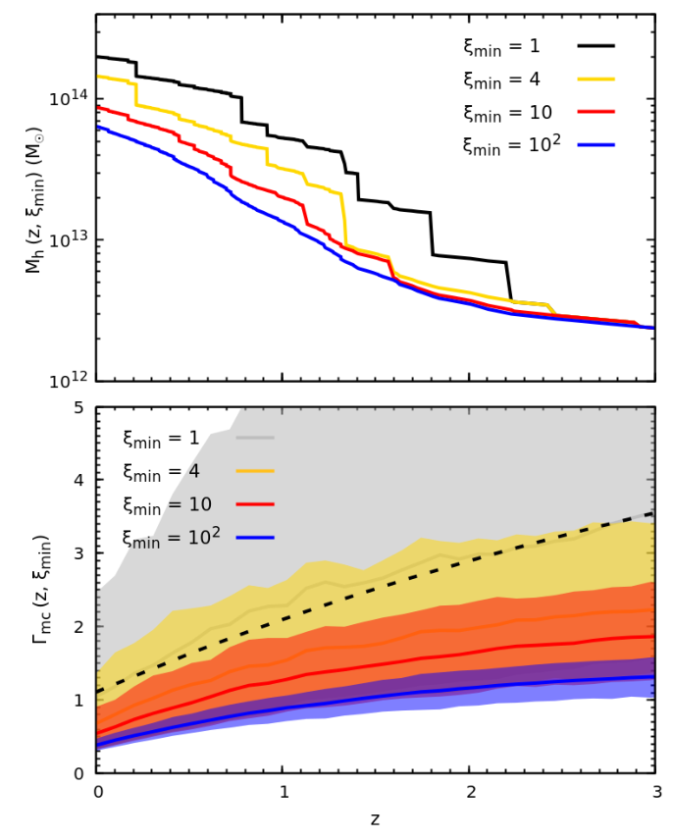
What is $Γ_{s}$ in the ΛCDM universe?
Most of clusters have low $Γ_{s} \left(\sim 1\right)$ in most of their lifetime.
EPS merger tree
How do mergers shape halo boundaries?
Zhang+2021

Slide 9
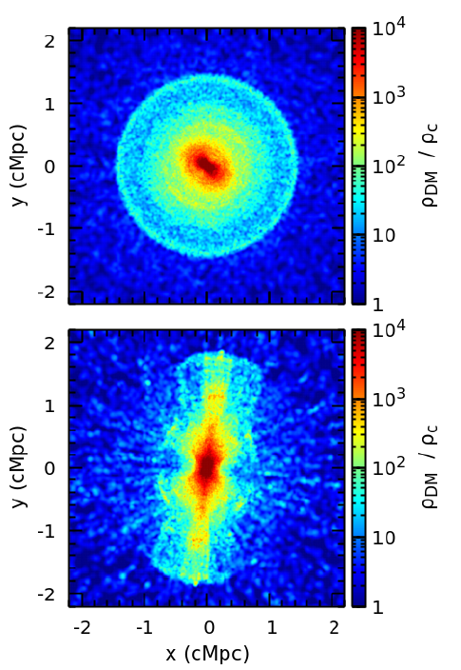
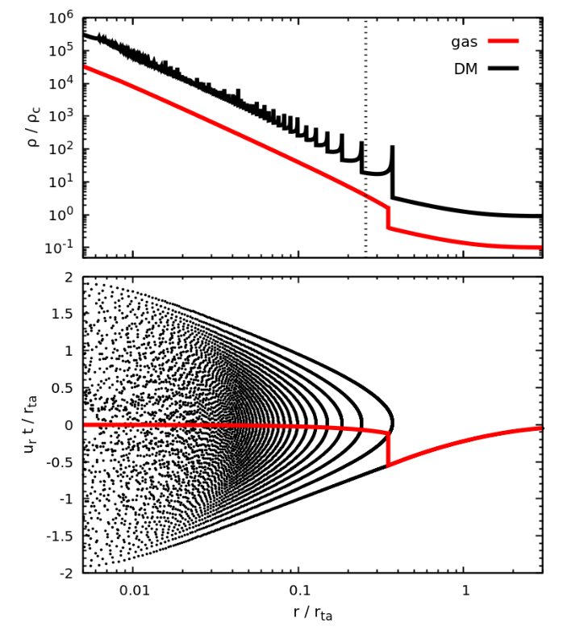
Modelling self-similar clusters

Slide 10
An example of idealized cosmological merger simulations (ξ = 2)
Zhang+2021b

Slide 11
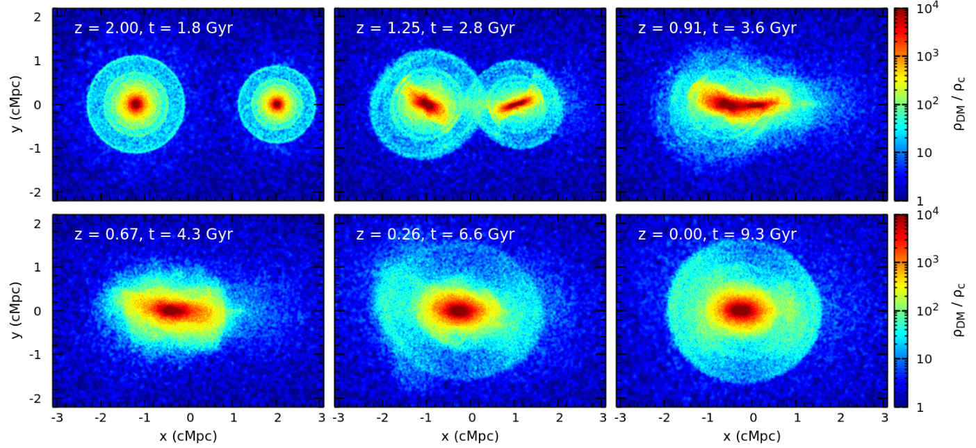
Evolution of DM distribution

Slide 12
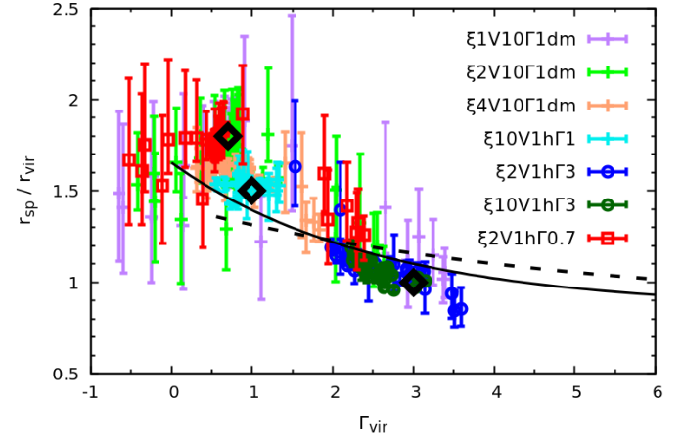
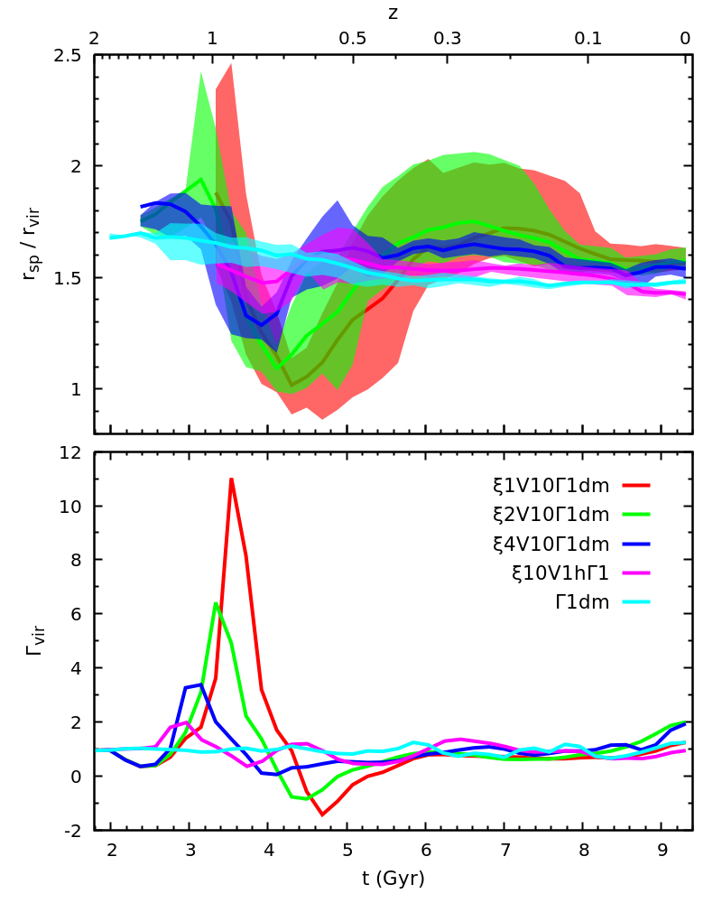
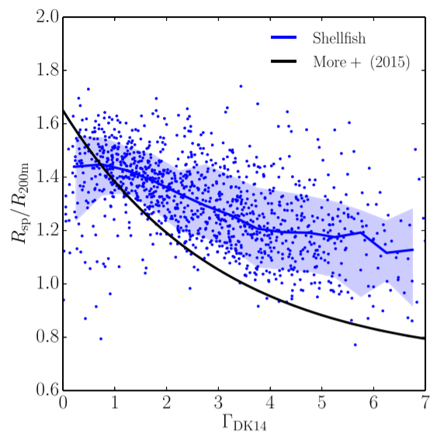
Δt ~ 1.2 Gyr
Γ_{s} = 1
ξ = 1
ξ = 2
ξ = 4
ξ = 10
isolated
Γ_{s}
Scatters in Γ – R_{sp} relation
Mansfield+2017

Slide 13
transitional stage: rapid contraction
smooth accretion dominates (>r_{vir})

Slide 14
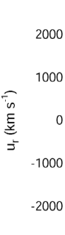
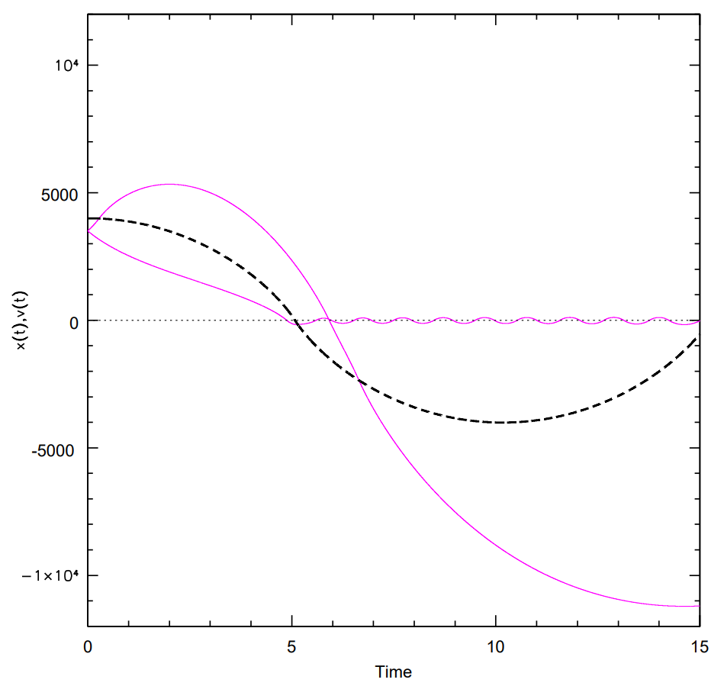
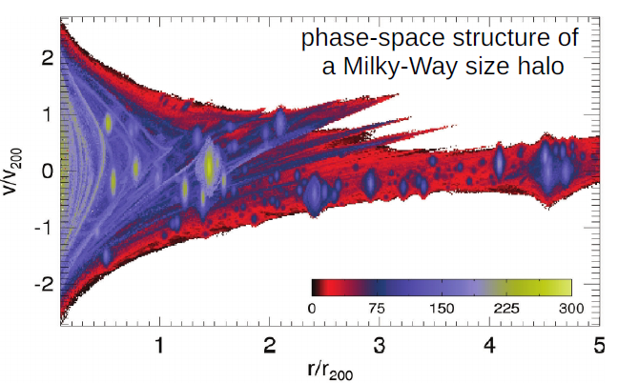
“3-body scattering”
subhalo
Credit: E. Churazov
Vogelsberger&White2011

Slide 15
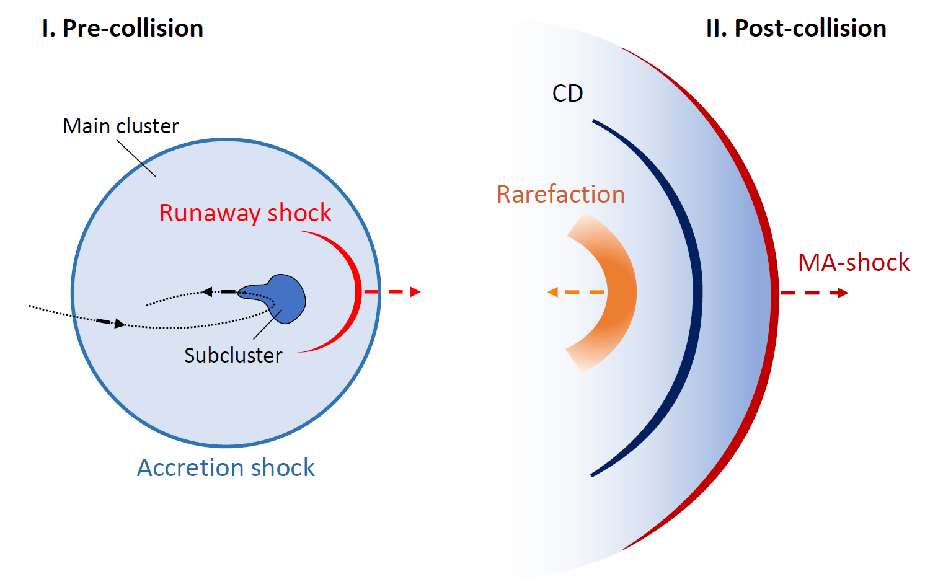
Runaway merger shock and merger-driven outflows
Shock-driven
Merger-accelerated Accretion shock (MA-shock)
Zhang+2020a, 2020b

Slide 16
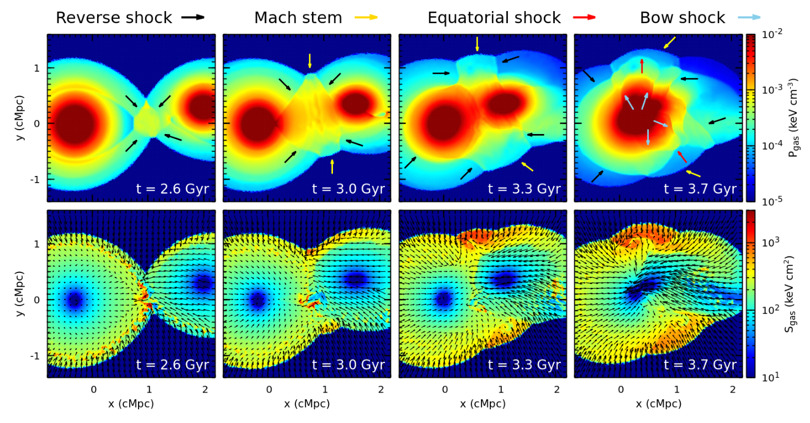
Evolution of gas atmospheres in the pre-merger stage

Slide 17
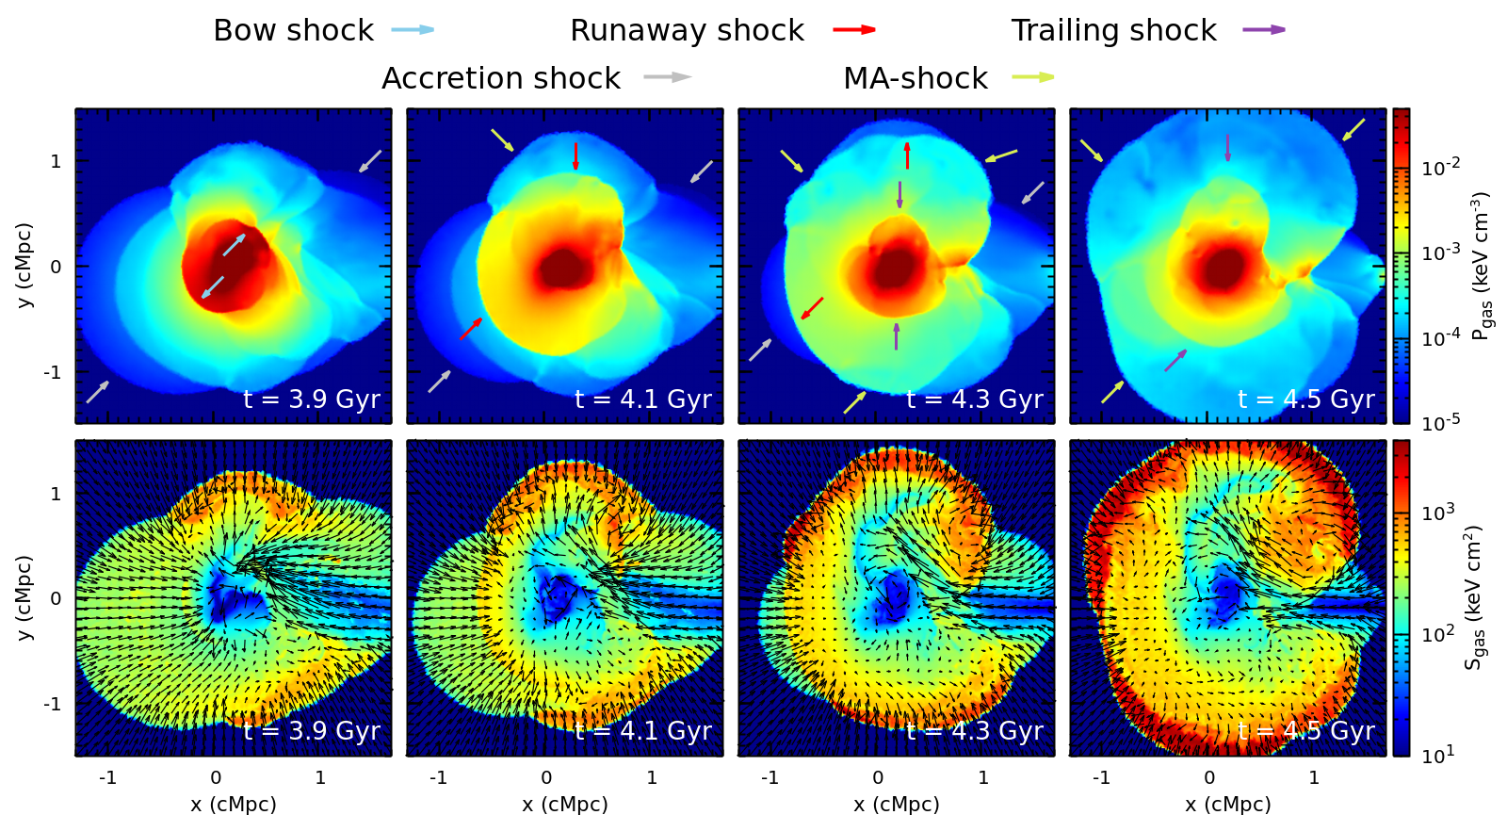
MA-shock

Slide 18
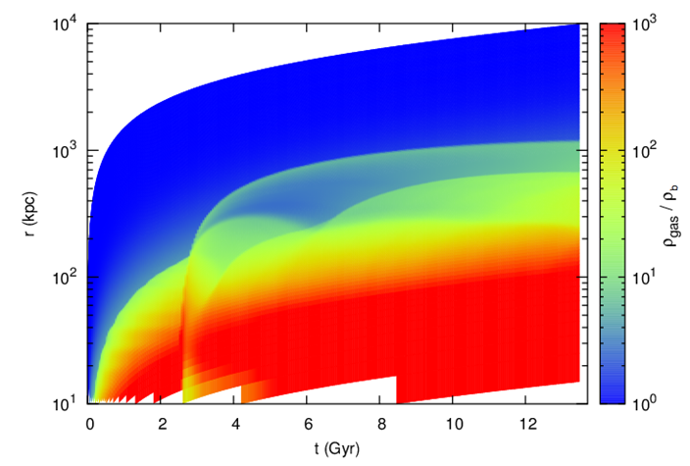
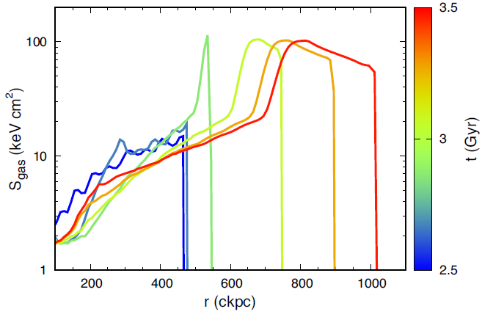
1D cosmological simulation
II
I
CD
Rarefaction
MA-shock
MA-shock
Accretion shock
CD
Merger shock

Slide 19
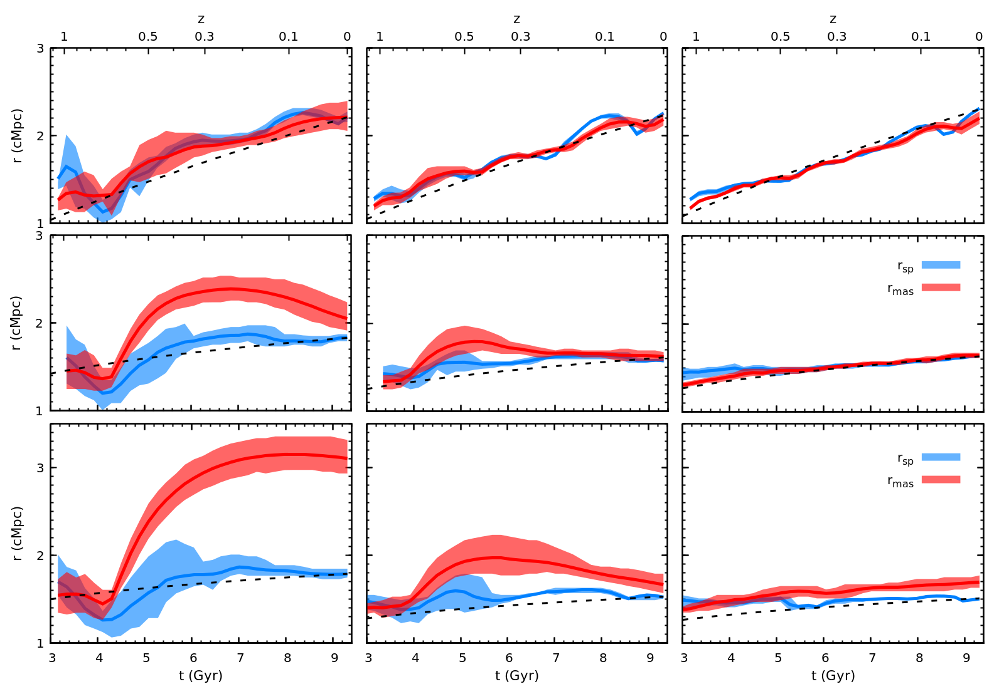
Shock-splashback radial offsets
Major merger (ξ = 2)
Minor merger (ξ = 10)
Isolated cluster
Γ_{s} = 3
Entropy
Γ_{s} = 1
Splashback radius
Shock radius
DM
Γ_{s} = 0.7
Splashback radius
Shock radius
Aung+2021

Slide 20
Anisotropic smooth mass accretion in galaxy clusters
Γ_{s} = 3
Γ_{s} = 1
Γ_{s} = 0.7

Slide 21
Take home messages
Total M$AR Γ_{vir}$vs. smooth MAR $Γ_{s}$
Splashback radius: $Γ_{vir}$
Shock radius: $Γ_{s}$
Mergers drive shock-splashback radial offsets

Slide 23
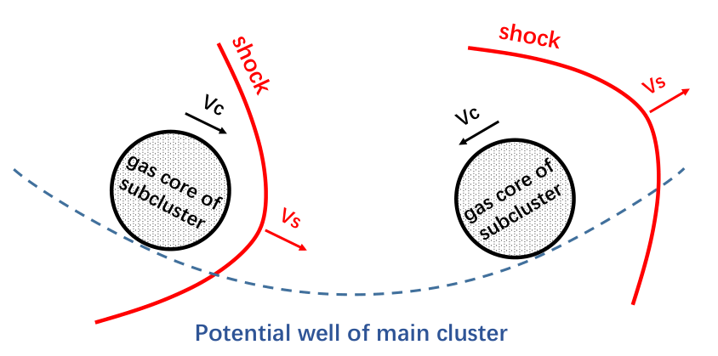
Evolution of merger shocks
Driven phase
Detached phase
Bow shock
Runaway shock

Slide 24
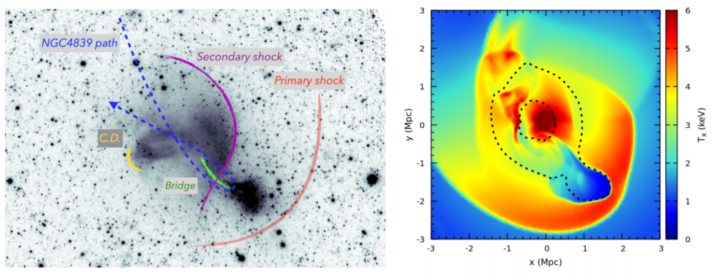
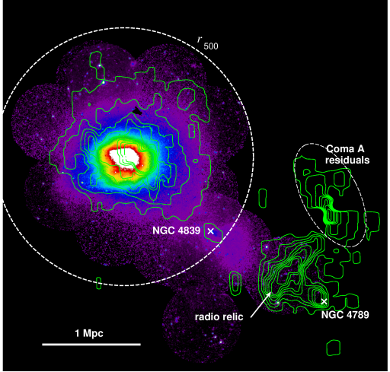
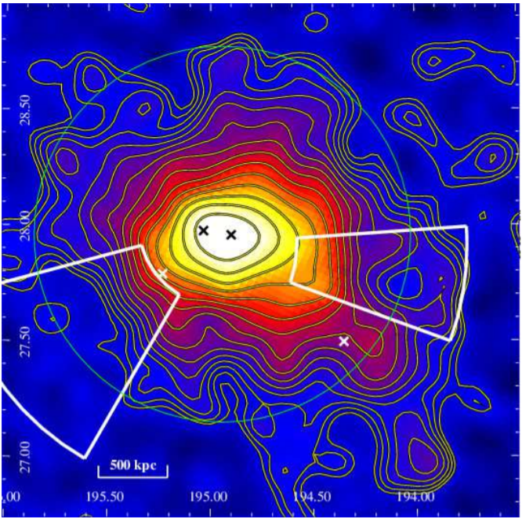
X-ray
Planck SZ
W
SE
SRG/eROSITA
Model
W
Zhang+2021a
Planck 2013
Churazov+2021,2022

Slide 25
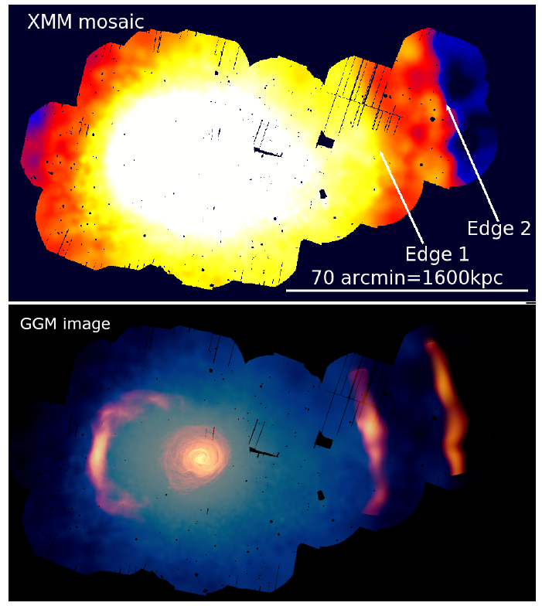
Shock-driven CDs in Perseus cluster?
Walker et al. 2022
Zhang+2020b
Notes:
Concentric circles

Slide 26
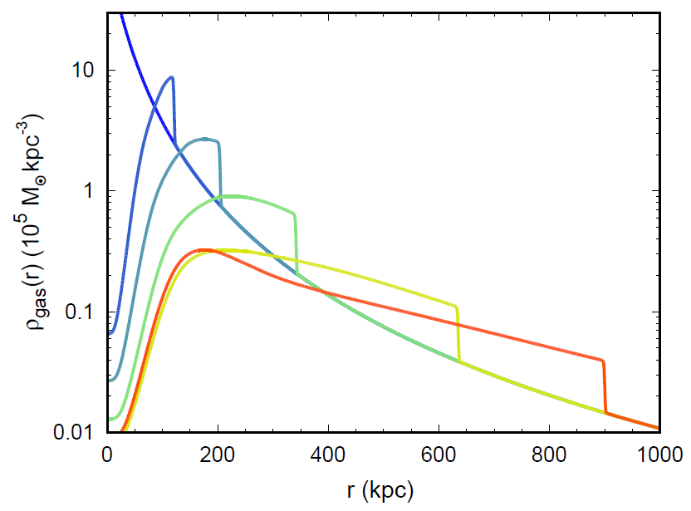
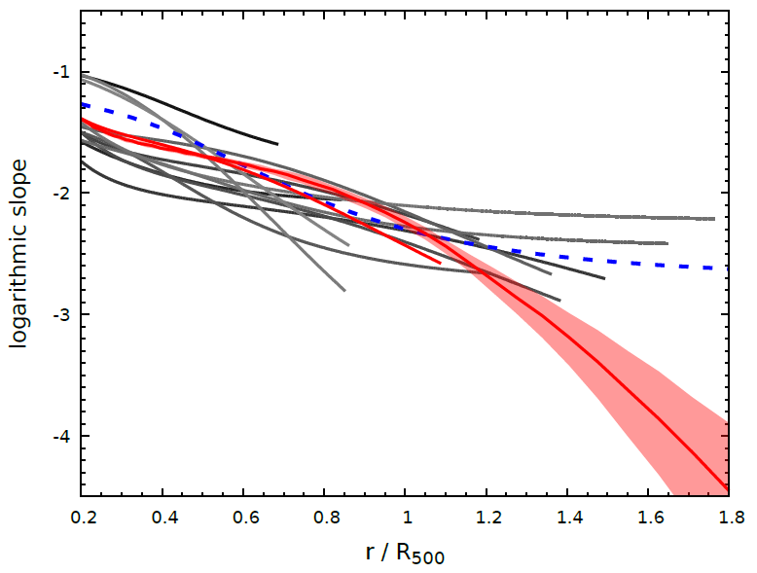
Runaway shocks are “long-lived” while moving down a steep gas density gradient
X-ray observations
“Habitable zone” of runaway shocks
ω = 3
Zhang+2019, Waxman+1993
Vikhlinin+2006, Ghirardini+2019

