Slide 1
Stirring up the intracluster medium with substructures
Go Ogiya (Zhejiang U)
with Daisuke Nagai (Yale); Oliver Hahn (Vienna); Xun Shi (Yunnan U)

Slide 2
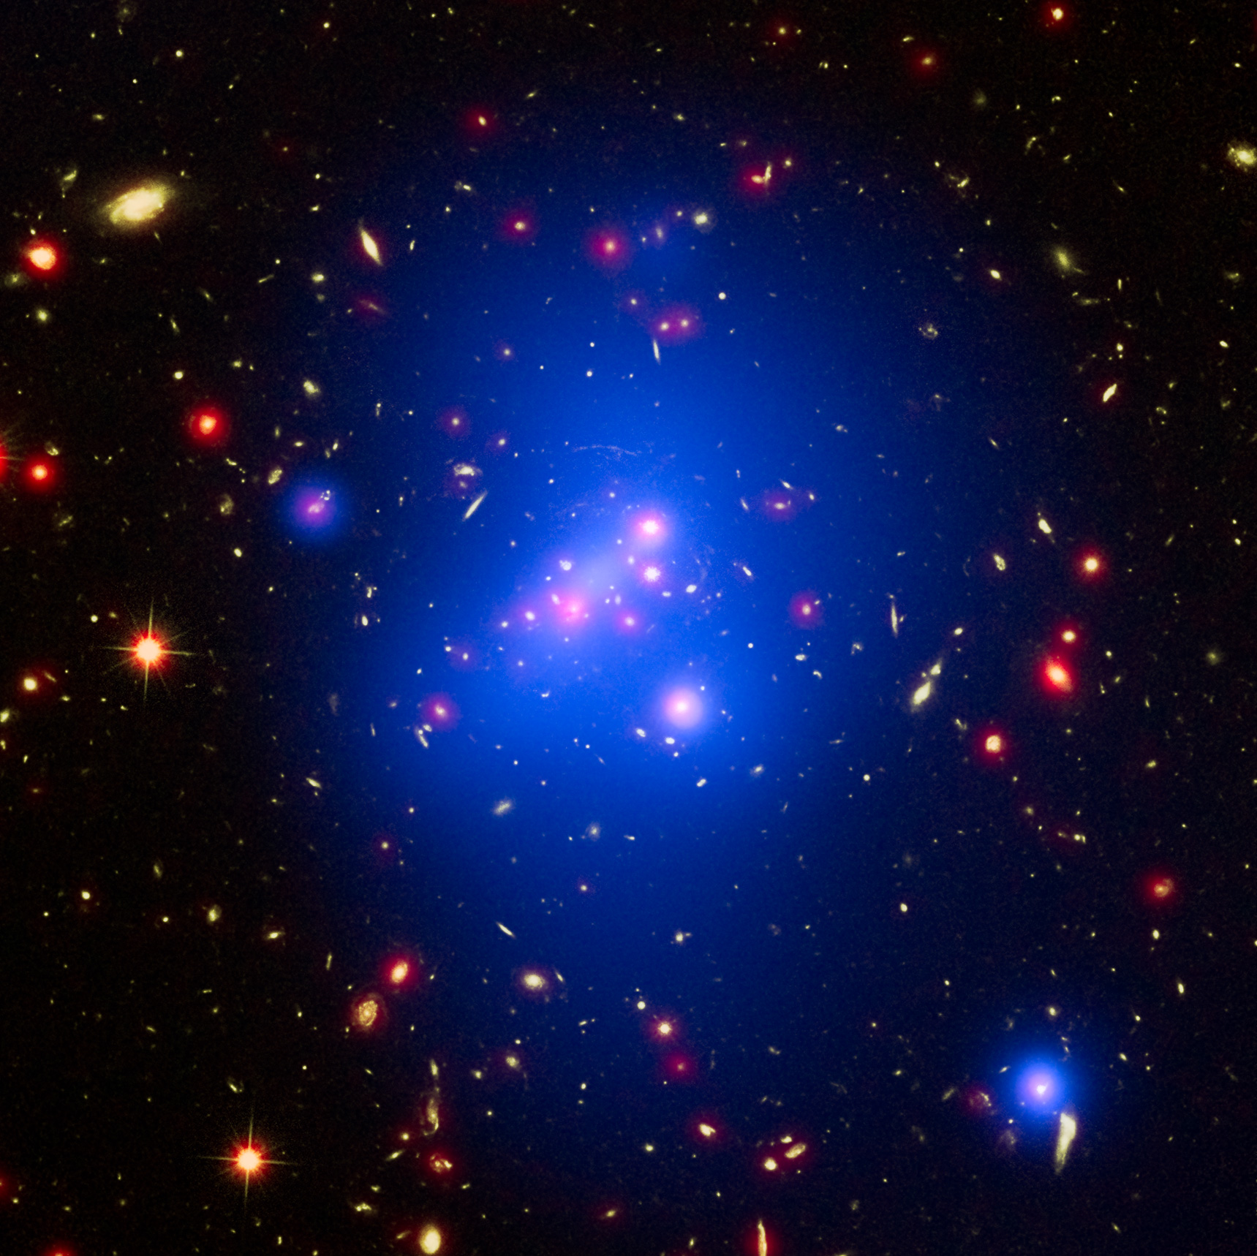
Galaxy clusters
By ESA and HST
Red: stars
Blue: ICM
Huge self-gravitational system
Hierarchical assembly
Structure formation
Cosmology
Components
Member galaxies
Dark matter halo
Intracluster medium (ICM)

Slide 3
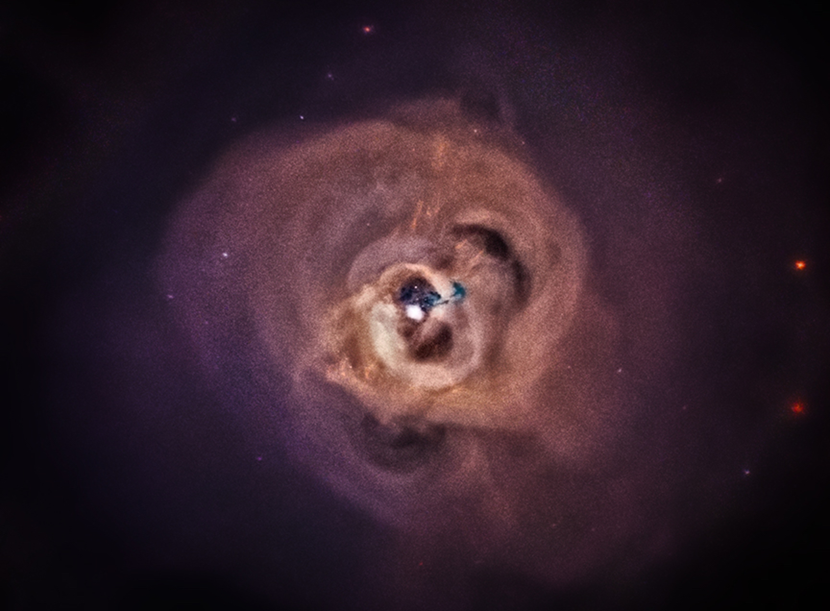
Turbulent ICM
Perseus cluster by Hitomi (precursor to XRISM)
Mild turbulence in the center
Mach ~ 0.1-0.2
Perseus, Centaurus, Coma, Abel2029, Hydra-A …
Complexed structures
Cavity, arc, filament
AGN feedback?
McNamara et al. (2000); Wagner at al. (2012); Zhang et al. (2022)
Gas sloshing?
Churazov et al. (2003); ZuHone et al. (2011); Roediger et al. (2024)
20kpc

Slide 4
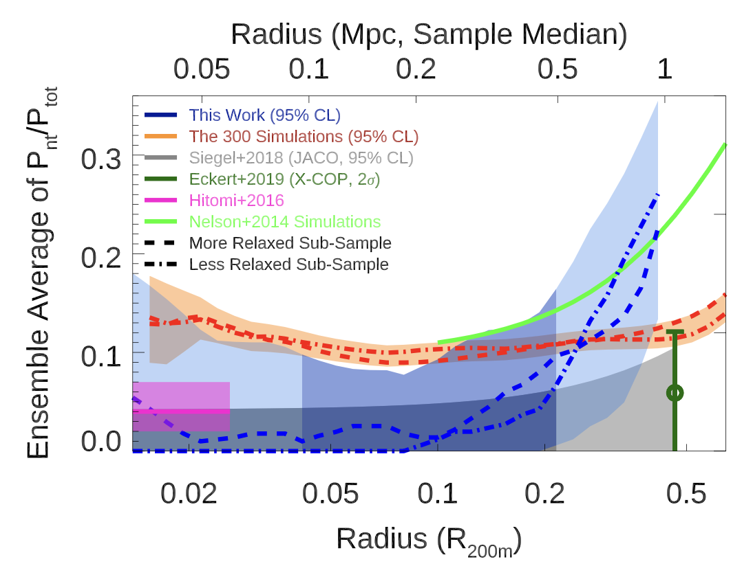
Turbulent ICM
Gas pressure of the ICM
Sub-sonic turbulence in entire clusters
Fraction of non-thermal term increases with radius
Mach ~ 0.5 at R=1Mpc
Sayers et al. (2021)

Slide 5
Substructures
By ESA and HST
Red: stars
Blue: ICM
Member galaxies
Surrounded by own halos
Hosting galactic gas
~10% of the cluster mass
Interaction with the cluster
Orbital E of substructures transferred to the ICM
Drive and maintain turbulence?

Slide 6
Cluster setup
Host cluster
NFW halo (Navarro et al. 1997)
ICM (based on universal entropy profile, Babyk et al. 2018)
Consistent with X-ray empirical relations (Vikhlinin et al. 2009)
Substructures
NFW halo + galactic gas
N and initial X and V of substructures are sampled from PDFs
Based on results from cosmological simulations

Slide 7
Semi-analytic model
Cluster is supposed to be static
Trace the evolution of substructures
Orbit: Global gravitational potential + Dynamical friction
Chandrasekhar (1943); Ostriker (1999); Escala et al. (2004)
Mass: Tidal stripping + Ram pressure stripping
Mori & Burkert (2000); McCarthy et al. (2008); Drakos et al. (2022)
Energy transfer from substructures to the ICM
Dynamical friction
Ram pressure
Gas sloshing
Trace the evolution of deposited energy
Dissipation (Shi et al. 2015)
Propagation

Slide 8
Hydrodynamic simulations
N-body (dark matter) + gas particles
GIZMO (Hopkins 2015)
No cooling, no star formation, no AGN feedback
Resolution: Ndm ~ 6Mio, Ngas ~ 2Mio, spatial res ~ 0.01Mpc
Both the cluster and substructures are live systems
Same initial X, V and M with those in the semi-analytic model

Slide 9
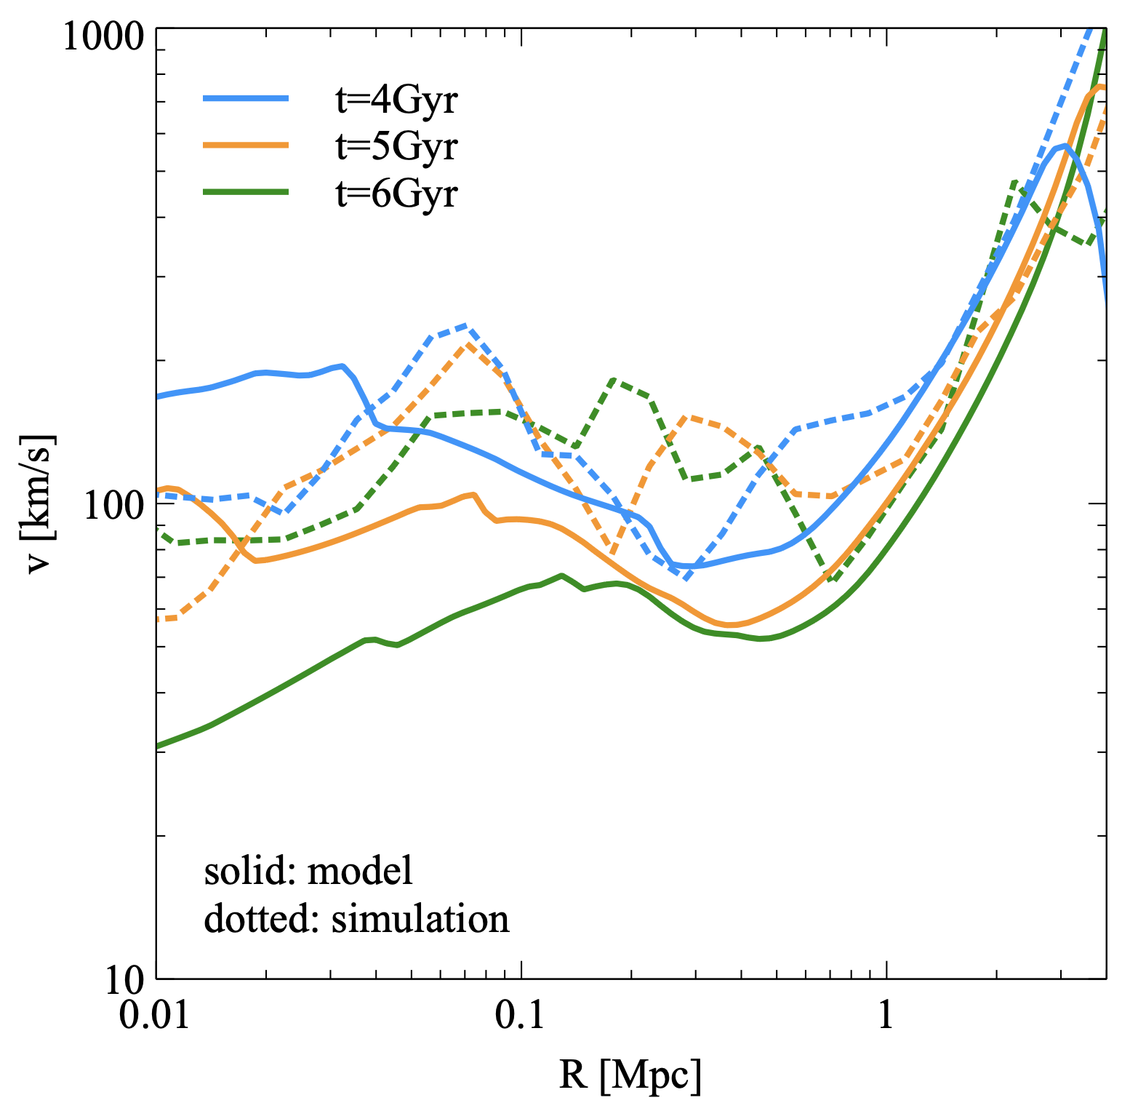
Model vs simulation
Energy at radius is converted to corresponding gas velocity
Semi-analytic model (solid) reproduces hydro sim (dotted) reasonably
In a broad R range
For > a few Gyr

Slide 10
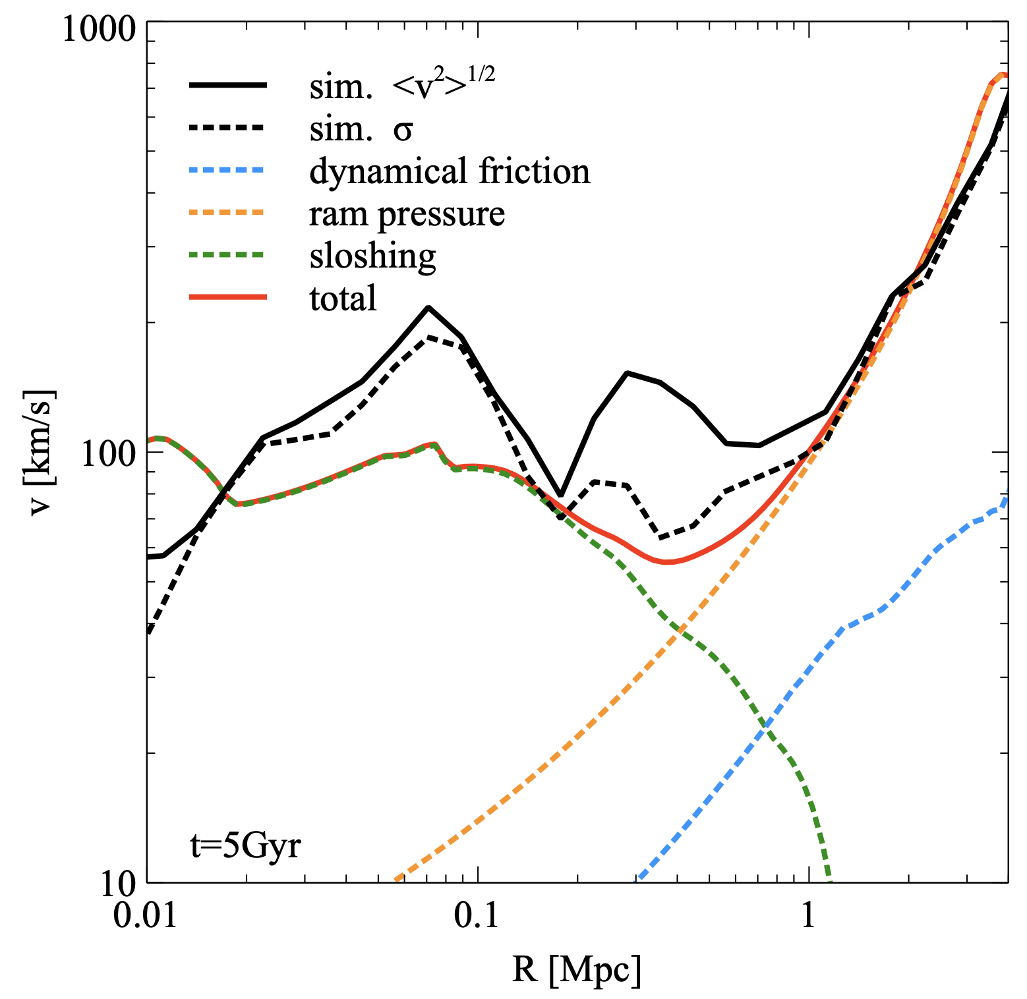
Decomposition
At r < 0.5Mpc, sloshing effects drive mild turbulence
100-200 km/s, Mach ~ 0.2
Consistent with observations
At r > 0.5Mpc, contribution from ram pressure is dominant
Turbulence gets stronger with R
At R=2Mpc, Mach ~ 0.5

Slide 11
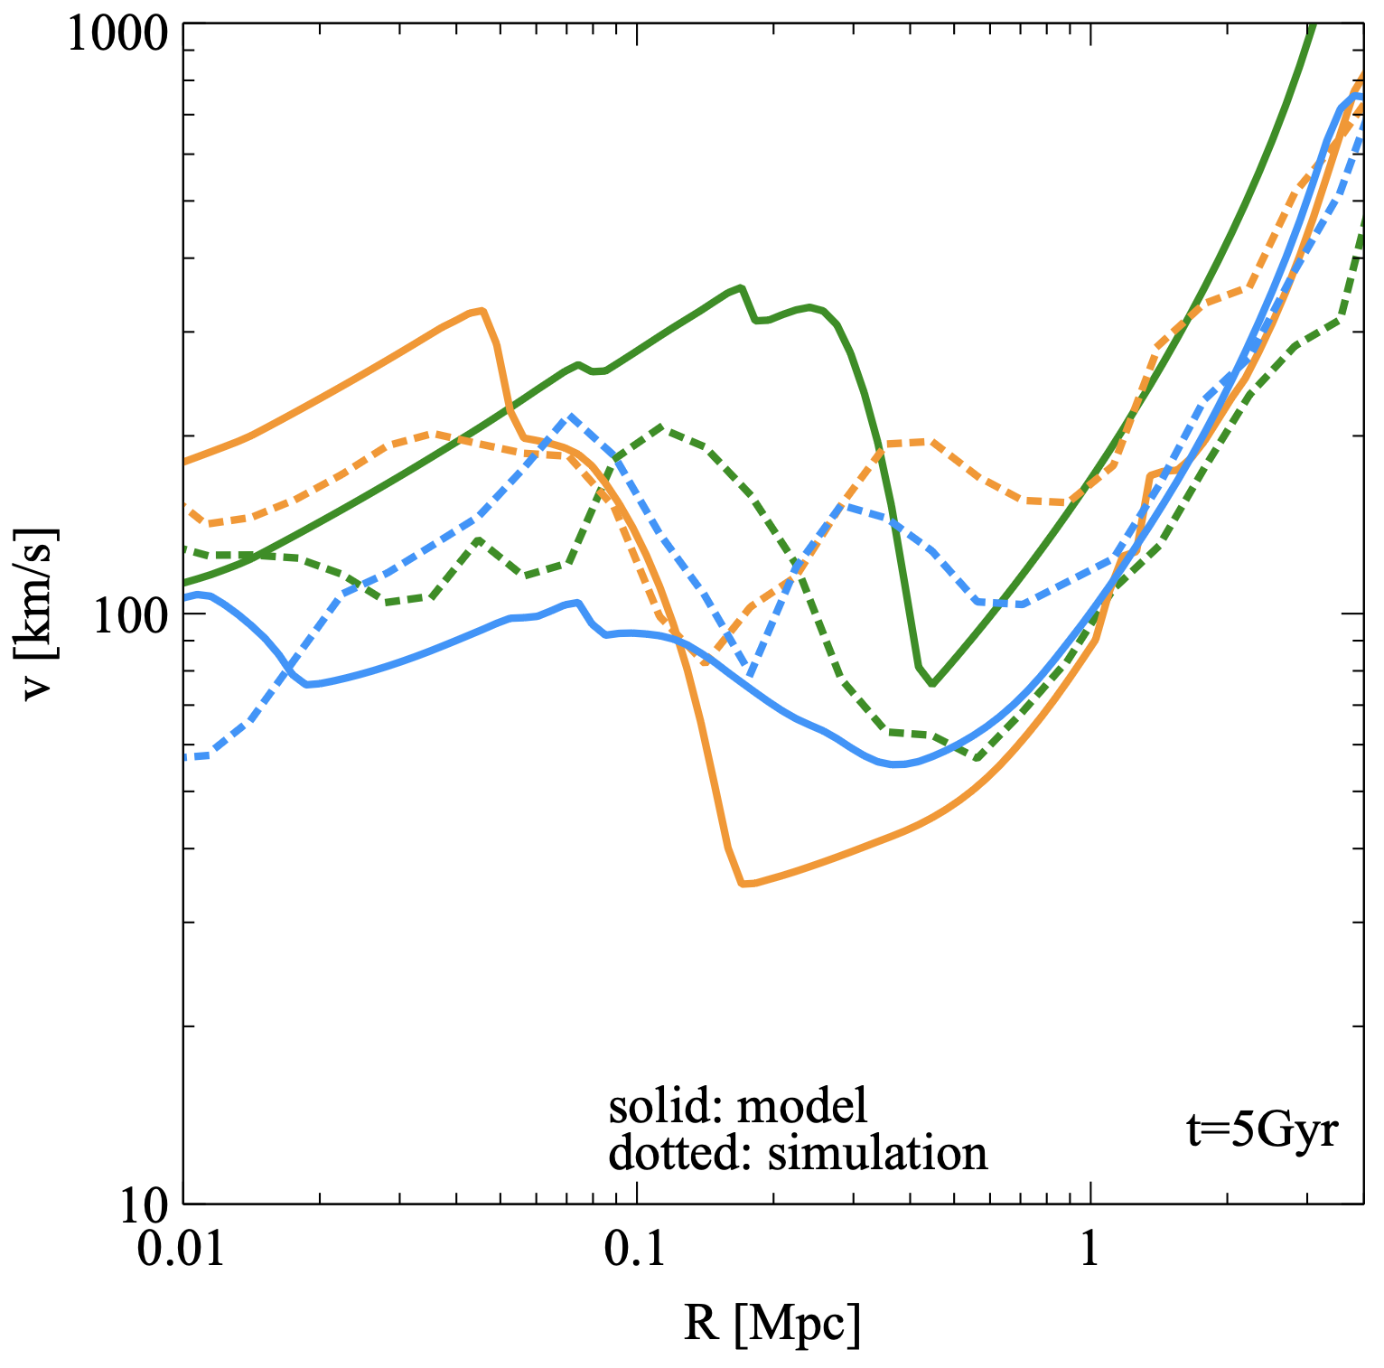
Realization variance
Initial X and V of substructures are sampled from PDFs
Results depend on realizations
Variance among realizations is small in the outskirts
Tens of substructures contribute
Larger variance in the center
A few substructures play a dominant role -> stochastic

Slide 12
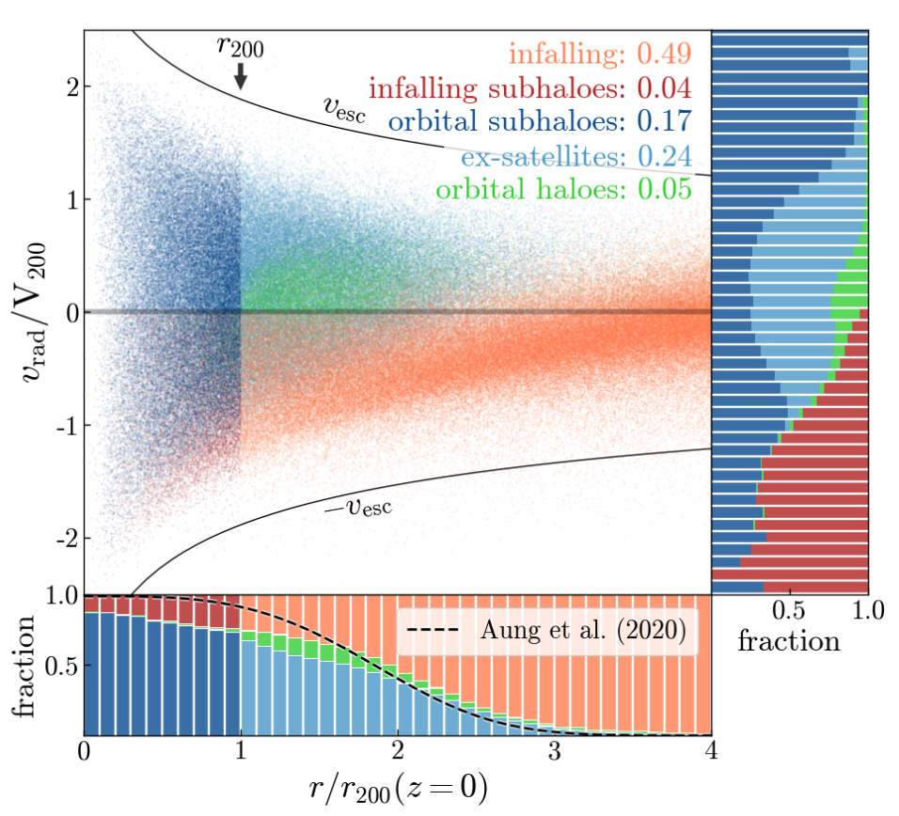
Cluster model
Two types of substructures
Orbiting population that experienced at least one pericentric passage
Number (Jiang & van den Bosch 2016)
Initial position and velocity (Jiang et al. 2015; Han et al. 2016)
Infalling population that has not experienced pericentric passage yet
Number (Fakhouri et al. 2010)
Initial position and velocity (Aung et al. 2021; Bakels et al. 2021)
X, V and M of substructures as the initial condition
Bakels et al. (2021)

Slide 13
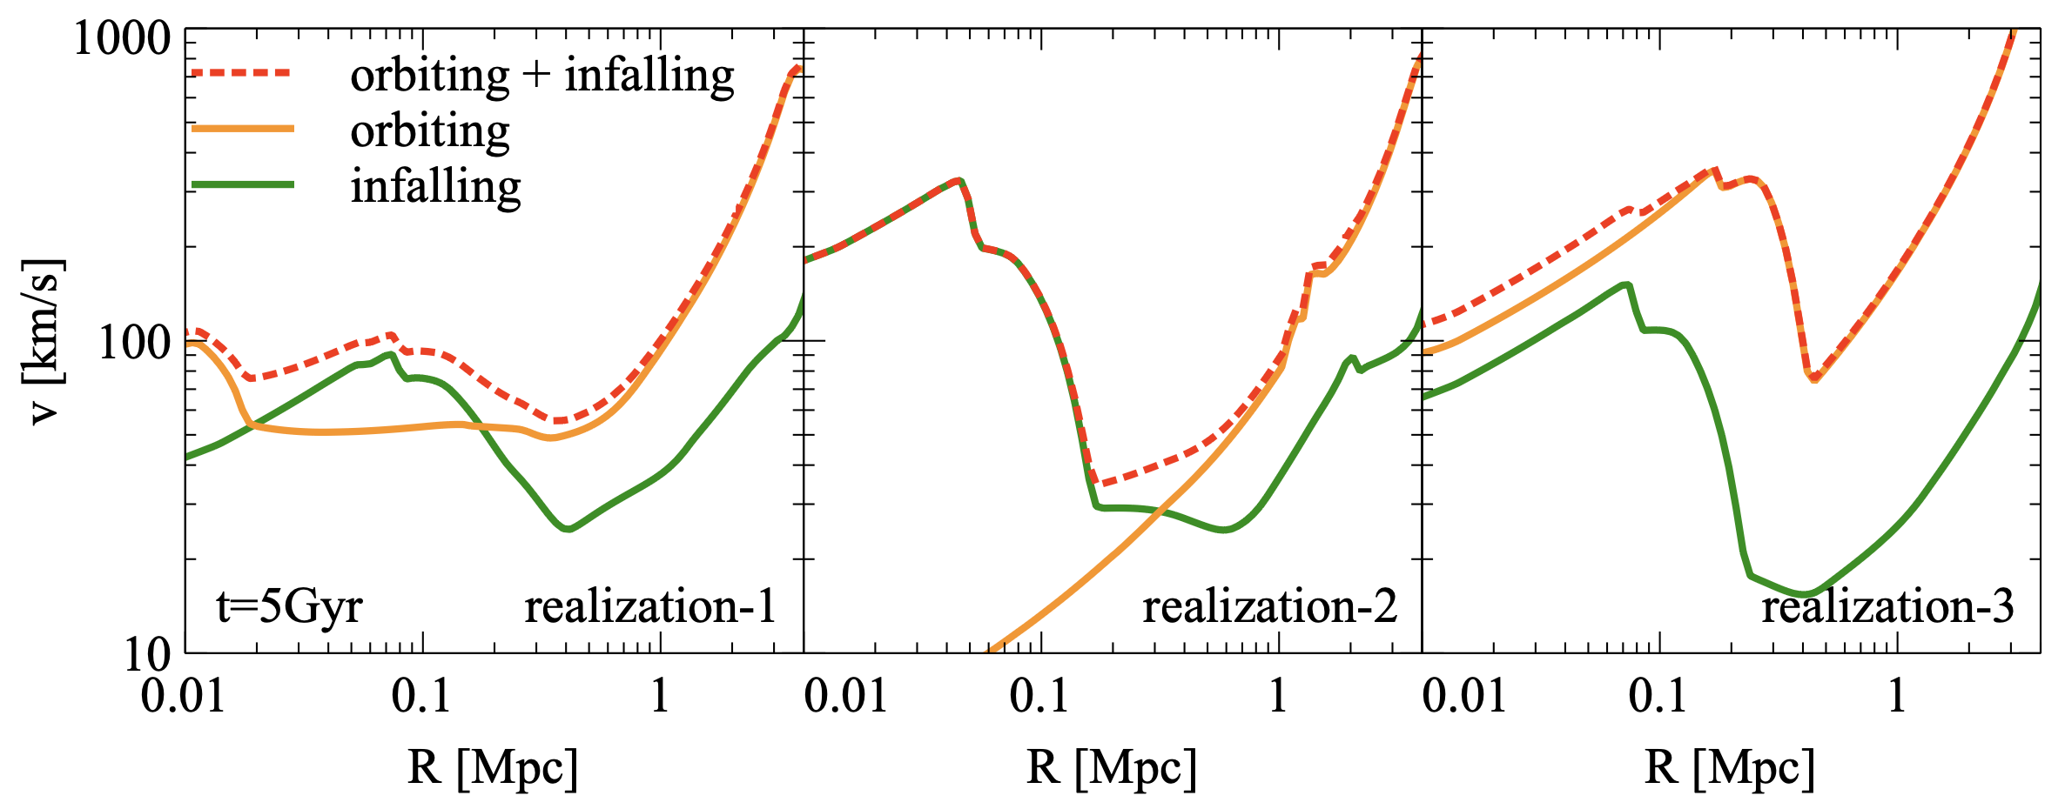
Orbiting vs Infalling
Total masses of orbiting and infalling populations are comparable
Orbiting subs stir up the outskirt (ram pressure, propagation)

Slide 14
Orbiting vs Infalling
Both populations can stir up the center (stochastic)
Improve the setup based on the depletion/splashback radius?

Slide 15
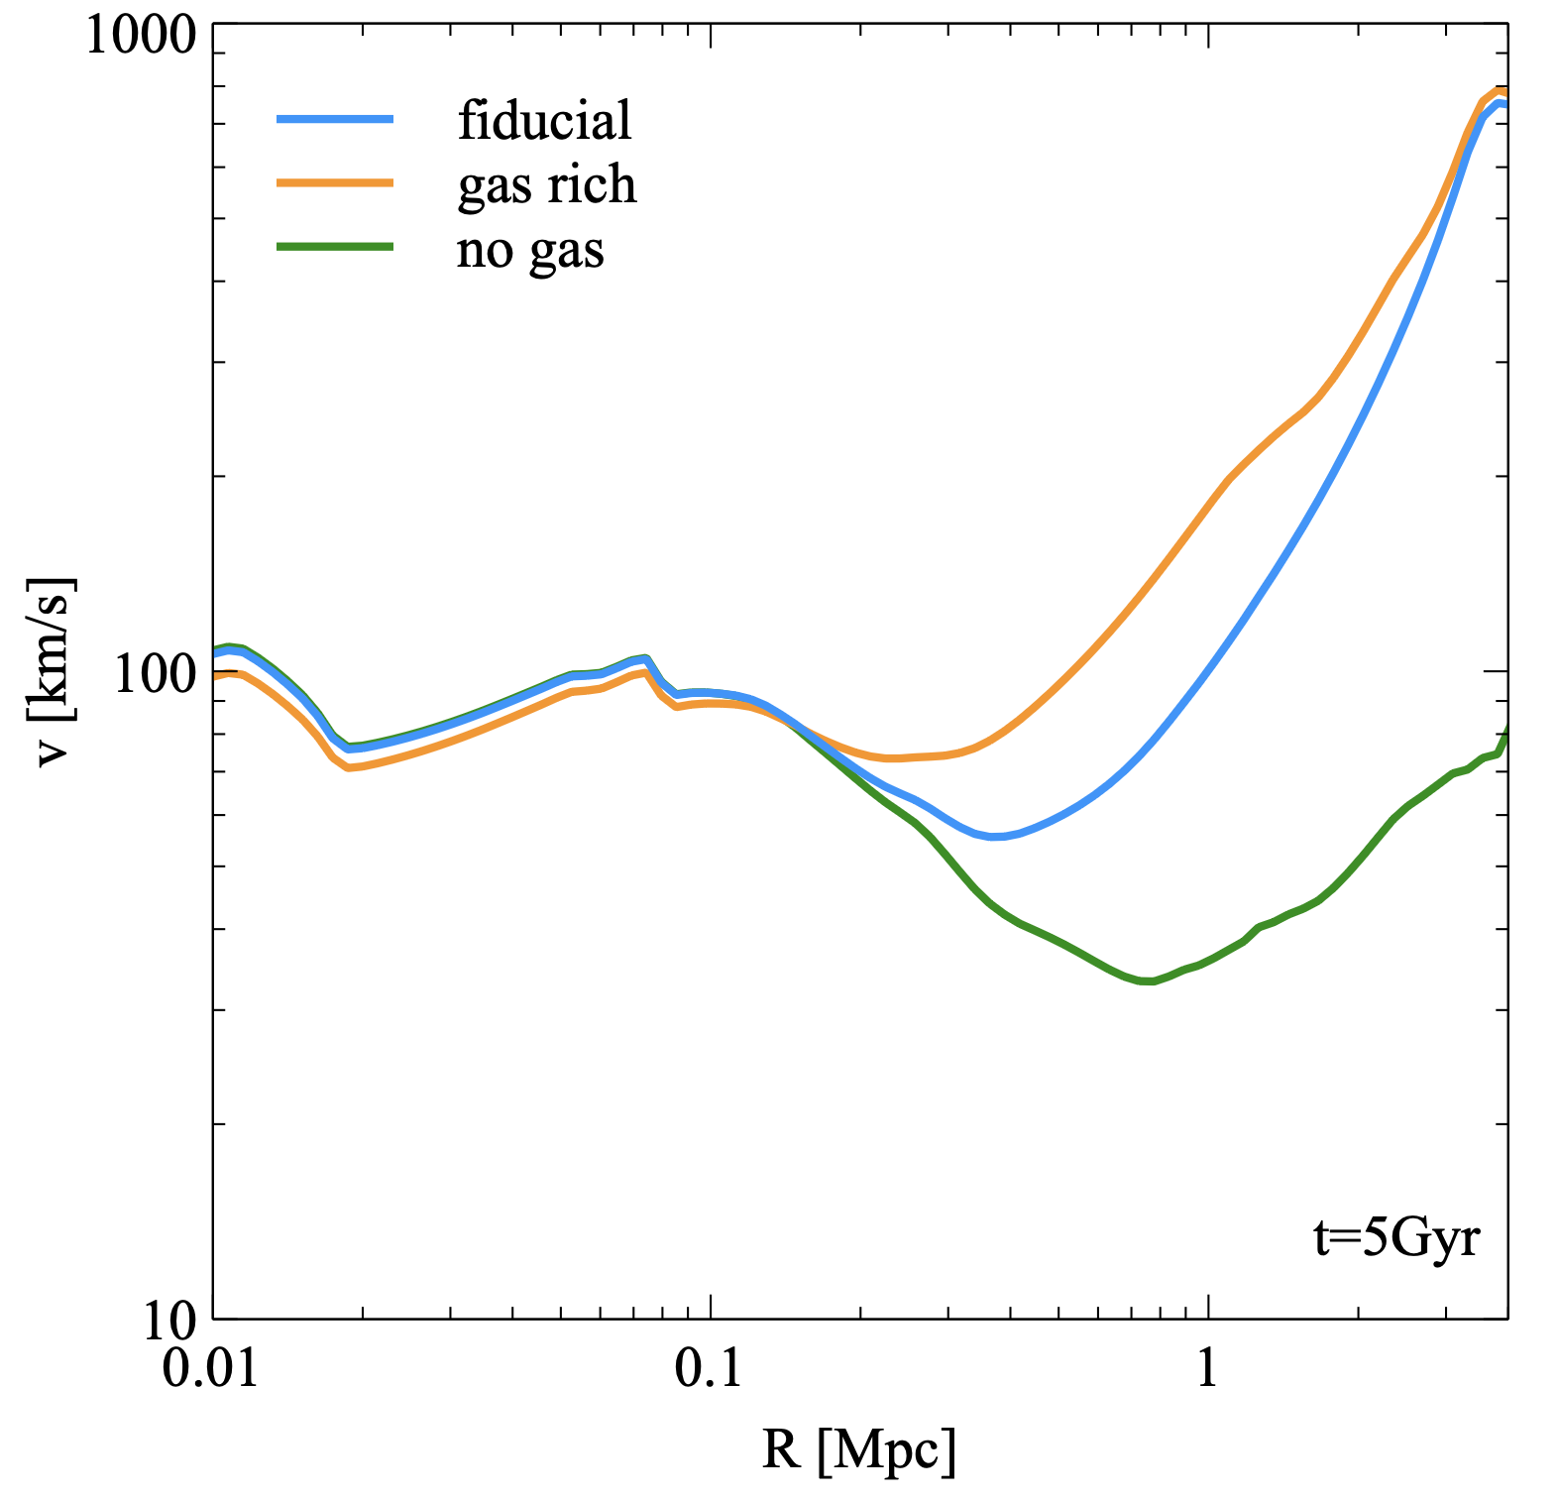
Substructure gas
Energy transfer by ram pressure is responsible to explain outskirt turbulence
Weaker turbulence in no-gas model
Increasing gas mass (x 10) while fixing total substructure mass
-> Enhancement of turbulence

Slide 16
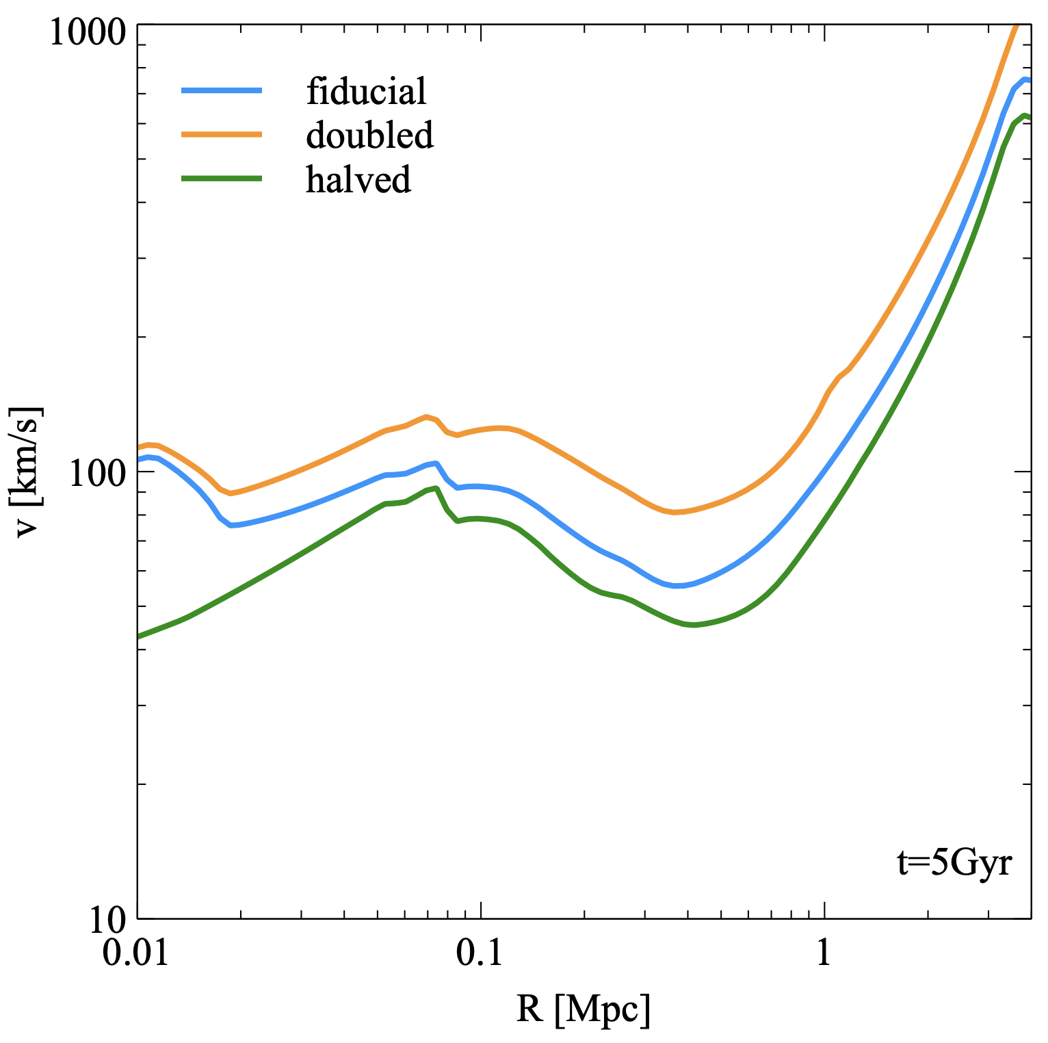
Total substructure M
Fraction of substructure mass at a fixed cluster mass has a variance of factor 2
Jiang & van den Bosch (2016)
When increasing/decreasing total substructure mass, turbulence gets stronger/weaker
Shape of turbulence profile preserved

Slide 17
Studying galactic dynamics at Zhejiang U
1-2 postdoc positions available
Welcome applications for graduate student programs
Feel free to contact me!
Email: gogiya@zju.edu.cn
WeChat

Slide 18
Summary
Energy transfer from substructures to the ICM as a possible mechanism to drive and maintain turbulence
Gas sloshing -> mild turbulence in the center
Ram pressure -> stronger turbulence in the outskirts
Variance in ICM turbulence due to
Stochasticity of close encounters
Total substructure mass (mass accretion rate)
Gas mass in substructures
More dedicated setup with depletion/splashback radius?

Slide 19
谢谢!
Questions?

Slide 20
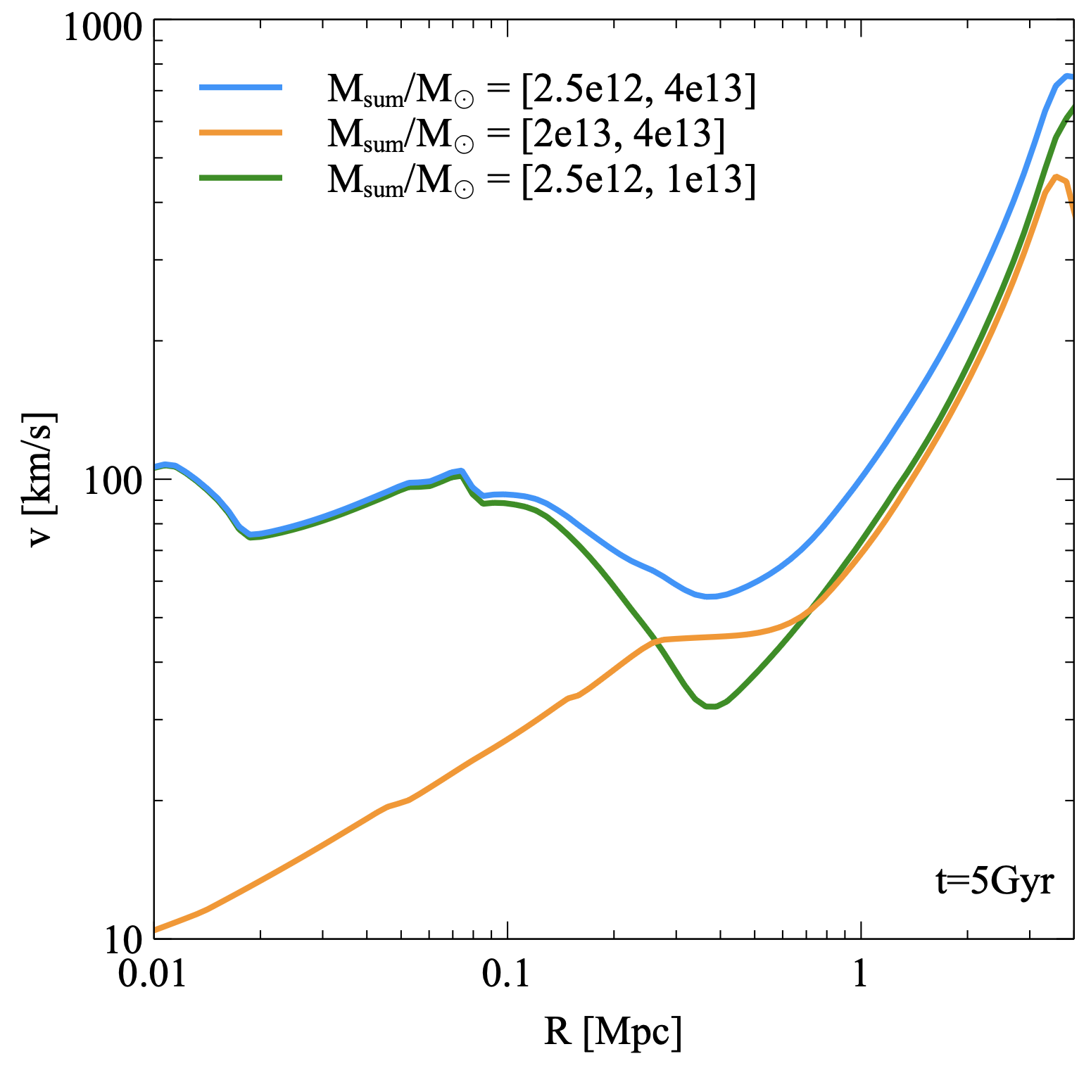
M of substructures
Massive substructures vs less massive ones
Comparable total masses
Central turbulence is driven by less massive (more abundant) ones
Both populations contribute to outskirt turbulence
Depending on realizations

