Slide 1
The Relation between Particle-Based and Galaxy-Based Measurements of the Halo Radius
Cheng Wu
University of Science and Technology of China
Mentor: Eduardo Rozo
University of Arizona

Slide 2
Dynamics-based halo model
A dark matter halo is comprised of the collection of particles orbiting in their own self-generated potential. (Garcia et al. 2023)
The truncation of the halo orbiting profile defines a unique halo radius. (Garcia et al. 2021, Salazar et al. 2025)
How does galaxy-based halo radius compare to particle-based halo radius?
Answer:
Halo radius of galaxies is smaller than that of particles.
The difference can be explained by dynamical friction.

Slide 3
Simulation data
MDPL2 dark-matter-only simulation.
Halo catalogue: ROCKSTAR halo finder.
We focus on central halos only.
Galaxy catalogue: UniverseMachine algorithm. (Behroozi et al. 2019)
Orphan galaxies are included.
Use kinetic-energy-cut method to split particles and galaxies.

Slide 4
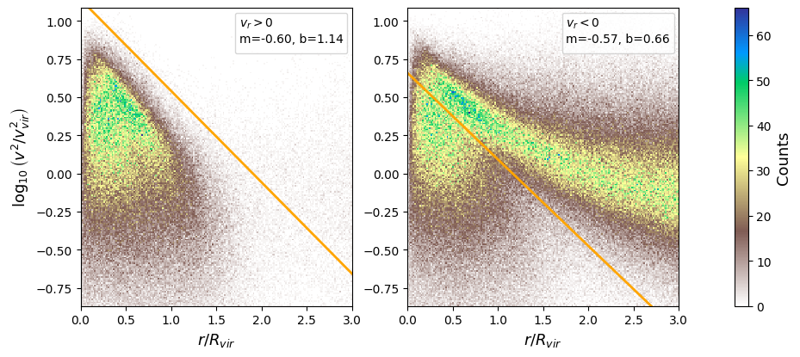
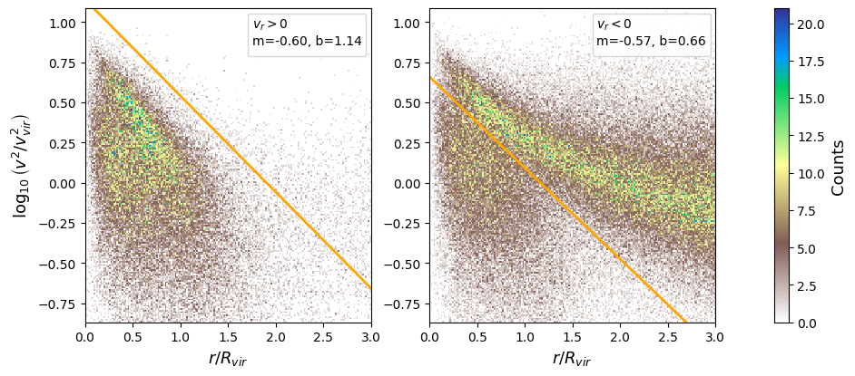
Split galaxies into orbiting/infalling component
PARTICLES
They can use the same cut line.
GALAXIES

Slide 5
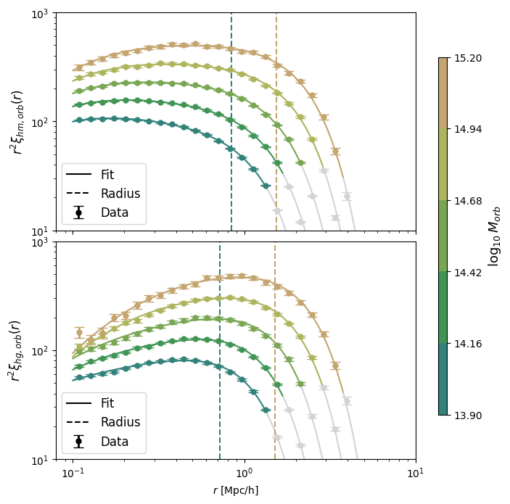
Galaxy-based radius is smaller than particle-based one
ξ_{orb} = ρ_{orb}/ρ_{total}
(ρ_{orb} is given by Salazar et al. 2025)
Halo radius from halo-mass correlation function
Halo radius from halo-galaxy correlation function

Slide 6
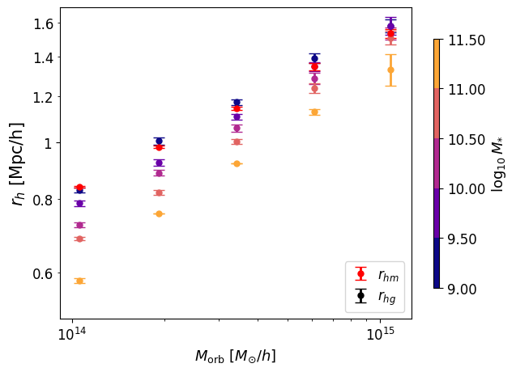
More massive galaxies result in smaller halo radii
Halo radius from halo-mass correlation function
Halo radius
Halo orbiting mass
Can these trends be explained by dynamical friction?

Slide 7
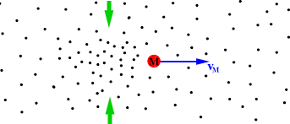
Dynamical friction (DF)
DF coefficient
Subhalo mass
Density of particles
Velocity distribution (CDF) of particles
Chandrasekhar, dynamical friction. I. general considerations: the coefficient of dynamical friction, Astrophys. J. 97, 255 (1943).
J. Binney and S. Tremaine, galactic dynamics: second edition (2008).
Gravity term
DF term

Slide 8
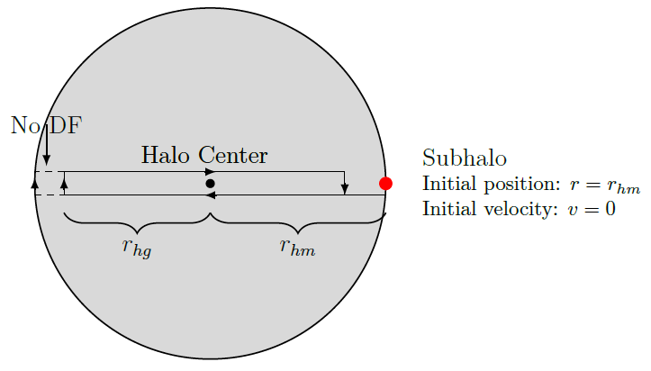
Dynamical friction model
⍴(r):
the density profile of orbiting particles
f(v, r):
the Maxwell–Boltzmann distribution
M_{sub}:
use a model for M*/M_{sub} to assign M_{sub}
𝛈:
free parameter to fit the data

Slide 9
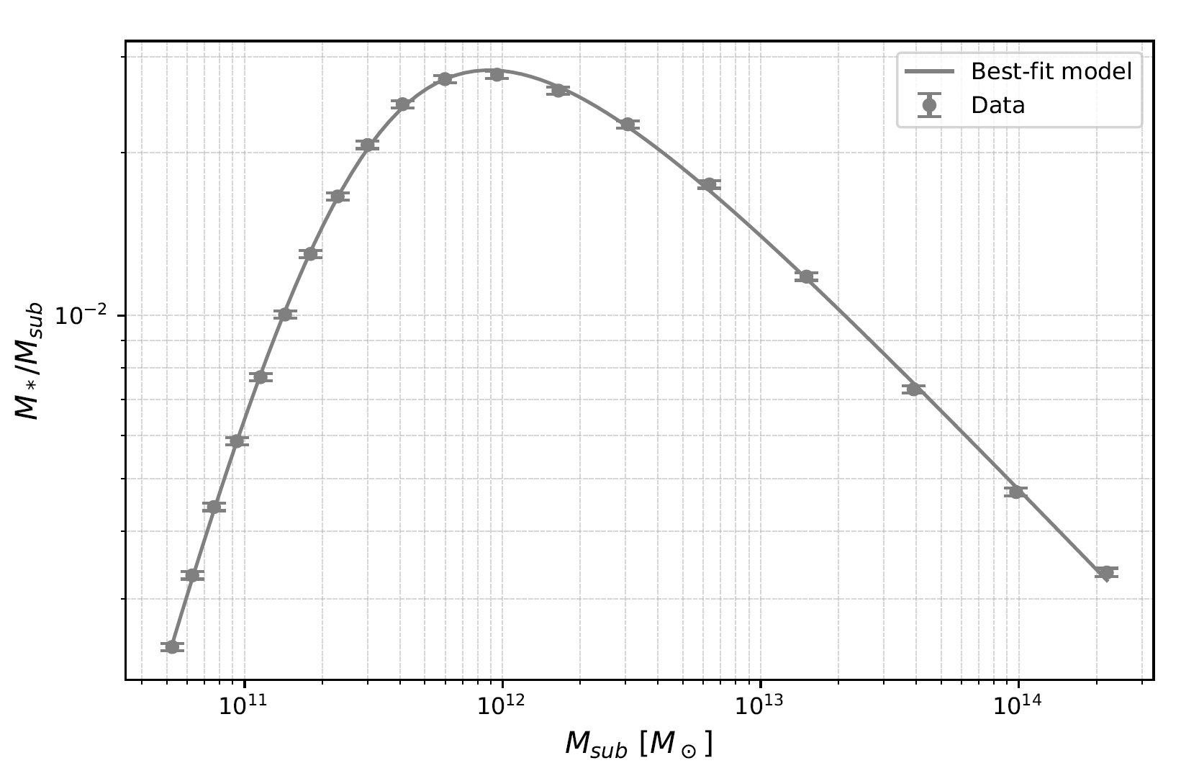
Modeling M_{sub}
M*/M_{sub}~M_{sub}
M_{sub}=M_{sub}(M*)

Slide 10
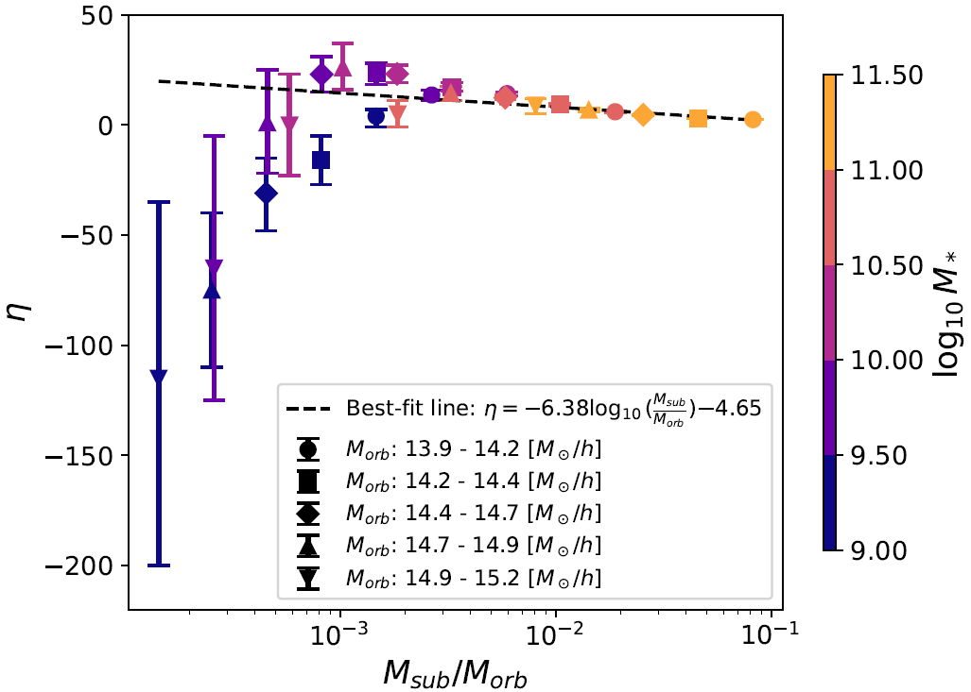
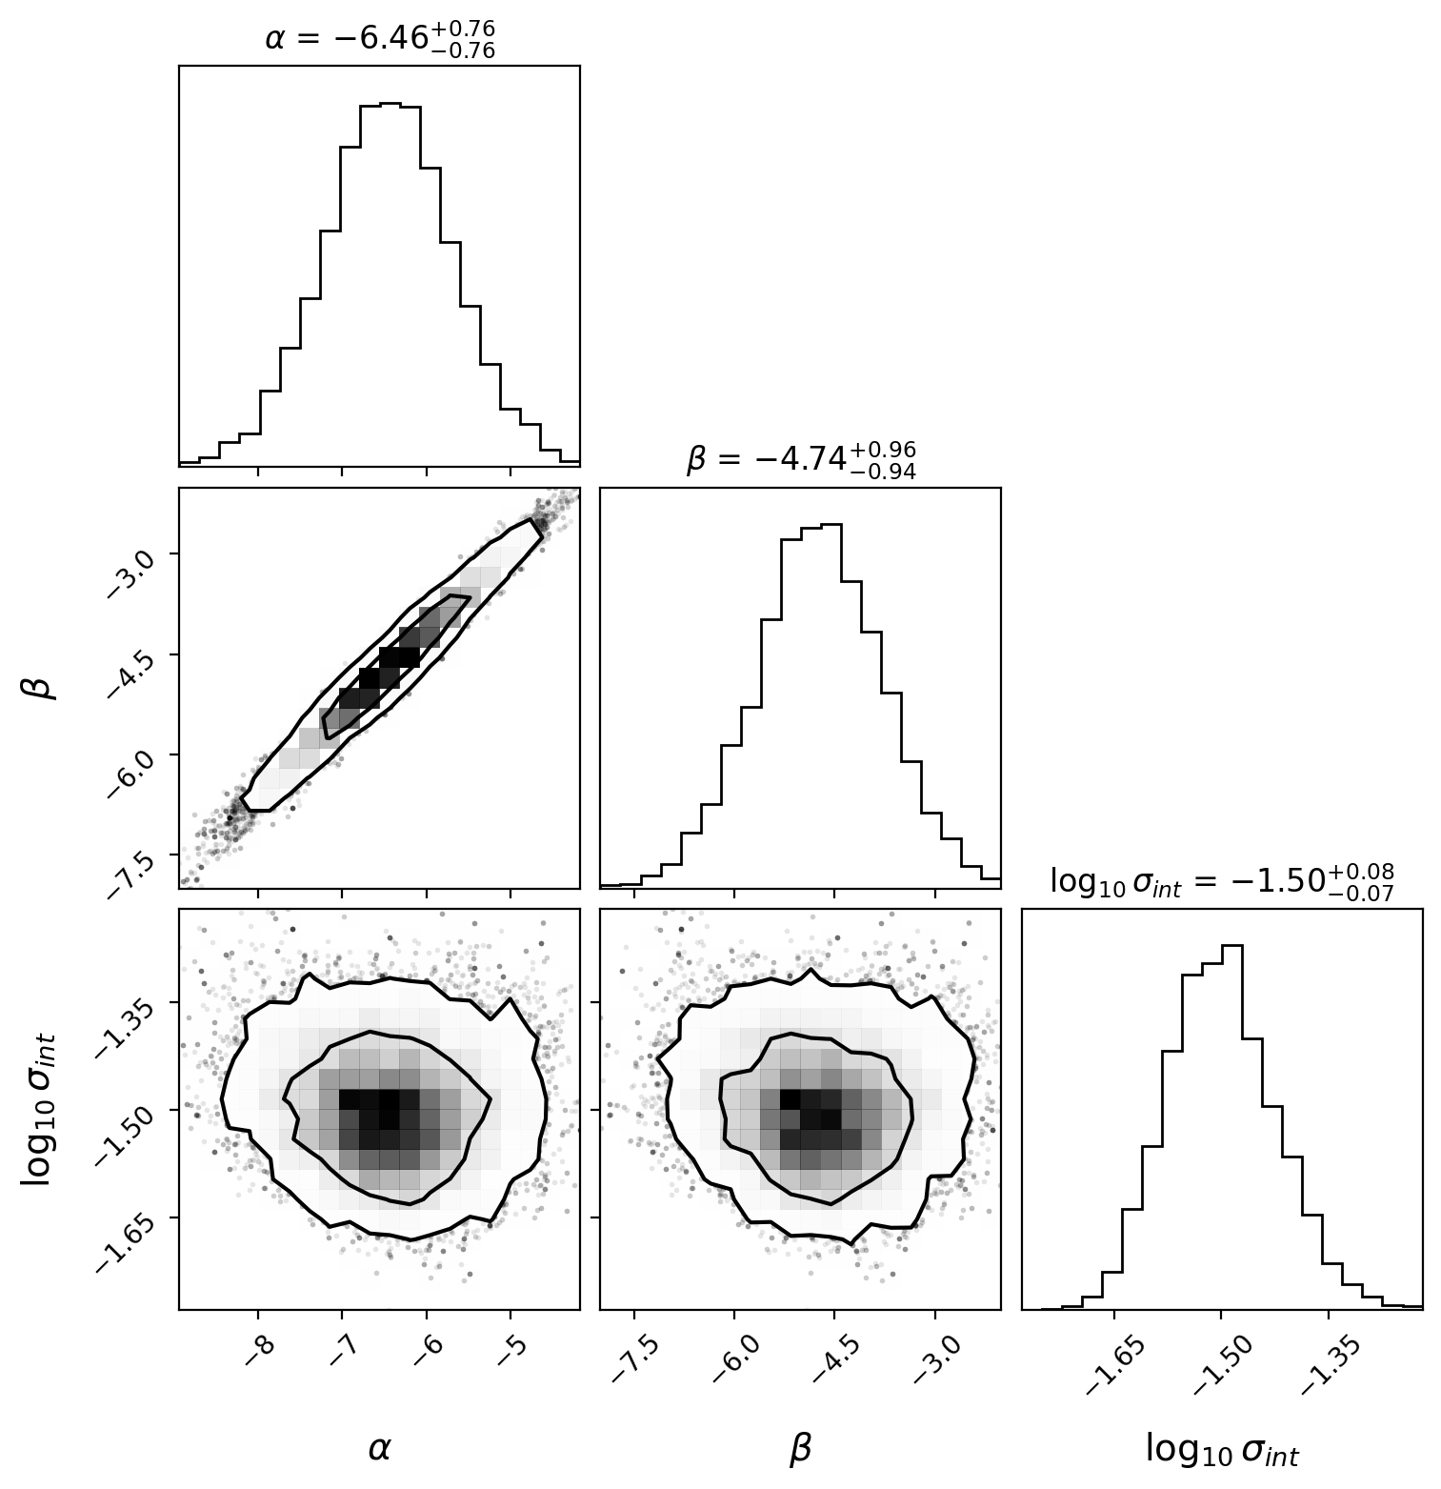
Modeling 𝜂
DF predicts η only depends on M_{sub}/M_{orb}.

Slide 11
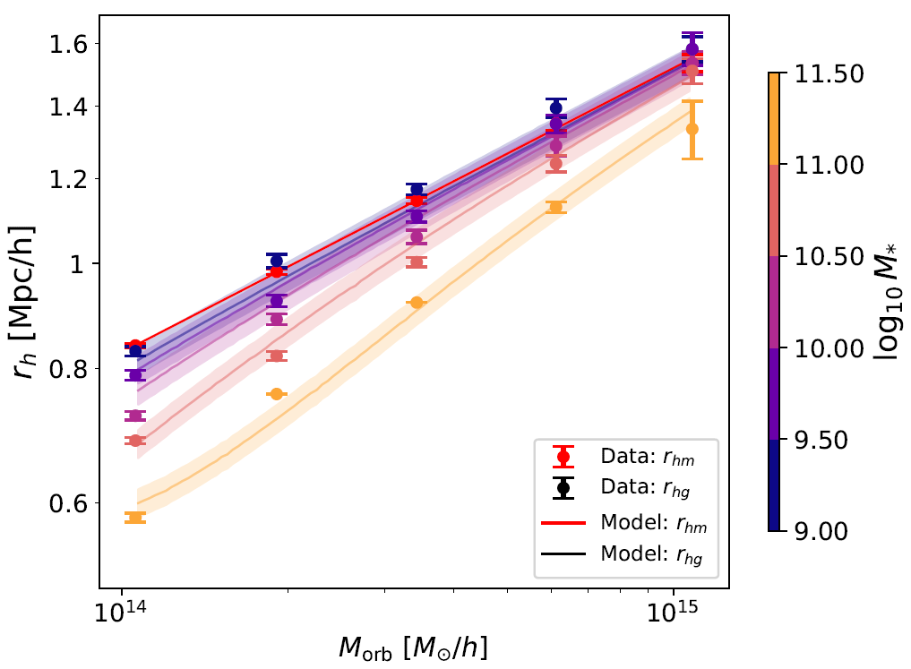
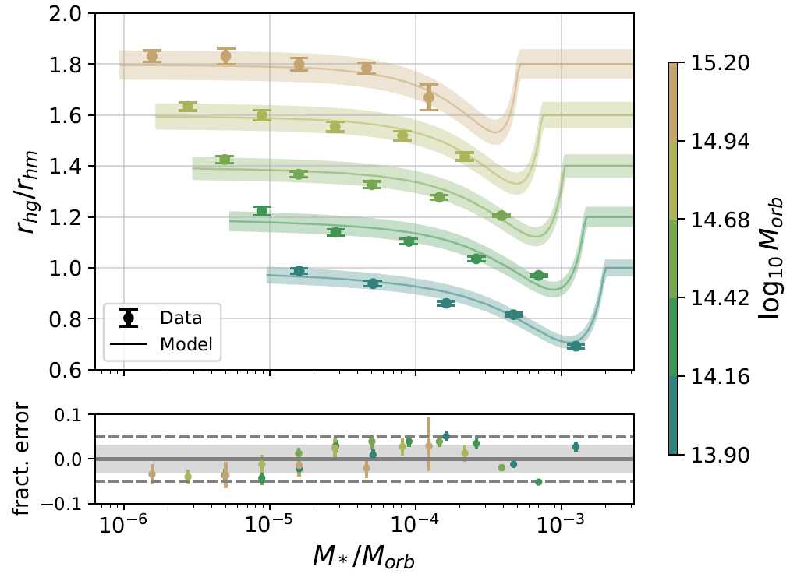
Model predictions
Each curve is manually shifted upward by 0.2 for clarity.
Error <= 5%
Our dynamical friction model accurately captures how galaxy selection impacts the recovered halo radius.

Slide 12
Could the change in halo radii be due to selection effects?
r_{hg} ~ r_{hg}(M_{orb}, M* ) → dynamical friction
r_{hg} ~ r_{hg}(M_{orb}, N_{orb} ) → secondary bias
Split halos into three bins according to N_{orb} at fixed halo mass M_{orb}.

Slide 13
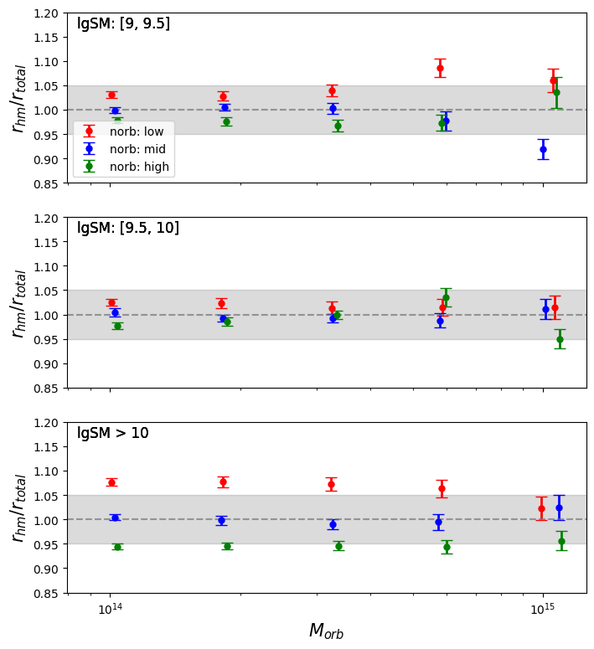
Secondary bias of N_{orb}
r_{hm} truly depends on N_{orb}.
n_{orb} bias leads to 5% difference.

Slide 14
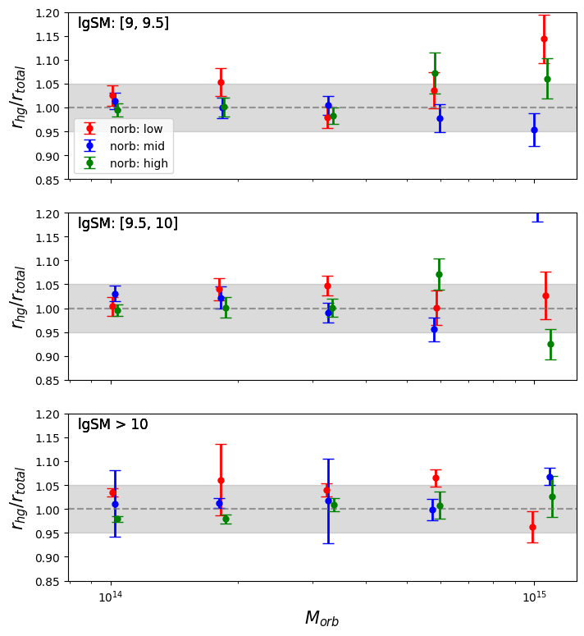
Secondary bias of N_{orb}
Dependence of r_{hg} on N_{orb} is noisier.
n_{orb} bias leads to 5% difference.

Slide 15
Summary
A dark matter halo is comprised of the collection of particles orbiting in their own self-generated potential.
The truncation of the halo orbiting profile defines a unique halo radius.
How does galaxy-based halo radius compare to particle-based halo radius?
Answer:
Halo radius of galaxies is smaller than that of particles.
The difference can be explained by dynamical friction.
N_{orb} bias causes 5% difference to the radius measurement.

Slide 16
Thank you!

Slide 17
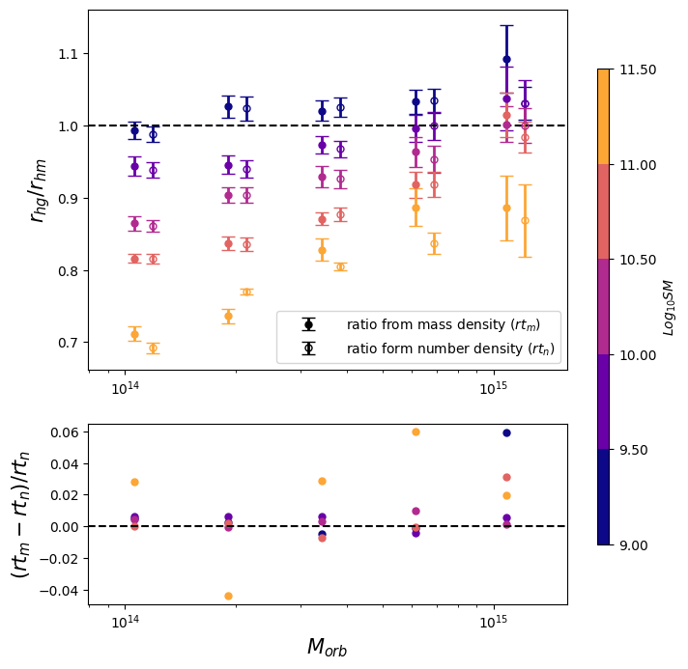
Secondary bias of N_{orb}
Define the effective mass for galaxies
to eliminate n_{orb} bias:
m_{eff,gal}=m_{orb}/n_{orb}.
Secondary bias of N_{orb} can’t explain the difference between r_{hg} and r_{hm}.

