Slide 1
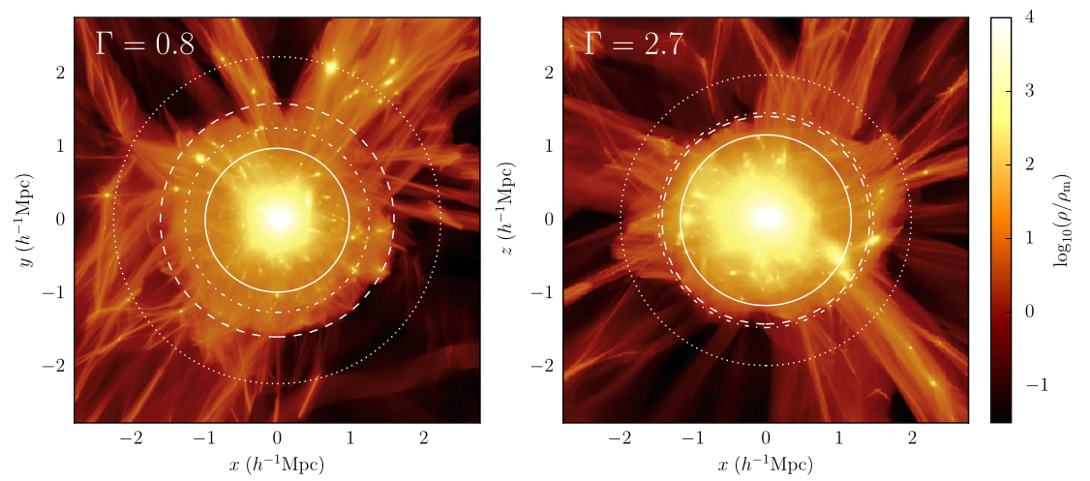

Galaxy Clusters: Cosmology via the Infall Zone
James E. Taylor
Waterloo Centre for Astrophysics
With Charlie Mpetha,
Syeda Lammim Ahad, Roan Haggar,
Rashaad Reid, Yuba Amoura,
+ Liza Sazonova, Azzam Bin Aamir,
Nicole Drakos, Justin Marchioni,
Jedri DeLuna, Spiros Vidiadakis
More+ 2015
Expanding the Boundaries of Dark Matter Halos Shanghai Jiao Tong University May 29, 2025
Notes:
Work by many people
More+ 2015 – matter distribution around rapidly accreting cluster of mass 2.6e14 M⦿ ; solid circle Rvir, dashed Rsp, dot-dashed R200m , dotted Rta; box width ~6Mpc

Slide 2
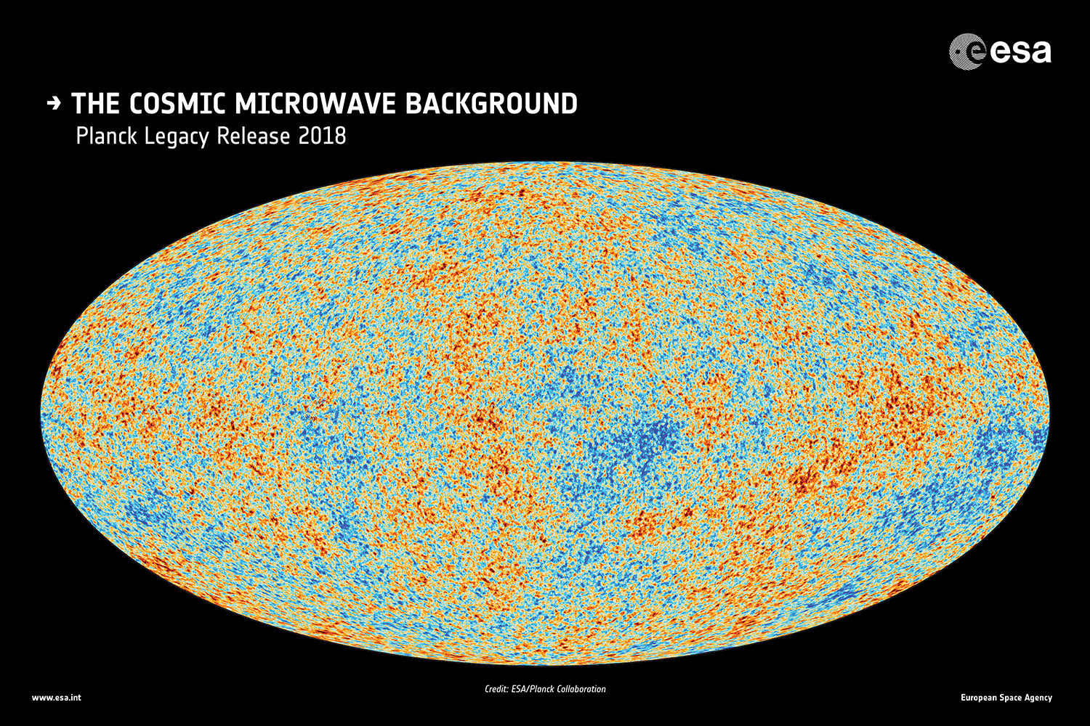

Slide 3
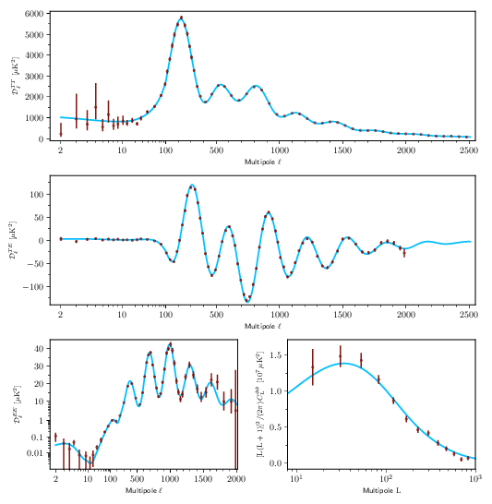
What’s so great about the CMB?
General set of possible cosmological models are completely calculable; specified by as few as 6 free parameters (A_{s} , n_{s} , 𝜌_{bar} , 𝜌_{m} , Ω, 𝜏)
The main observed phenomena (blackbody temperature + 6 auto/cross-correlation angular power spectra) provide a rich set of features to fit
Lots of modes, so measurement errors are tiny
Planck 2018 power spectra – Aghanim et al. 2018
Notes:
\Planck\ CMB power spectra. These are foreground-subtracted, frequency-averaged, cross-half-mission angular power spectra for temperature (top), the temperature-polarization cross-spectrum (middle), the E mode of polarization (bottom left), and the lensing potential (bottom right). Within \LCDM\ these spectra contain the majority of the cosmological information available from \Planck, and the blue lines show the best-fitting model. The uncertainties of the TT spectrum are dominated by sampling variance, rather than by noise or foreground residuals, at all scales below about ℓ=1800 -- a scale at which the CMB information is essentially exhausted within the framework of the \LCDM\ model. The TE spectrum is about as constraining as the TT one, while the EE spectrum still has a sizeable contribution from noise. The lensing spectrum represents the highest signal-to-noise ratio detection of CMB lensing to date, exceeding 40σ. The anisotropy power spectra use a standard binning scheme (which changes abruptly at ℓ=30), but are plotted here with a multipole axis that goes smoothly from logarithmic at low ℓ to linear at high ℓ. In all panels, the blue line is the best-fit \Planck\ 2018 model, based on the combination of TT, TE, and EE.

Slide 4
(If you’re interested in cosmology) why bother with anything after last scattering?
There are a few fundamental things the CMB can’t tell us:
(Time dependence) What happened at later times? E.g. the curvature of the universe indicates it must contain another component, ‘dark energy’ . What are the properties of this component, e.g. the E.O.S. w(z)
(Scale dependence)What happens on small scales? Diffusion erases CMB features below the Silk damping scale, ~30 Mpc, so no direct constraint on, e.g., galaxy scales
(Curvature dependence) What happens as fluctuations grow in amplitude, out of the linear regime?

Slide 5
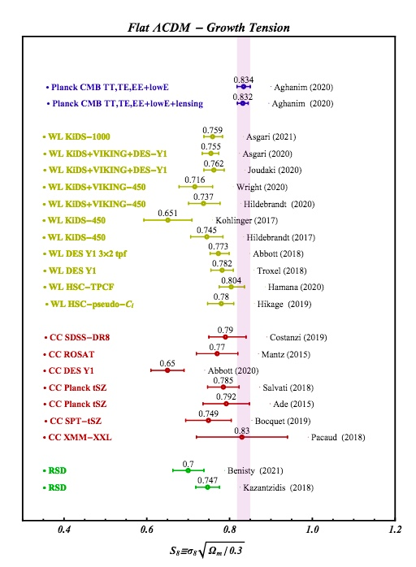
This might seem academic, but… We live in an age of tension!
e.g. the S₈ tension:
CMB and local (cluster abundance, lensing) estimates of the amplitude of fluctuations disagree at > 3σ (e.g. Heymans+ 21)
(Hubble tension similar, mismatch between CMB & low-redshift measurements)
Perivolaropoulos & Skara 2022
Notes:
As we discussed at dinner

Slide 6
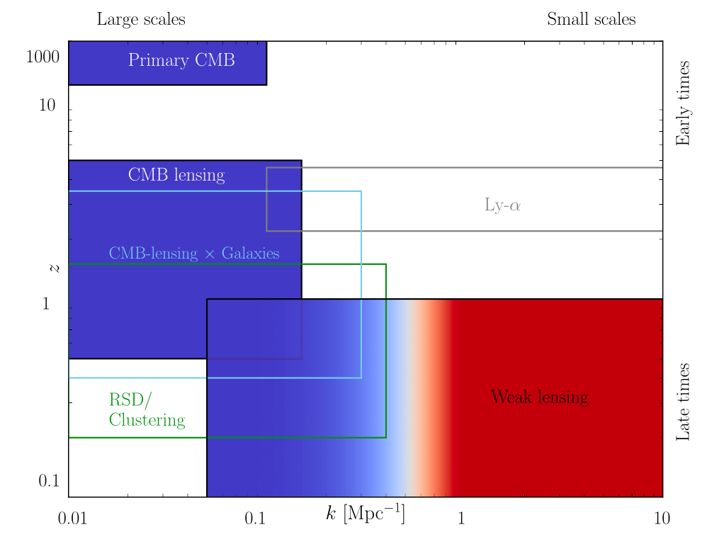
Could these be measurements of different things?
Different tests have different baselines in redshift and spatial scale
Thus, they could indicate different growth history or different power spectrum, relative to default LCDM.
Alternatives may also depend on energy/curvature/acceleration scale (e.g. clusters vs galaxies)
CMB errors already small; to make progress, need to reduce errors on local tests.
Preston, Amon & Efstathiou 2023

Slide 7
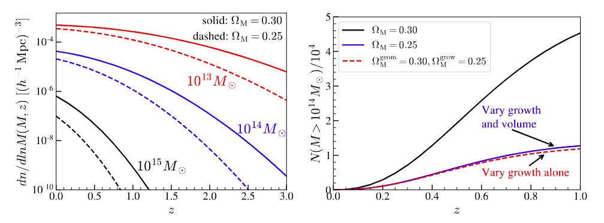
A Classic Low Redshift Test: Galaxy Cluster Abundance
(Left) Changing the matter density by 0.05 changes the abundance of clusters by an order of magnitude at high redshift (Right) The effect comes almost entirely from the change in the growth factor (Huterer 2023)
Notes:
What are the features:
- asymmetry
- substructure
- concentration
- shape
[- spin]

Slide 8
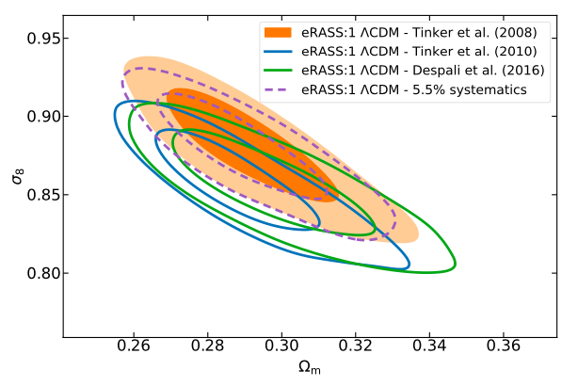
(Very) large cluster samples are forthcoming
A number of O(10⁴ – 10⁵)-cluster samples expected over the next decade:
Optical/NIR: Roman Space Telescope
X-ray : eROSITA (Pillepich et al. 2012)
mm: CMB-S4 (Abazajian et al. 2019)
ground-based:
UNIONS (Chambers et al. 2020)
DESI (DESI Collaboration 2016)
Rubin LSST (LSST Science Collaboration 2009)
The challenge: high-redshift clusters rare; for low redshift clusters, fundamental degeneracy: abundance the combined effect of early fluctuation amplitude (𝜎₈) and subsequent growth (Ω_{m})
Ghirardini+ 2024: eROSITA cluster abundance constraints
Notes:
What are the features:
- asymmetry
- substructure
- concentration
- shape
[- spin]

Slide 9
(Very) large cluster samples are forthcoming
Early formation
A number of O(10⁴ – 10⁵)-cluster samples expected over the next decade:
Optical/NIR: Roman Space Telescope
X-ray : eROSITA (Pillepich et al. 2012)
mm: CMB-S4 (Abazajian et al. 2019)
ground-based:
UNIONS (Chambers et al. 2020)
DESI (DESI Collaboration 2016)
Rubin LSST (LSST Science Collaboration 2009)
The challenge: high-redshift clusters rare; for low redshift clusters, fundamental degeneracy: abundance the combined effect of early fluctuation amplitude (𝜎₈) and subsequent growth (Ω_{m})
Late growth
Ghirardini+ 2024: eROSITA cluster abundance constraints
Notes:
What are the features:
- asymmetry
- substructure
- concentration
- shape
[- spin]

Slide 10
Consider the growth history
e.g. the half-mass redshift z₅₀
Notes:
What are the features:
- asymmetry
- substructure
- concentration
- shape
[- spin]

Slide 11
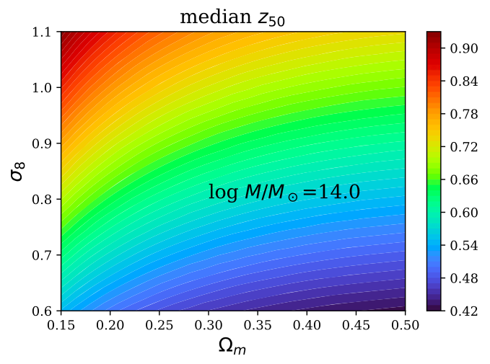


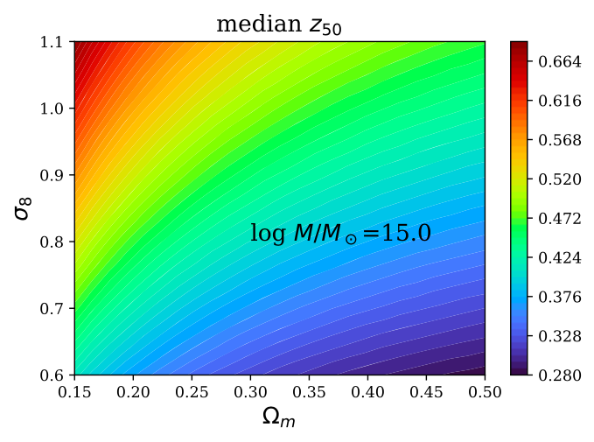
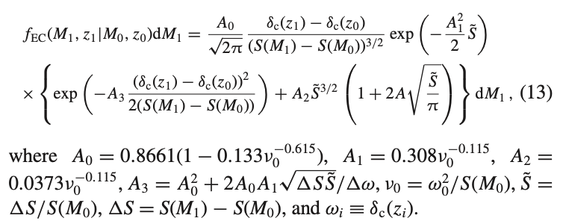
Predicted z₅₀ dependence is almost orthogonal to abundance
Yuba Amoura
using the ellipsoidal conditional probability (Zhang+ 2008) f = f_{EC} :
Half-mass assembly redshift vs. cosmology (Amoura+ 2021)
Notes:
What are the features:
- asymmetry
- substructure
- concentration
- shape
[- spin]

Slide 12
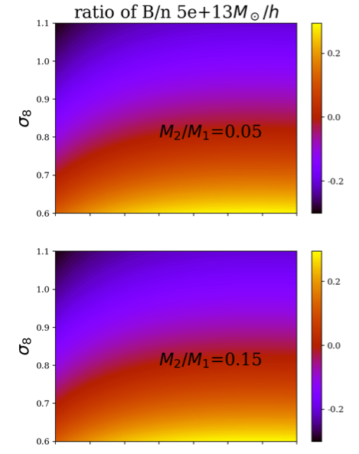
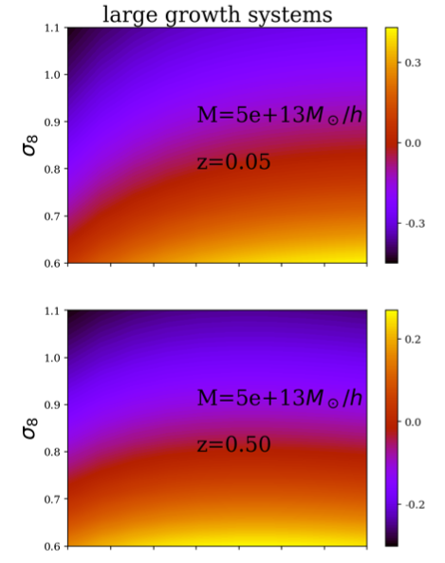
… and similarly for merger, growth rates
Merger Rate per Halo
Fraction w. Recent Growth
(Amoura+ 2023)
Notes:
What are the features:
- asymmetry
- substructure
- concentration
- shape
[- spin]

Slide 13
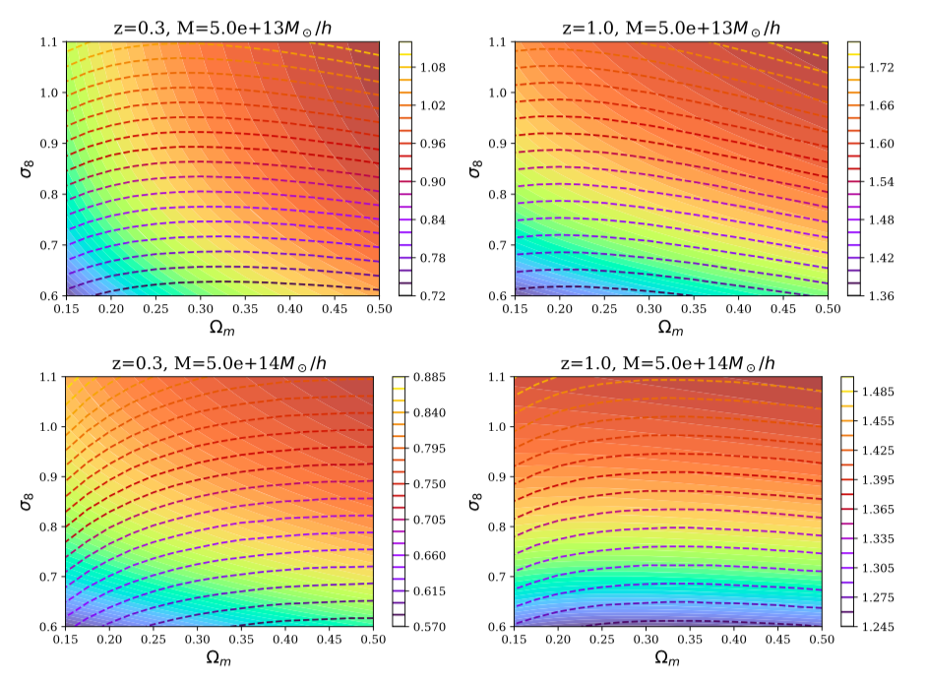
Overall complementarity between age and abundance
z₅₀ contours (dashed lines) almost perpendicular to abundance (colour gradient).
Amoura+ 2021
Notes:
Depending on mass and redshift scale, contours are almost orthogonal

Slide 14
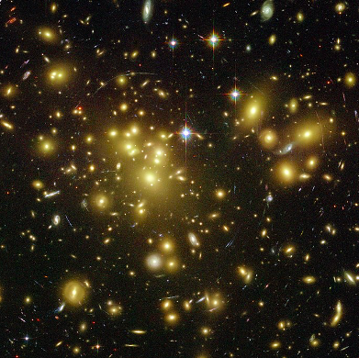
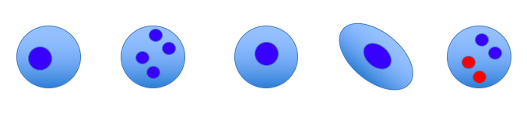
But how to estimate age observationally?
“Older” clusters (earlier z₅₀) show systematic differences in:
- Asymmetry (e.g. centre of mass/light vs density peak)
- Substructure (peaks in mass/light/galaxy distribution, or overall 𝜒²)
- Concentration (from lensing or galaxy distribution?)
- Shape
(- possibly also Spin, accessible via galaxy redshifts)
A S C Sh Sp
But how to quantify these in large, noisy samples? Want something we can easily stack…
Notes:
Thinking of how to quantify this,

Slide 15
Or, to put it another way, why do you think I came to this workshop?
Notes:
Thinking of how to quantify this,

Slide 16
Growth history encoded in the outer parts of clusters…
Reid in prep.: mean mass accretion histories for clusters selected on structural features
More+ 2015 – slice through matter distribution around slowly (left) and rapidly (right) accreting cluster of mass ~14 M⦿
red circle Rvir, blue Rsp, dot-dashed R200m , dotted Rta
Notes:
Surhud - The outer part of clusters is complex, with several different regions

Slide 17
Mass high ½ orbital period in the past
large acceleration
⬄ large splashback radius
Mass low ½ orbital period in the past
small acceleration
small splashback radius
M₀
M₀
Mass
Mass
M₁
High accretion rate
Low accretion rate
M₂
½ orbital period
M₂
M₁
Time
Time
M₂
M₂
M₁
M₁
So radius is anti-correlated with accretion rate
M₀
M₀
Adhikari + 2014

Slide 18
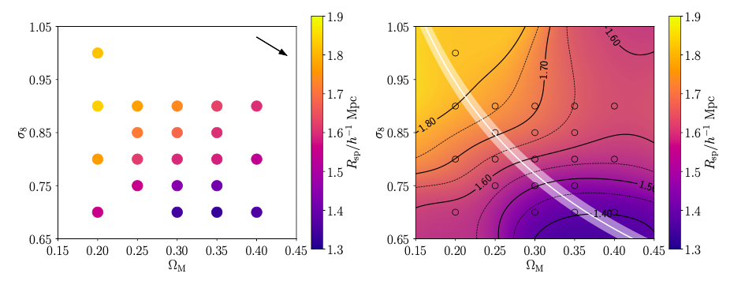
The Splashback Radius as a Cosmological Test (Haggar+ 2024)
old
young
* Material falls in, accelerated by potential, reaches apocentre at Rsp over half an orbital period (c. 2 Gyr)
* Ratio of Rsp to Rvir gives the ratio of the mass 2 Gyr ago to the current mass ⬄ current accretion rate
* Overall variation 20-30% along the “banana”
Notes:
What are the features:
- asymmetry
- substructure
- concentration
- shape
[- spin]

Slide 19
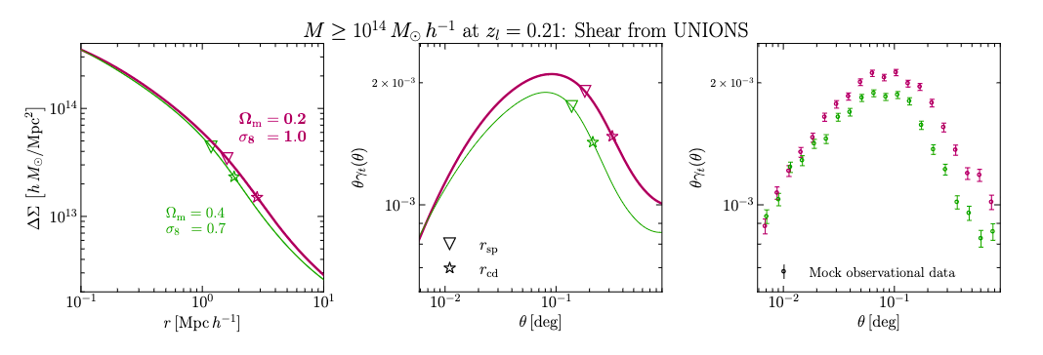
Alternately, could fit the whole infall zone…
Mpetha+ 2024
Given weak lensing measurements around a stacked cluster sample of known mean mass,
shape of the shear profile outside the virial radius gives the mean accretion rate
⬄ location along the banana

Slide 20

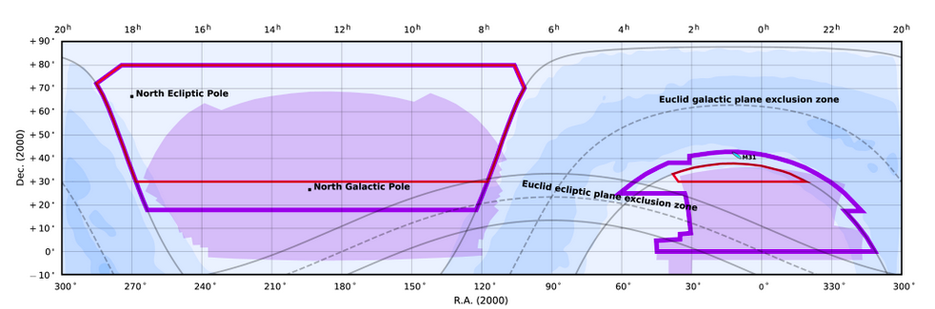
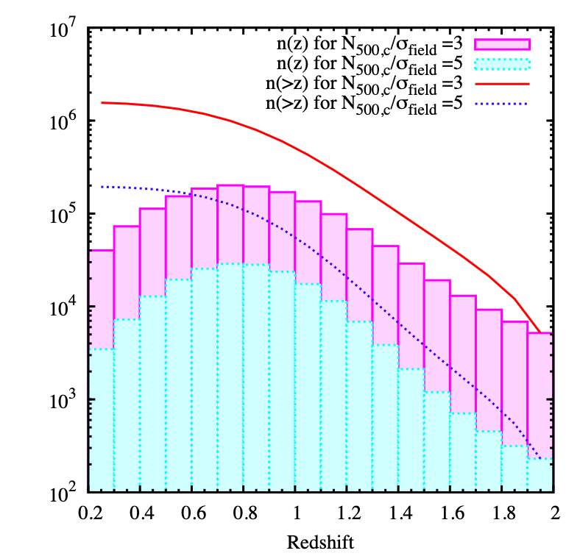

Measure this in current and forthcoming surveys
UNIONS: : 4800 deg ² in ugriz
Expect O(10⁴) significant lensing detections to z=1?
(masses log M₂₀₀ ≈ a few x 10¹⁴ M⊙)
O(10⁵) photometric clusters
In short term: use clusters from the DESI Legacy survey; Wen & Han 2024
Euclid wide: 14,900 deg ² in Vis (r-z) & 3 NIR bands
Expect O(10⁵) significant lensing detections out to z=1?
O(10⁶) photometric clusters
Sartoris+ 2016
Notes:
COSMOS: 8 clusters 1e14 over 1.6 square eg, so 5/deg SNR 2x UNIONS 5 sigma at z=0.3 = 1e14

Slide 21
(cf. Charlie’s talk)
Notes:
Thinking of how to quantify this,

Slide 22
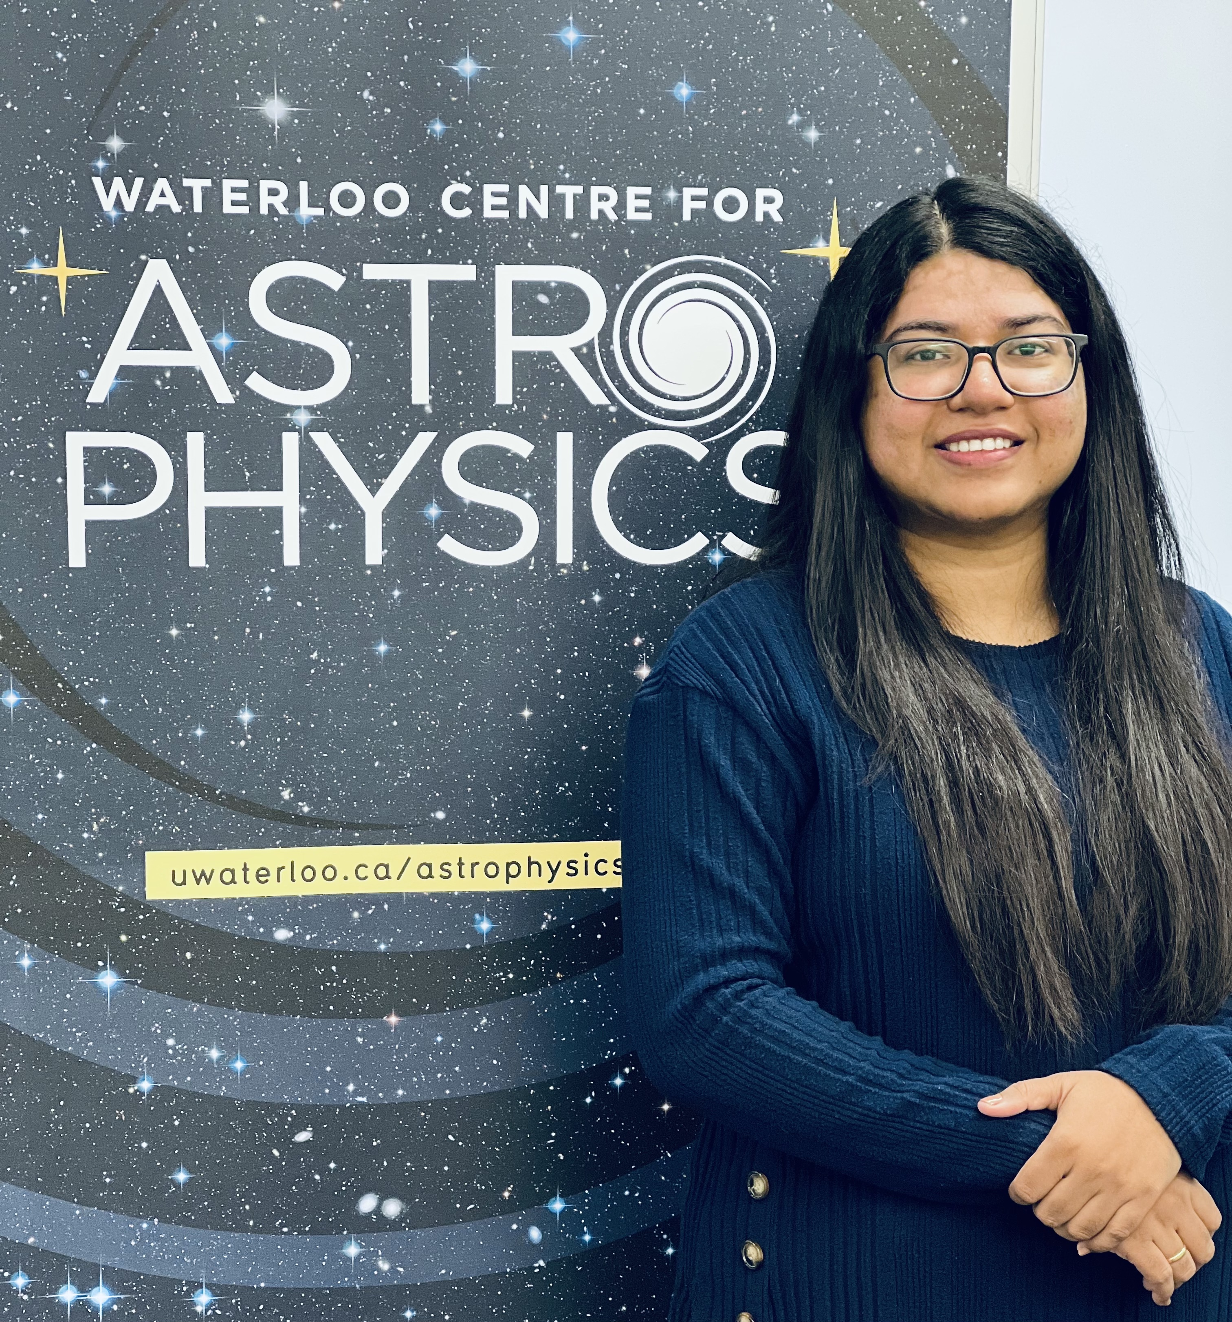
Digging into the cluster samples: structure vs. dynamical state
(Lammim Ahad, Rashaad Reid, Charlie Mpetha)
Basic Cluster Sample:
Wen & Han 2024 catalogue: search in photo-z space based on DESI Legacy survey DR10 photometry
Overlap with UNIONS includes 250,000 objects
Cut these down to sample with spectroscopic redshifts and N_{FOF} > 10 members
Data includes redshift, member galaxies spatial distributions, magnitudes, stellar mass estimates (within r₅₀₀)
Lammim Ahad
Notes:
COSMOS: 8 clusters 1e14 over 1.6 square eg, so 5/deg SNR 2x UNIONS 5 sigma at z=0.3 = 1e14

Slide 23
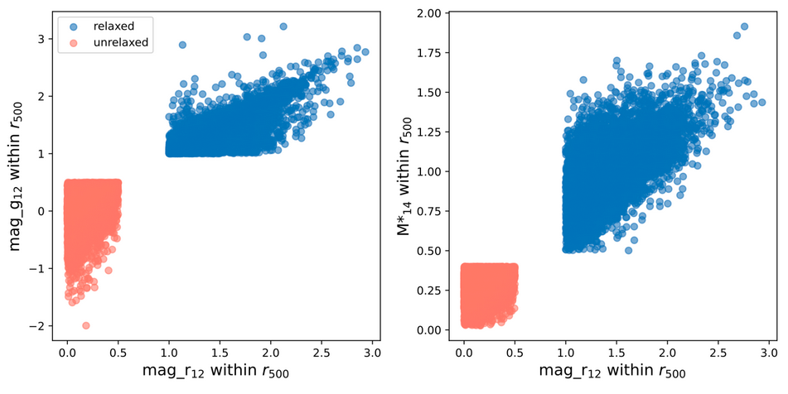
Splitting clusters on luminosity or stellar mass function
Select ‘relaxed’ and ‘unrelaxed’ subsets based on magnitude gap or stellar mass ratio; c. 7000 members in each
Notes:
COSMOS: 8 clusters 1e14 over 1.6 square eg, so 5/deg SNR 2x UNIONS 5 sigma at z=0.3 = 1e14

Slide 24
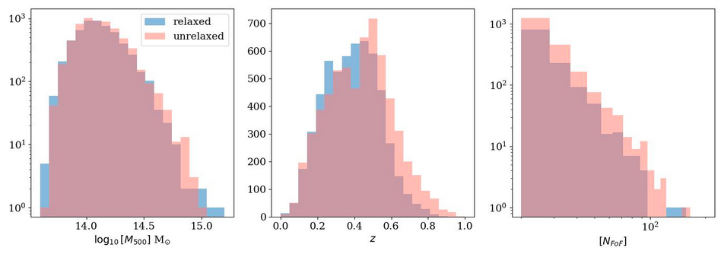
Samples similar in mass, redshift, richness distributions
Notes:
COSMOS: 8 clusters 1e14 over 1.6 square eg, so 5/deg SNR 2x UNIONS 5 sigma at z=0.3 = 1e14

Slide 25
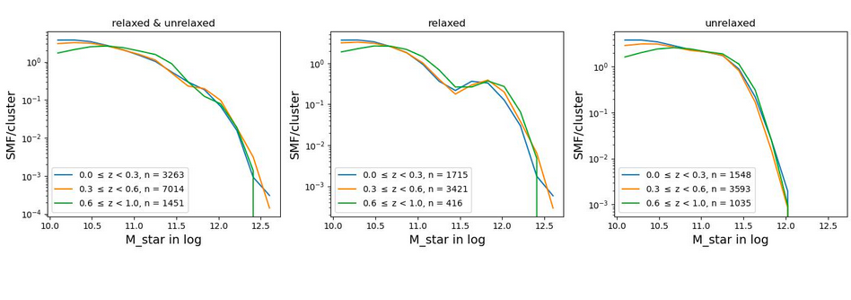
… but very different stellar mass functions
Dramatic difference: large population of massive (quenched?) systems present in “relaxed” clusters, absent in “unrelaxed” ones
Notes:
COSMOS: 8 clusters 1e14 over 1.6 square eg, so 5/deg SNR 2x UNIONS 5 sigma at z=0.3 = 1e14

Slide 26
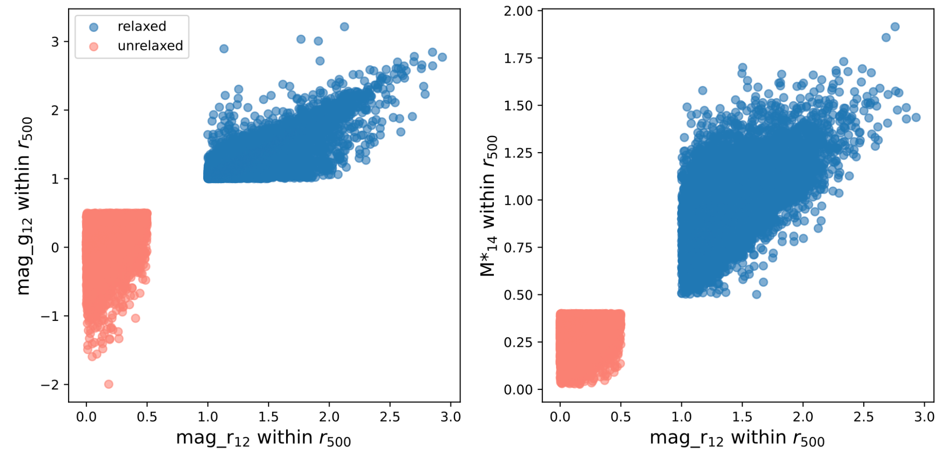

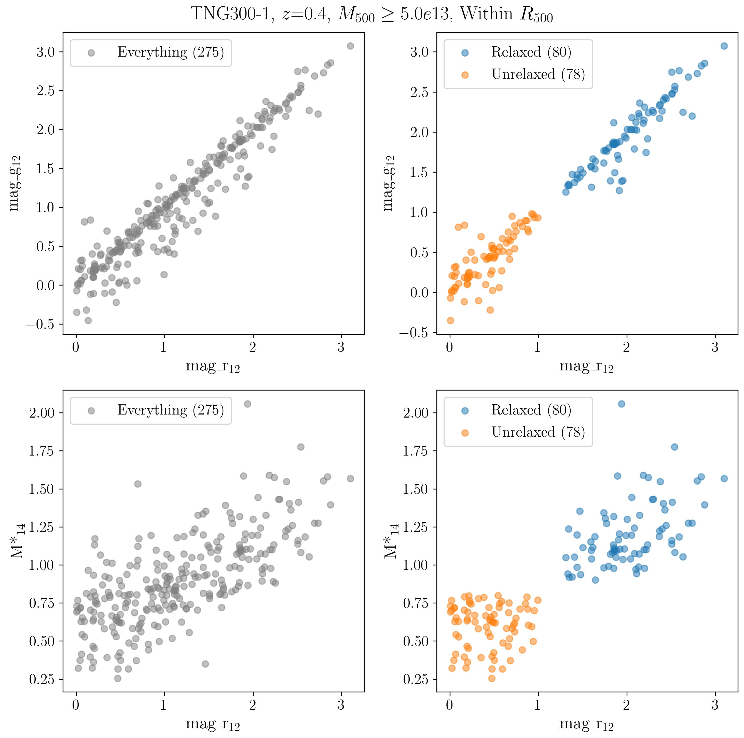
Comparison to Simulations
Rashaad Reid: Comparison with
Illustris TNG
Note colours and magnitude gaps distributions quite different; select split to give similar numbers relative to main sample
Notes:
COSMOS: 8 clusters 1e14 over 1.6 square eg, so 5/deg SNR 2x UNIONS 5 sigma at z=0.3 = 1e14

Slide 27
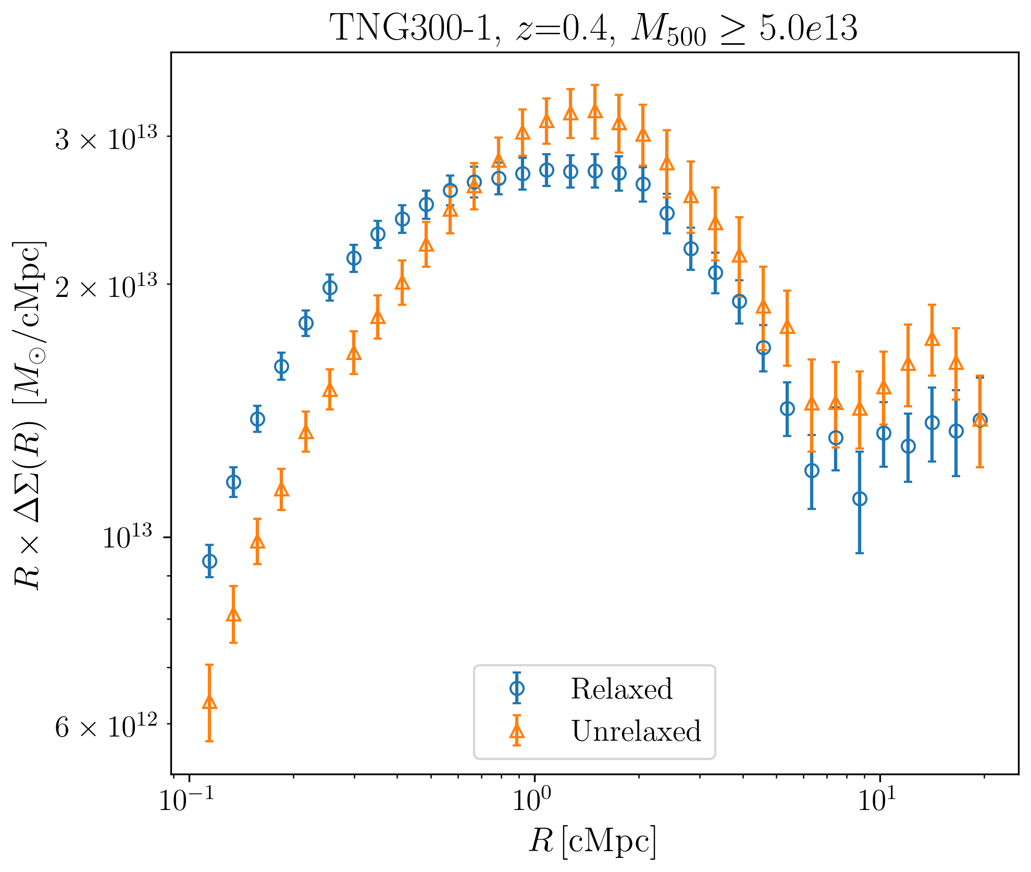
Comparing the Lensing Signal
Major differences between the relaxed and unrelaxed subsamples
Notes:
COSMOS: 8 clusters 1e14 over 1.6 square eg, so 5/deg SNR 2x UNIONS 5 sigma at z=0.3 = 1e14

Slide 28
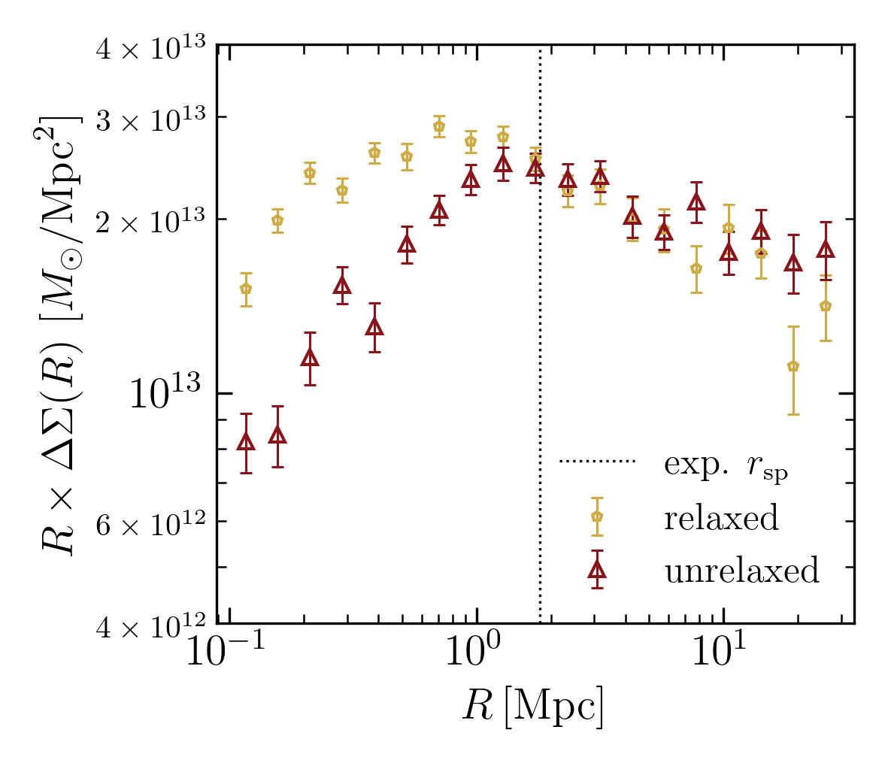
Comparing the Lensing Signal
Major differences between the relaxed and unrelaxed subsamples, but simulations don’t quite match stacked lensing measurements
Notes:
COSMOS: 8 clusters 1e14 over 1.6 square eg, so 5/deg SNR 2x UNIONS 5 sigma at z=0.3 = 1e14

Slide 29
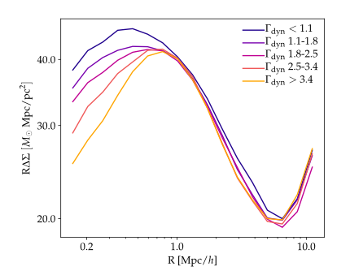
Comparing the Lensing Signal
Major differences between the relaxed and unrelaxed subsamples, but simulations don’t quite match stacked lensing measurements
Prediction from Xhakaj+ 2022:
Inner profile should vary with accretion rate, concentration, etc.
Notes:
COSMOS: 8 clusters 1e14 over 1.6 square eg, so 5/deg SNR 2x UNIONS 5 sigma at z=0.3 = 1e14

Slide 30
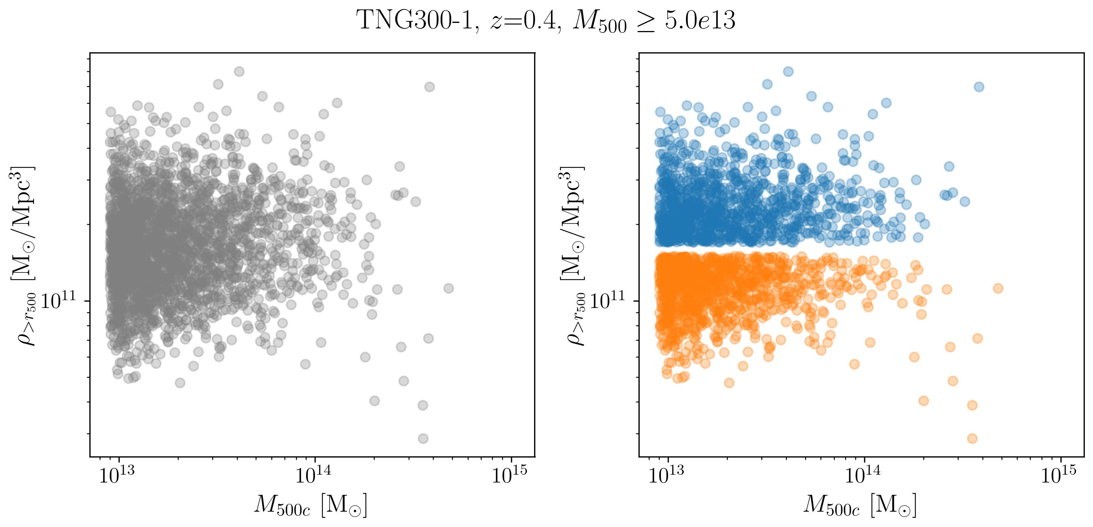
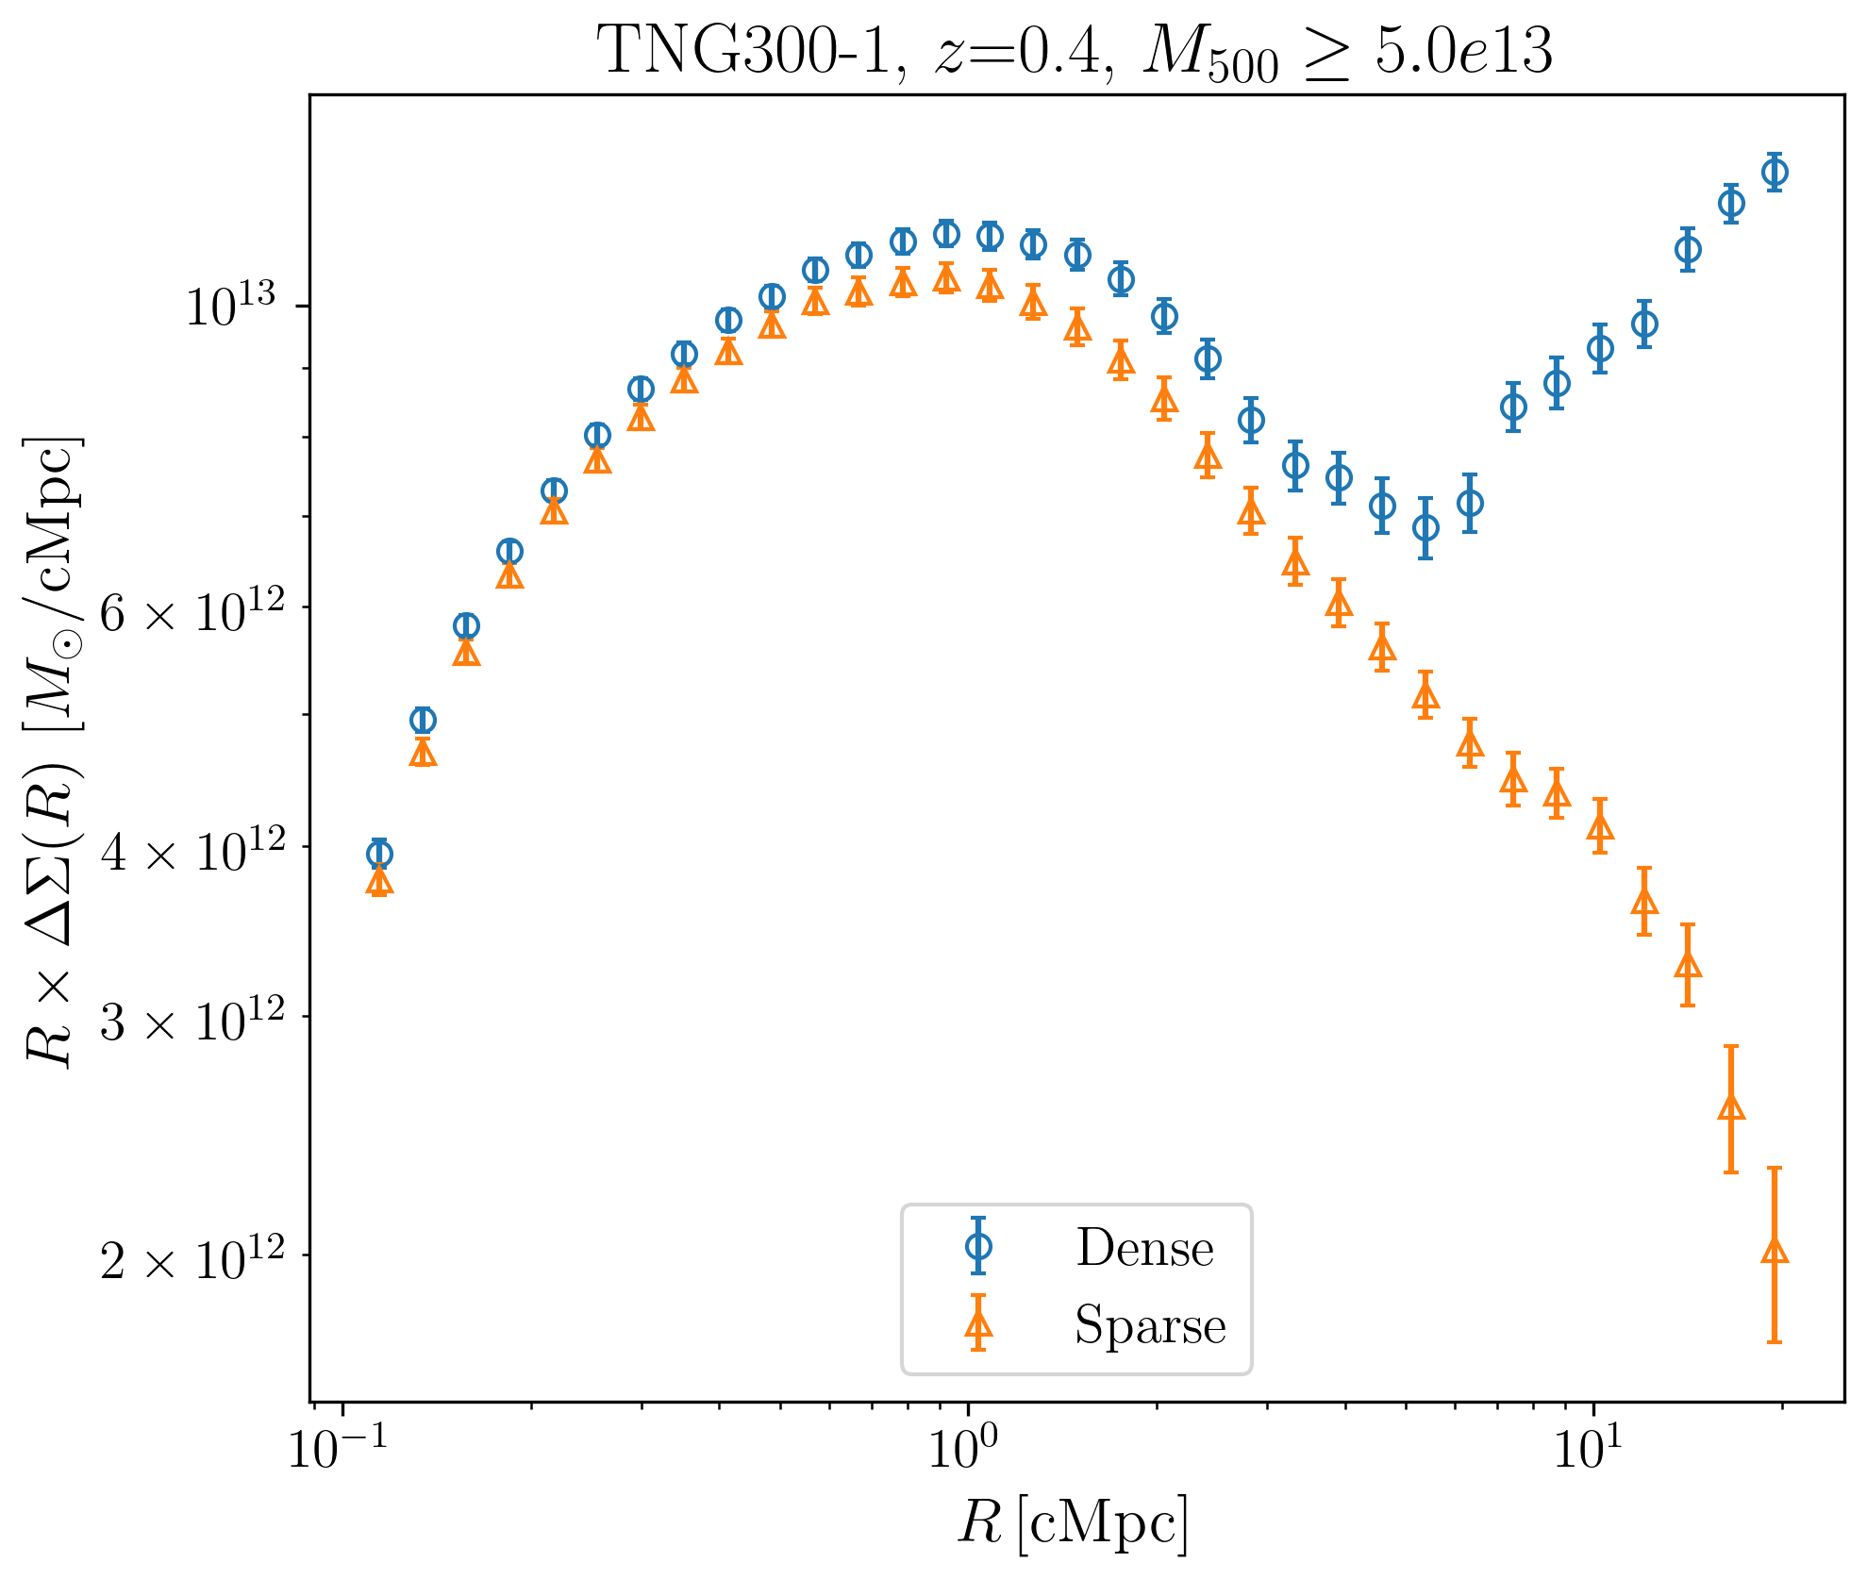
One major issue: environmental density (⬄ bias)
Systems in dense regions have a very different out profile
Notes:
COSMOS: 8 clusters 1e14 over 1.6 square eg, so 5/deg SNR 2x UNIONS 5 sigma at z=0.3 = 1e14

Slide 31
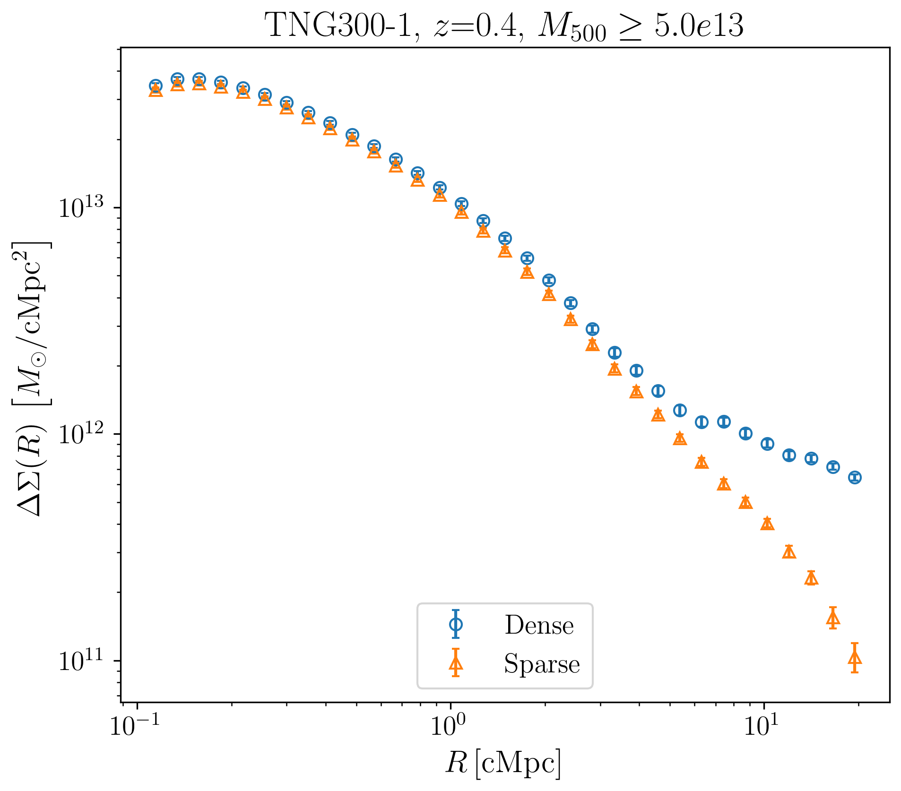
One major issue: environmental density (⬄ bias)
Systems in dense regions have a very different out profile
Notes:
COSMOS: 8 clusters 1e14 over 1.6 square eg, so 5/deg SNR 2x UNIONS 5 sigma at z=0.3 = 1e14

Slide 32
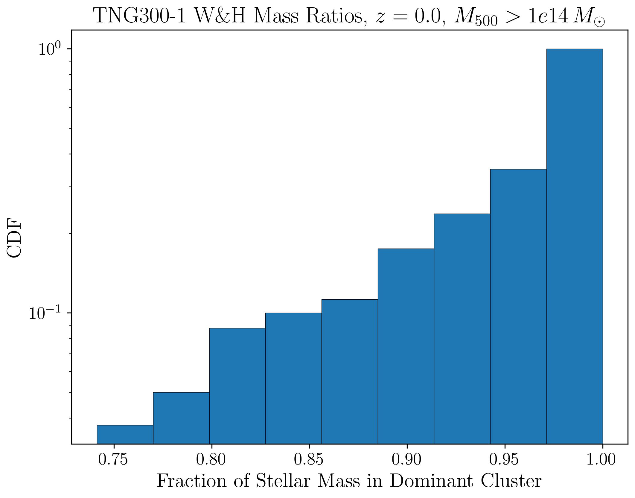
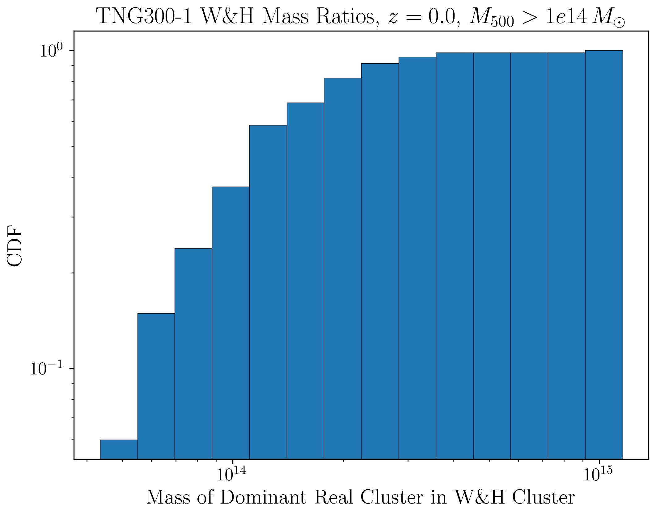
Another major issue: projection effects
Mock-up of selection function suggests that while most clusters include a massive halo, 20% of the time it only contributes 90% of the mass or less; also 30-40% of the time it is below our nominal mass threshold
Notes:
COSMOS: 8 clusters 1e14 over 1.6 square eg, so 5/deg SNR 2x UNIONS 5 sigma at z=0.3 = 1e14

Slide 33
Conclusion: the complexities of observed cluster samples
Studying the mass profiles of subsamples, we start to uncover many complicating factors:
– miscentering (esp. in optical)
– correlation of concentration w. age, environment (i.e. assembly bias)
– overall environmental density
– projection effects (usual 2-halo, but may also be amplified
by cluster selection function)
Importantly, these effects may be different for clusters in different dynamical states.
So get robust measurements of the infall region, we will have to model all this carefully…

Slide 34
Summary
* Cosmology requires low-redshift tests to resolve tensions;
measuring the age/growth rate of clusters is one example
* Measurements in the “infall zone” provide a useful, stackable measurement; we’ve demonstrated an initial version in UNIONS ; should be powerful in Euclid
* On the other hand, careful work required to disentangle coupling between dynamical state, projection effects and cluster selection function
Expanding the Boundaries of Dark Matter Halos. – Shanghai Jiao Tong University – May 29, 2025

Slide 35
Thanks!

Slide 37
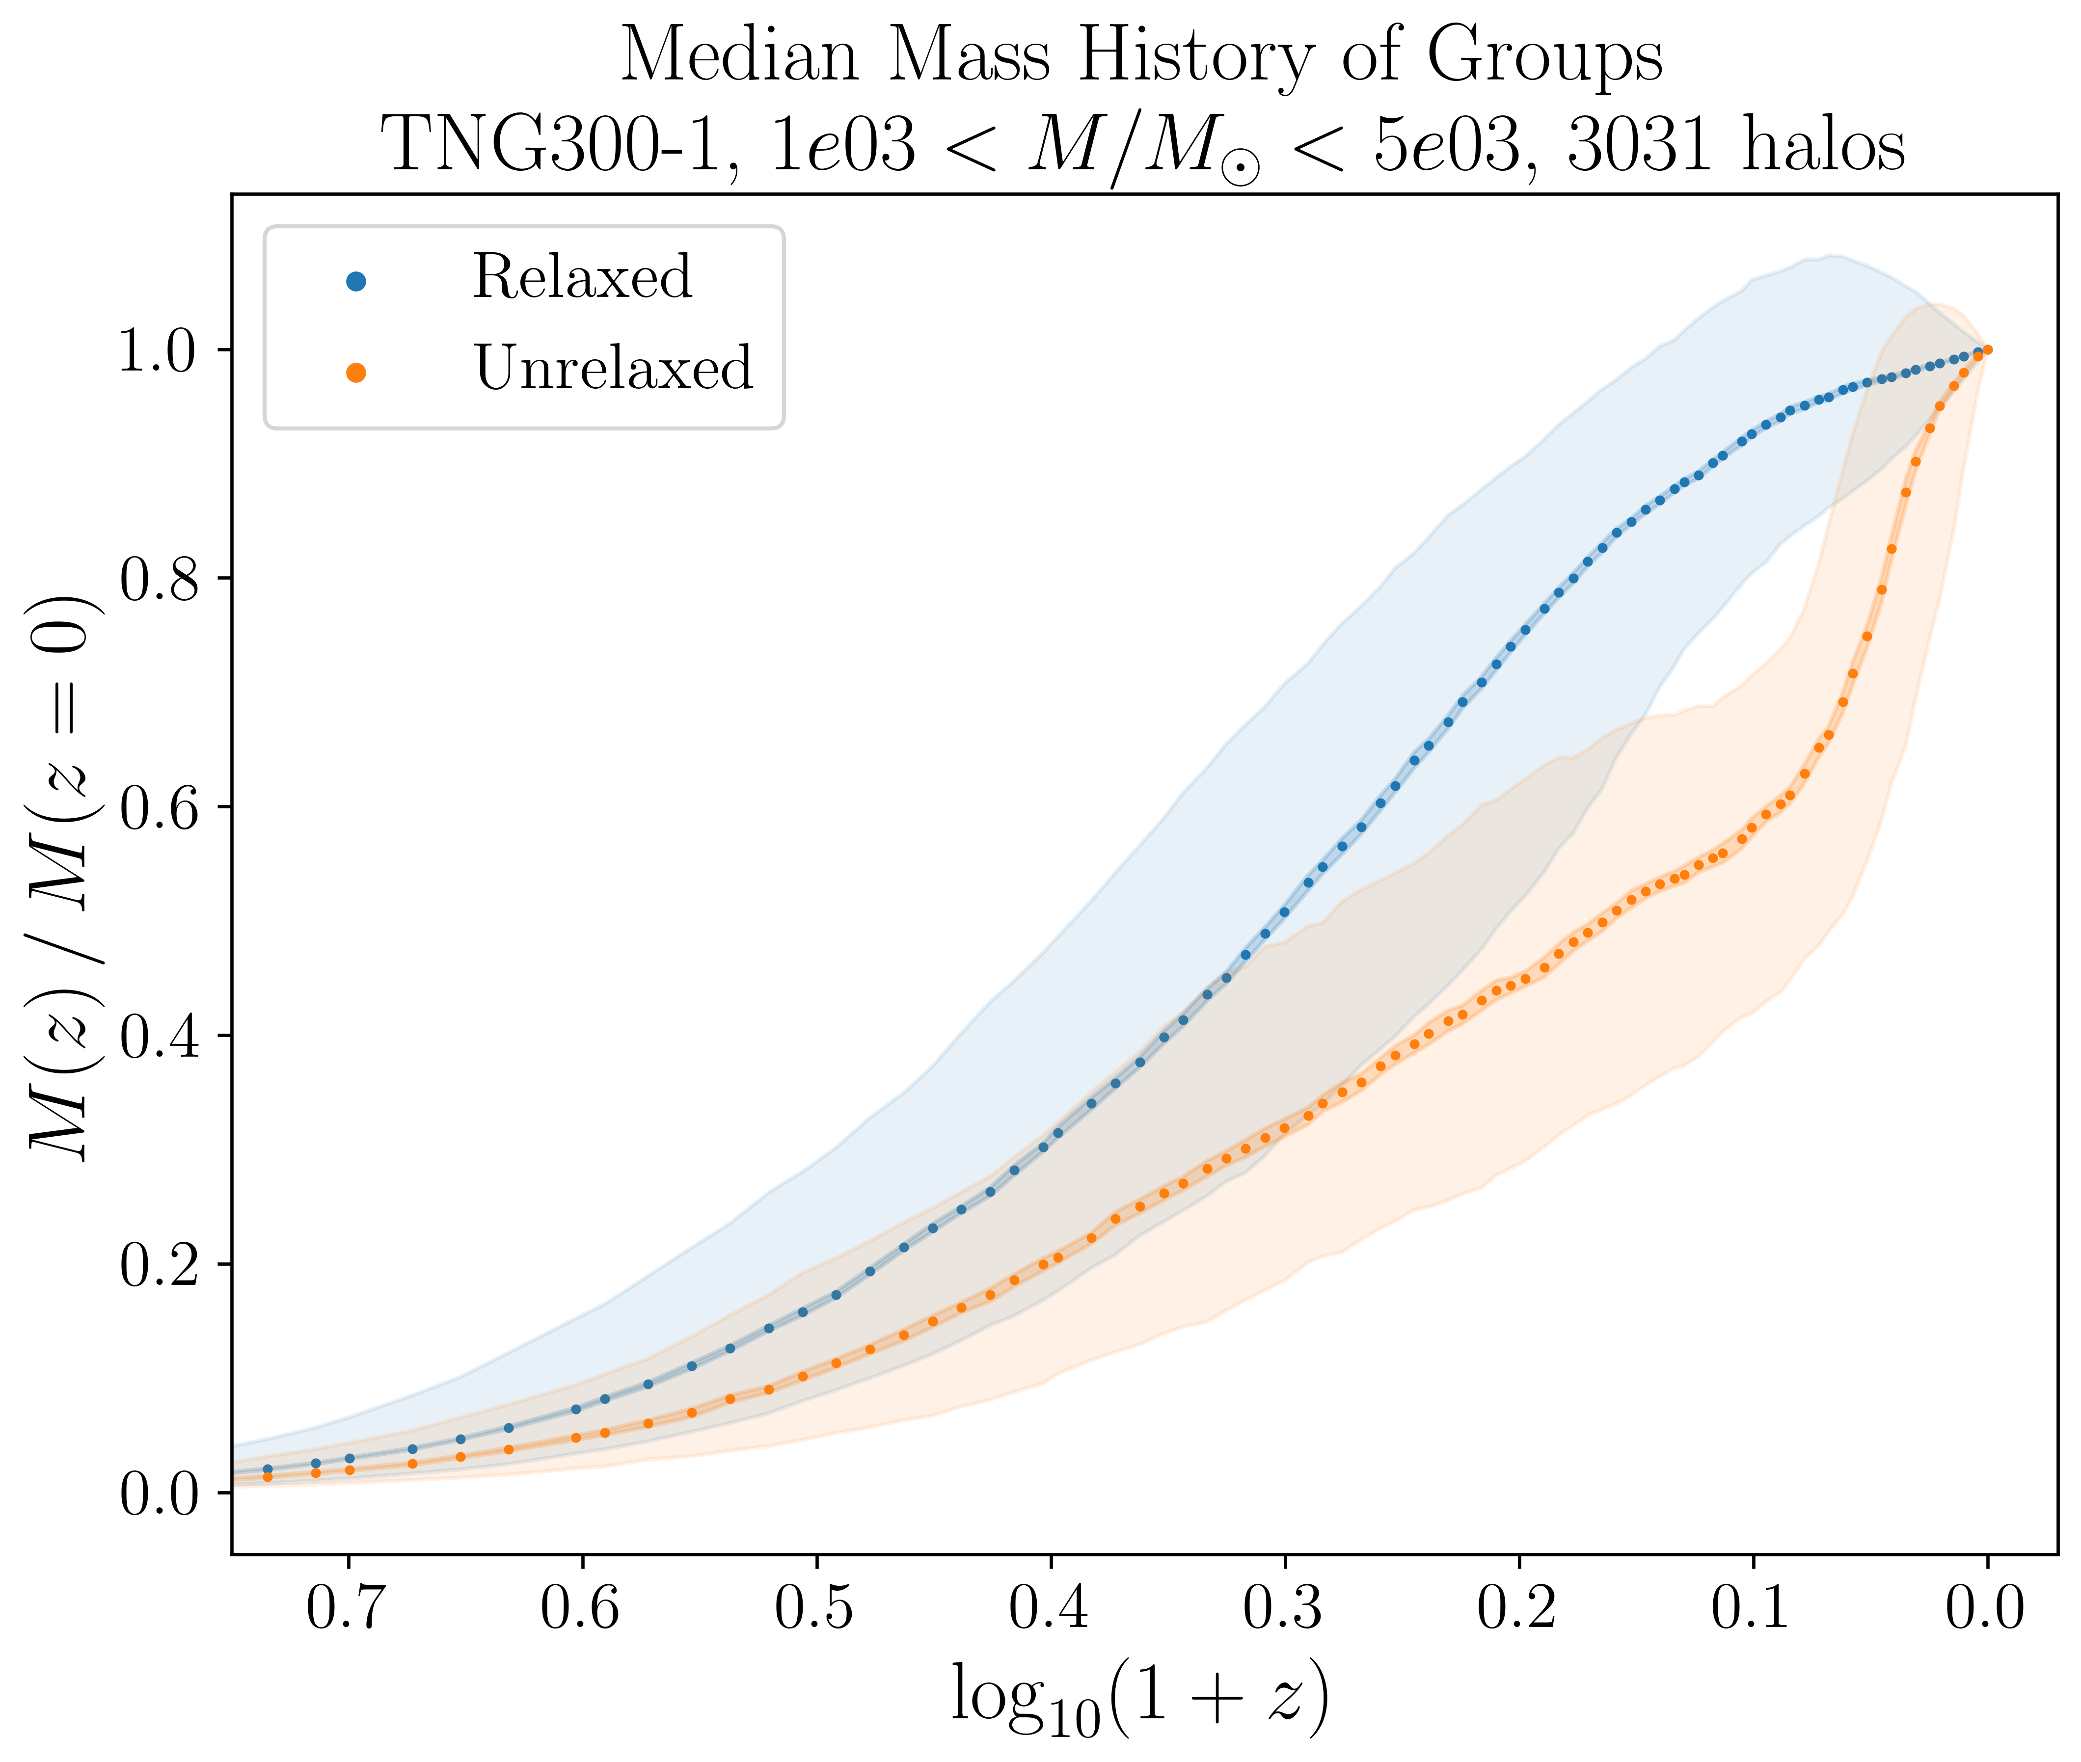
Application to galaxy evolution: matched samples with different infall histories
Reid in prep.: mean mass accretion histories (MAH) for subsamples selected on structural features

Slide 38
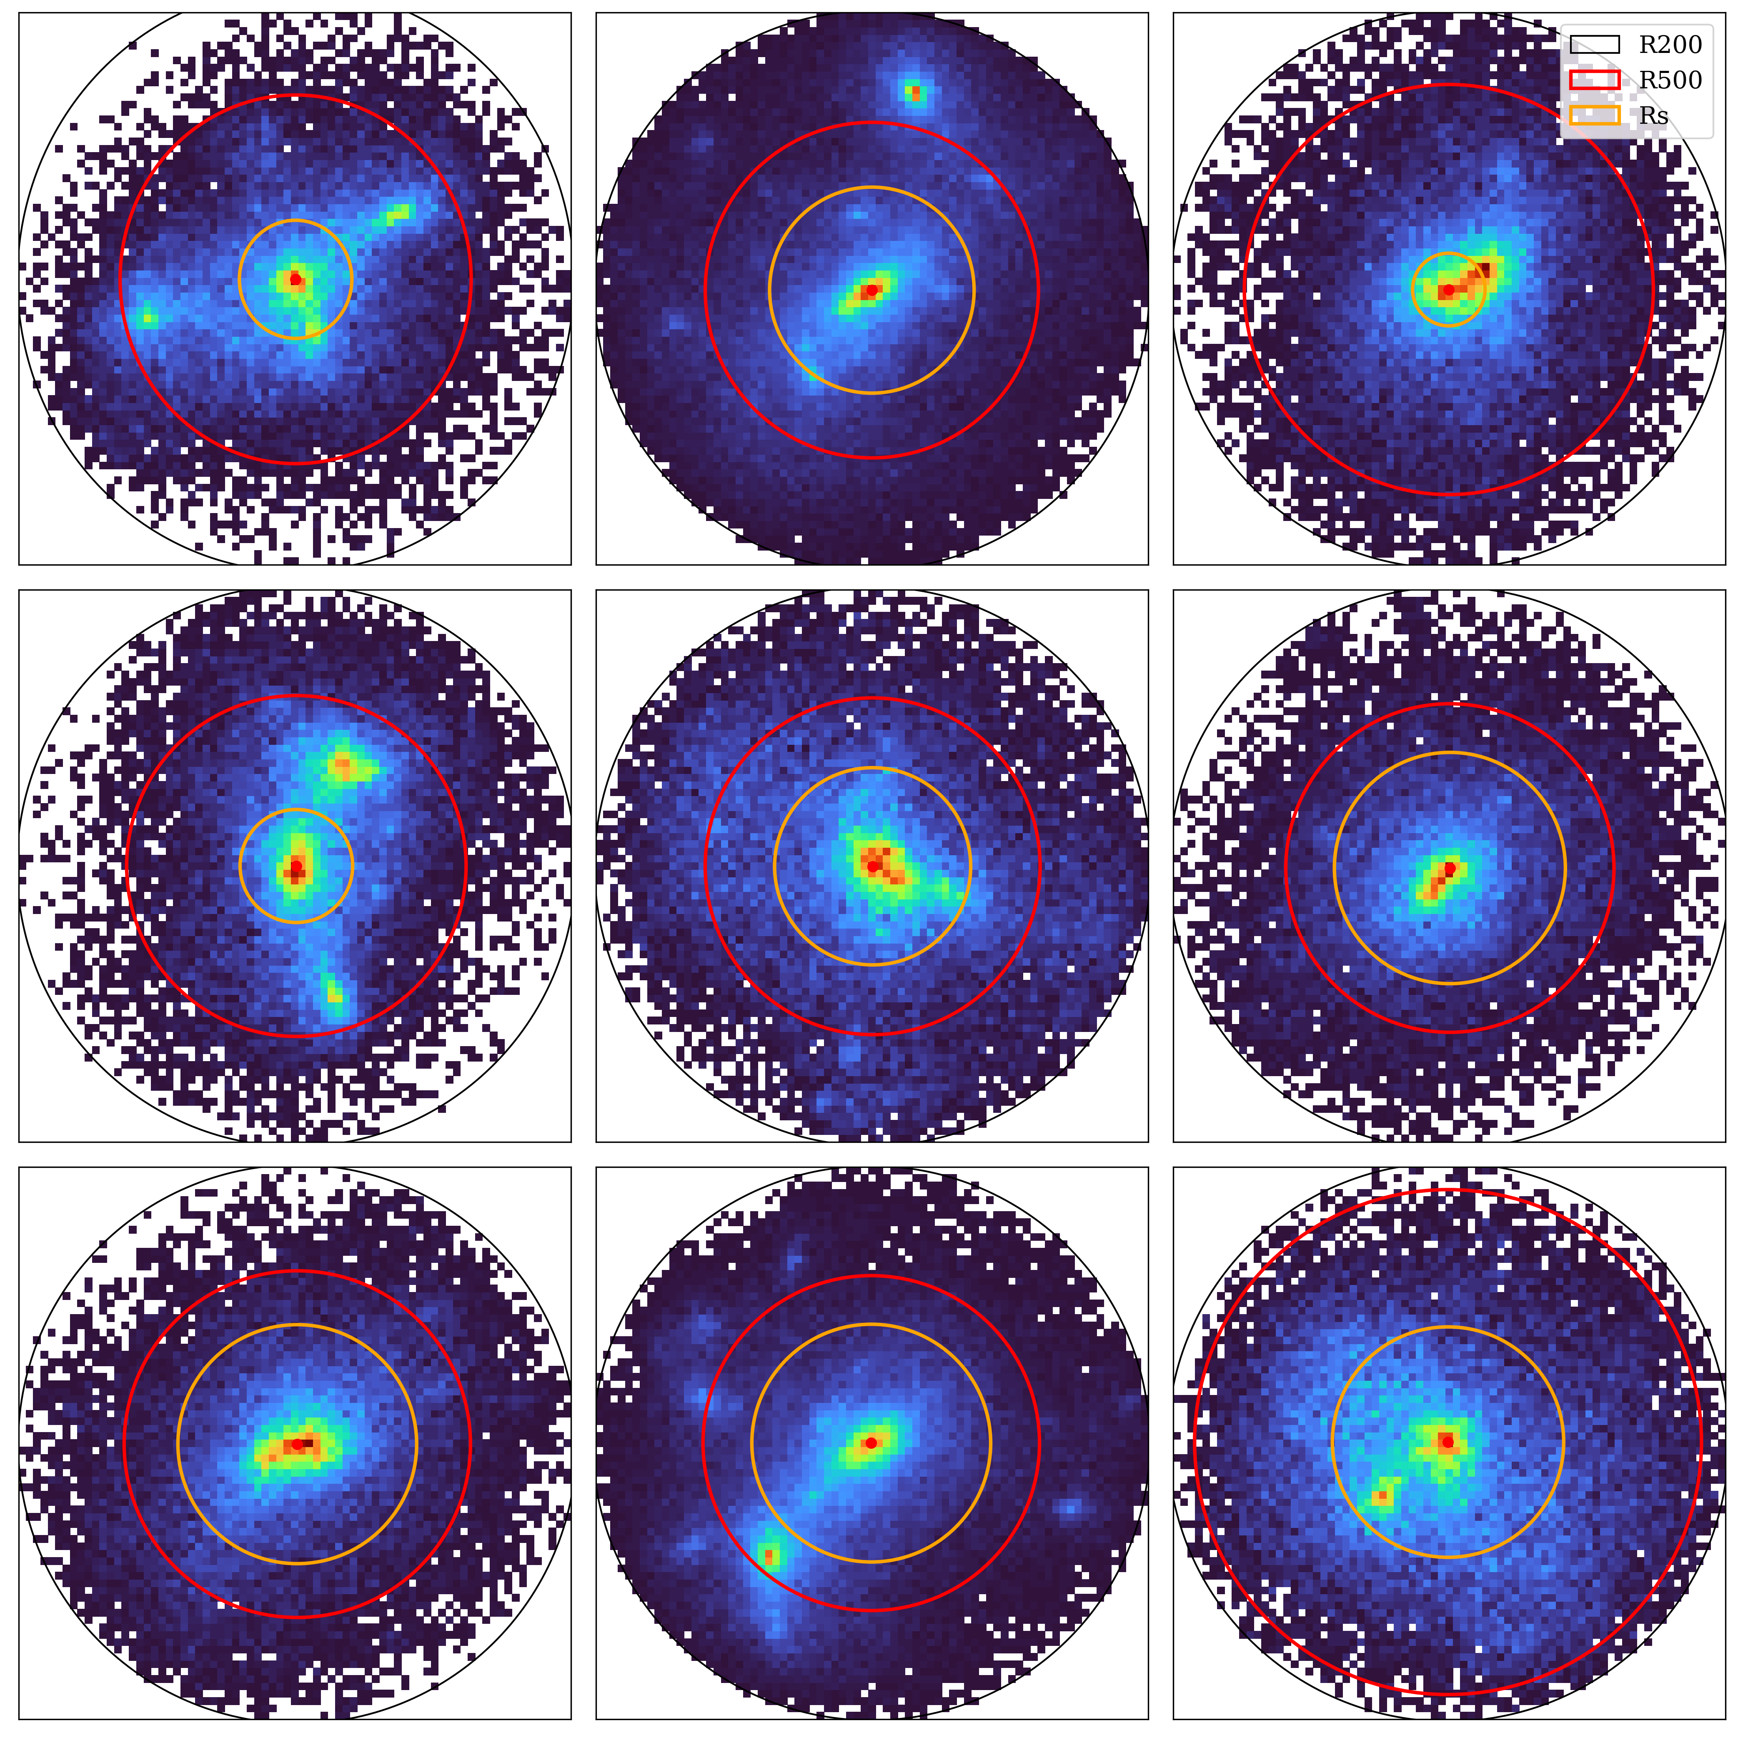
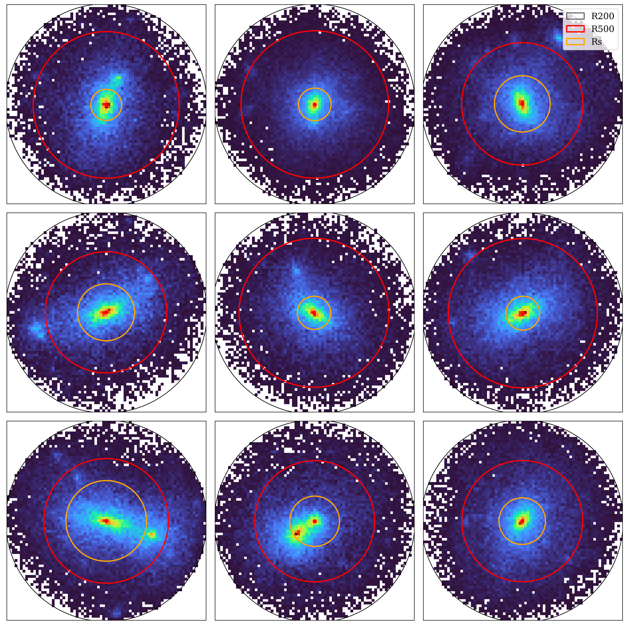
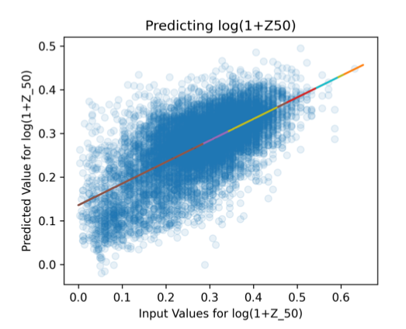
N.b. can we do better than a single measure?
Z₅₀ estimated by a CNN
(Azzam bin Aamir, Liza Sazonova)
Notes:
What are the features:
- asymmetry
- substructure
- concentration
- shape
[- spin]

Slide 39
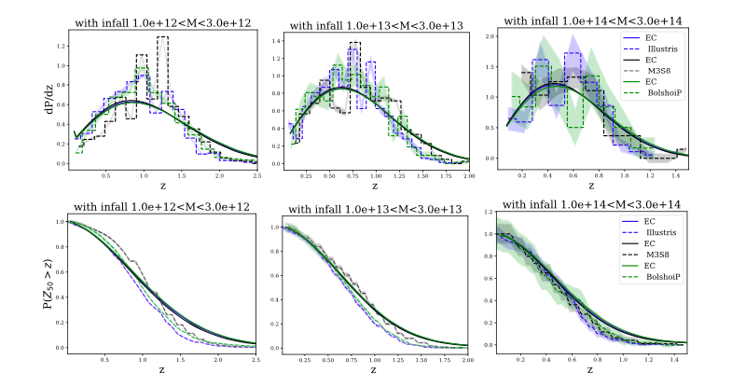
N.B. how well do formation times agree with theory? (Amoura+ 2021)

Slide 40
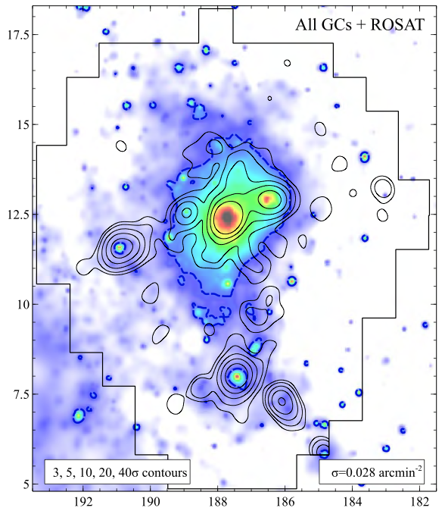

Observational clusters vs theoretical clusters
Virgo X-ray/GC structure (Durrell+ 2014)
Notes:
What are the features:
- asymmetry
- substructure
- concentration
- shape
[- spin]

Slide 41
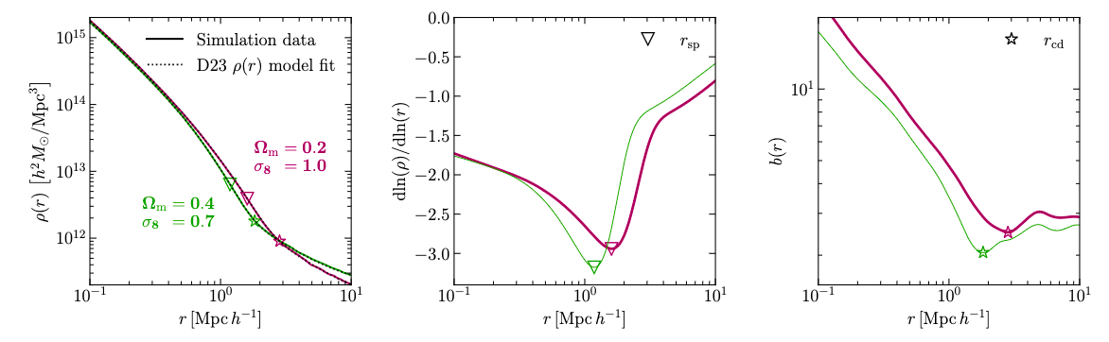
Features of the outer density profile depend on the accretion rate
Splashback radius
Depletion radius
Several radii/features to measure:
Splashback radius (first apocentre of accreted orbits; steepest slope)
Depletion radius (minimum bias relative to matter-matter correlation function)
Overall shape on infall zone
Mpetha+ 2024

Slide 42
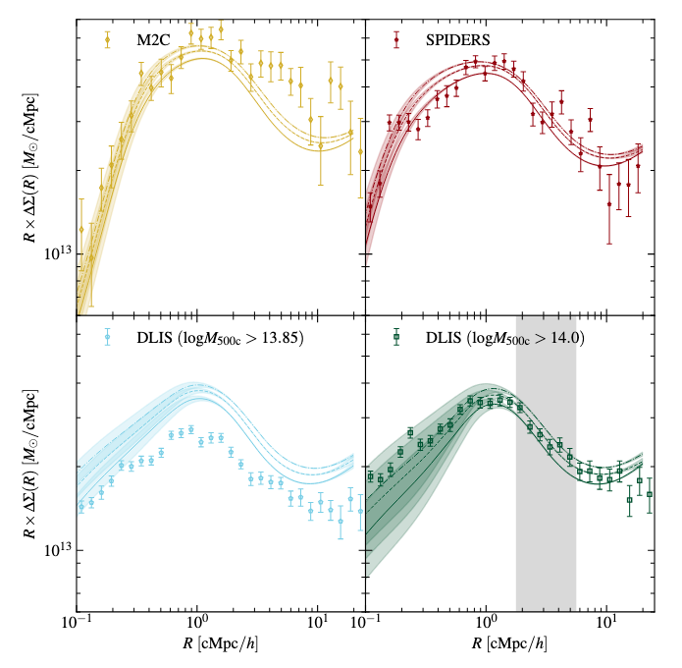
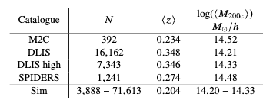
Initial test in UNIONS (Mpetha + 2025)
Measure stacked lensing signal around 4 cluster samples.
Various issues: centering, contamination, large-scale bias…
Mpetha+ 2025
Notes:
COSMOS: 8 clusters 1e14 over 1.6 square eg, so 5/deg SNR 2x UNIONS 5 sigma at z=0.3 = 1e14

Slide 43
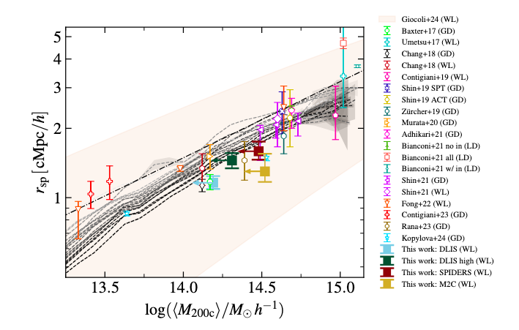
Initial test in UNIONS (Mpetha + 2025)
Derive splashback radius; correct for possible mass bias
Results consistent with previous measures, but a bit low…
Mpetha+ 2025
Notes:
COSMOS: 8 clusters 1e14 over 1.6 square eg, so 5/deg SNR 2x UNIONS 5 sigma at z=0.3 = 1e14

Slide 44
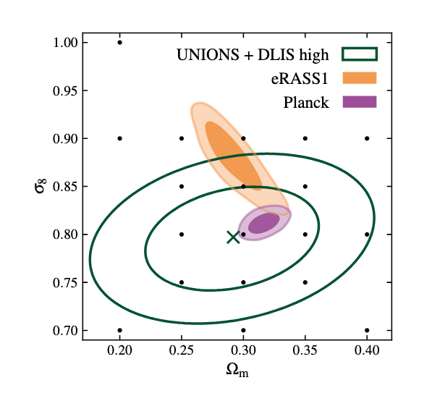
Initial test in UNIONS (Mpetha + 2025)
Despite the challenges, obtain the first cosmological constraints with this method!
Many issues left to address, but potential for Euclid seems promising…
Mpetha+ 2025
Notes:
COSMOS: 8 clusters 1e14 over 1.6 square eg, so 5/deg SNR 2x UNIONS 5 sigma at z=0.3 = 1e14

Slide 45
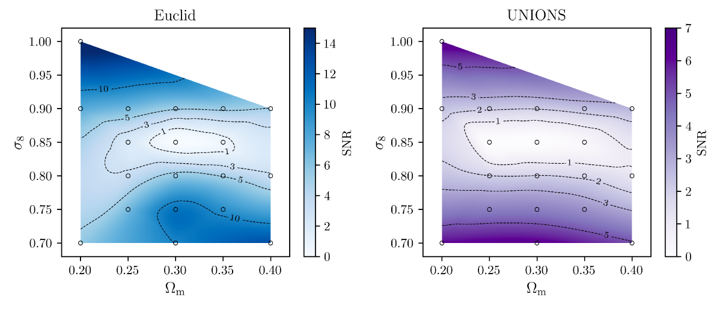
Final predictions for UNIONS & Euclid [single lens mass/redshift bin]
Mpetha in prep..
Mpetha 2024.
(Note slight tilt to horizontal – think this comes from mean mass variation in sample)

