Slide 1
The next-generation halo model based on the depletion radius
Yifeng Zhou (周义丰)
Supervisor: Jiaxin Han （韩家信）
Department of astronomy, Shanghai Jiao Tong Univerity
arXiv: 2303.10886, 2407.08381

Slide 2
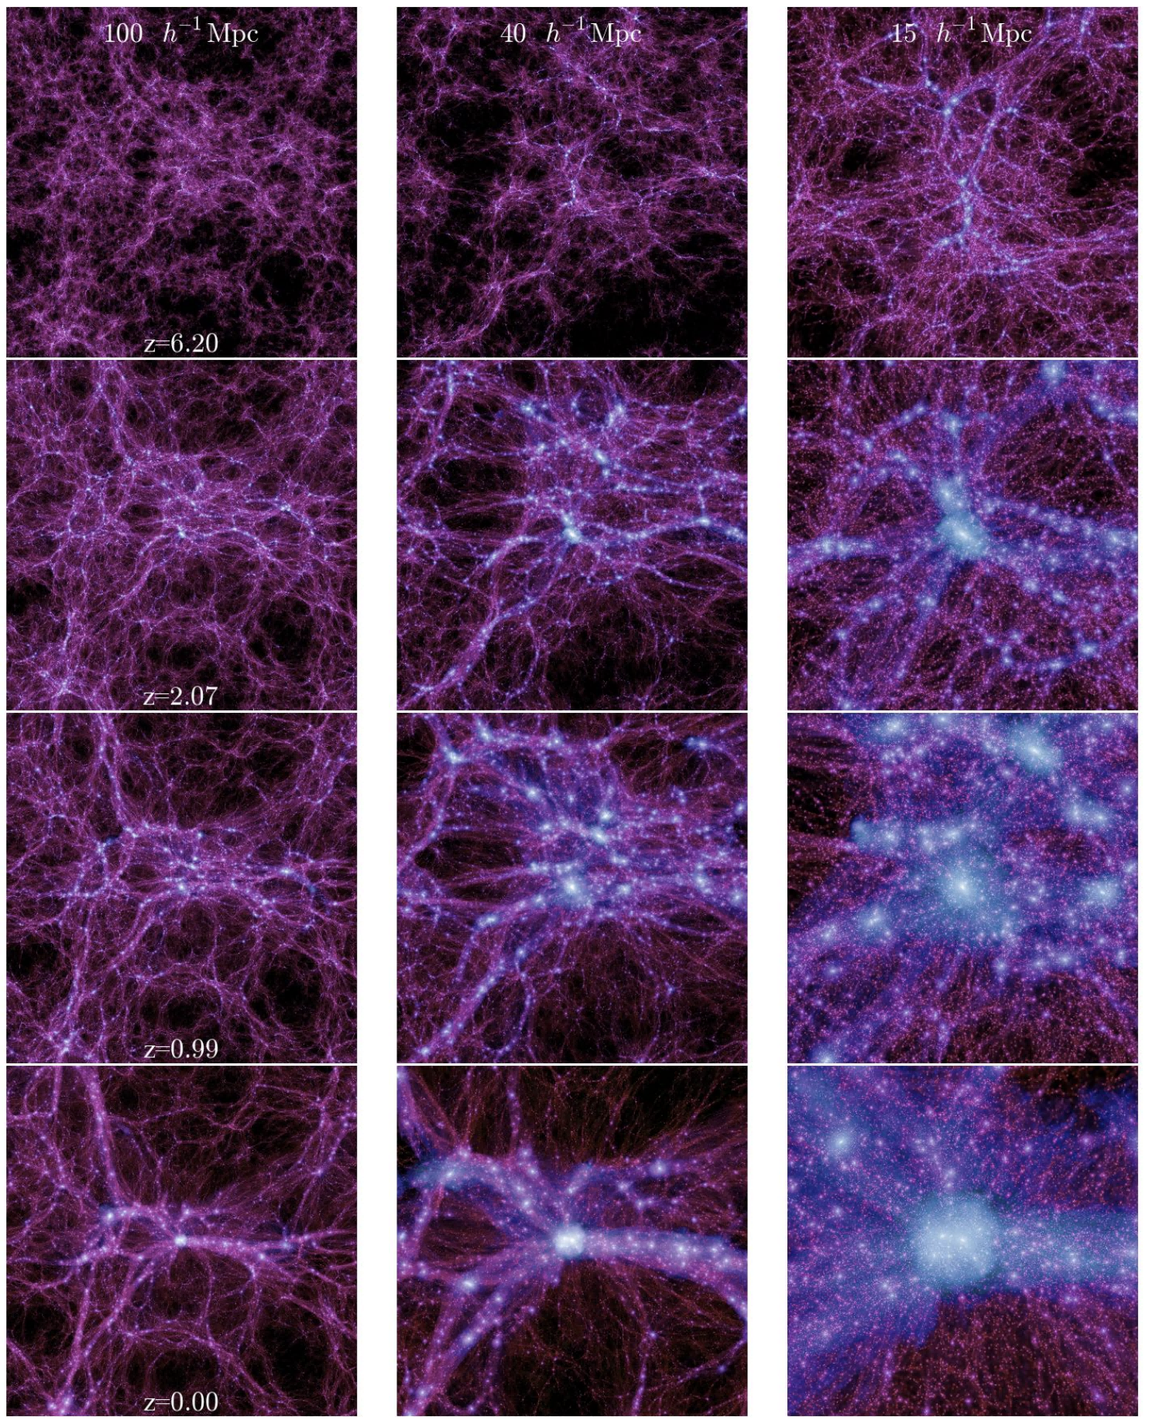
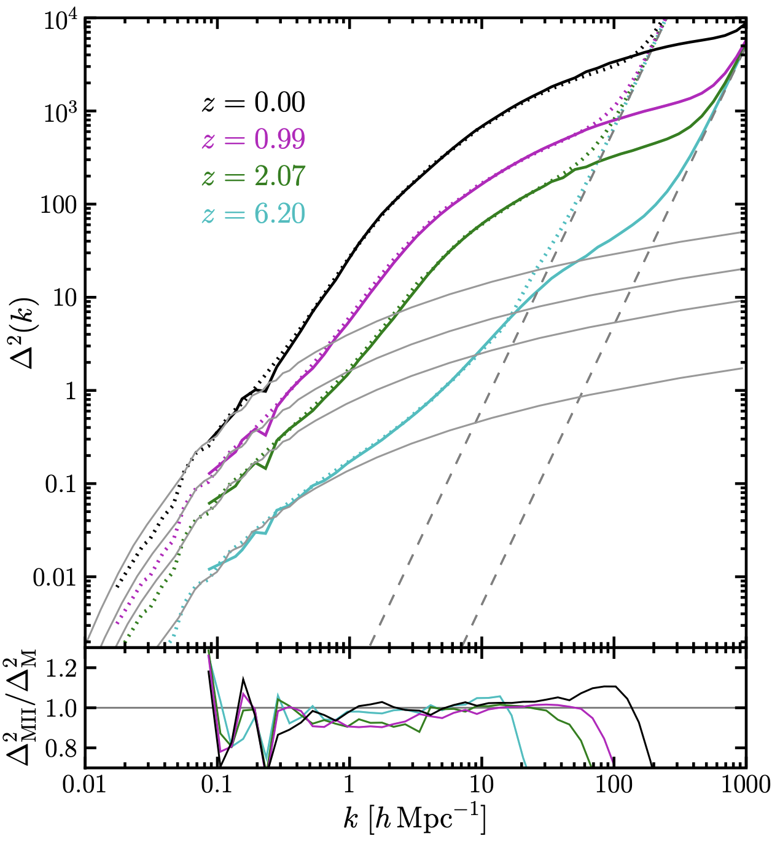
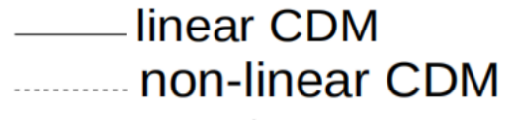
Halo model of large-scale structure
Cosmological simulation
Matter power spectrum
Linear regime
Non-linear regime: dark matter halos
Millennium-II Simulation [Boylan-Kolchin et al. (2009)]

Slide 3
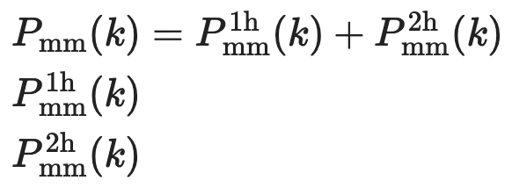
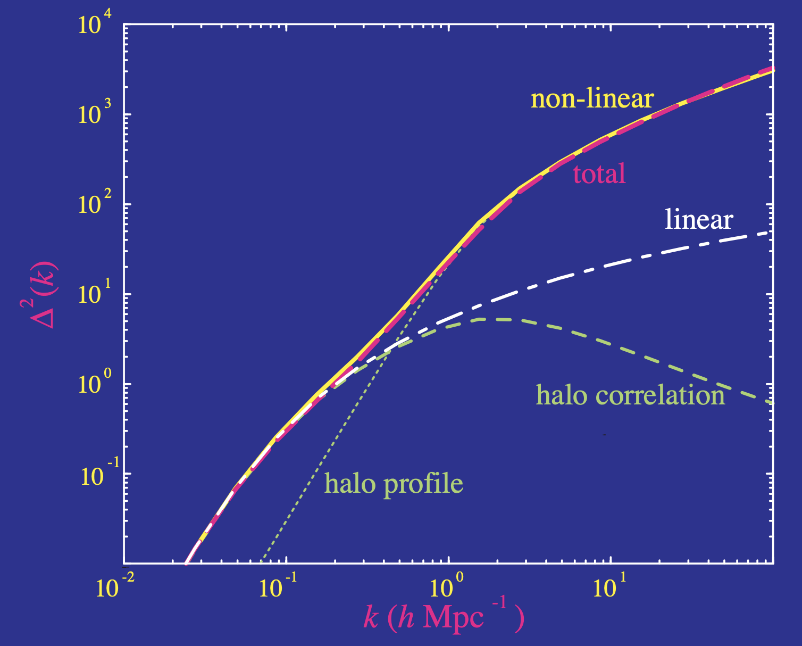
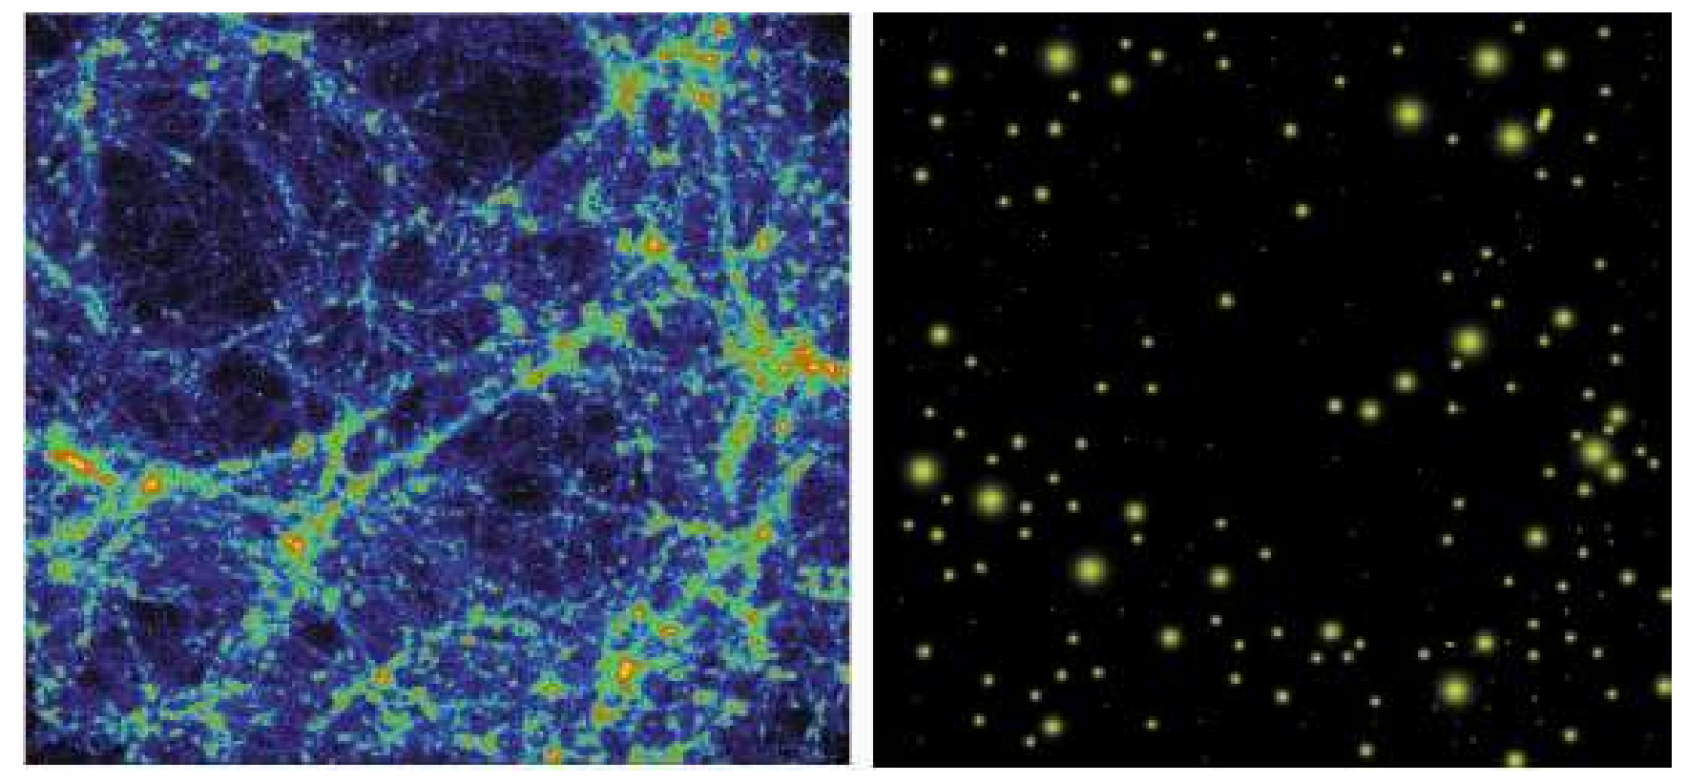

Halo model of large-scale structure
The idea of halo model
matter field = halo field＊halo profiles
Cooray & Sheth (2002)
1-halo term：
clustering form particles within the same halo
2-halo term：
clustering from different halos
Model ingredients
  halo mass function;
  halo spatial distribution (halo bias);
  halo density profile;

Slide 4
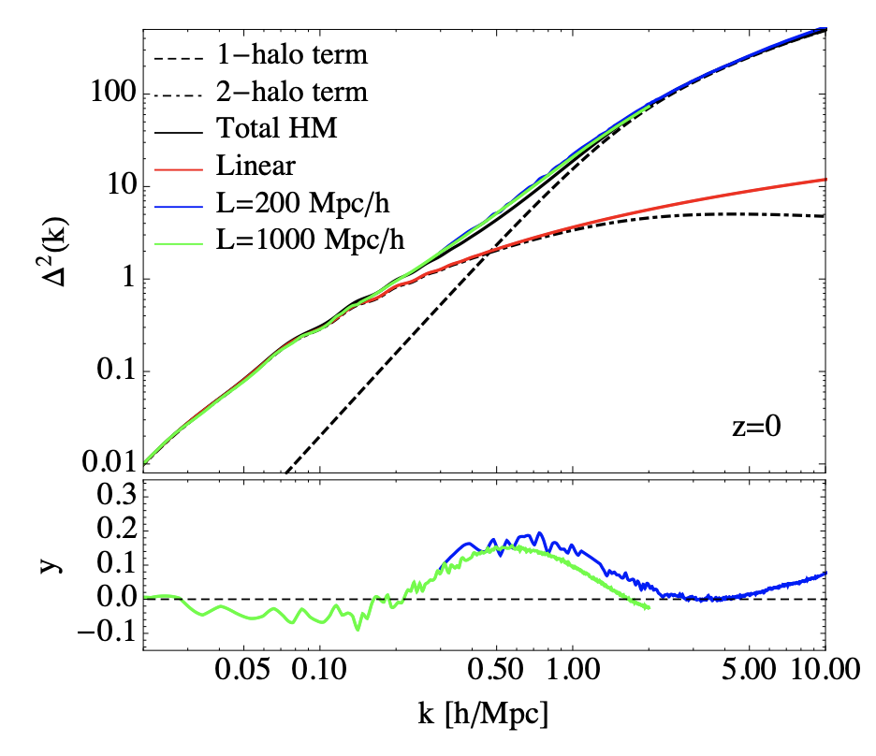
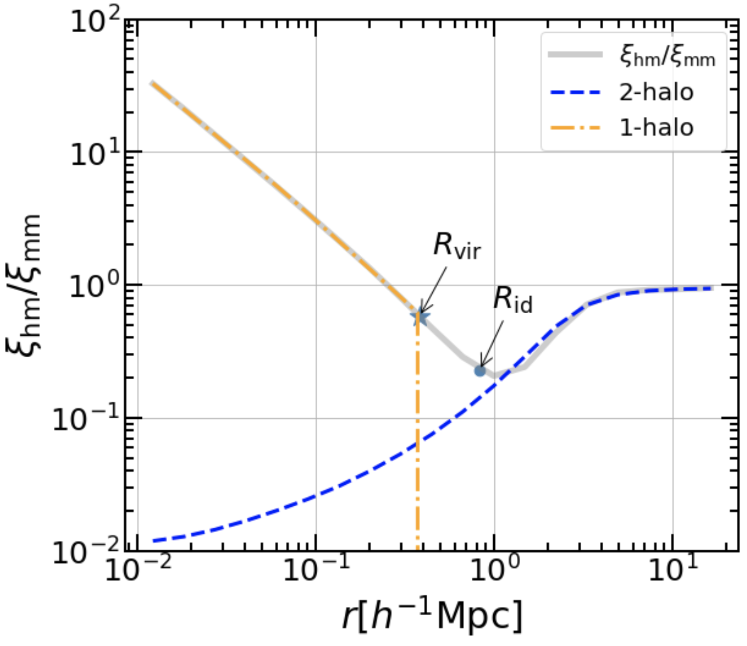
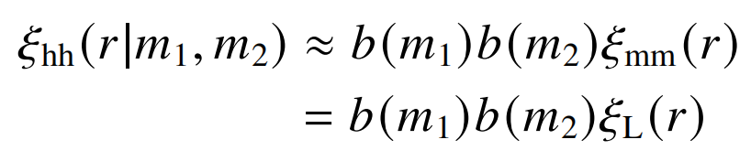
Halo model of large-scale structure
A notorious deviation between the halo model and the simulatons for about 0.1<k<1 hMpc⁻¹
Classical halo model
1-halo: truncated NFW profile
2-halo:
Massara et al. (2014)
Explanations for the deviation
  Transition around the halo boundary;
  Halo exclusion;
  Diffuse matter between haloes
Motivation 1: halo model requires a new halo boundary to improve accuracy

Slide 5
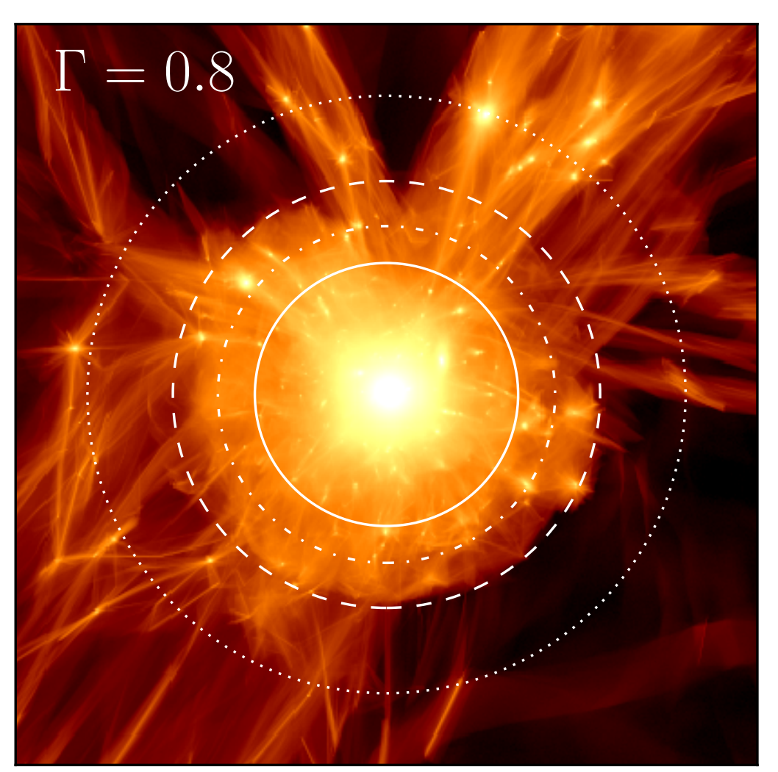

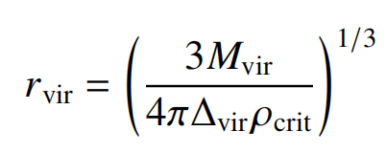
Virial radius of halos
Classical boundary definition
R_{vir}
Virial equilibrium：
virial radius R_{vir}：
halo is a extended structure beyond R_{vir}
  R_{vir} only describes the virialized inner region;
  Halo is a dynamic structure growing in the cosmic web
    Continuous accretion and mergers；
    Enveloped by a wide non-virialized region
More et al. (2015)
Motivation 2: Halo need a extended boundary definition

Slide 6
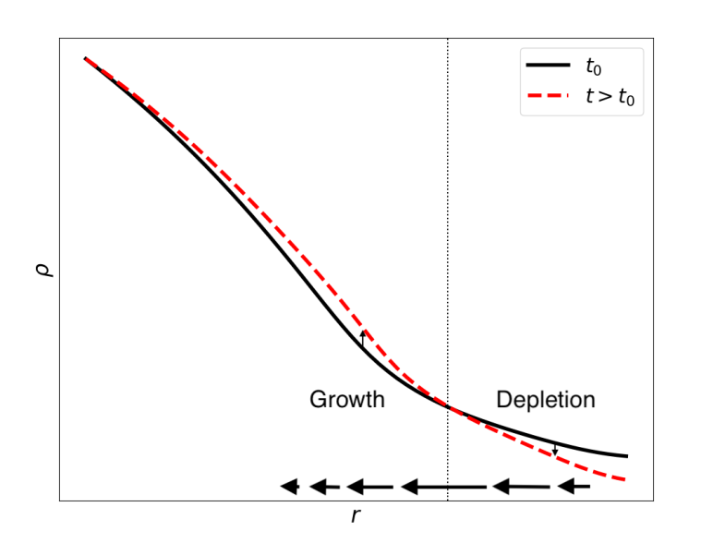
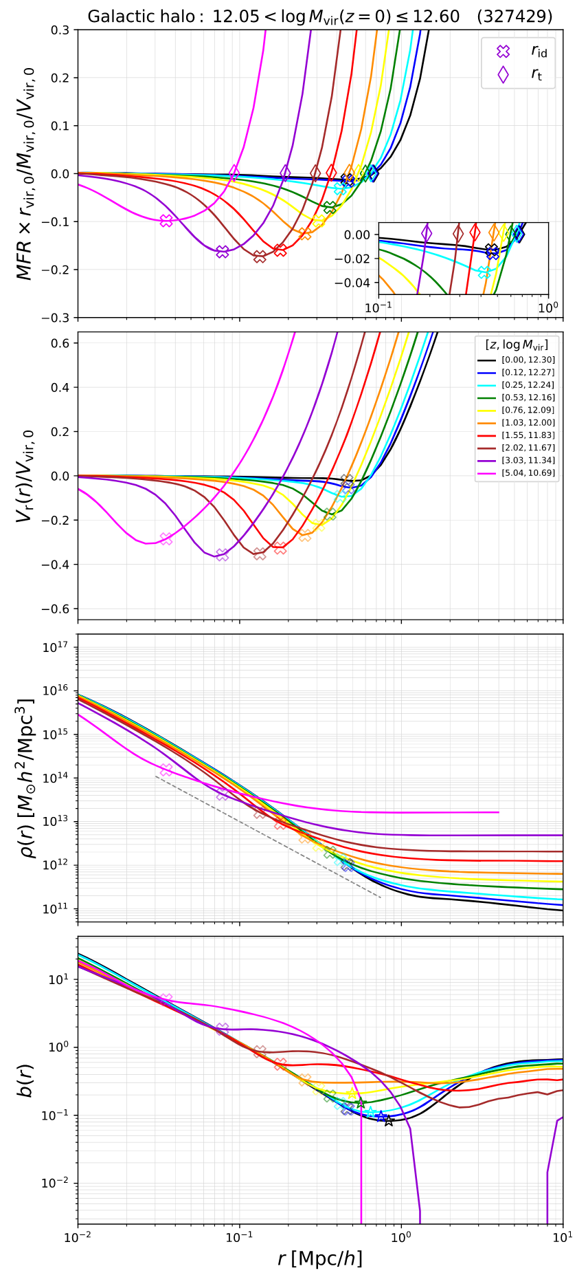



The depletion radius
Halo growing <---> Environment depleting
Continuity equation
R_{id}
Mass Flow Rate (MFR)
Fong & Han (2021)
Gao, Han+ (2023)
Maximum infall rate location: inner depletion radius R_{id}

Slide 7


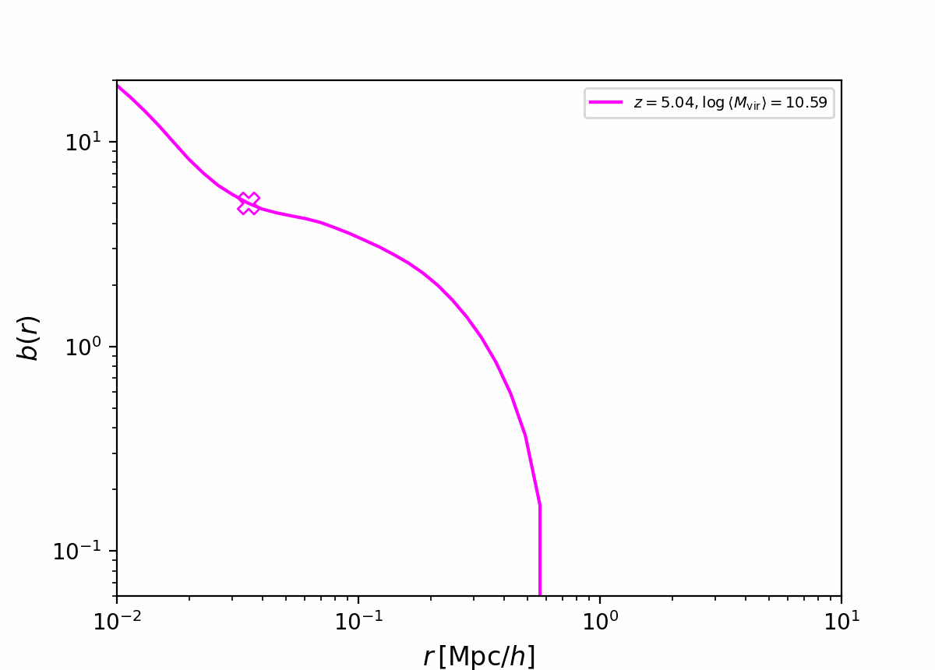
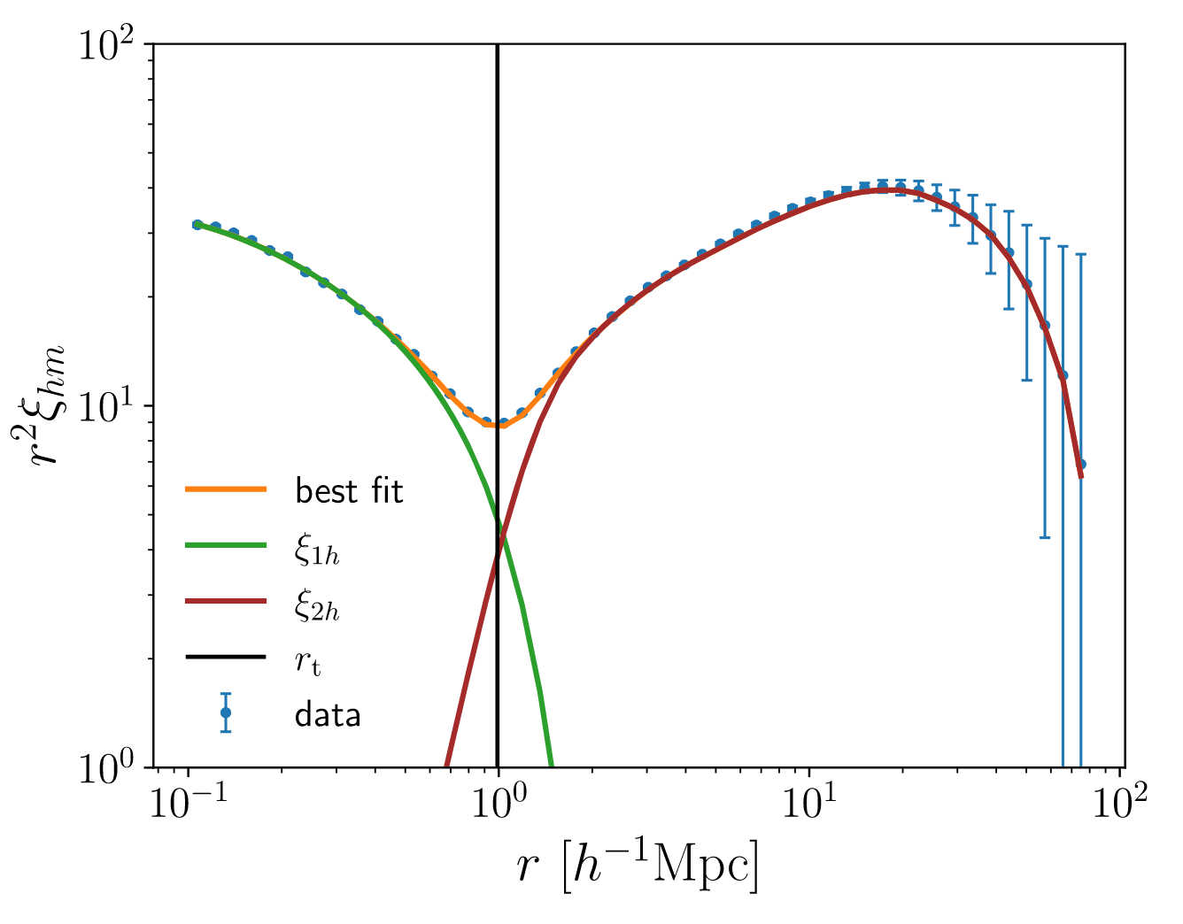
The depletion radius
A natural boundary definition
The effect of halo growth
The exclusion radius of halo model
relative clustering profile:
optimal exclusion radius:
Gao et al. (2023)
Garcίa et al. (2021)
R_{id} characterises the weakest clustering region
R_{id} is close to the optimal exclusion radius
R_{id} a natural boundary to separate the halo and the environment

Slide 8
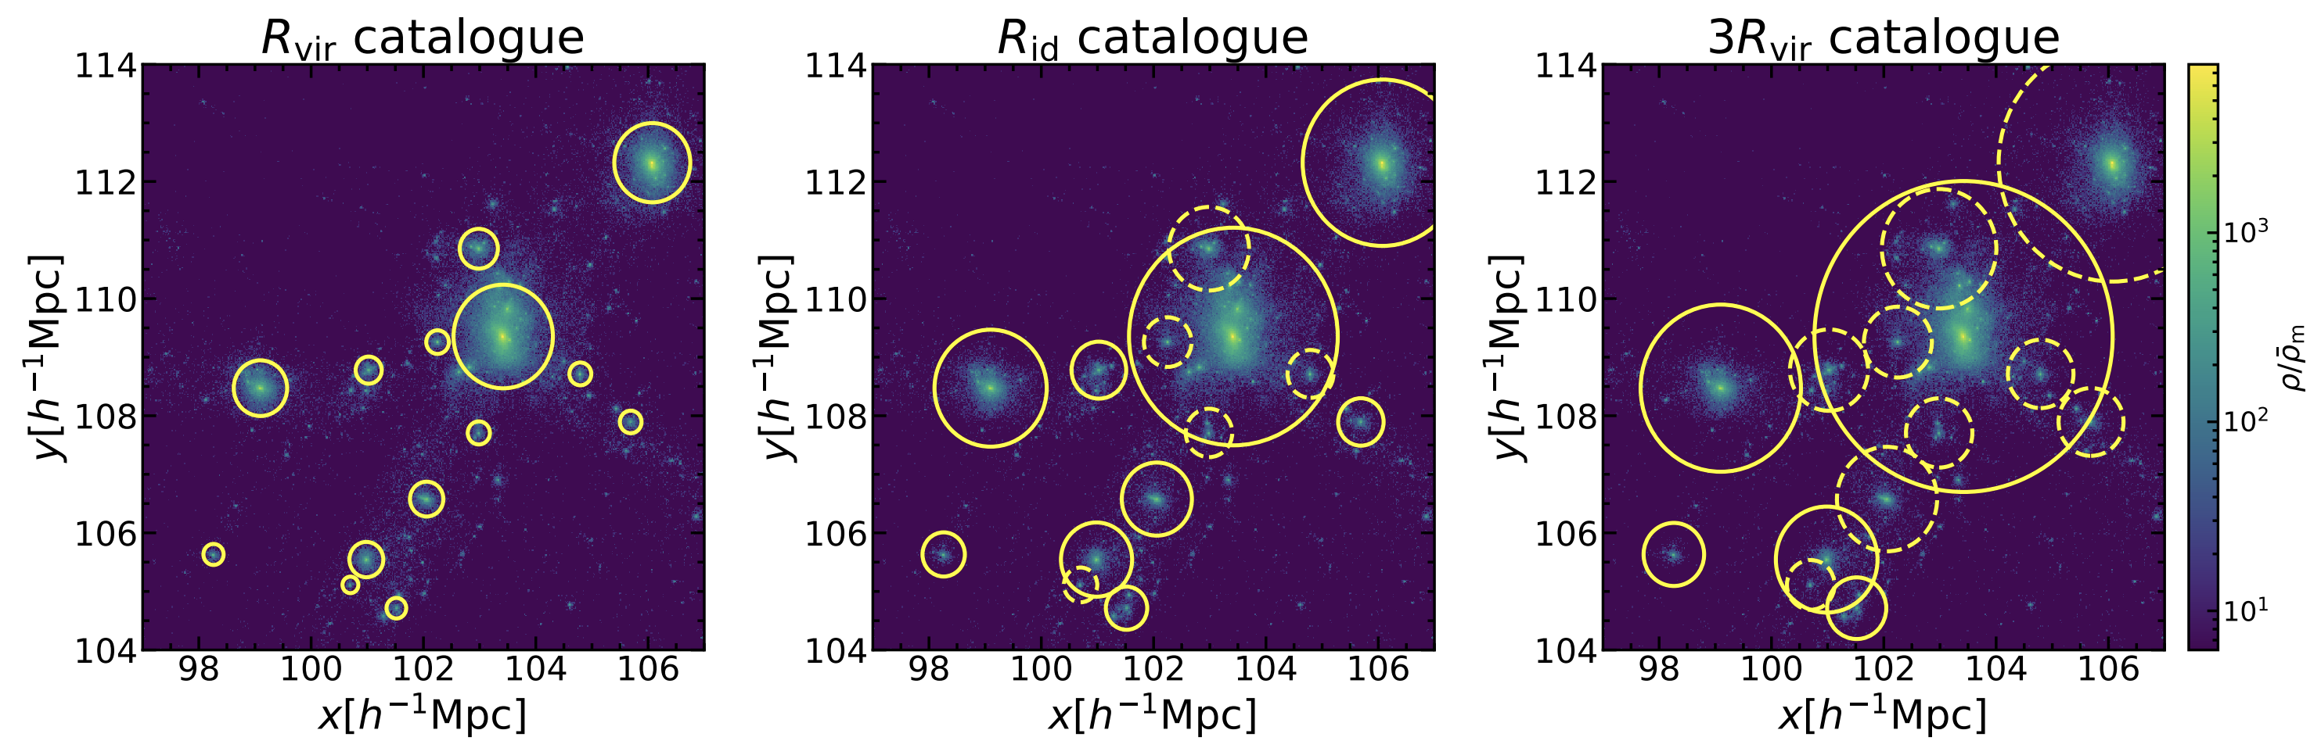
Halo catalog based on the depletion radius
exclusion criterion
Changes of model ingredients：
  Spatial distribution (halo bias)
  Halo mass function
  Density profile
FoF halo catalog
new halo catalog
（R_{id} catalog）
d > R_{ex}(m₁)+R_{ex}(m₂)
R_{ex}=R_{vir}
R_{ex}=R_{id} ~ 2.1R_{vir}
R_{ex}=3R_{vir}

Slide 9
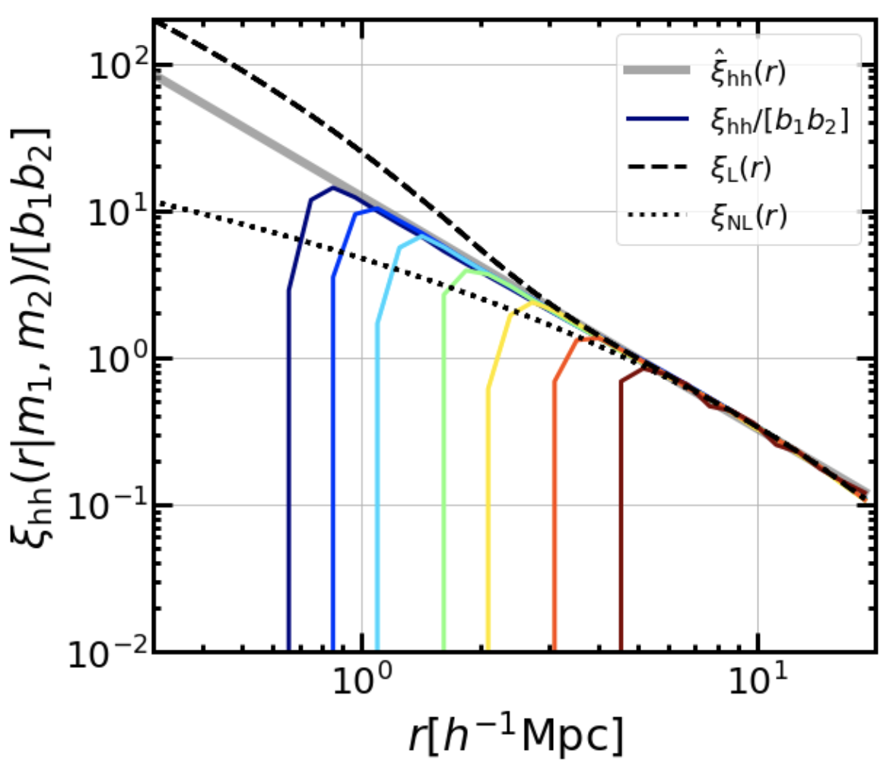
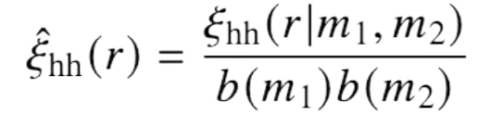
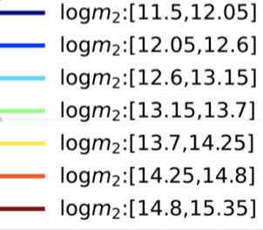
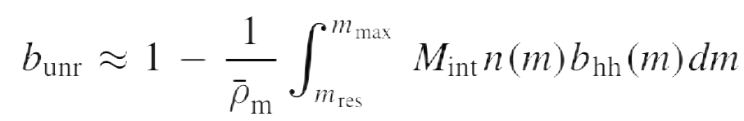
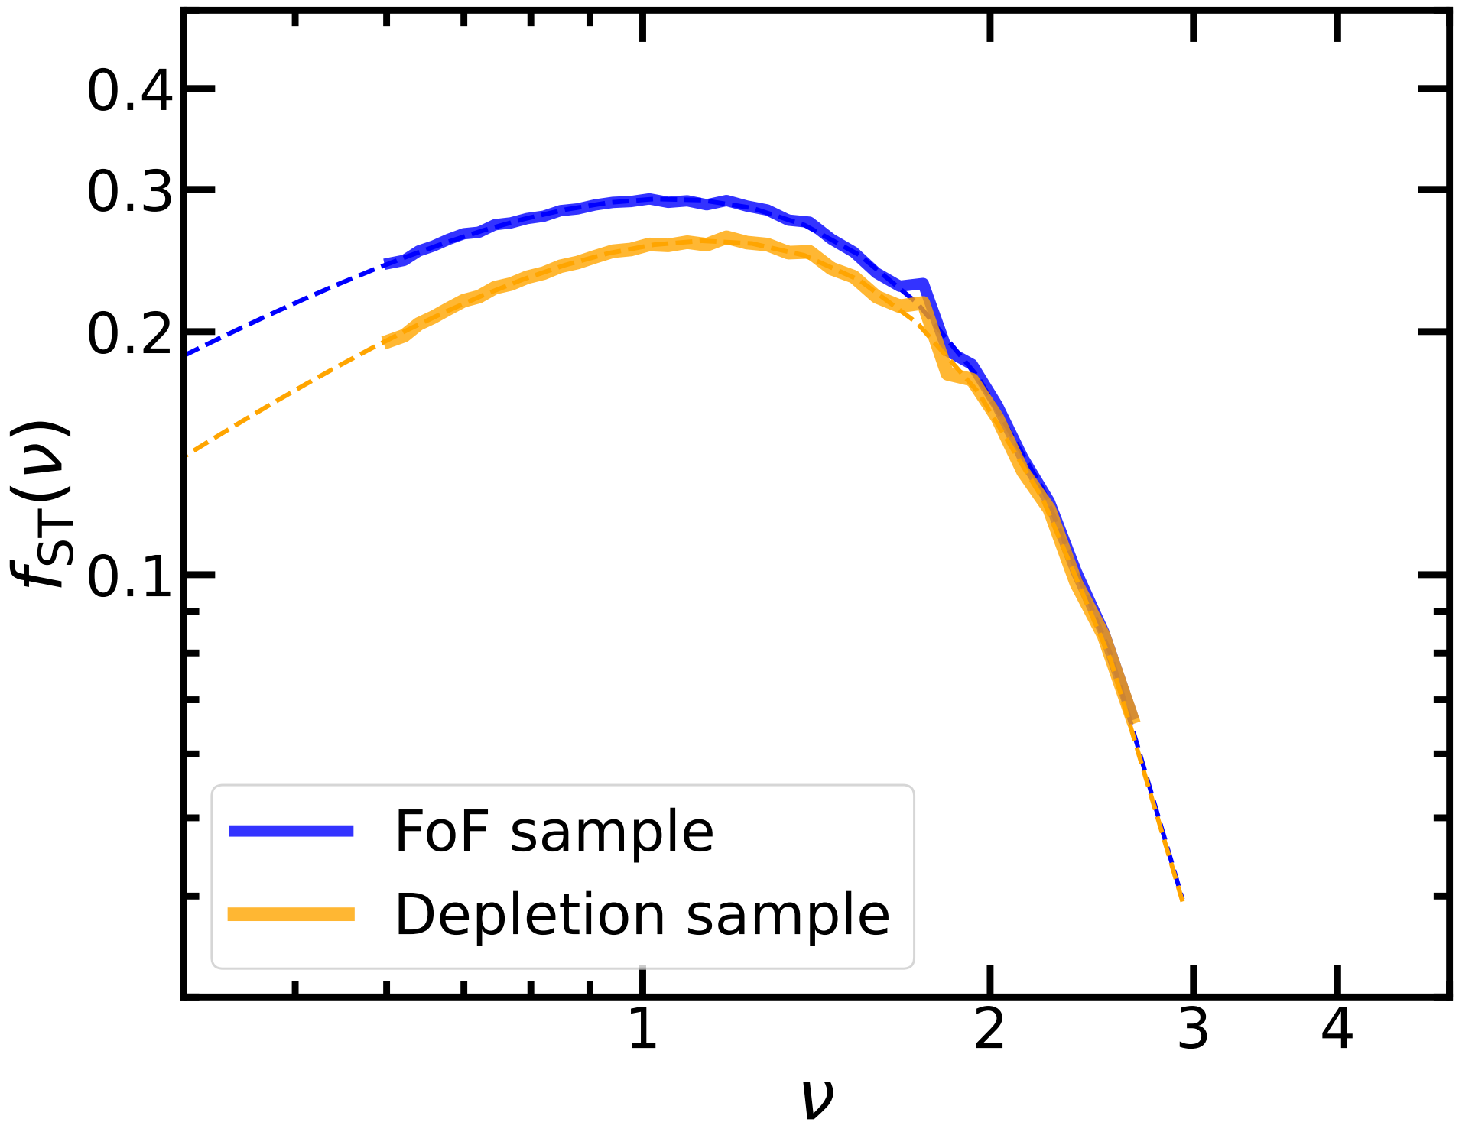
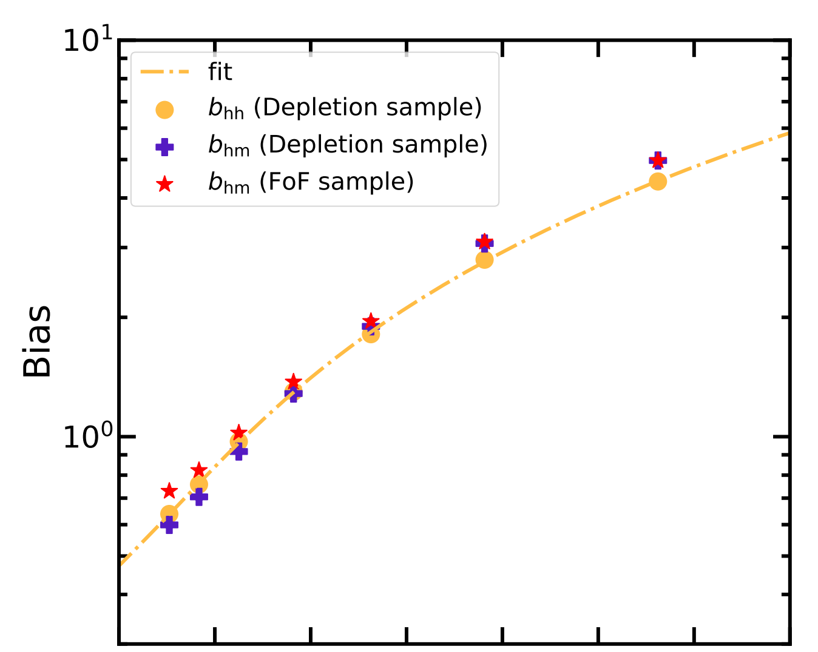
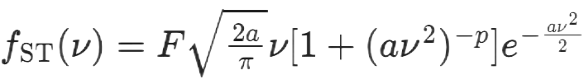
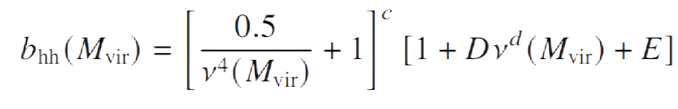
Properties of R_{id} catalog
halo radial distribution
unresolved term
Halo correlation function：
Radial distribution：
Mass fraction：
Radial distribution = powerlaw×truncation
Halo mass function
Halo bias
Sheth-Tormen formula:
Jing98 formula:
with refitted parameters
with refitted parameters

Slide 10
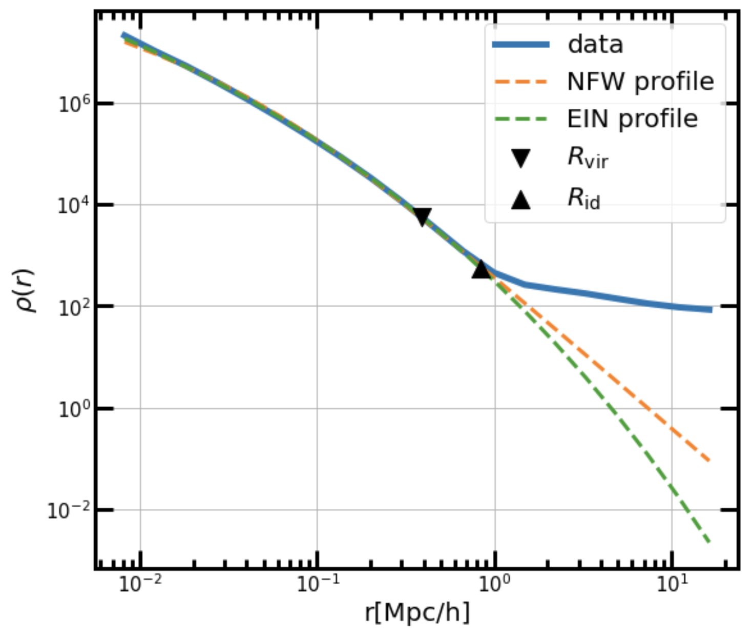
Halo density profile
Disentangling the density profiles
Reconstructionn：
matter field = halo field＊halo profiles
Decomposition：
halo profiles = matter field / halo field (in Fourier space)
Solving for the matching profile
Matter field: {P_{hm}(k|m_{i})}
A set of constraints derived from the halo model
halo catalogue: {P_{hh}(k|m_{i})}, {n(m_{i})}
A set of matching profiles {W(k|m_{i})}
Unresolved term: {{P^{unr}(k|m_{i})}}

Slide 11
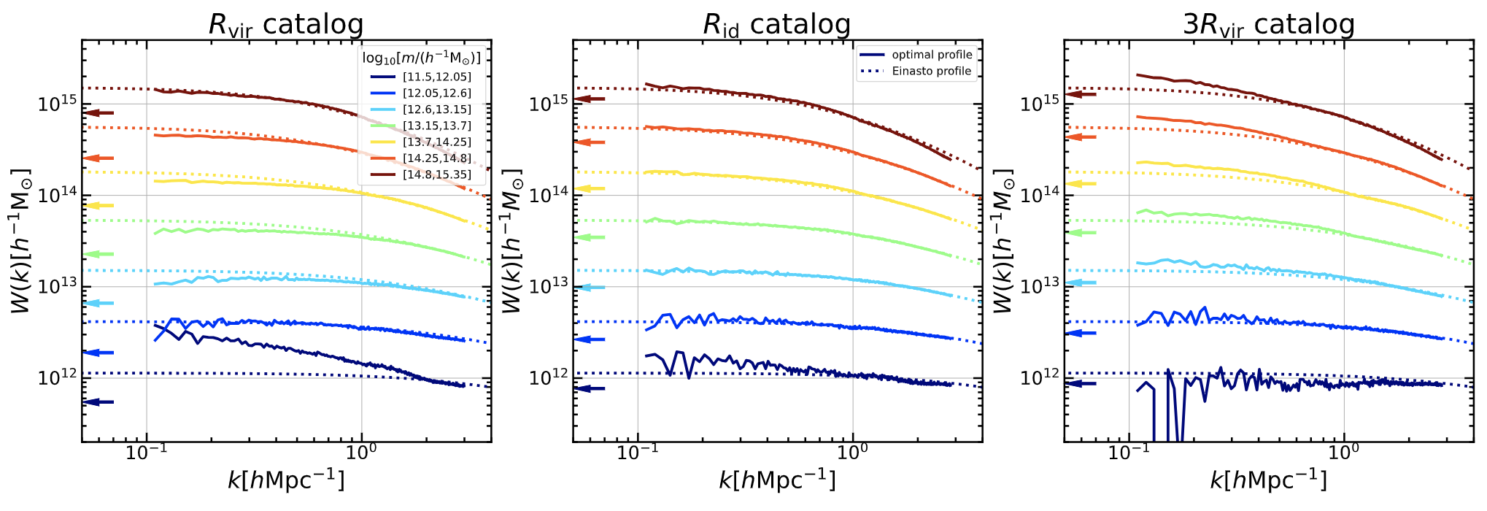
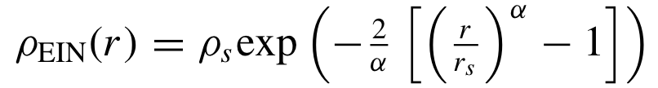
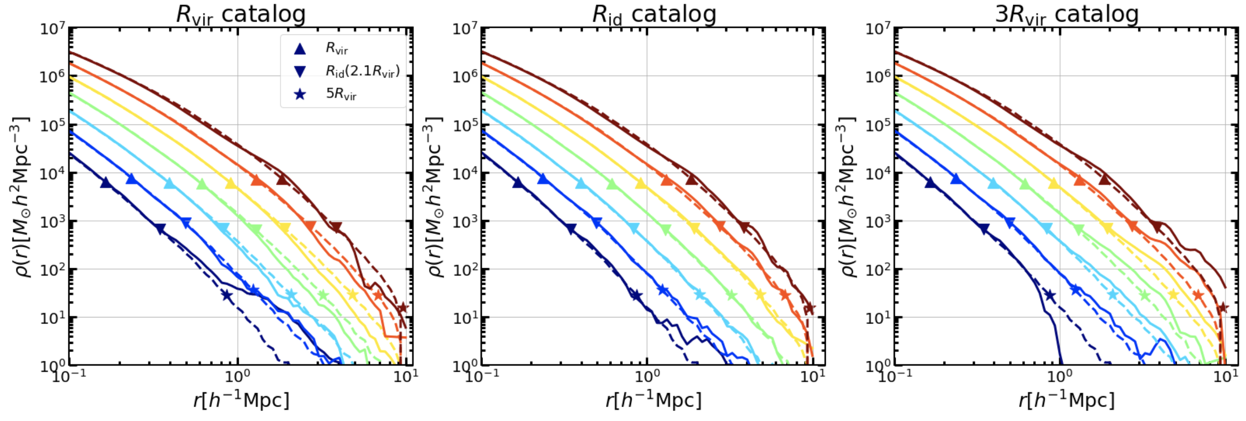
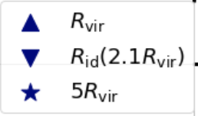
Halo density profile
Matching profiles of R_{id} catalog
Einasto profile (dashed curves):
Input R_{id} catalog
R_{id} matching profiles agree well with Einasto fit up to large scale (5R_{vir});
R_{id} and Eiansto profile are coupled.
Fourier space:
Real space:

Slide 12
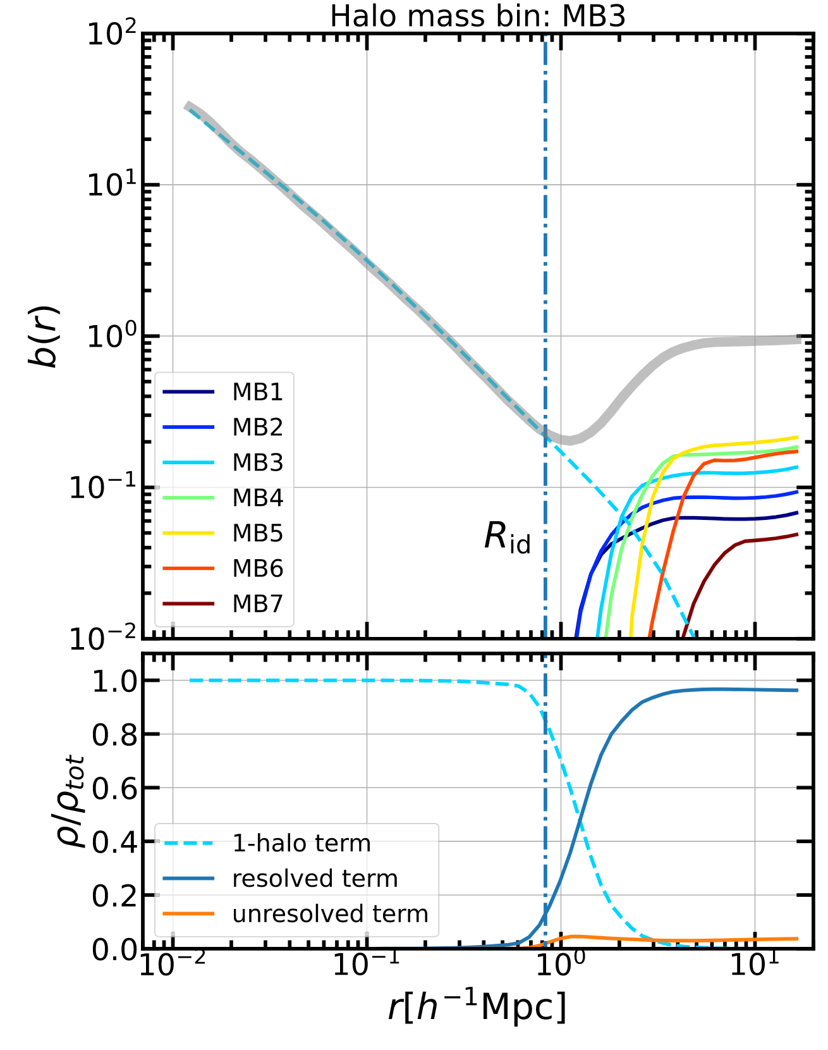
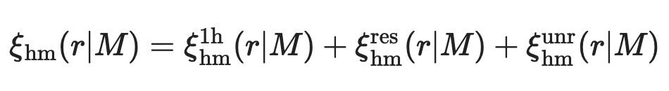
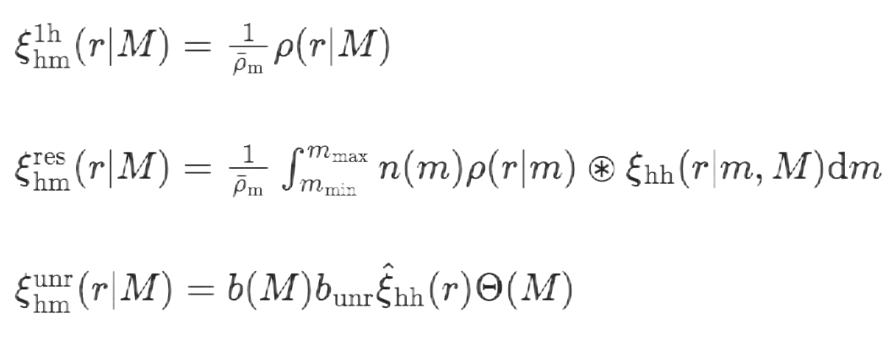
Halo model implementation
Model compoments
Halo-matter correlation function:
logm₁:[13.15,13.70]
1-halo term
2-halo term
1-halo term:
Resolved term:
Unresolved term:
Relative density profile:

Slide 13
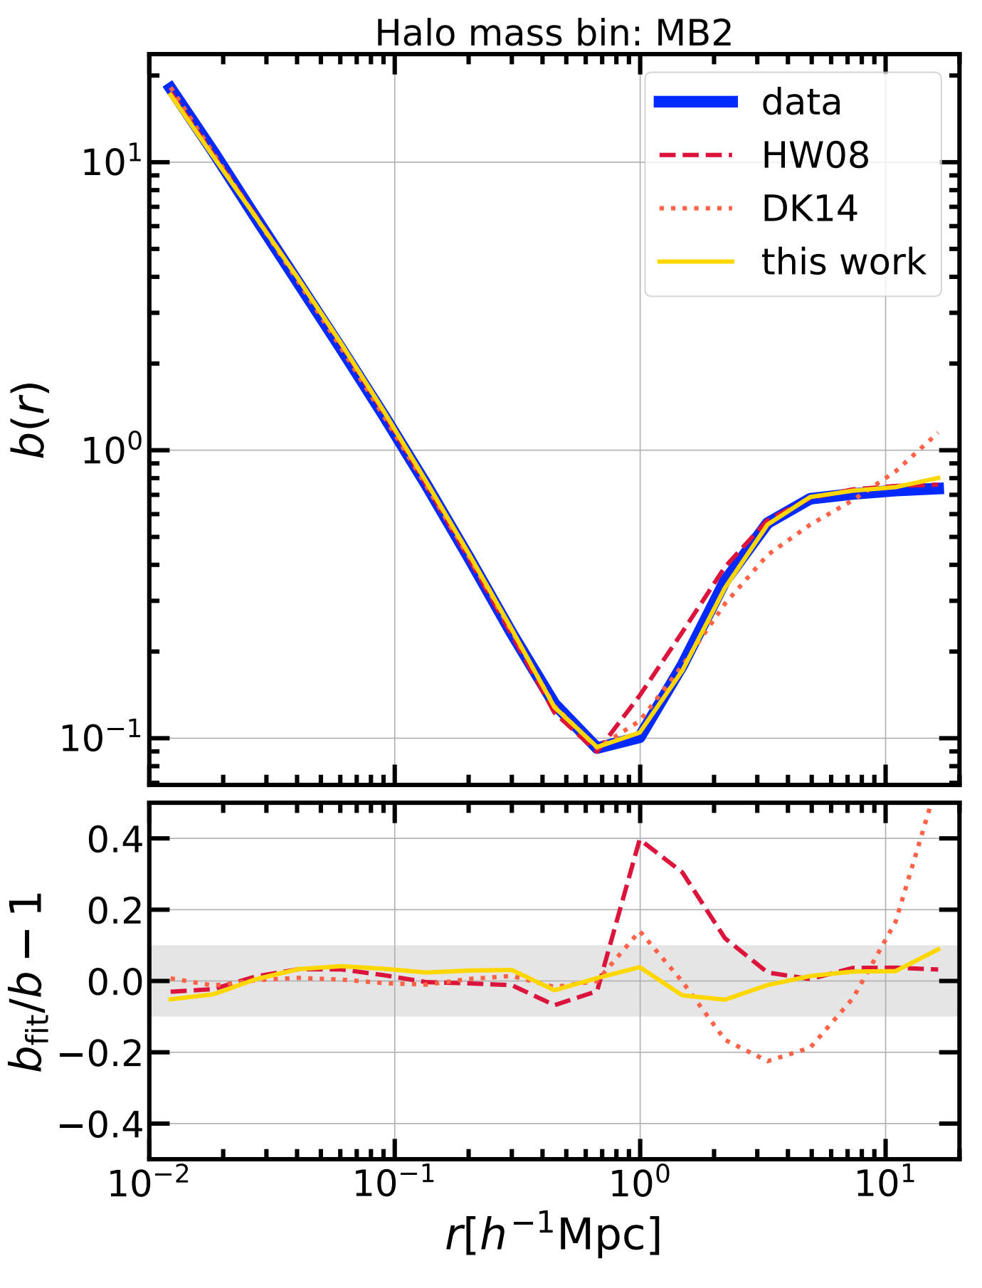
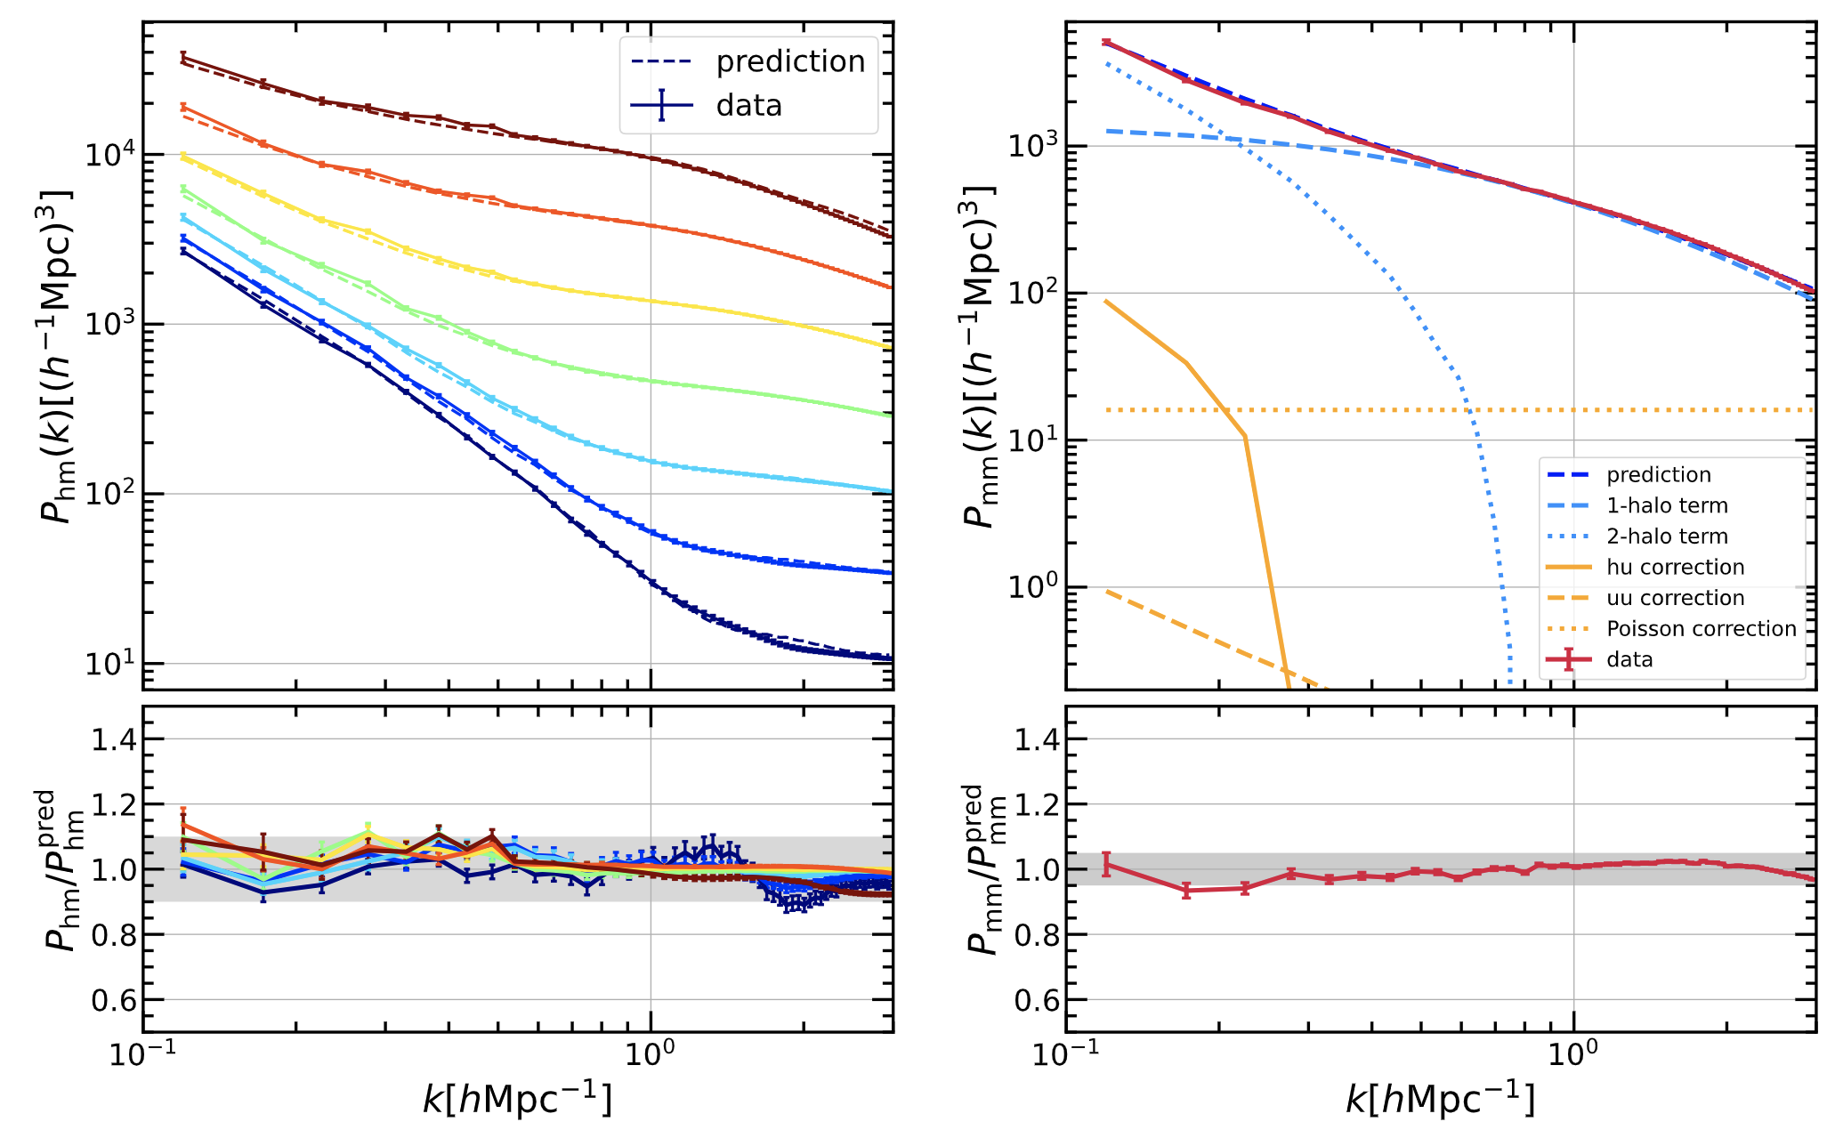
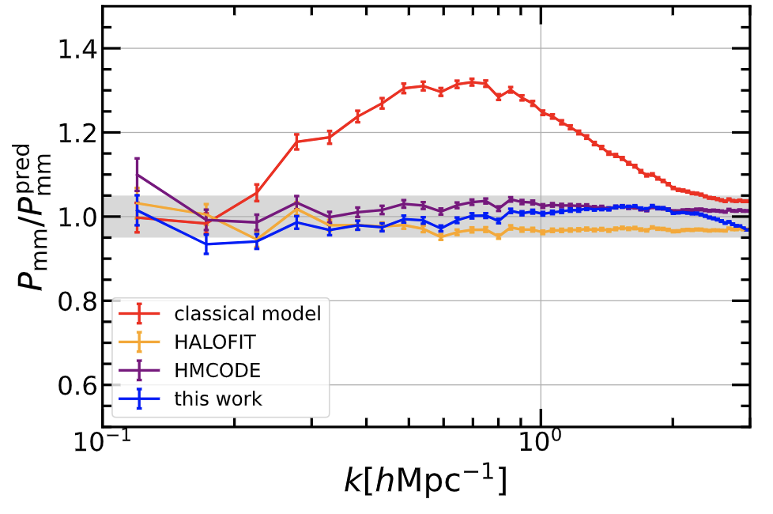
Model performance
Halo-matter correlation function
Power spectrum
logm:[12.60,13.15]
halo-matter
matter-matter
Zhou&Han (2024)
Zhou&Han (2023)

Slide 14
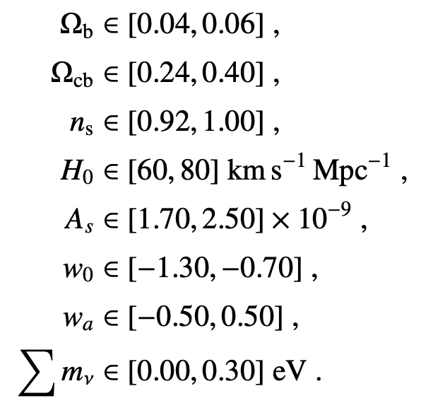
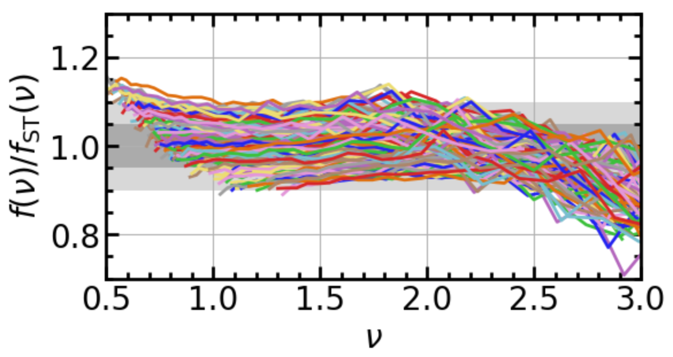
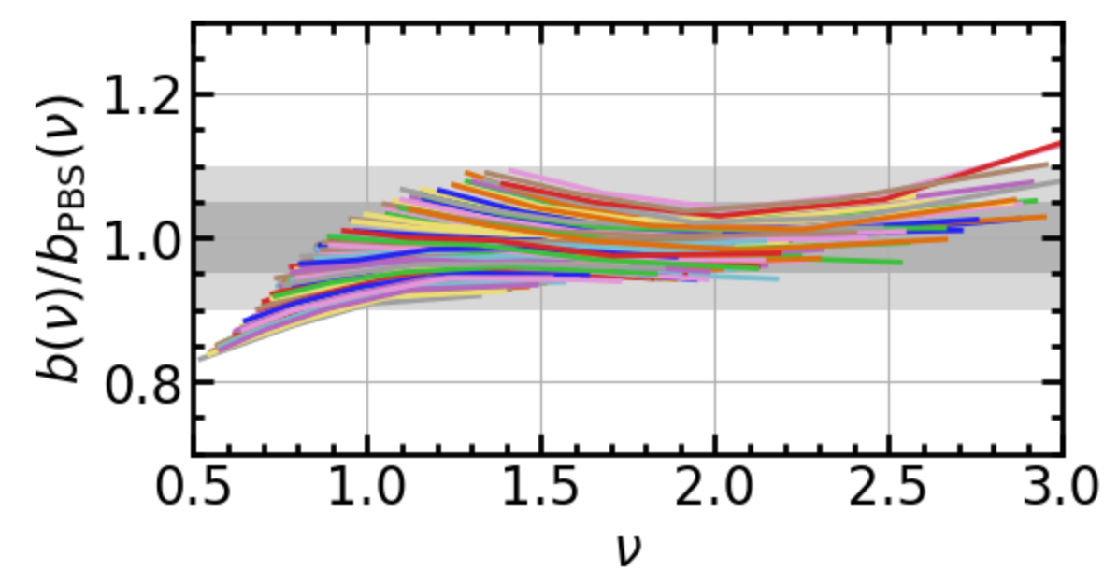
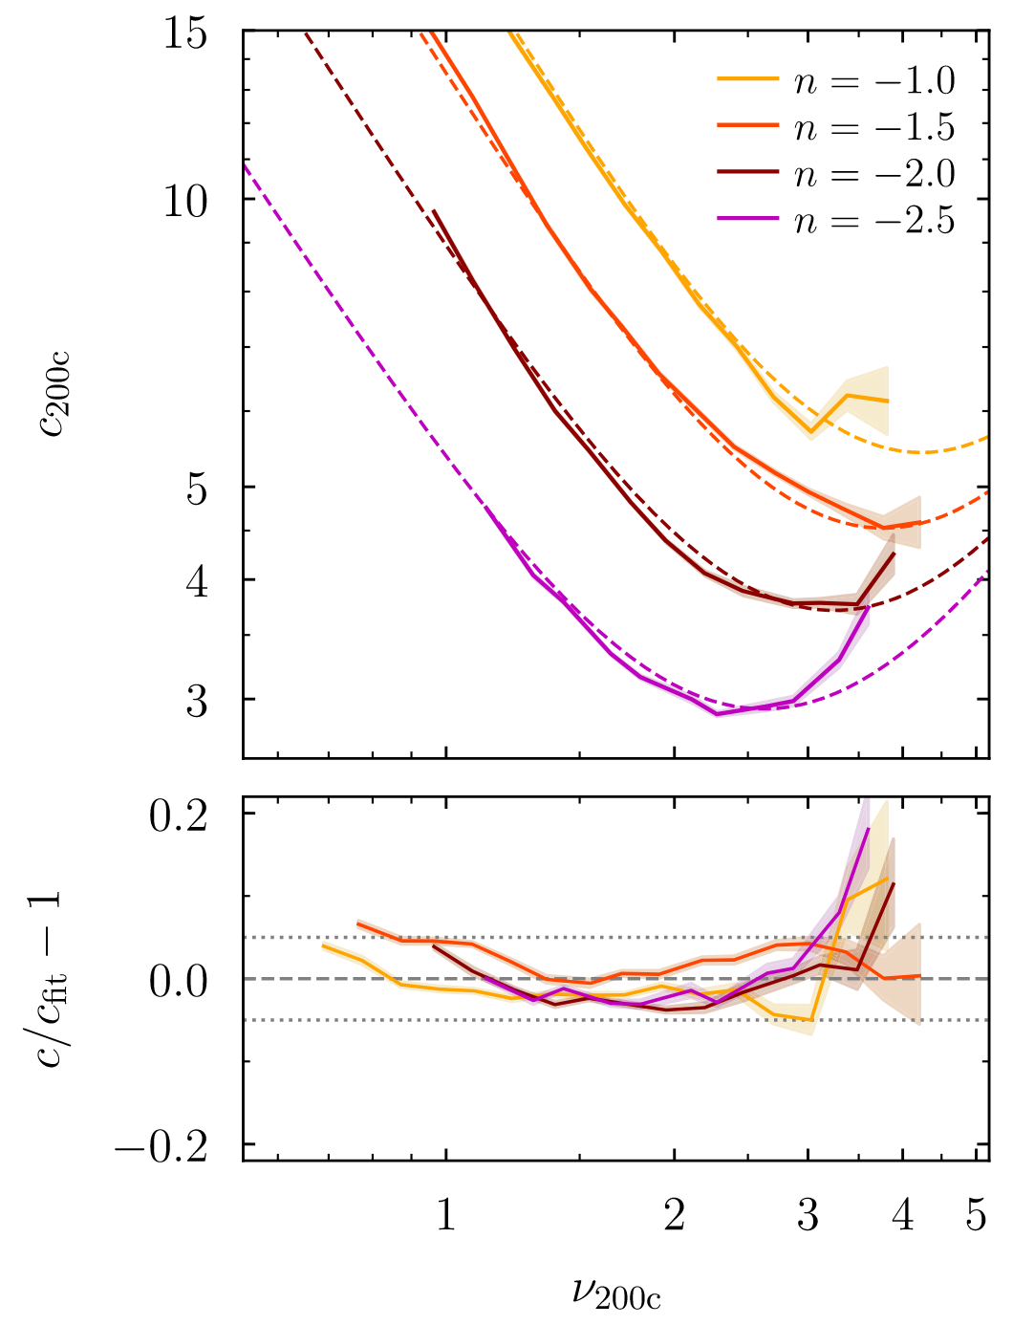
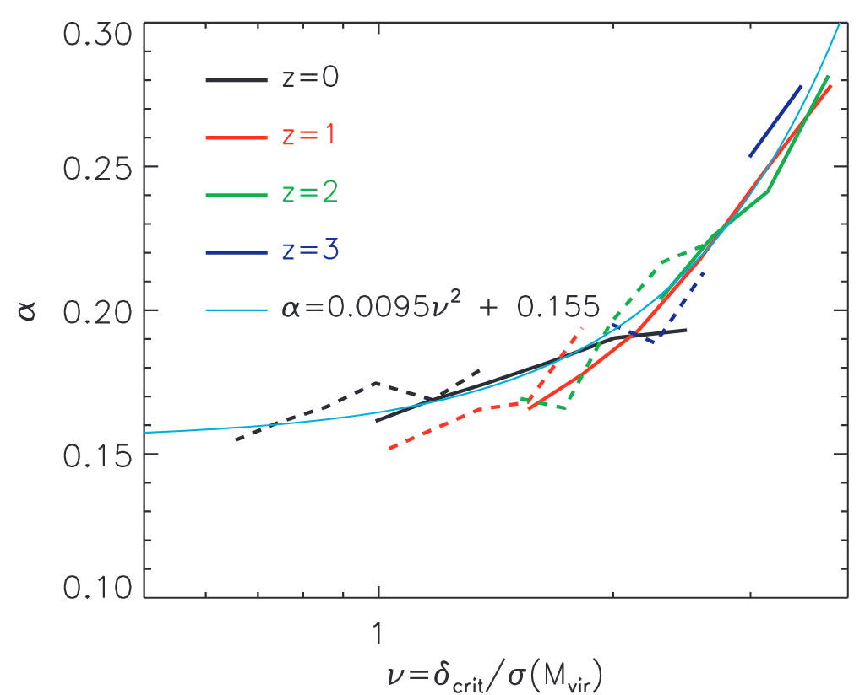
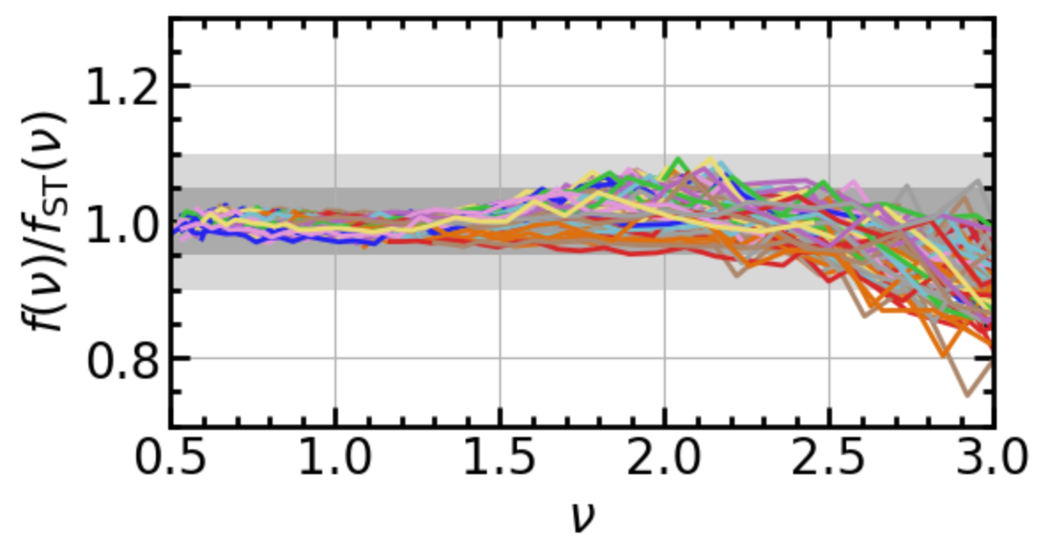
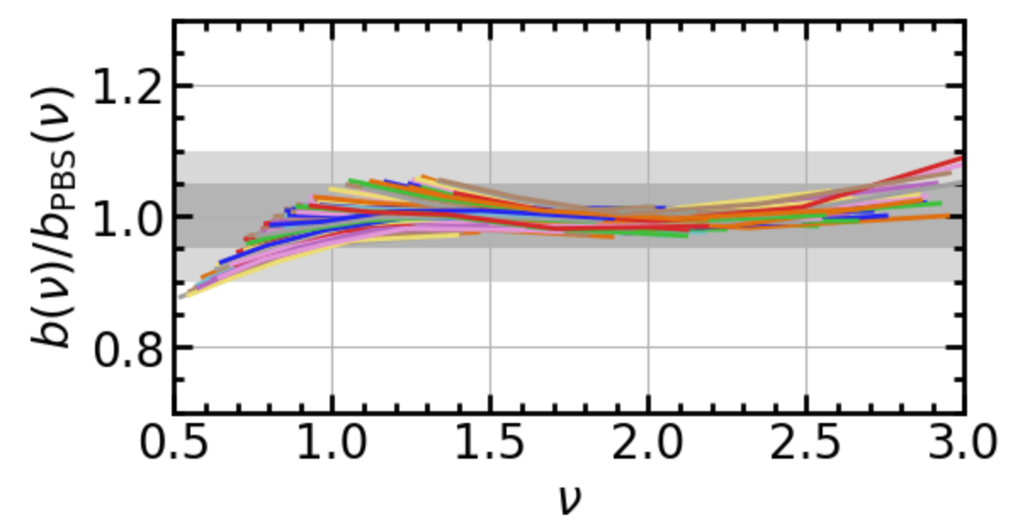
Model extension (In Prep.)
Halo properties in various cosmologies (R_{id} catalog)
129 cosmological simulations:
Halo mass function
Halo bias
Chen et al. (2025)
Nearly universal but weakly depend on {σ₈, w₀, w_{a} ...}
Absorb the dependence using some parametric function
Halo profile
Gao et al. (2008)
Diemer & Joyce (2019)

Slide 15
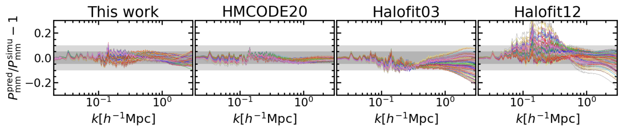
Model extension (In Prep.)
Halo properties (R_{id} catalog) in various cosmologies
Matter power spectrum in various cosmologies
To be improved:
  BAO feature;
  small scale (k>1) power spectrum;
  ...

Slide 16
Compare to other methods
Model | Accuracy | Physicality | Interpretablility | versatility
HALOFIT | ~5% | fitting method without involving halo property | Parameters are less interpretable because the models do not correspond to physical halo population | only P_{mm}
HMCODE | ~2.5% | A ‘semi-analytical’ halo model pertaining to a population of ‘effective haloes’
ZHOU&HAN24 | ~5% | Based on the R_{id} catalogue without ad-hoc fix | Parameters and the model ingredients are more interpretable | Multiple statistic (mm, hm, hh, halo properties...)
The next-generation halo model is more physical, interpretable, and versatile

Slide 17
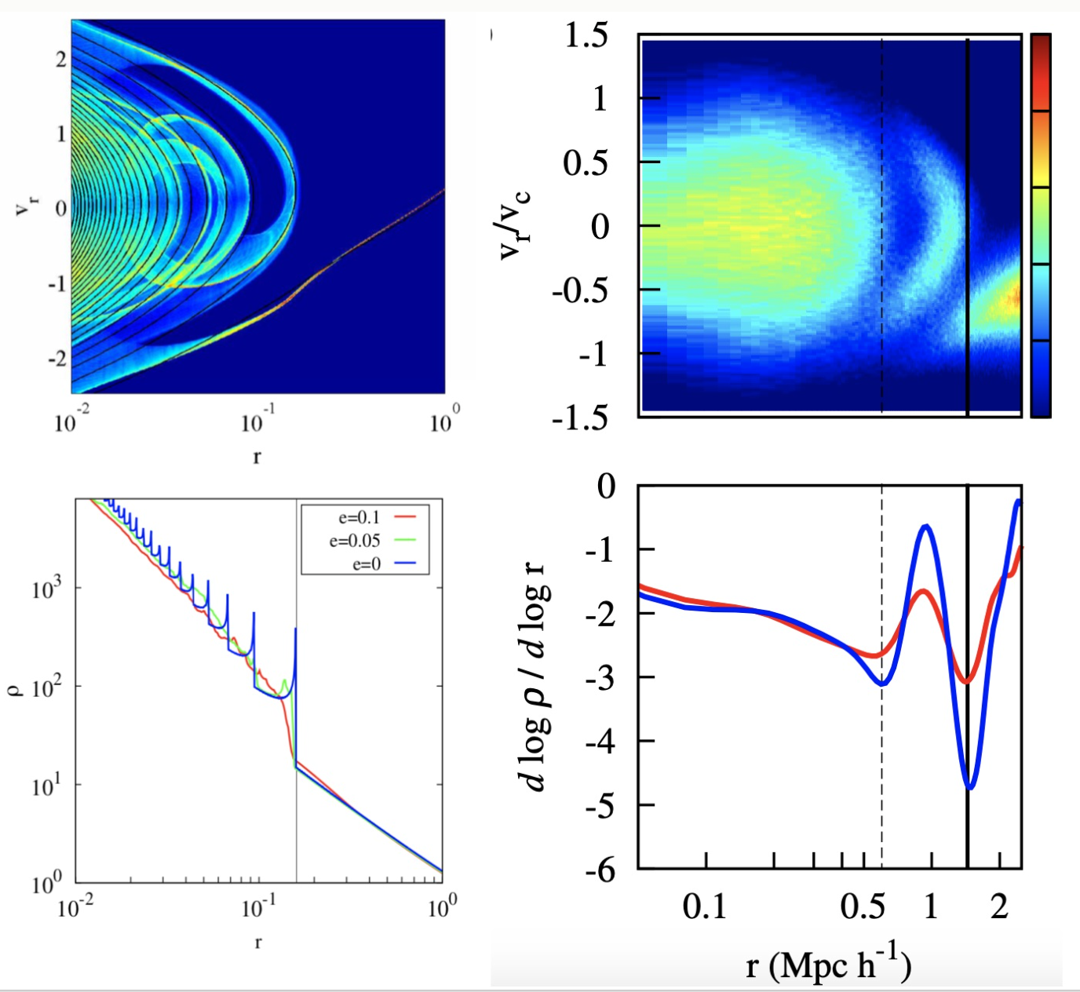
New efforts on the halo boundary
Be ambiguous in defining a single splashback radius for a halo
Splashback radius: the first apocenter of the orbit of the an infalling particle in growing halos
Idealized case: splashback feature <---> density caustic
Realistic case: splashback feature is washed out
Adhikari et al. 2014
Fong & Han (2021)

Slide 18
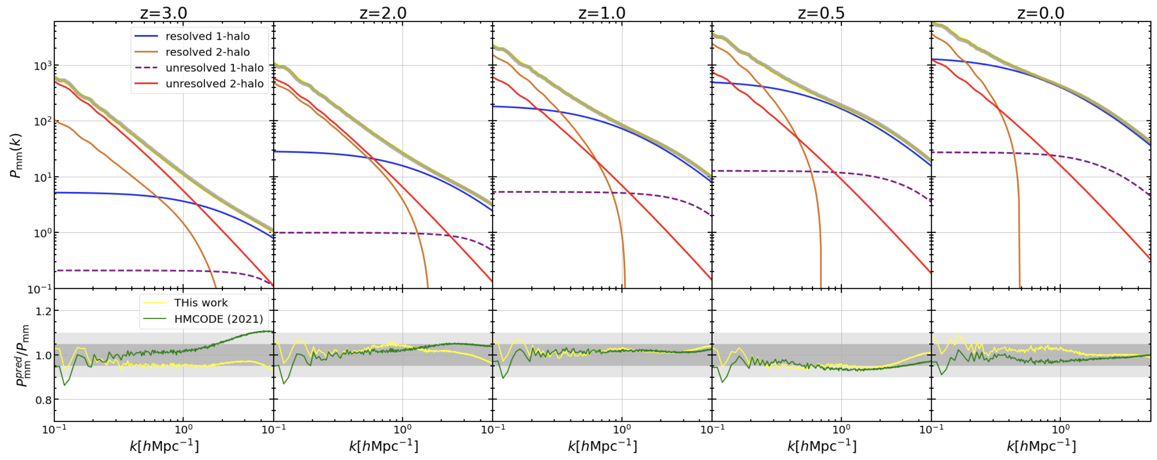
Next-generation halo model
Particle mass ~ 5×10⁸ h⁻¹M_{sun}
Resolved halo mass > 5×10¹⁰ h⁻¹M_{sun} (about 100 particles)
p r e l i m i n a r y

Slide 19
Matching profile for other boundaries
Eiansto profile is the theoretical dual of the depletion radius
Profile-boundary is one-to-one map in the halo model;
Einasto profile-depletion radius is a good combination for analytical modeling.
Follow Einasto fits
Deviate from Einasto fits beyond R_{id}

Slide 20
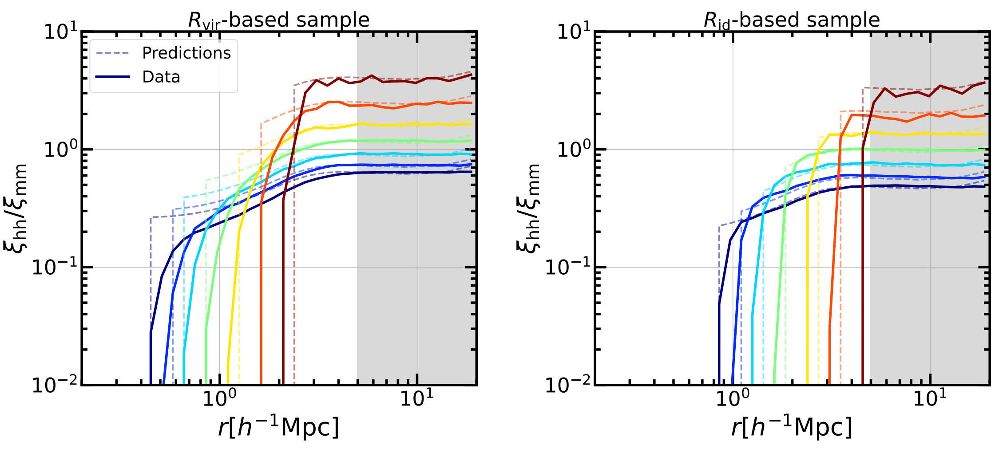
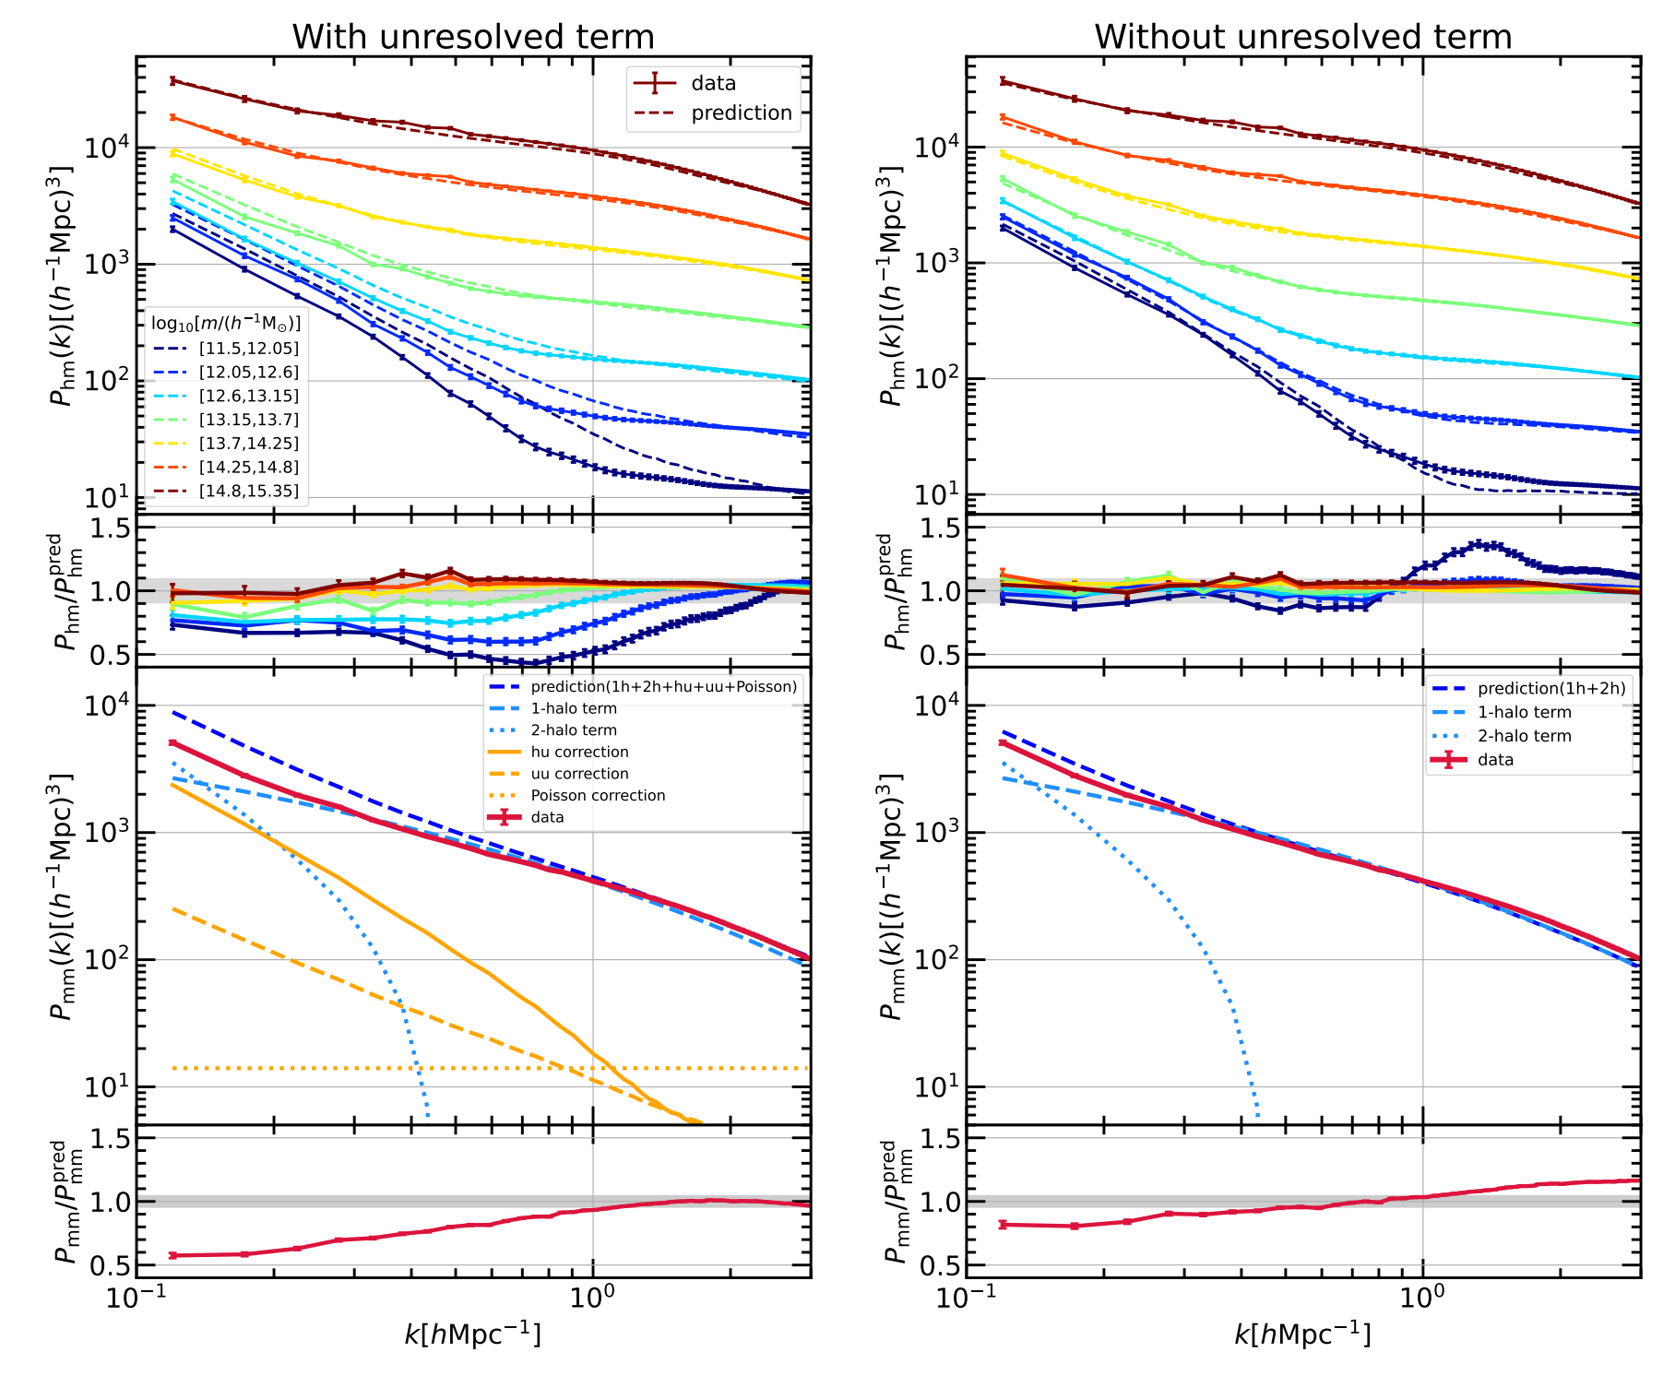
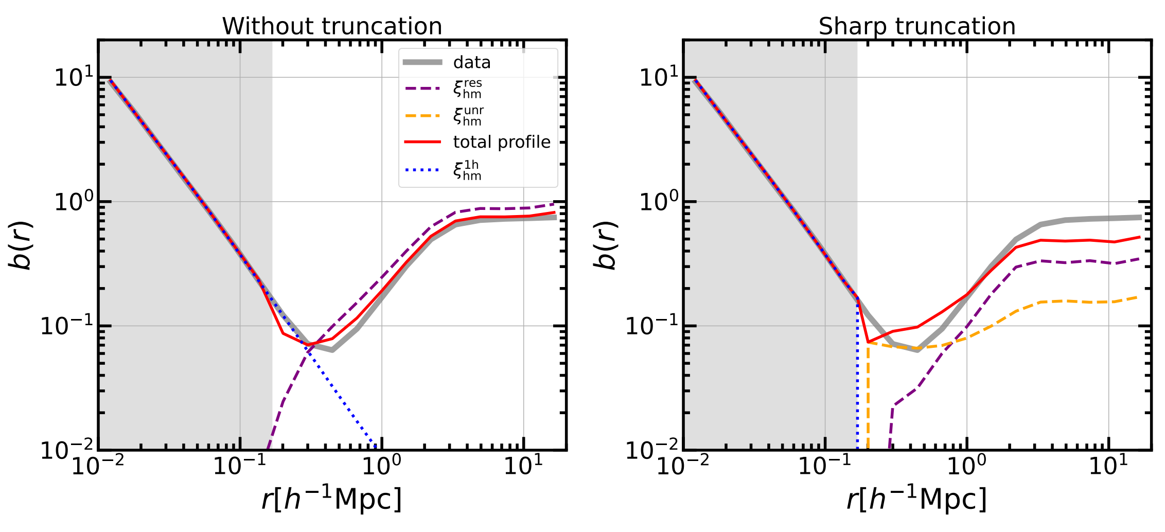
Halo model with other boundaries
R_{vir} based catalog
3R_{vir} based catalog

Slide 21
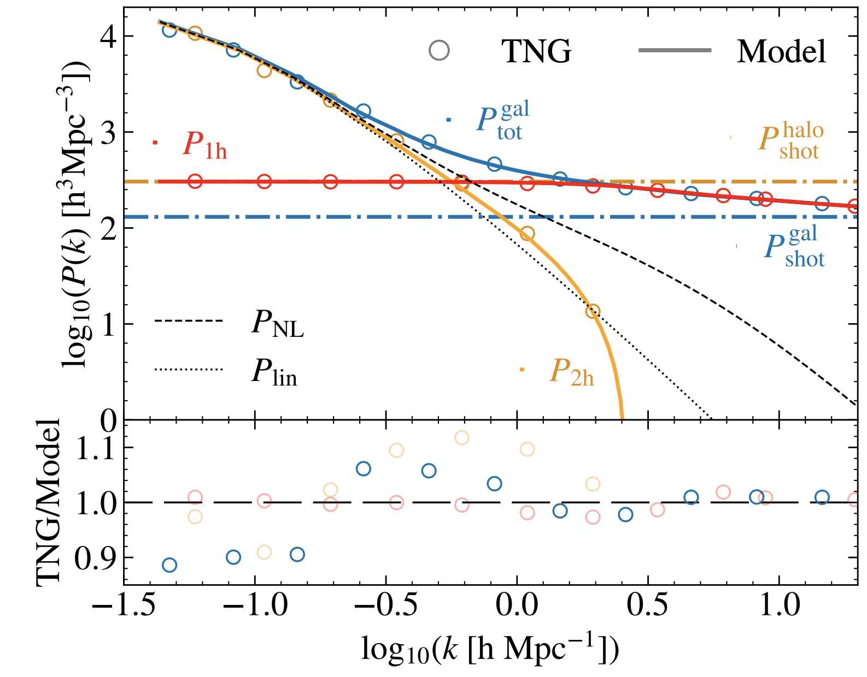
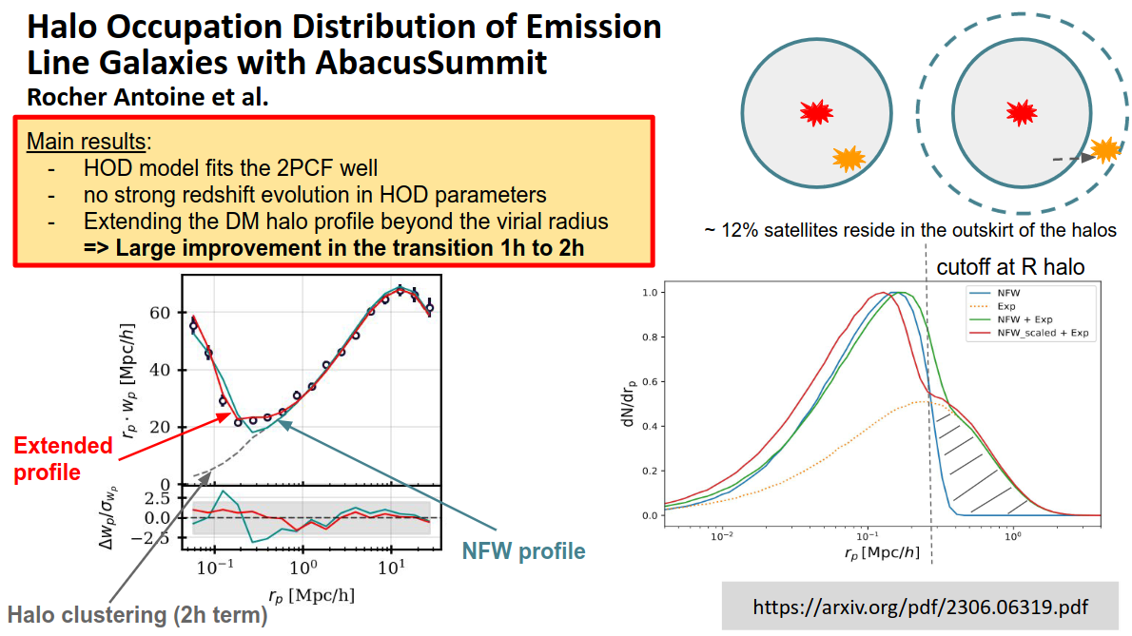
Galaxy-halo connection
Our model provides an accruate description for the halo outskirts,
and more insights into the galaxy-halo connection.
arXiv: 2410.16588

Slide 22


Neutrino mass
Our model is accurate in the transition region of the power spectrum
Reaction of massive neutrinos
Power spectrum

