Slide 1
Self-similar decomposition of the hierarchical merger tree of dark matter halos
Wenkang Jiang
Supervisor: Jiaxin Han
arxiv:2502.20181

Slide 2
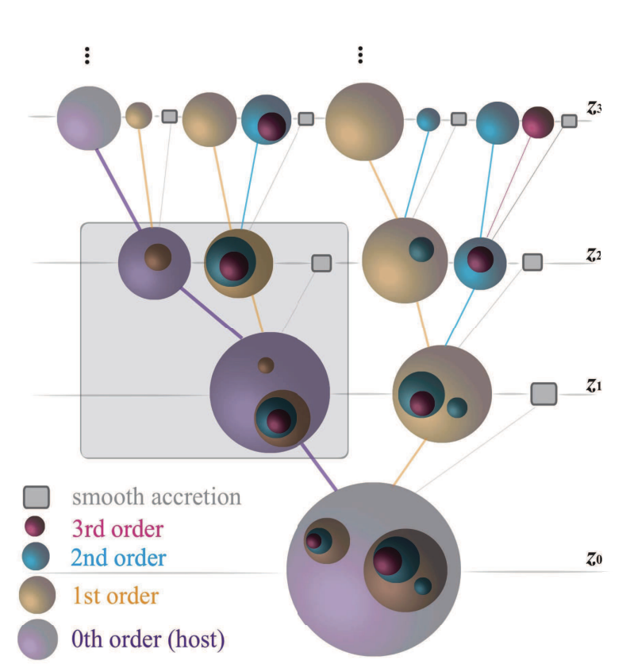
The Peak Mass Function
Universal specific merger rate
Universal progenitor mass function
maximum mass of progenitors reached in their histories

Slide 3
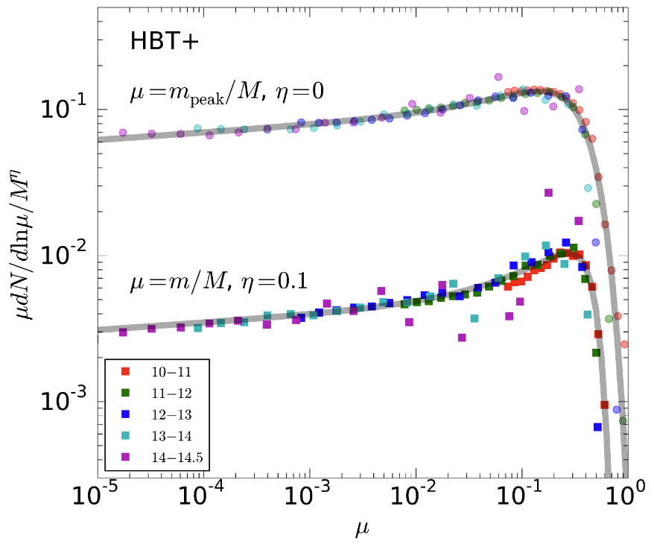
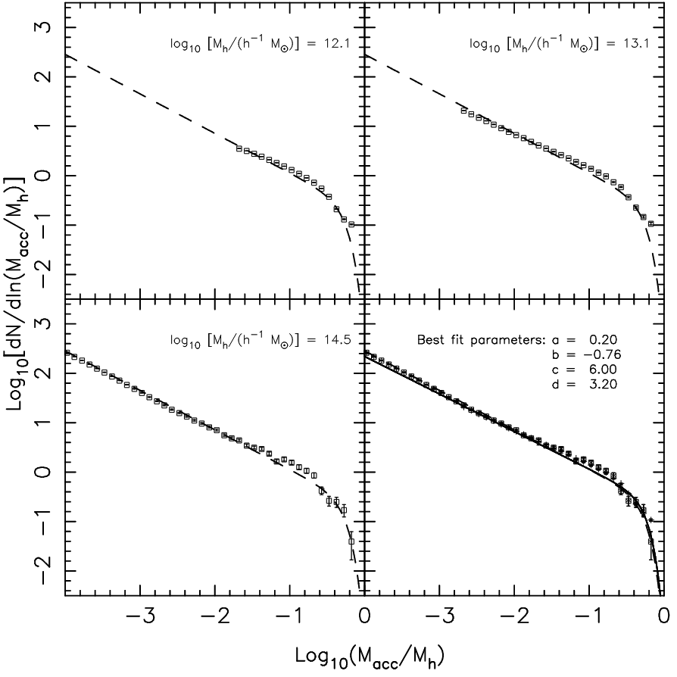
Studies on PMFs
All level
Level 1
Relation ？
Han et al. 2018
Li & Mo 2009
Notes:
在这里介绍一下mu的定义

Slide 4
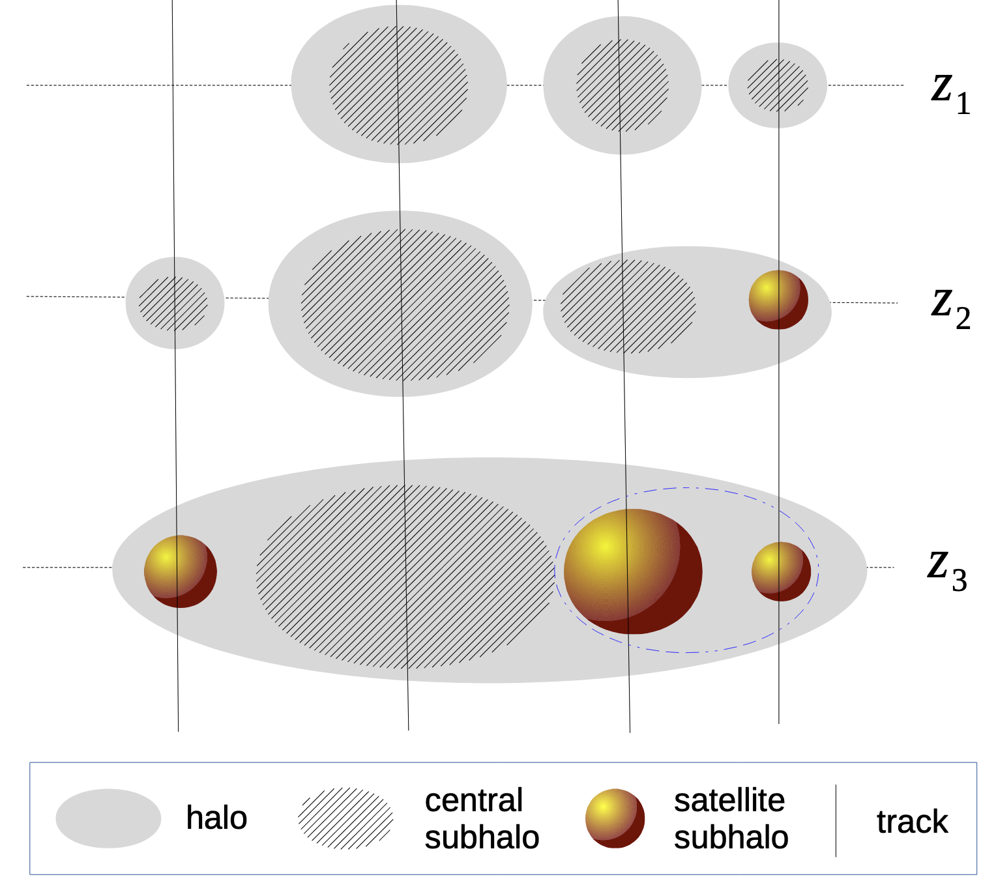
Simulation & Subhalo Finder
LCDM Simulation
depth: level of subhalos according to the merger history
HBT+
(Han et al. 2018)

Slide 5
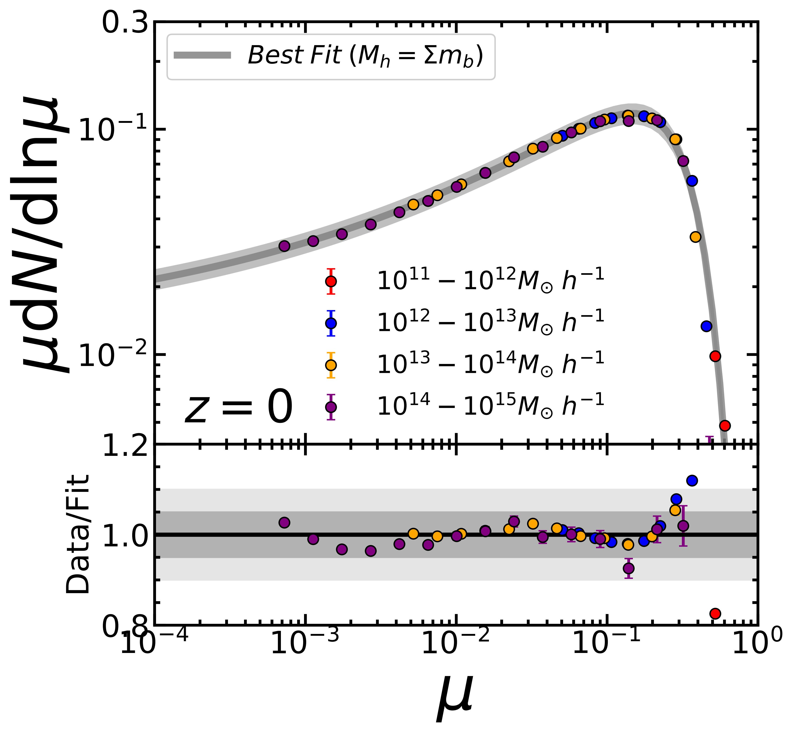
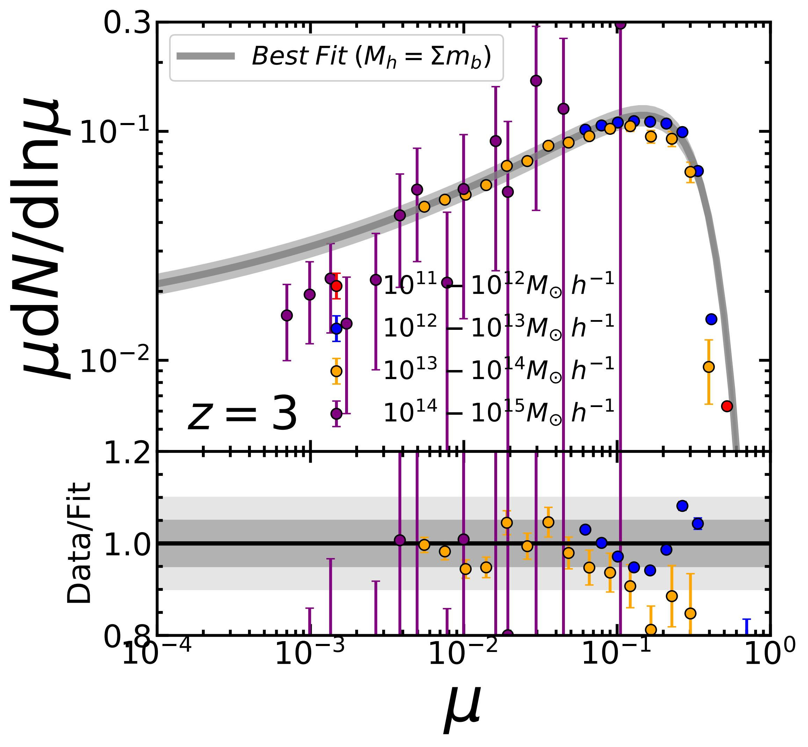
The universality of the level-1 PMF
For different $M_{h}$, the universality reaches 5%.
At z=3, the universality can still be preserved within 10%.

Slide 6
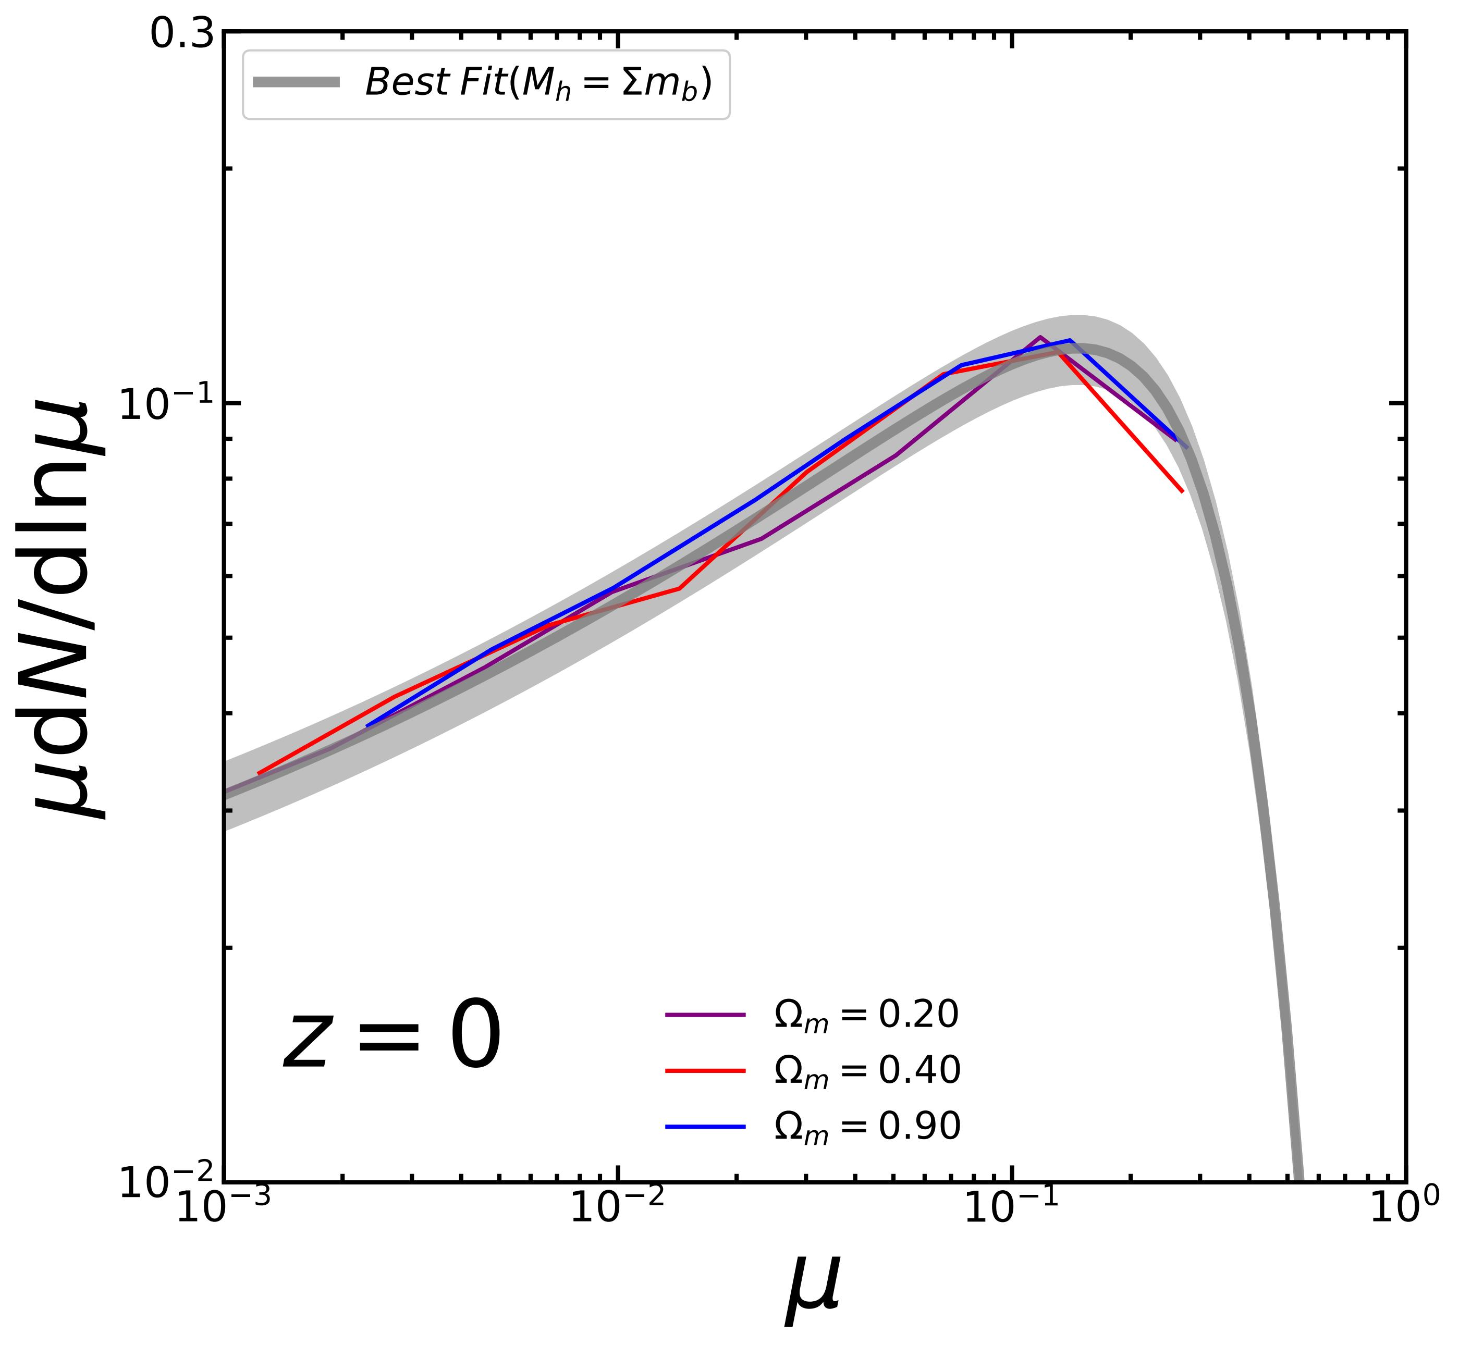
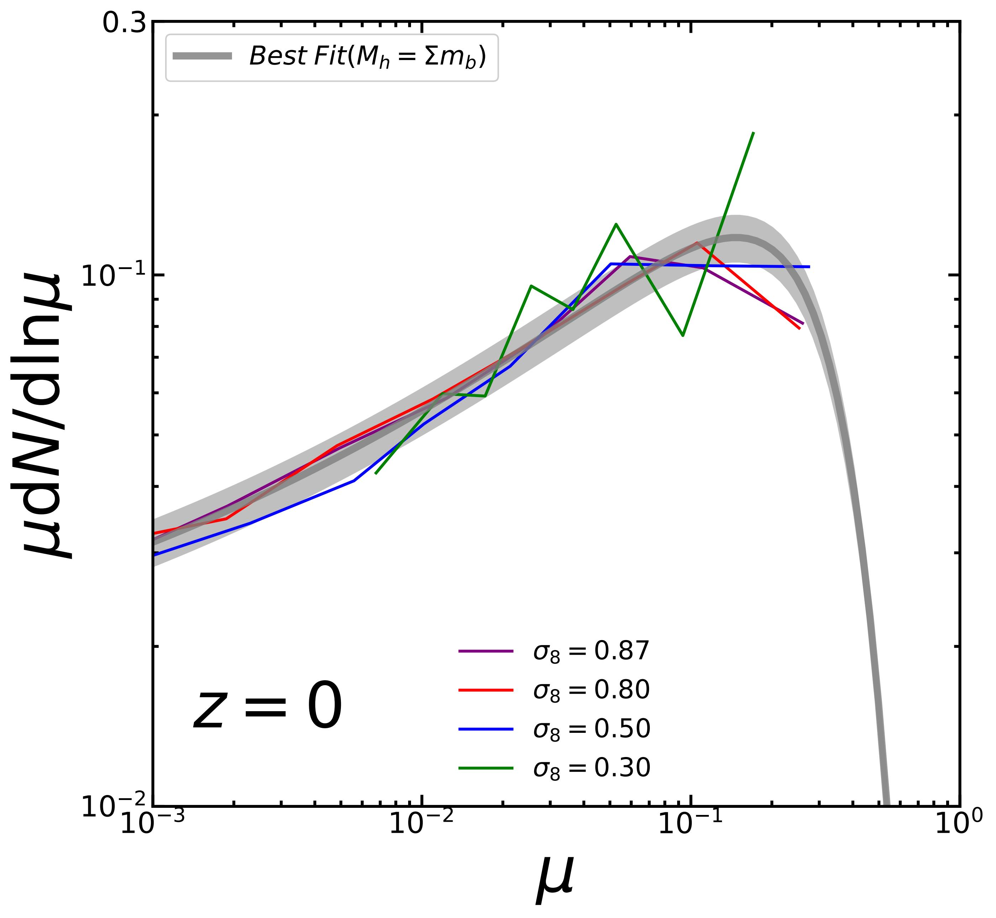
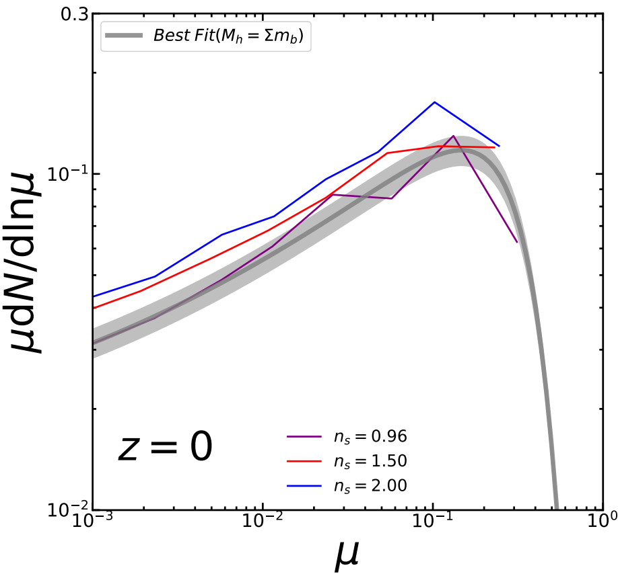
Cosmological Dependence
The universality of the level-1 PMFs can be preserved within 10% across comologies with different and , but it shows mild dependence on .

Slide 7
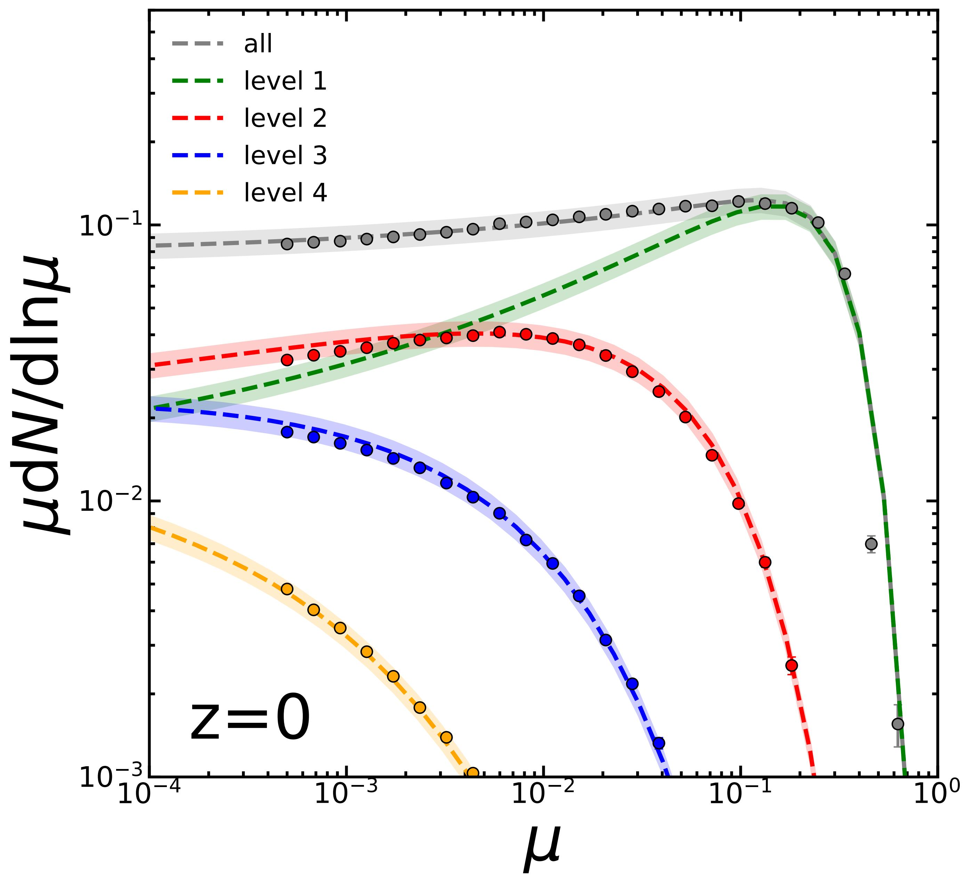
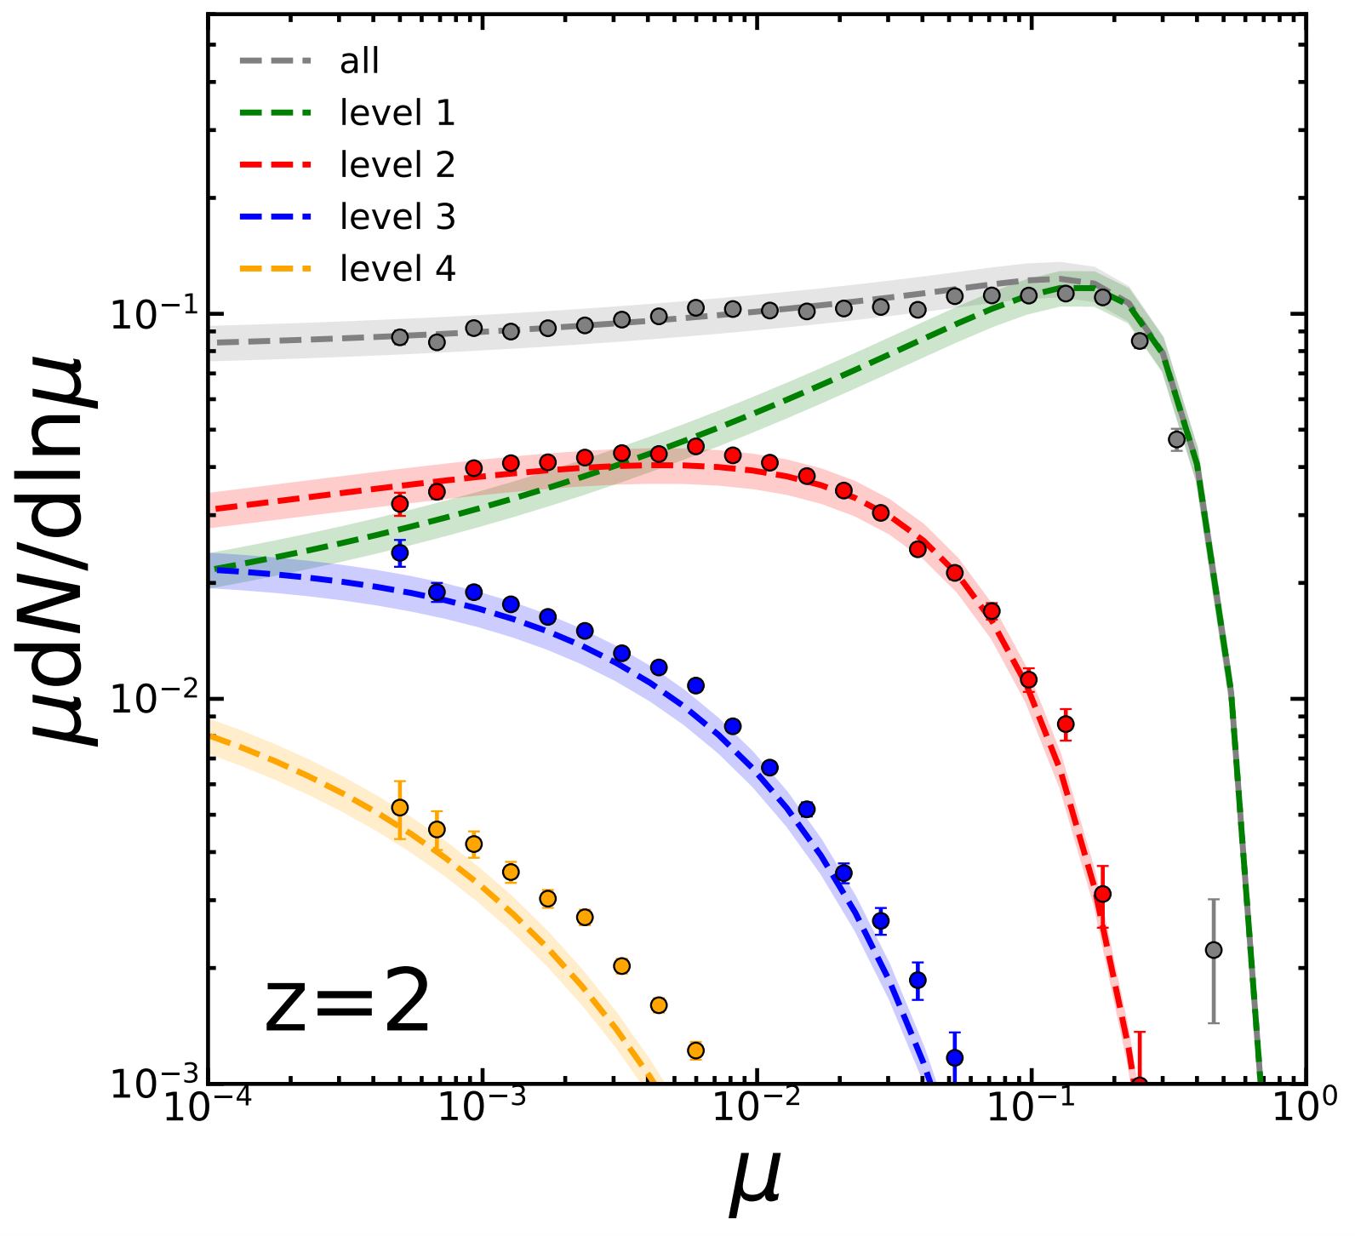
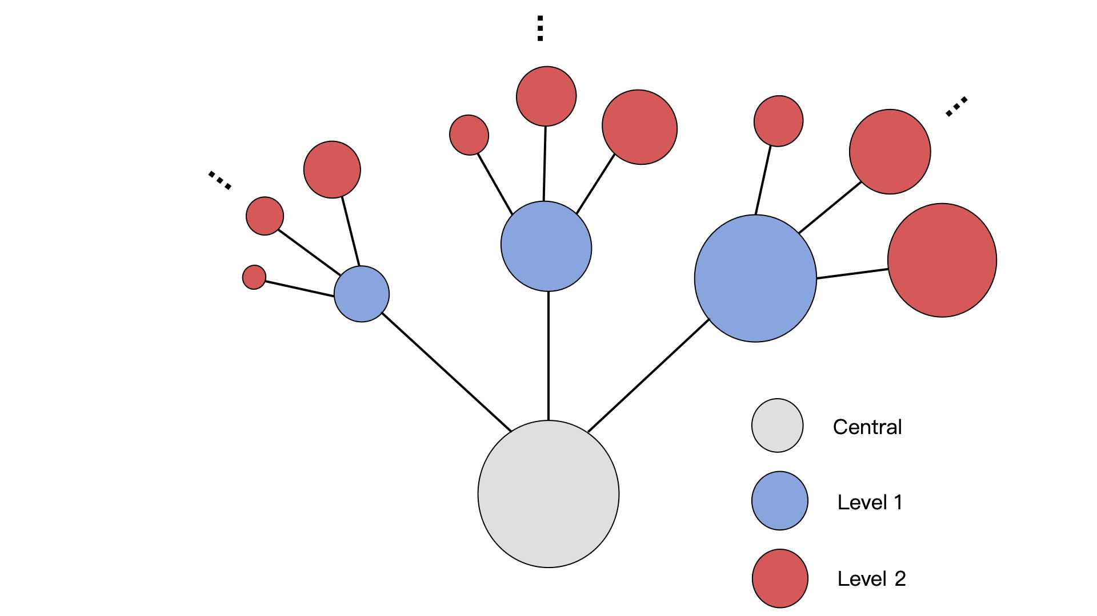
Build up the subhalo hierarchy
“Convolution” for sub-subhalos :
$$g_{2}{=g}_{1} g_{1}$$
More general :
$$g_{n}{=g}_{1} g_{n−1}$$
level-1 PMF
play equivalent roles in the hierarchy
level-1 PMF
align well with the simulation at z=0 (<10%)
The universality can still be preserved (<10%)

Slide 8
Self-Similarity in merger tree
...
...
level 2
level 1
The tree truncated at any branch has the same branching properties as the root branch.

Slide 9
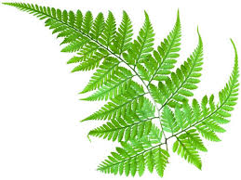
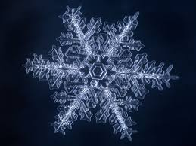
Self-Similarity in merger tree
...
...
level 3
level 2
Fractals in nature
level 1
The tree truncated at any branch has the same branching properties as the root branch.

Slide 10
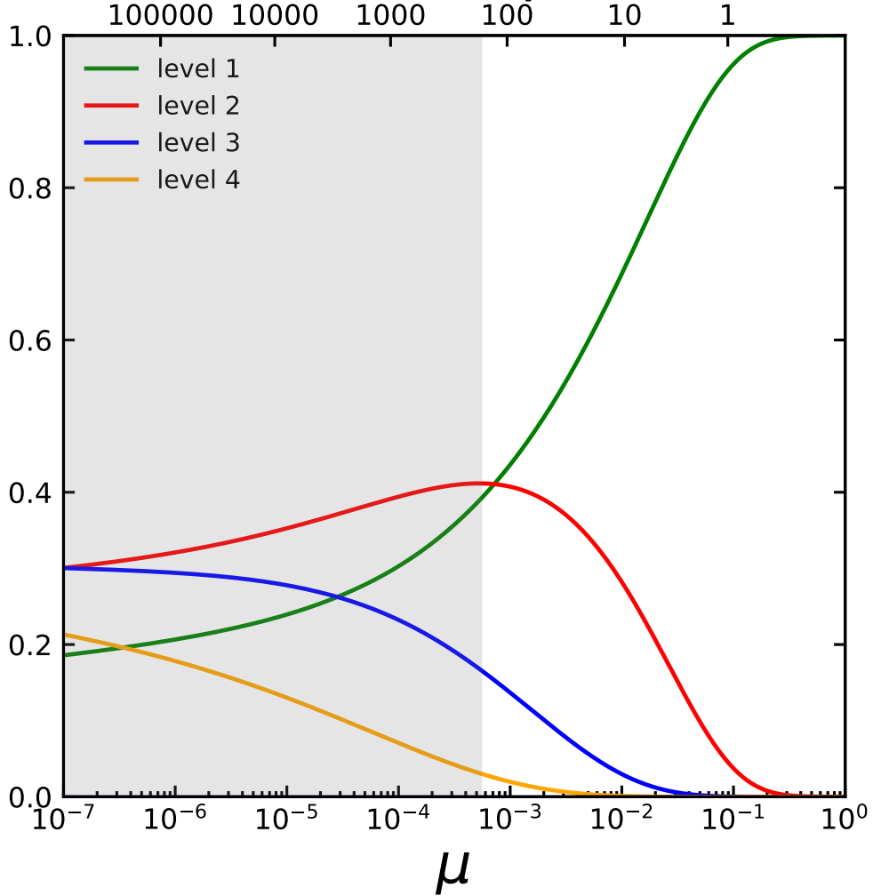
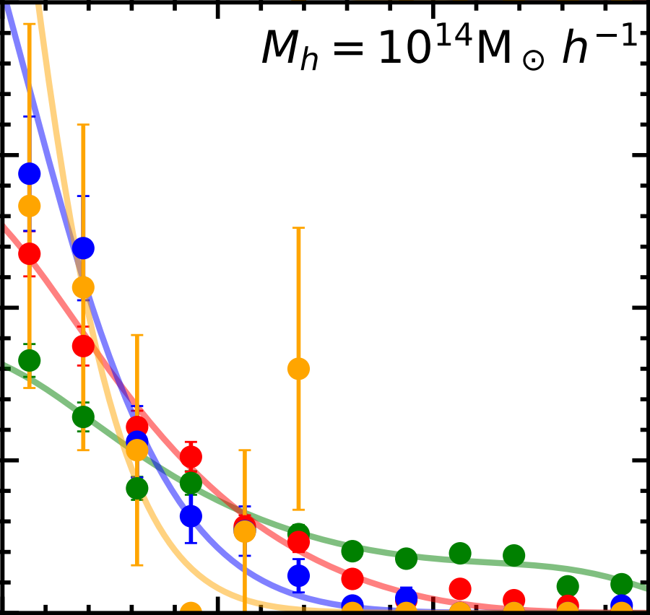
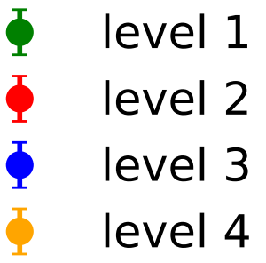
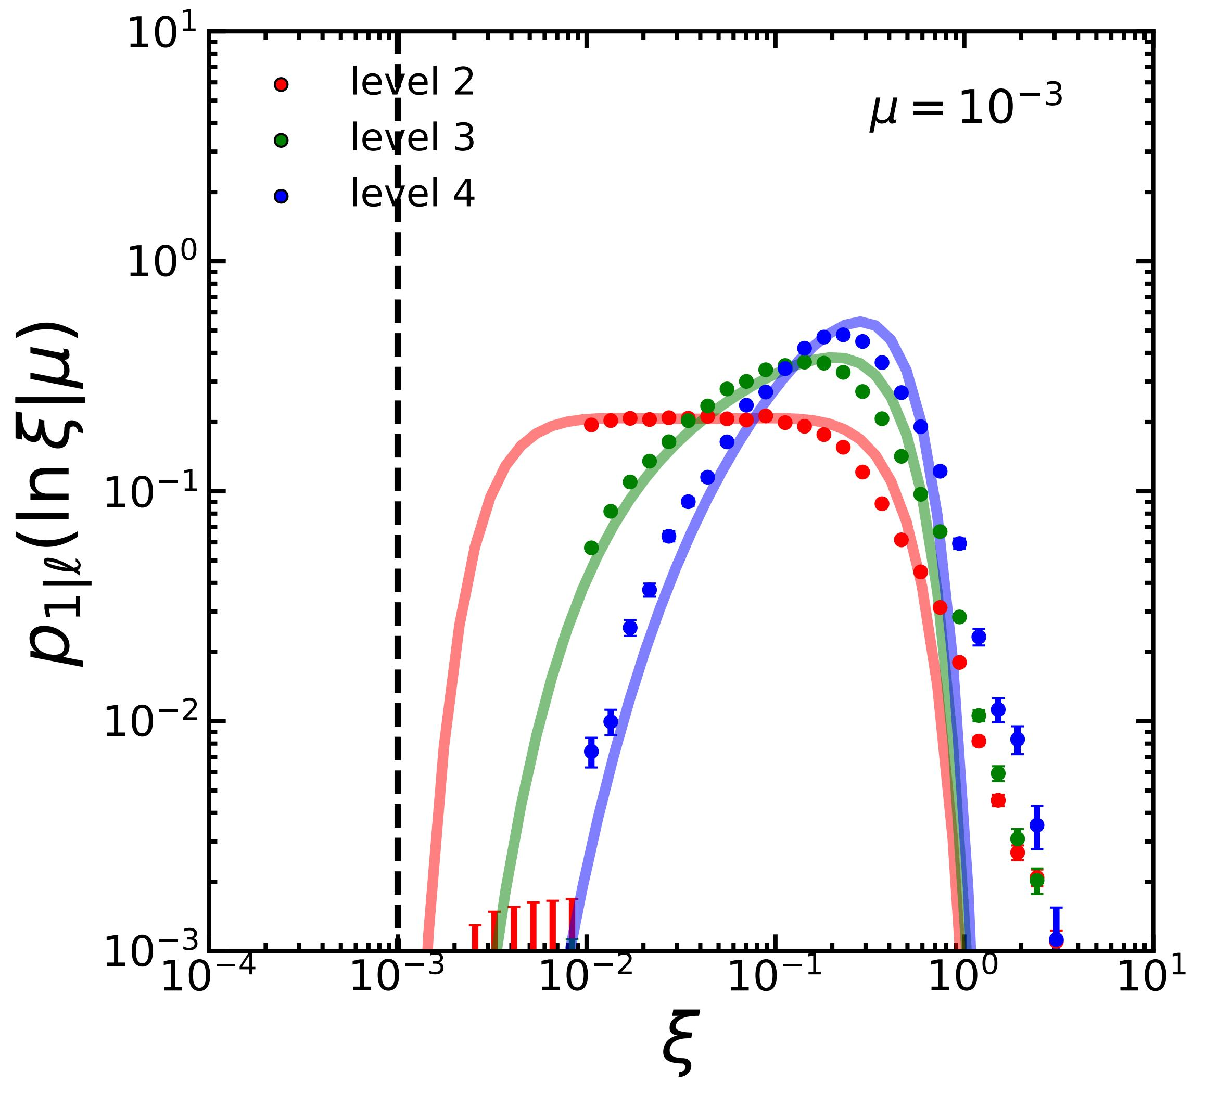
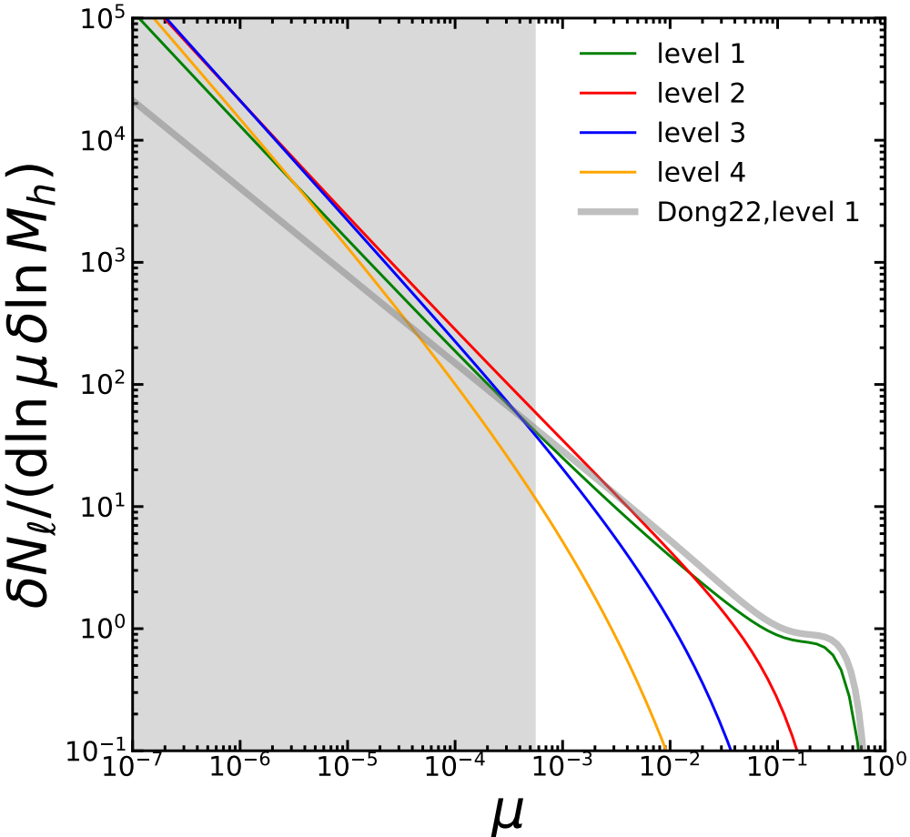
Model Applications
Composition of the subhalo population
Accretion redshift
$$μ={10}^{−2}$$
Fraction
Initial merger ratio
Subhalo accretion rate

Slide 11
Model Applications
Only 40% of the top 100 subhalos by mass originate from direct mergers with main halos.
Fraction
The higher-level subhalos become more popular with decreasing peak mass ratio.

Slide 12
Composition of the subhalo population
Accretion redshift
$$μ={10}^{−2}$$
Low-mass subhalos are dominated by high-level ones.
High-level subhalos are built up more recently.
Majority of high-level ones have experienced major mergers.
...
Fraction
Initial merger ratio
Subhalo accretion rate

Slide 13
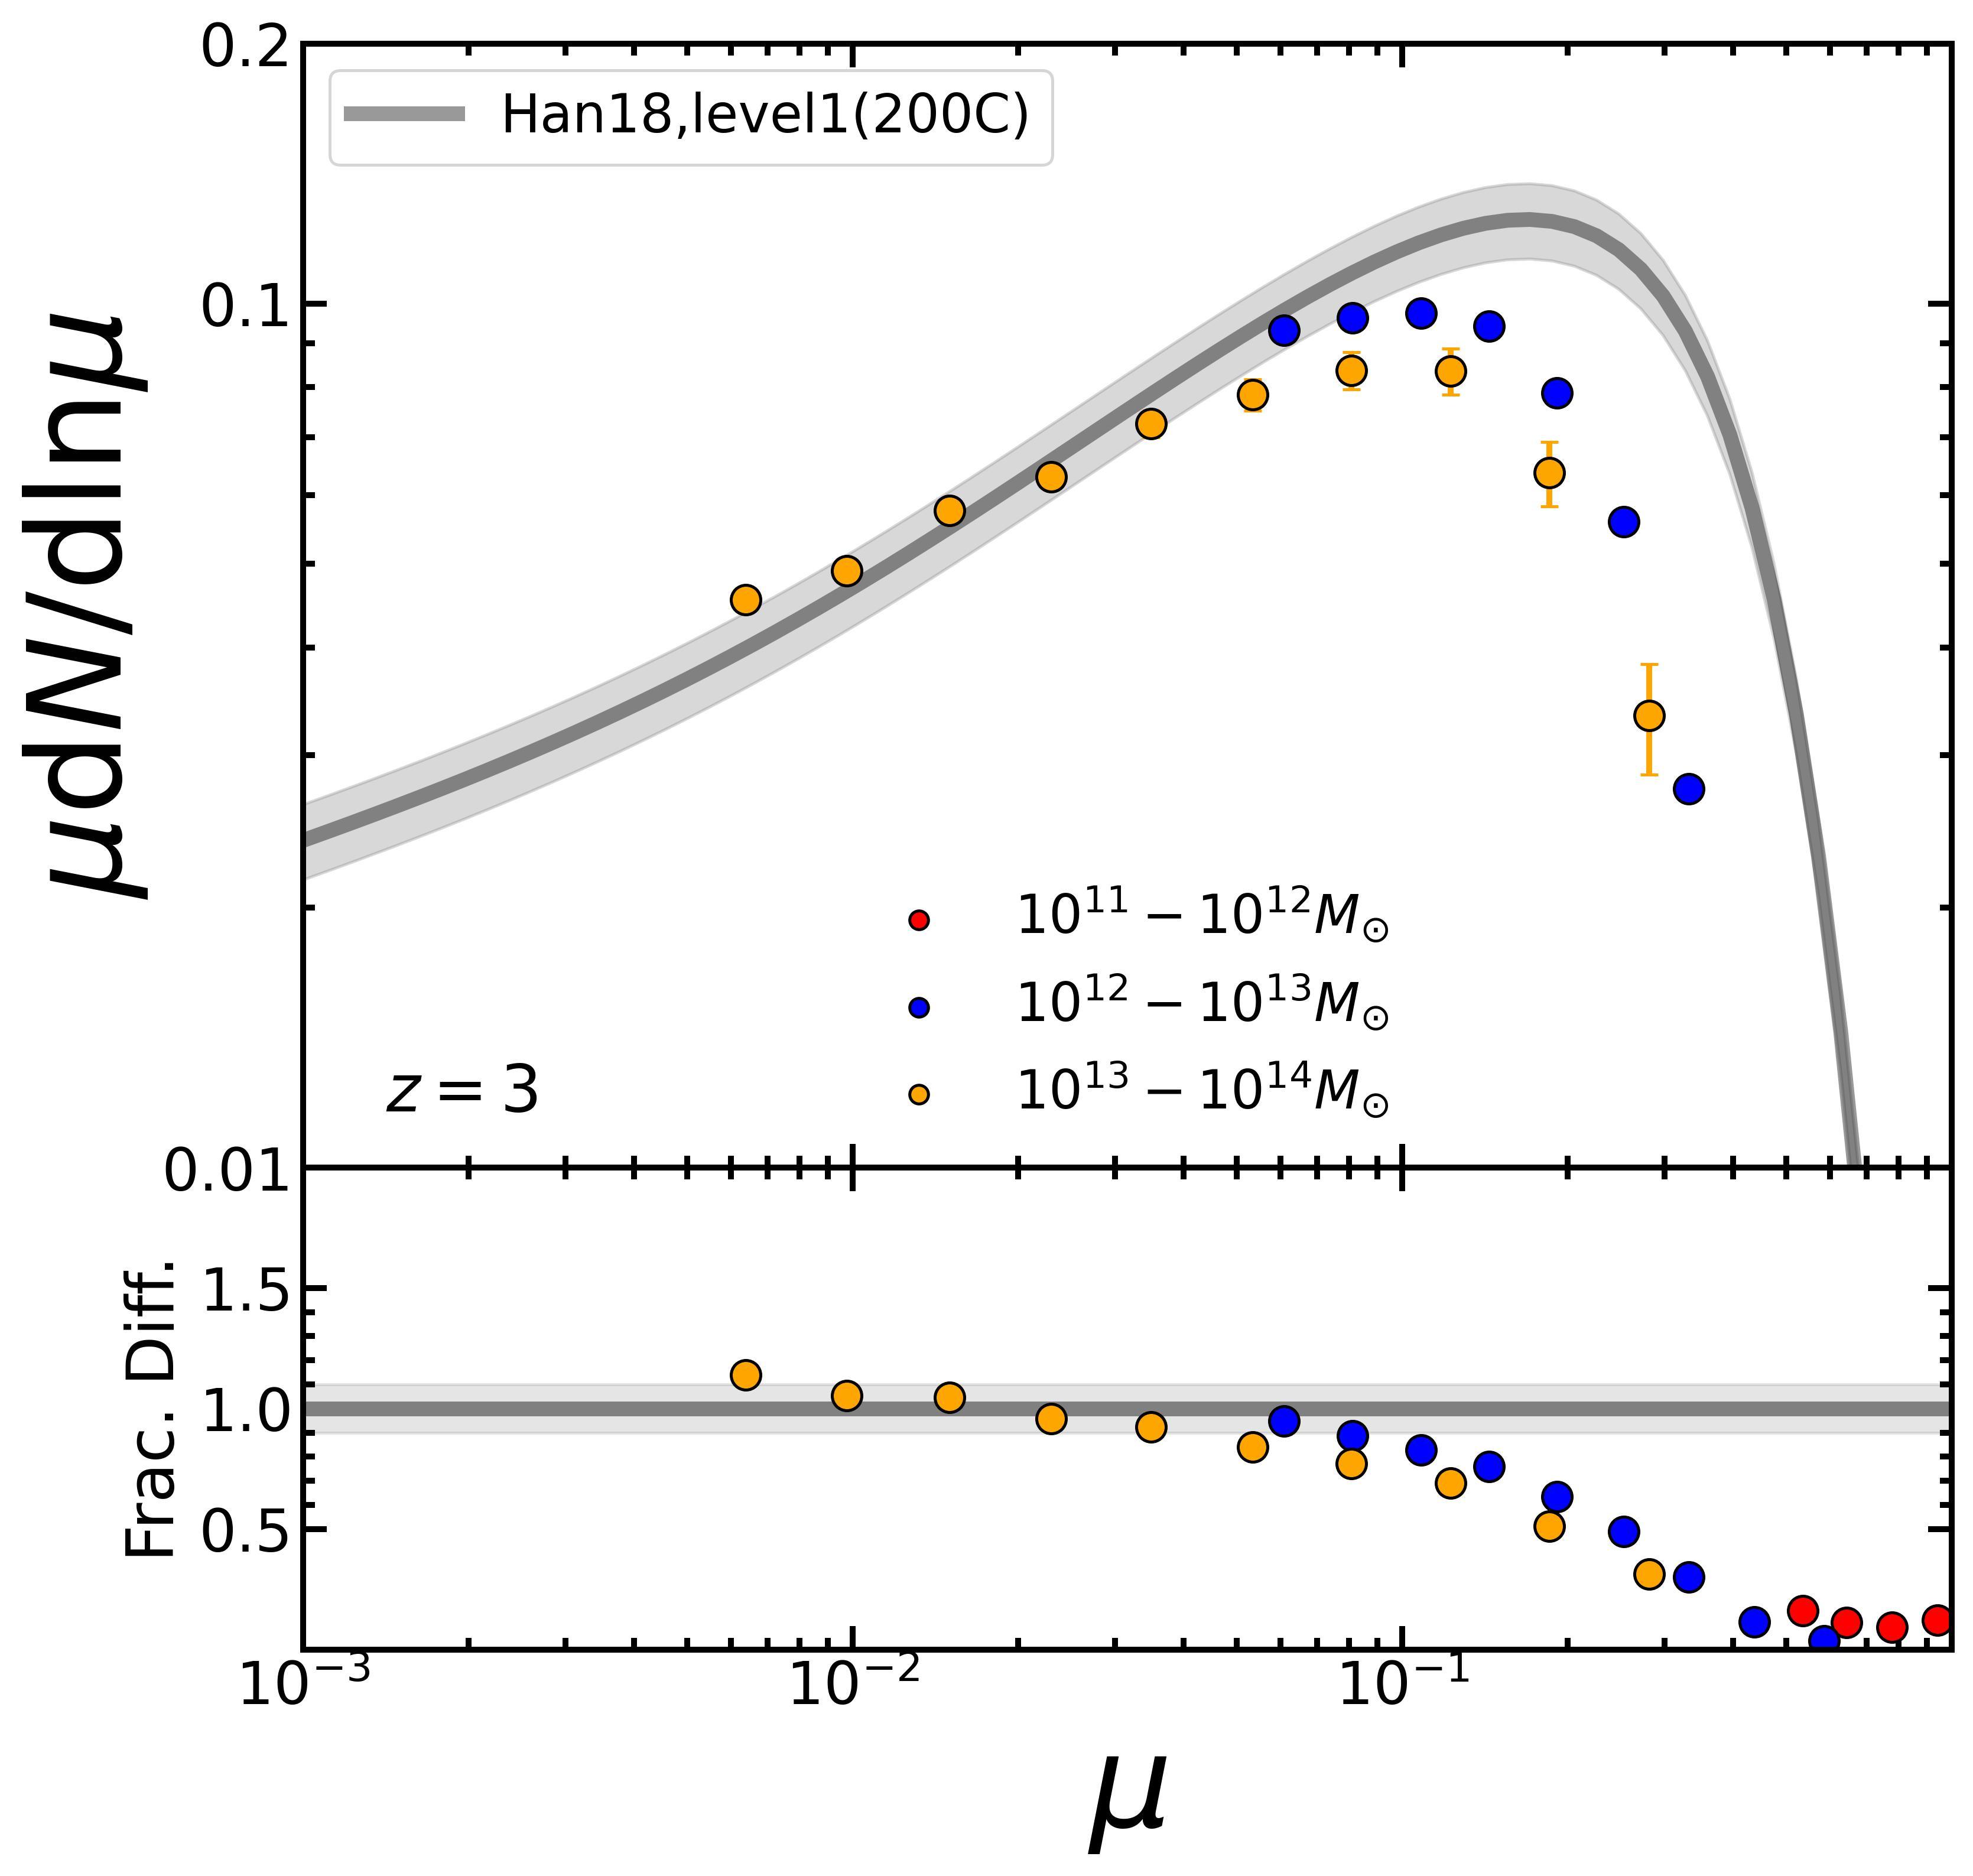
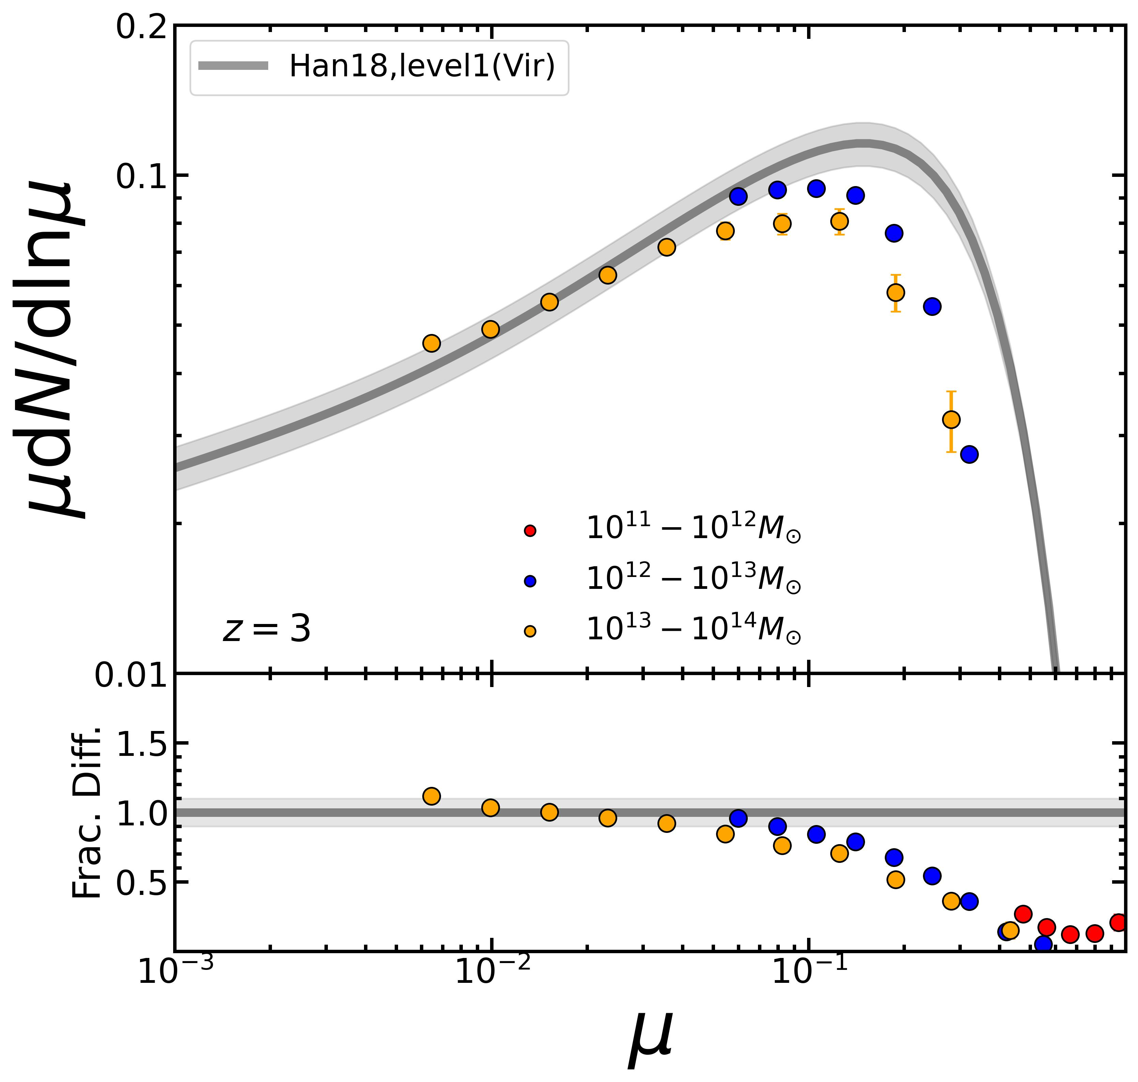
Non-universality from other definitions
The non-universality emerges for the halo boundary determined by SO.

Slide 14
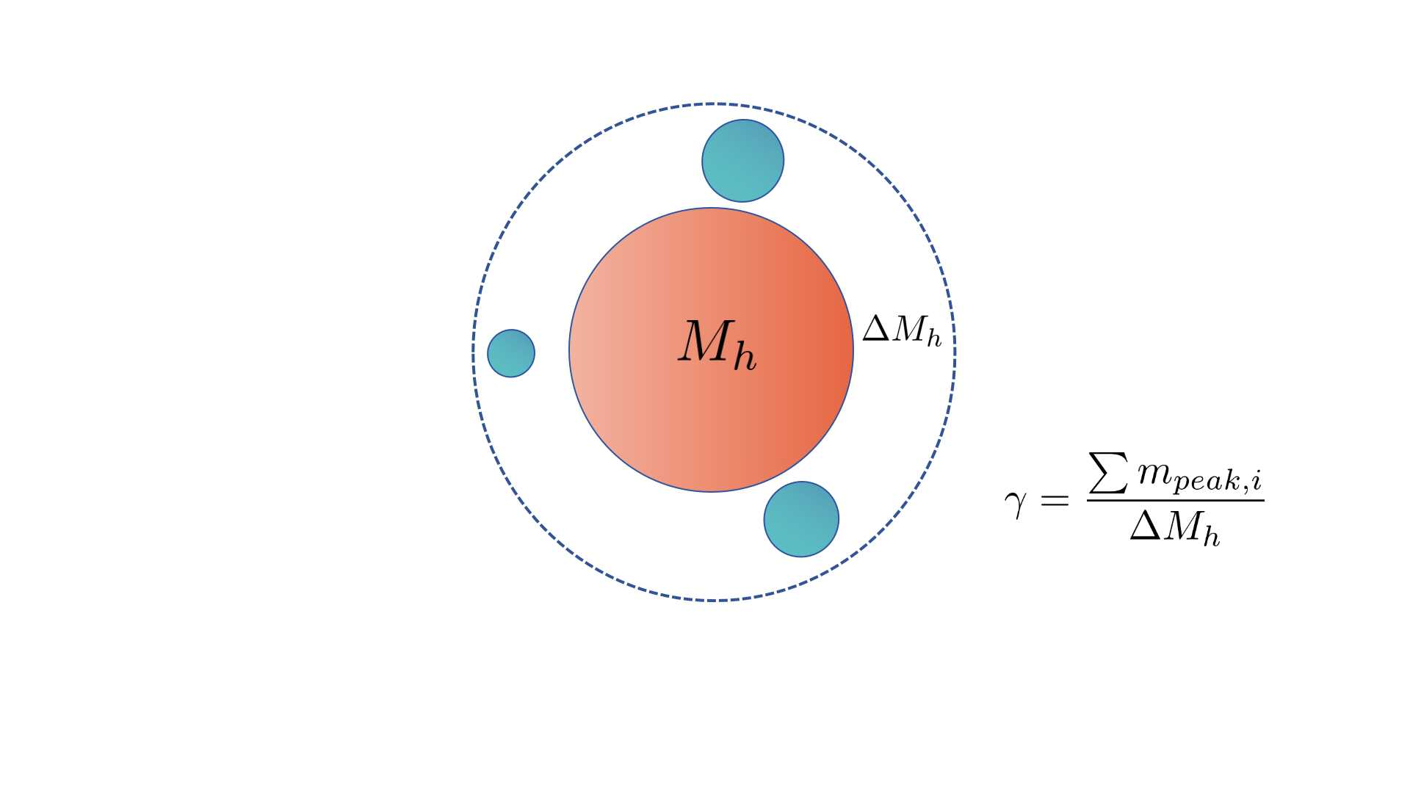
Mass Conservation
Newly accreted subhalos
The universality implies that gamma must remain constant across halos of different and .

Slide 15
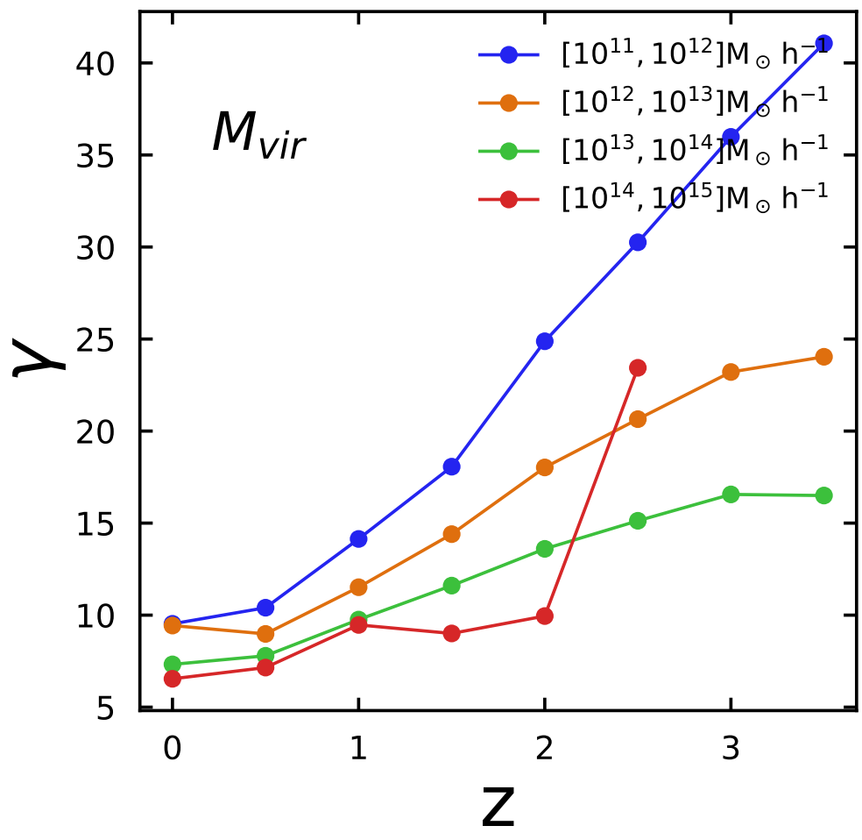
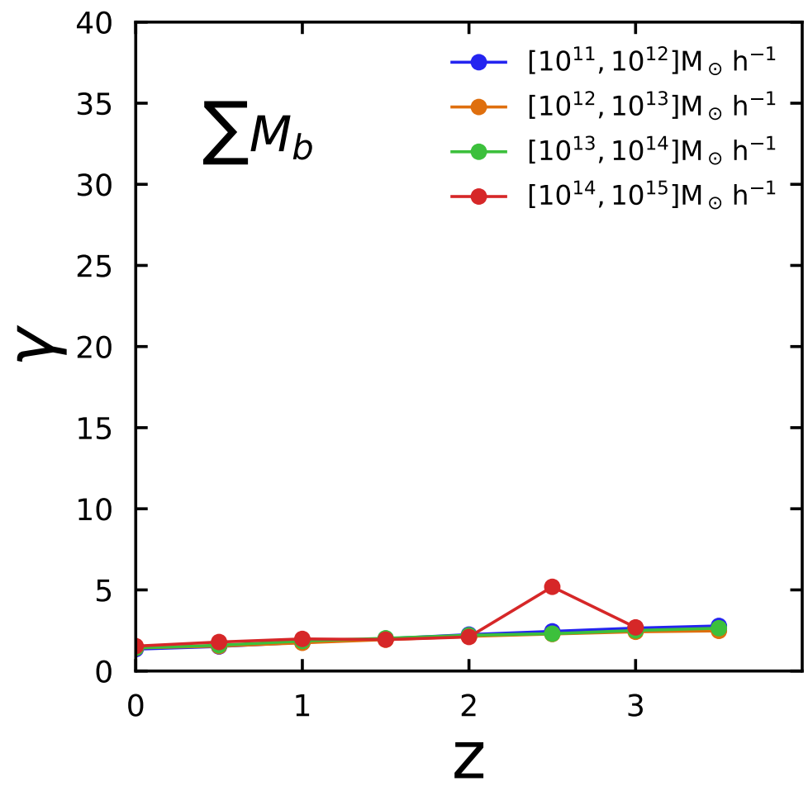
Self-consistent Halo Boundary
The halo boundary does not consistently match the orbital extents of its member particles.

Slide 16
Summary
The PMFs across all levels exhibit approximate universality and can be obtained analytically via "convolution" from the PMFs at the first level. Such universality reveals the fractal structure of the merger tree.
Using the model, we study subhalo properties across levels: contributions to the total, accretion redshifts, and merger ratios.
A physical definition could potentially provide more self-consistent boundaries for the study of halo mergers.

