Slide 1
Dynamical Halos
Eduardo Rozo
Expanding the boundaries of dark matter halos.
Shanghai Jiao Tong University
Shanghai, China, June 2025

Slide 2
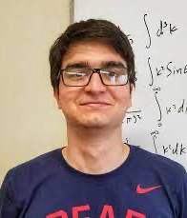
Bulk of the work shown here was performed by:
Rafael Garcia
Edgar Salzar
Hengwei Chang
Tristen Shields
In collaboration with:
Benedikt Diemer
Vladimir Ze’ev
Calvin Onsaga

Slide 3
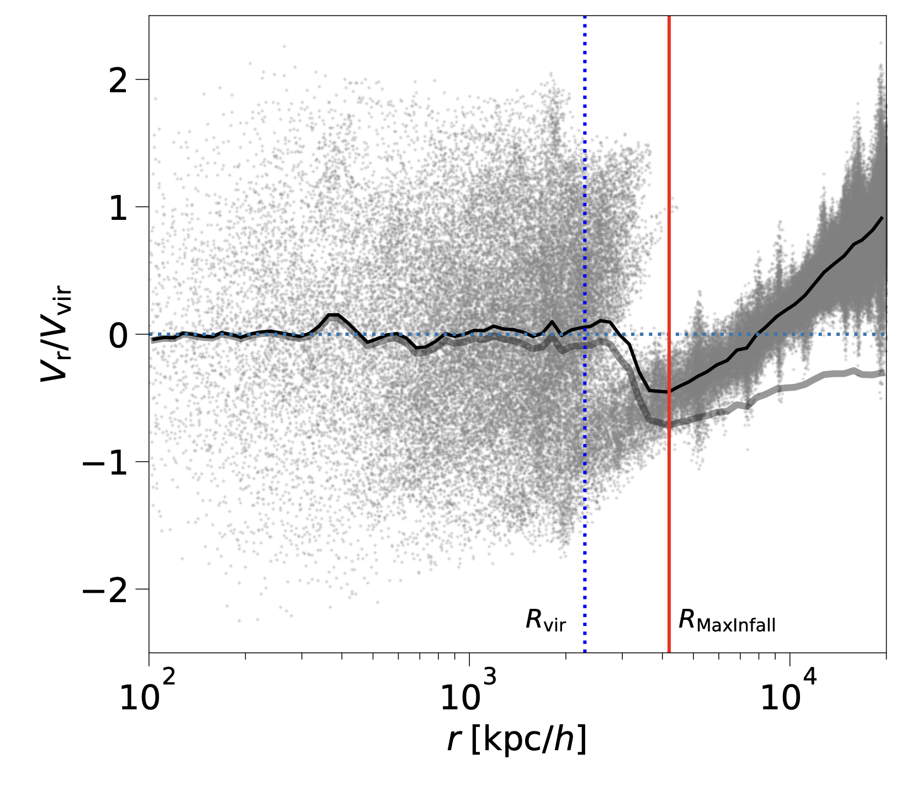
What is a Halo?
This is a halo
This is not a halo

Slide 4
There is no radial boundary that separates “halo” from “non-halo”
This is a halo
This is not a halo

Slide 5
A halo is the collection of particles orbiting in their self-generated potential.
Useful for coarse-grained descriptions and LSS modeling.
Halo
Differences in definitions are small if dynamics-based:
Pericenters (Benedikt)
Not a halo
Boundedness (Tamara)
Accretion time (Garcia)

Slide 6
This talk:
Are there advantages to foregoing the idea of a halo boundary?
Spoilers:
Yes.

Slide 7
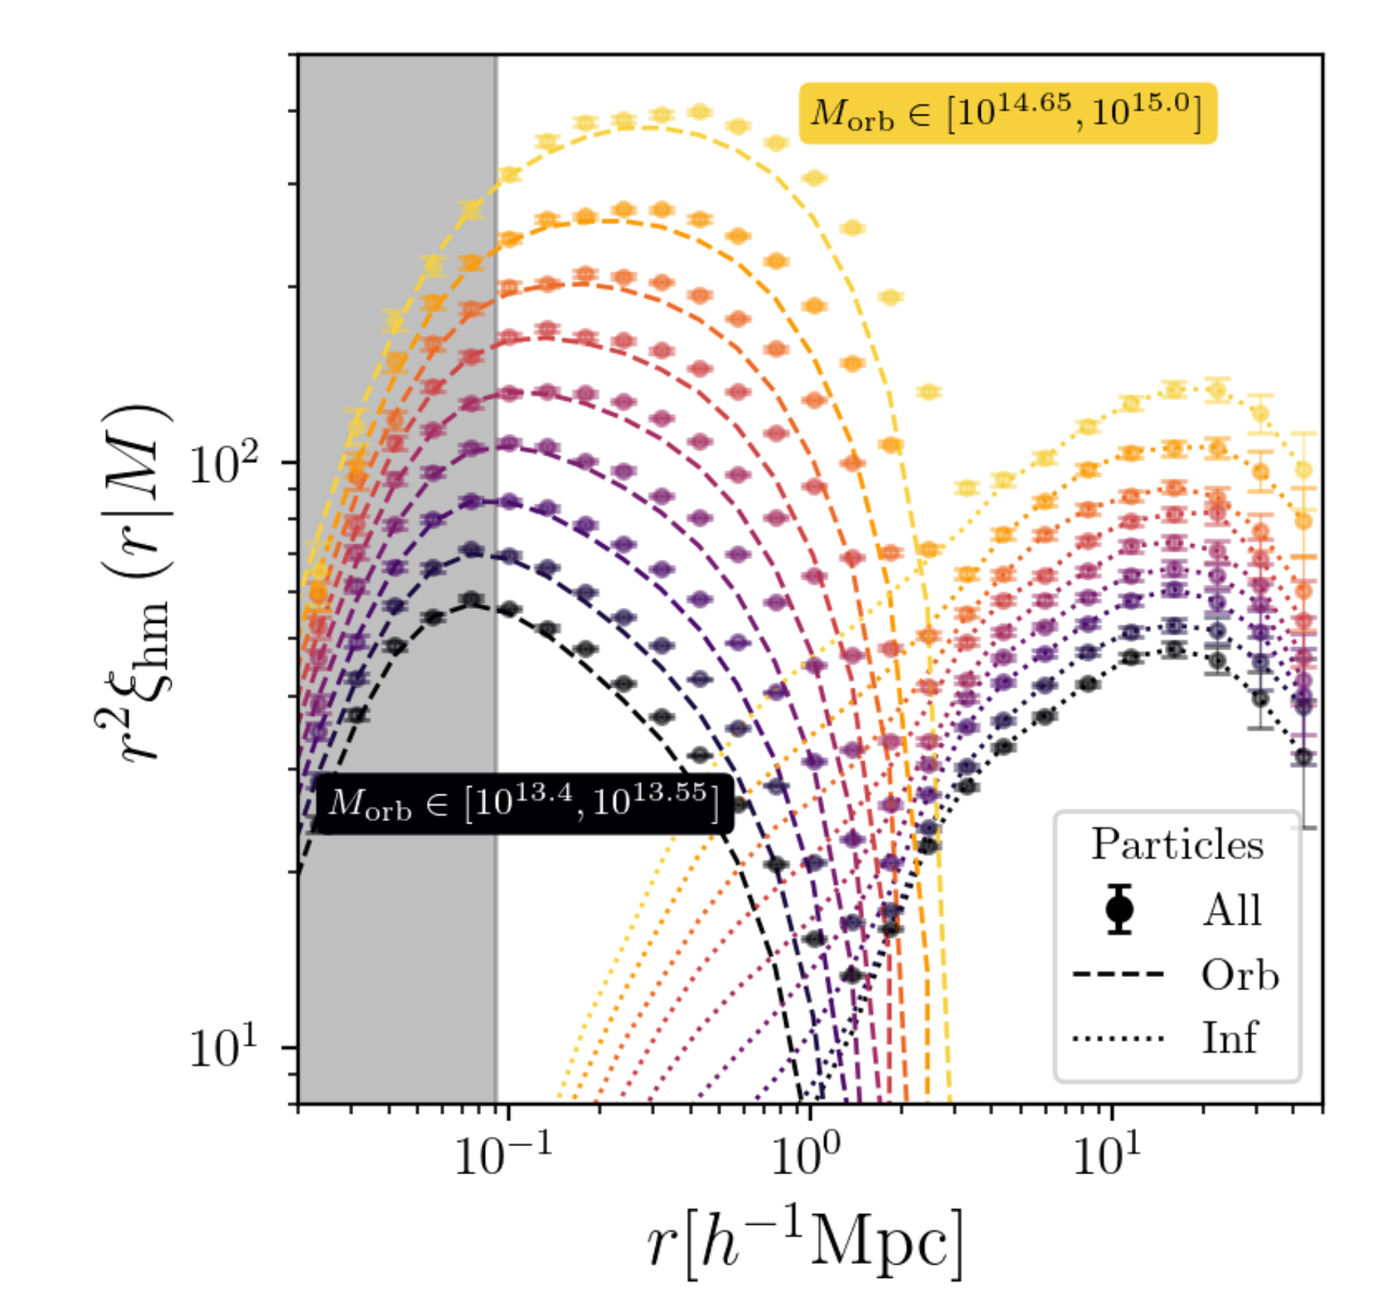
Advantage no. 1:
Dynamical Halos can ”fit” all the phenomenology of different halo boundaries.
Points w/ error bars: simulation data.
Dashed lines: orbiting particles.
Dotted lines: infalling particles.
Salazar et al. 2024: arXiv:2406.04054

Slide 8
Advantage no. 1:
Dynamical Halos can ”fit” all the phenomenology of different halo boundaries.
Splashback radius ($r_{steep}$):
Steepening of total density is due to the truncation of orbiting profile.
(see Benedikt’s talk)
Depletion radius:
Depletion feature arises from the interplay of orbiting/infalling particles.
Salazar et al. 2024: arXiv:2406.04054

Slide 9
Advantage no. 2:
Dynamical halos enable us to build a better halo model (see also Yifeng’s talk)
Need to characterize both to get an effective halo model.
Salazar et al. 2024: arXiv:2406.04054

Slide 10
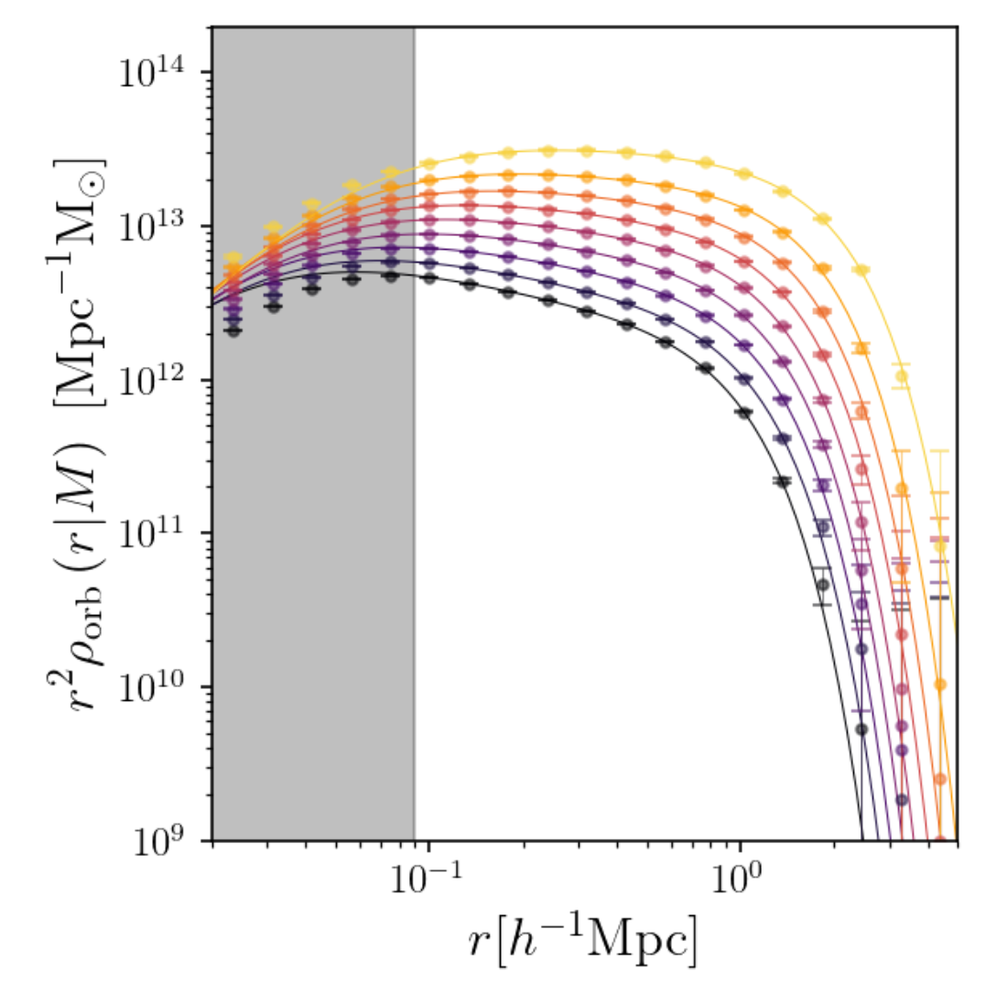
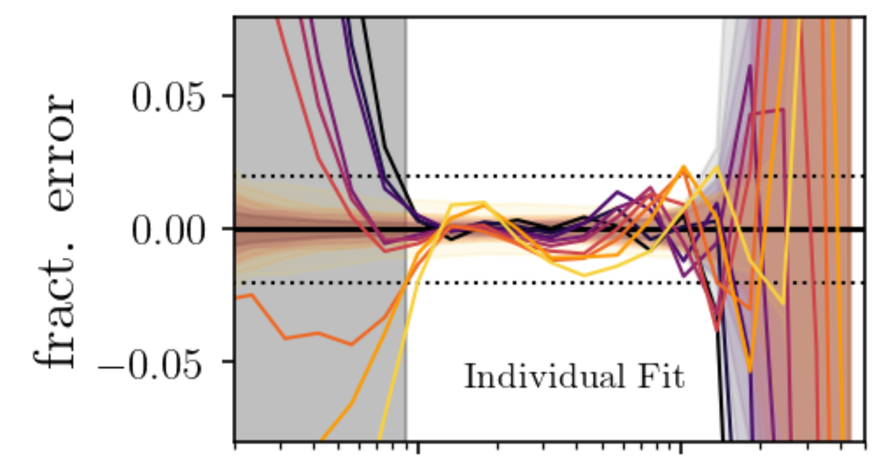
The orbiting profile defines a halo radius $r_{h}$!
Orbiting profile has two key features:
Exponential truncation: defines the halo radius ($r_{h}$).
$≈$equivalent to $r_{t}$ in Diemer model.
Slowly varying slope in the core.
0.05
Profiles can be fit using two parameters: $r_{h}$, and a characteristic slope.
Frac. Error
-0.05
Salazar et al. 2024: arXiv:2406.04054

Slide 11
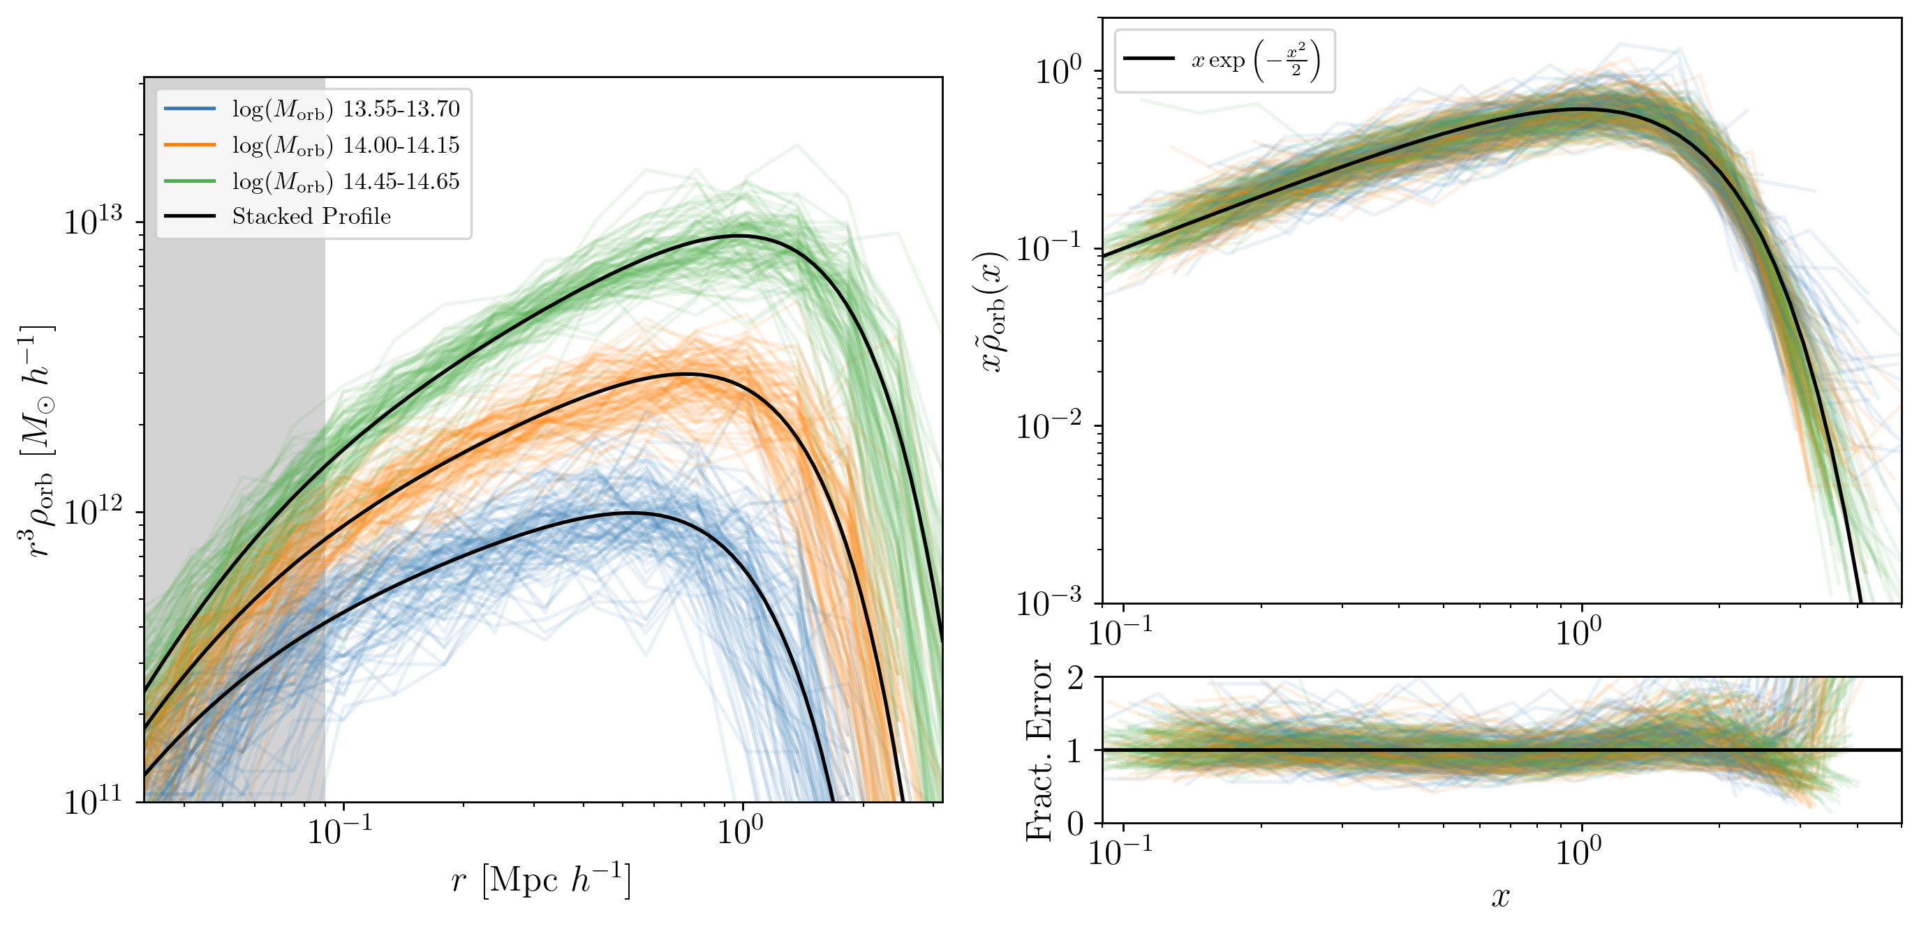
The same model can fit individual halos.
Profiles rescaled according using best 2-parameter fit.
Shields et al., in preparation.

Slide 12
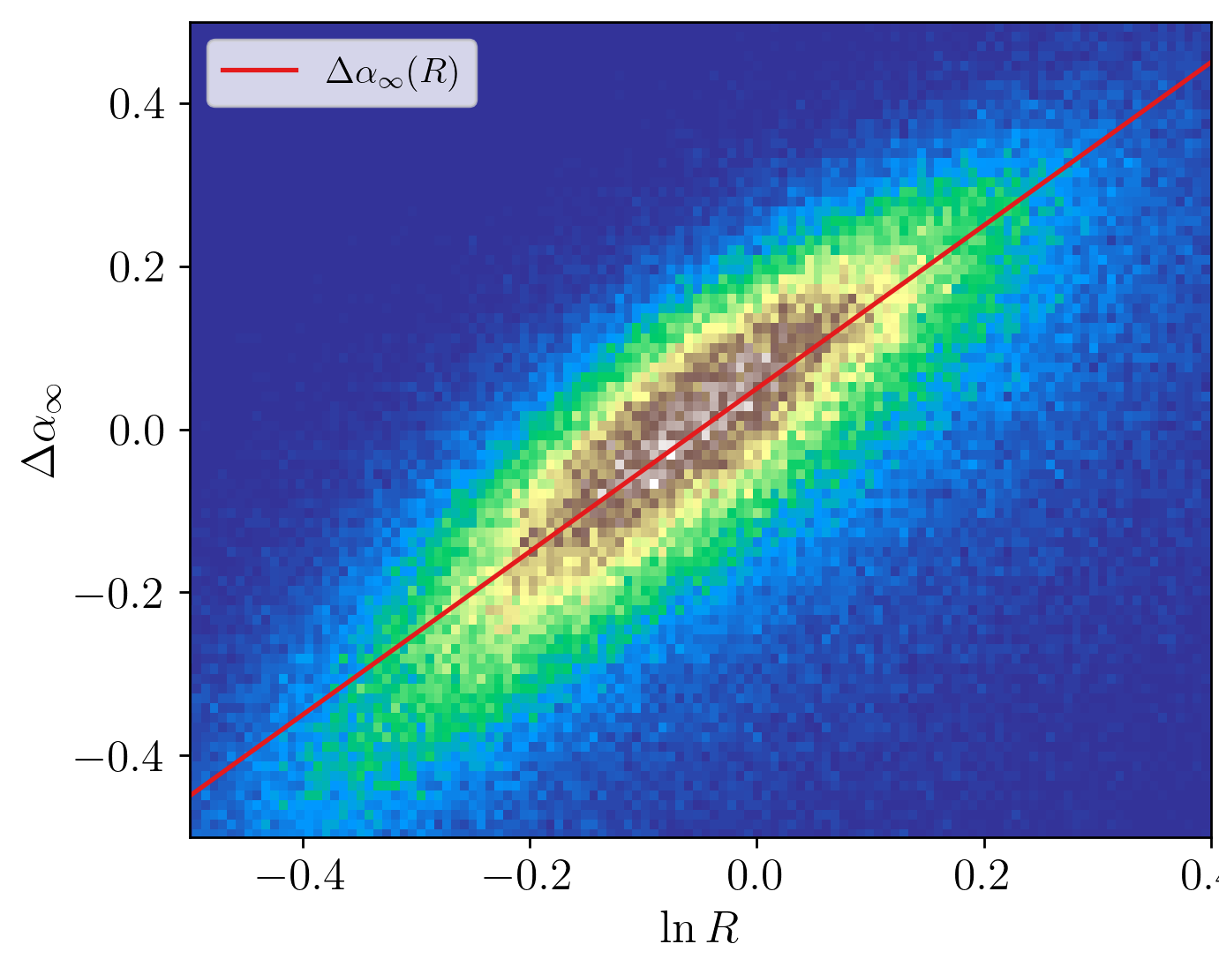
Profiles can be described using only one dof: the halo radius!
Plot best fit slope against best fit radius
Only one dof: if you know the halo radius, you know the entire profile!

Slide 13
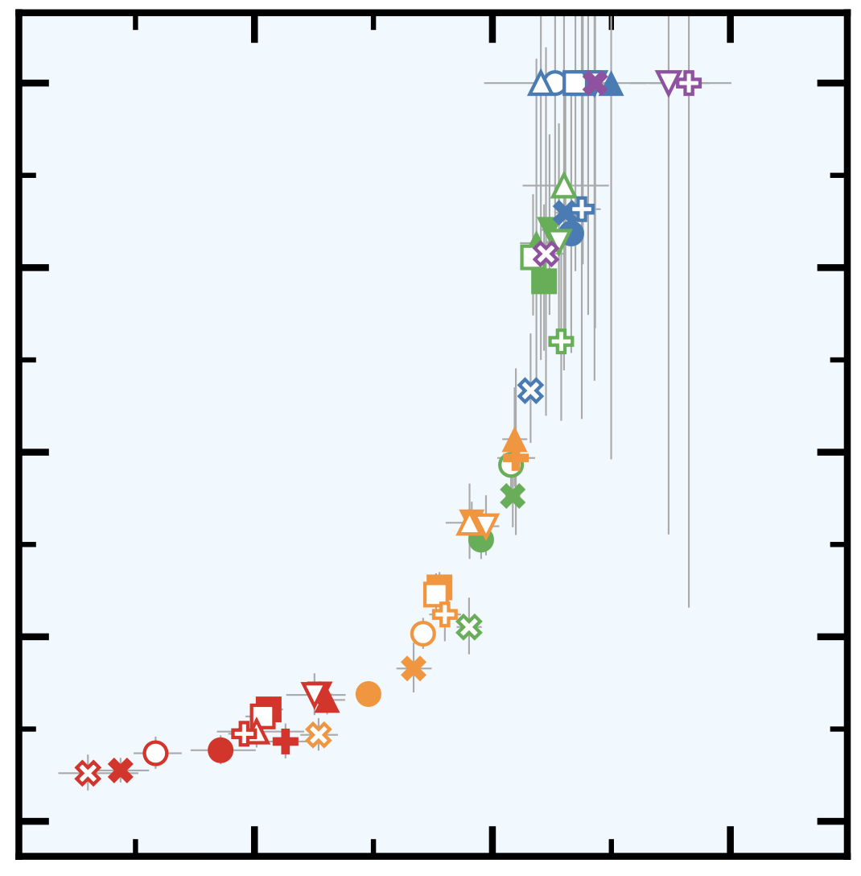
Profiles can be described using only one dof: the halo radius!
This statement does not contradict what you heard from Benedikt.
Physics!
$$β$$
5 parameters don’t are not degenerate when you fit them.
But- recovered values form a tight locus in parameter space!
$$α$$
Diemer 2025, 2410.17324

Slide 14
Long term goal:
Predict profile parameters (halo radius and slope) from first principles!
0.05
Can we make this a zero free parameters fit?
Frac. Error
-0.05
Salazar et al. 2024: arXiv:2406.04054

Slide 15
Advantage no. 2:
Dynamical halos enable us to build a better halo model
Orbiting/Infall split allows us to model Corr. Func. w/ 2% accuracy
Salazar et al. 2024: arXiv:2406.04054

Slide 16
Advantage no. 2:
Dynamical halos enable us to build a better halo model
Problem:
Non-linear growth is treated in an ad-hoc way.
Power-law: captures non-linear growth
EFT not good enough at these scales

Slide 17
Advantage no. 3:
The dynamical halo framework opens new theoretical avenues.
Key idea:
Non-linear evolution of the density field is due to mass falling in towards the halo.
We can treat infall analytically using spherical collapse!
Initial conditions set by Gaussian + linear theory.
Approach trades perturbative limit for spherical symmetry.

Slide 18
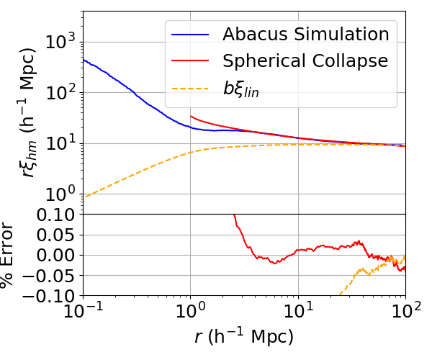
$$Ω_{m}=1$$
Simulation data
Spherical collapse accurately models infall profiles.
Spherical collapse
Generalization to $ΛCDM$ in progress.
Linear theory
Is this be a viable alternative to EFT for LSS analyses?

Slide 19
Advantage no. 4:
The Mass Function + Bias of Dynamical Halos is Easier to Model!
Spherical collapse predicts a Press-Schechter mass function.
Traditional approach:
Identify collapsed mass with spherical overdensity (virial) mass.
New approach:
Identifies collapsed mass with orbiting mass.
This is a very natural identification!

Slide 20
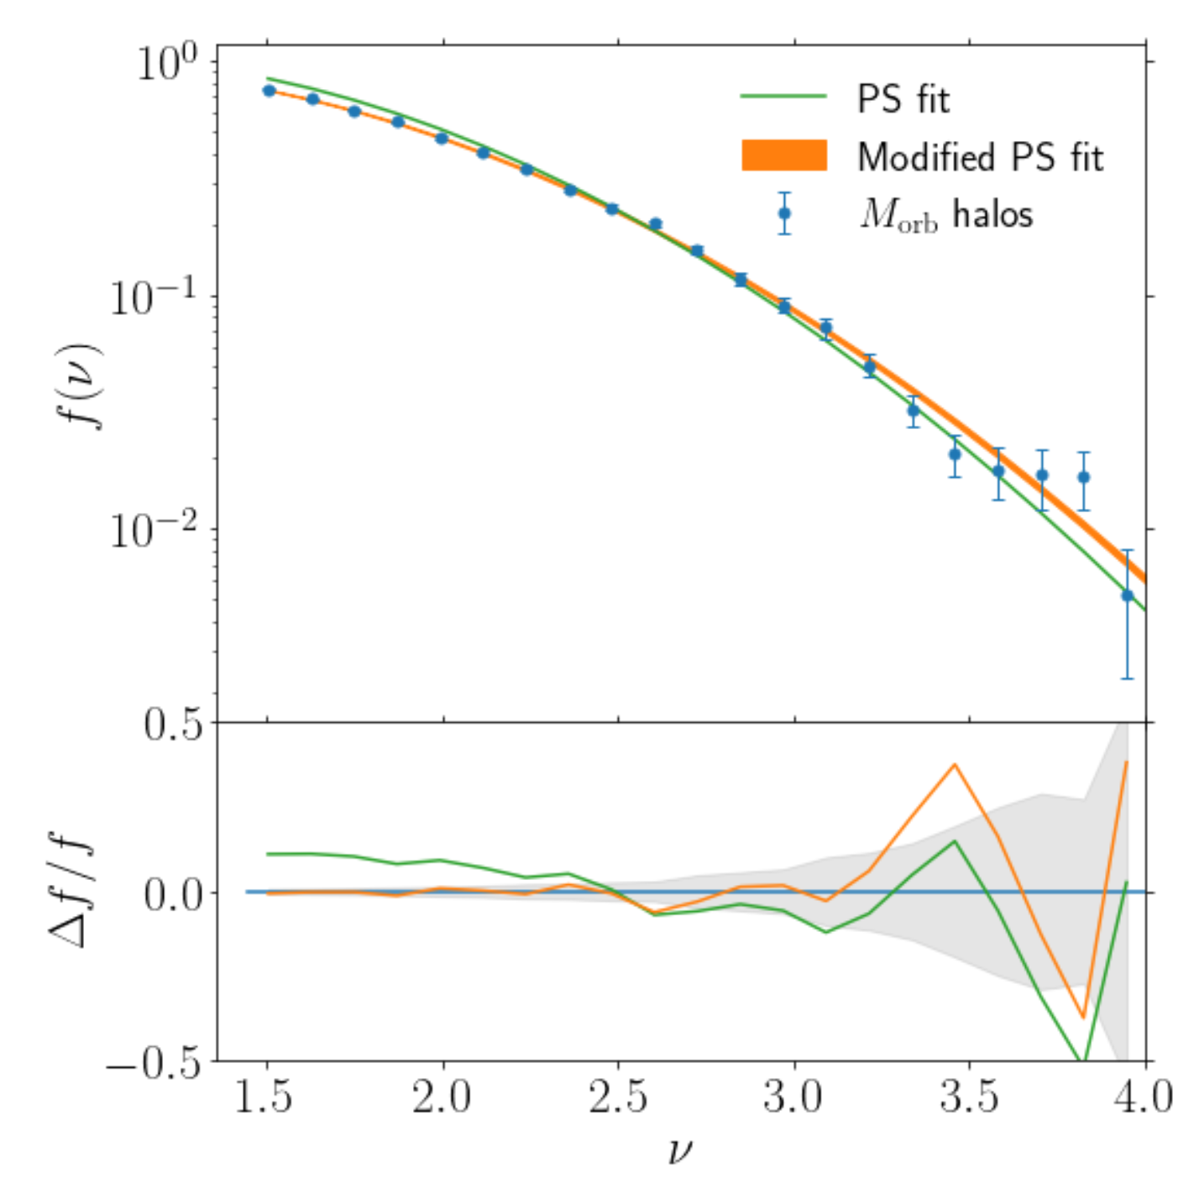
Advantage no. 4:
The Mass Function + Bias of Dynamical Halos is Easier to Model
Excellent agreement with a mass-dependent threshold $δ_{c}$.
Find: $δ_{c}∈[1.52,1.68]$
Recovered values of $δ_{c}$ match expectations (Shapiro et al. 1999).
Halo bias is consistent w/ peak/background split.
Garcia et al. 2023, 2207.11827

Slide 21
Advantage no. 4:
The Mass Function + Bias of Dynamical Halos is Easier to Model
Excellent agreement with a mass-dependent threshold $δ_{c}$.
Warning: This breaks down at lower masses!

Slide 22
Wow! This is great!
I will only use dynamical halos from now on!

Slide 23
But wait a minute…
Finding dynamical halos looks like a lot of work!
E.g. Sparta, Strawberry, and Garcia et al. 2023.

Slide 24
Parallelized post-processing of Rockstar catalogs to produce a catalog of dynamical halos.
Fast: e.g. Quijote post-processing takes 50 min for a 1024³ simulation using 50 cores on a server bought second-hand.
Salazar et al., in preparation

Slide 25
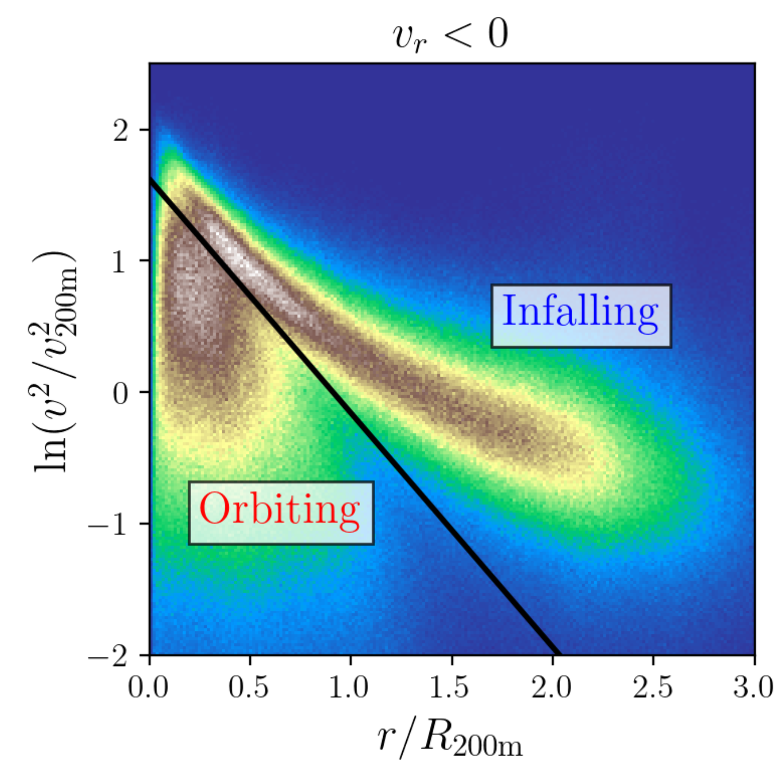
Key idea:
Orbiting particles have less KE than infalling particles!
Select orbiting particles with a KE energy cut.
KE can be self-calibrated from the simulation.
Salazar et al., in preparation

Slide 26
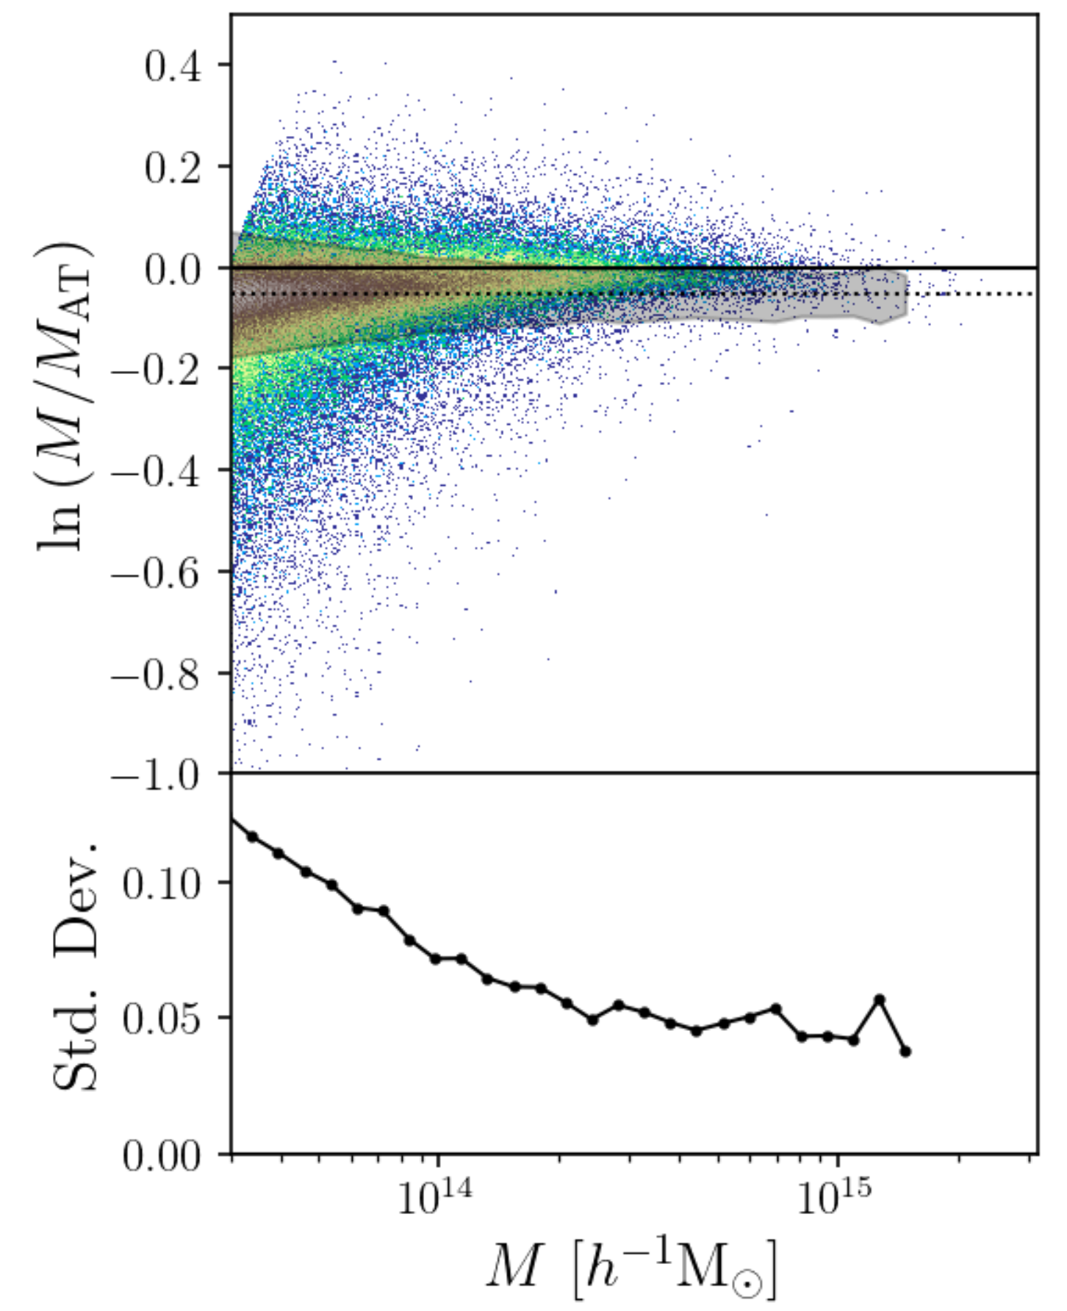
Oasis Results:
KE and orbit-based masses are tightly correlated.
5% offset with 5% scatter.
Mass functions also match within 5%
Salazar et al., in preparation

Slide 27
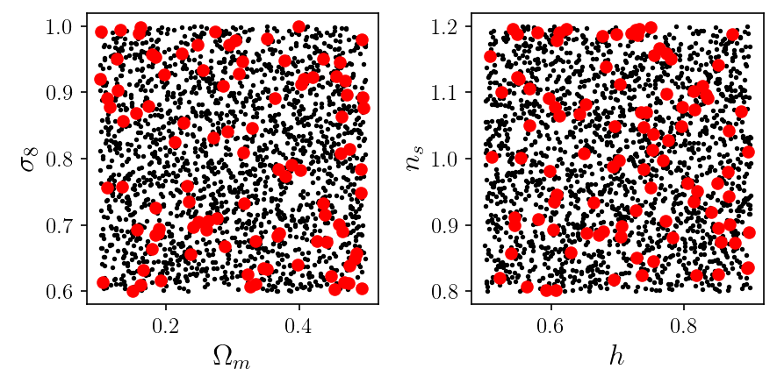
Oasis Results:
Ran on 100 Quijote simulations spanning a range of flat $Λ$CDM cosmologies.

Slide 28
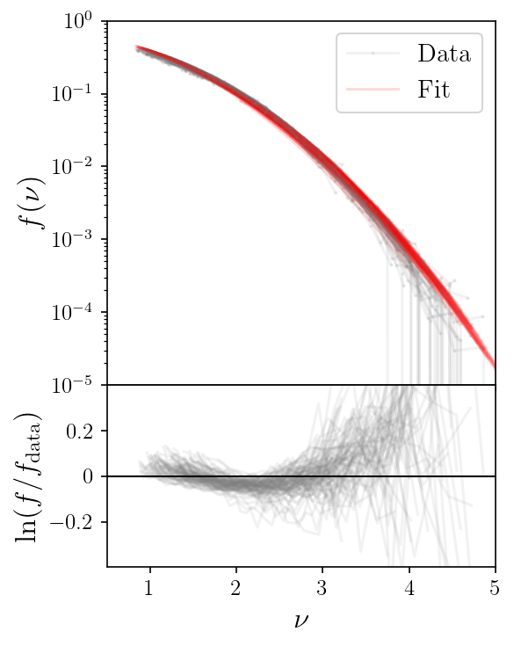
Oasis Results:
High mass end of the mass-function is:
Approximately Press-Schechter
Approximately universal with $δ_{c}≈1.52.$
Difference from PS is not due to a running threshold for collapse!

Slide 29
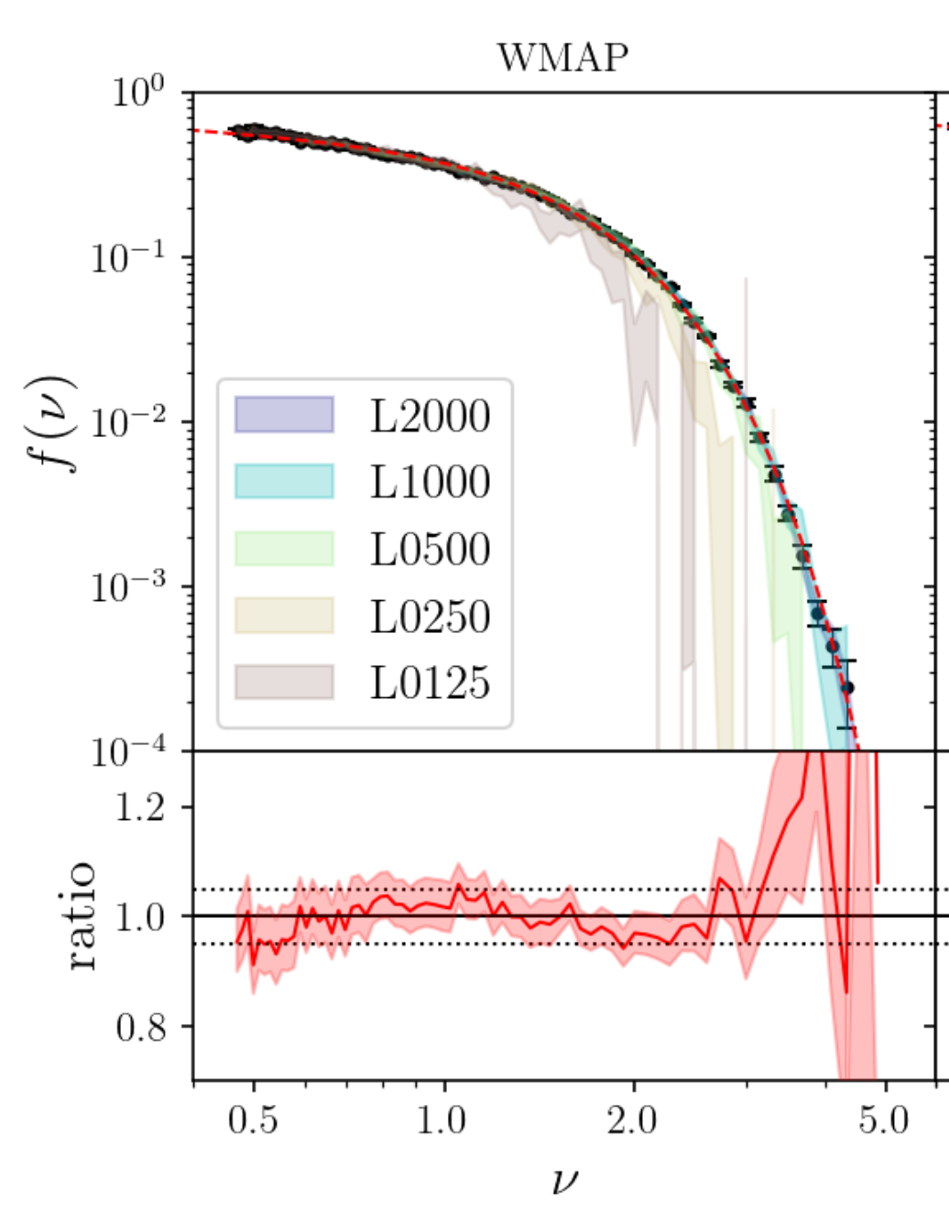
Oasis Results:
Low mass end of the mass function is not Press-Schechter.
Can’t be accommodated by a running collapse threshold.
Standard generalization works:
Salazar et al., in preparation

Slide 30
Summary
This is a halo
This is not a halo

Slide 31
Summary
Halos do not have radial boundaries: rather, halos should be defined as the collection of all orbiting particles.
Dynamical halos have many advantages:
Naturally gives rise the 1-halo/2-halo structure of the halo model.
Orbiting profile has a single degree of freedom: the halo radius.
Infall profile can be modelled using spherical collapse (in progress).
Dynamical halos are easier to model (improves agreement between simulations and Press-Schechter).

Slide 32
Developed a fast algorithm to generate dynamical halo catalogs from simulations.
https://github.com/edgarmsalazar/oasis

