Slide 1
The depletion radius of dark matter halo
Jiaxin Han （韩家信）
Shanghai Jiao Tong University
2025/05/26
With: Matthew Fong, Hongyu Gao, Yifeng Zhou, Zhaozhou Li, Jiale Zhou
arXiv: 2008.03477, 2105.04978, 2205.01816,
2303.10886, 2303.10887, 2407.08381

Slide 2
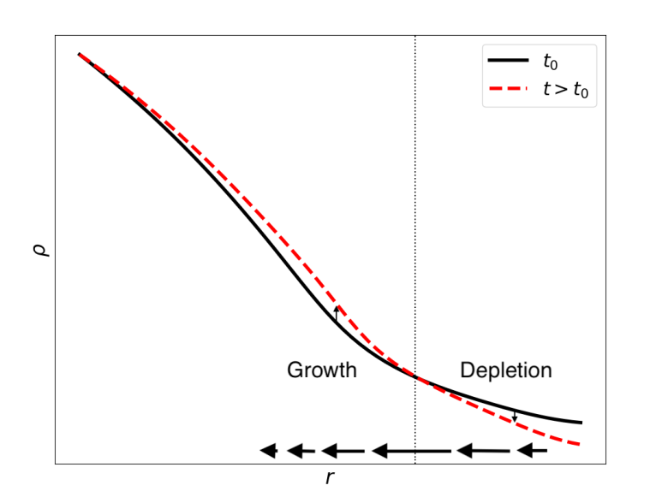

Characterizing a growing halo
-- macroscopic physics
Growth of a halo ⬅➔ depletion of environment
  Maximum infall rate location: inner depletion radius
Mass Conservation
$$\dot{ρ }4πr^{2}dr=−dMFR$$
Fong & Han 2021

Slide 3
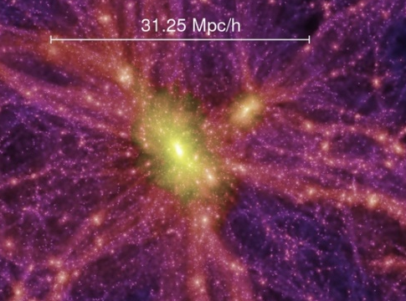
The depletion radius: example
Splashback
The depletion radius defines a more complete halo in both spatial coverage and physical processes
Halo Model
Evolution Probe

Slide 4
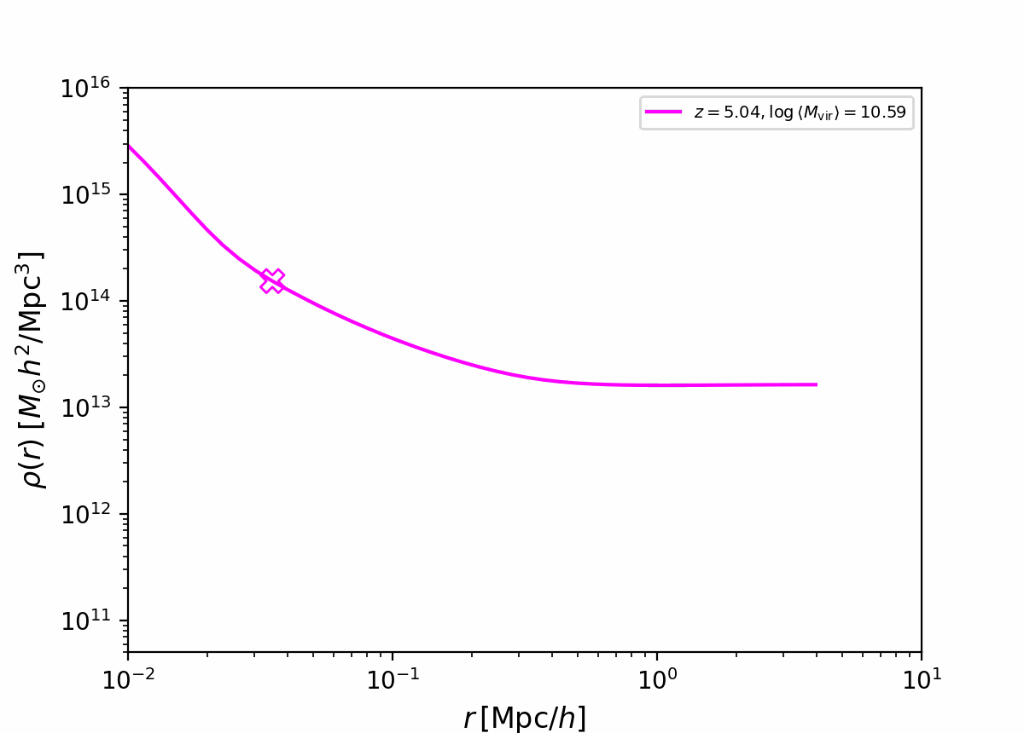
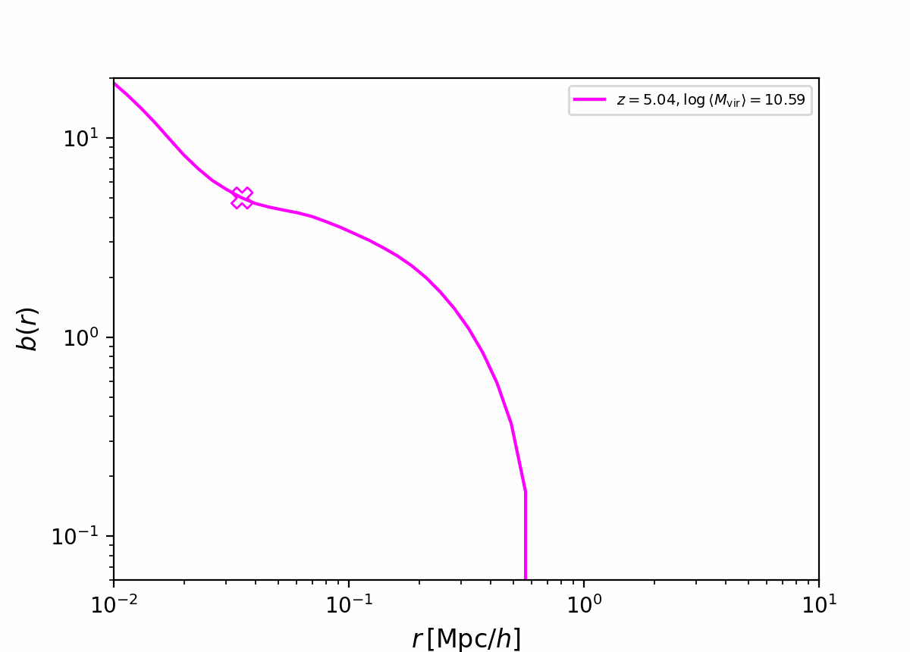

The process of depletion
Expanding universe—background density also receding
Halo growth – neighborhood extra depletion
Relative density profile unveils depleted region
  Characteristic depletion radius:
  (relative) clustering is the weakest: region of influence
Gao, Han+, 2023

Slide 5
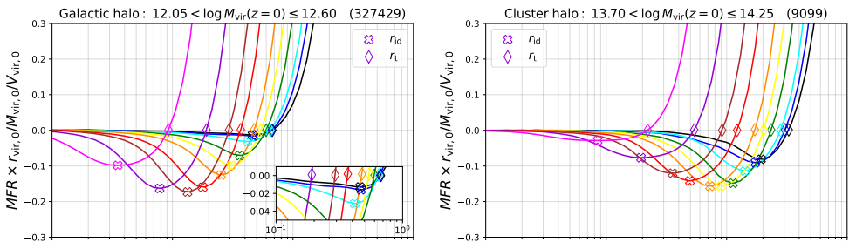
Depletion radius as a halo evolution probe
Two phases in halo evolution
depletion rate first increases then decreases
Fast→slow growth transition

Slide 6
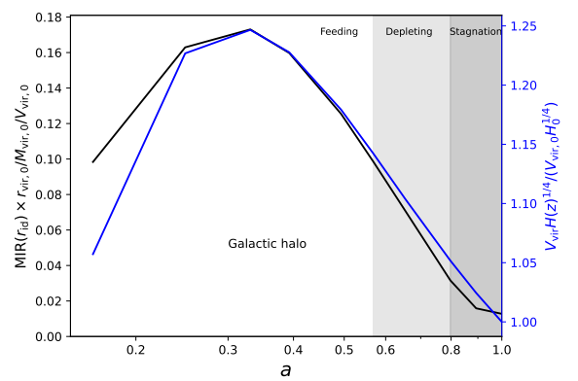
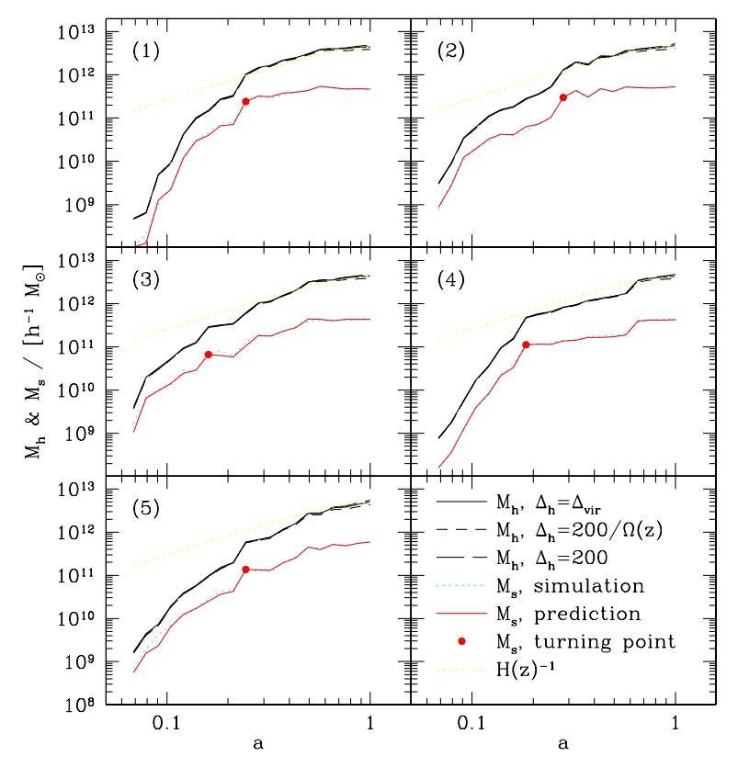
Depletion radius as a halo evolution probe
Halo evolution undergoes fast & slow accretion phases (Zhao et al. 2003)
The transition determines halo concentration
The depletion process provides a natural explanation of the two-phase halo growth
  Accelerated Depletion
  Decelerated Depletion
Fast
Slow

Slide 7


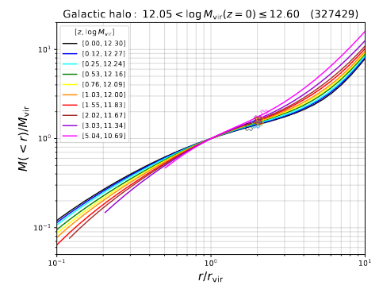
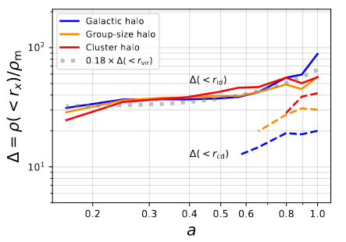

Depletion radius evolution
Why?
Well proportional to virial quantities across redshift
$$M\sim r^{0.66}$$

Slide 8
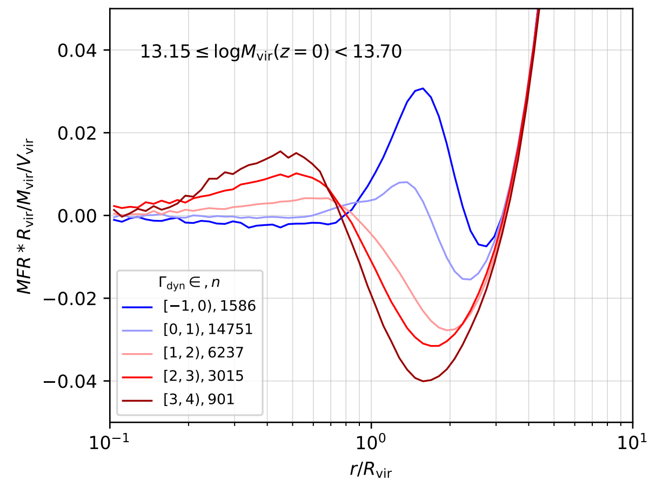

What determines the depletion radius?
$R_{id}/R_{vir}$ independent on mass, but sensitive to mass accretion rate
See Jiale’s talk

Slide 9
The depletion radius defines a more complete halo in both spatial coverage and physical processes
Halo Model
Evolution Probe

Slide 10
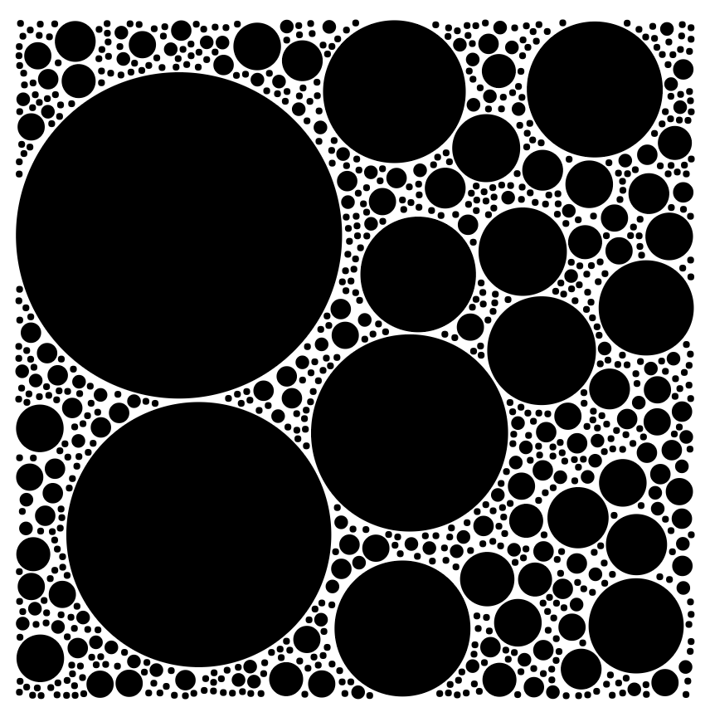
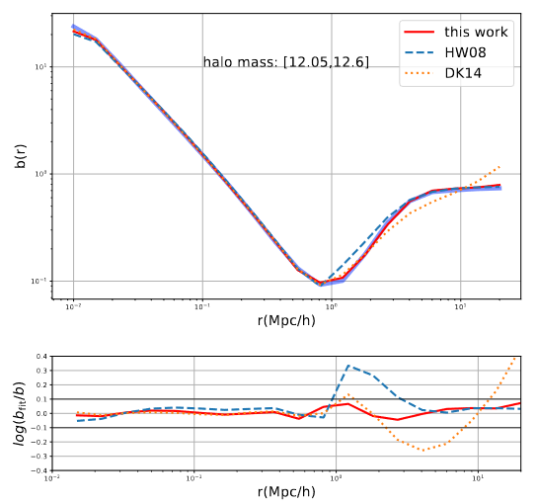
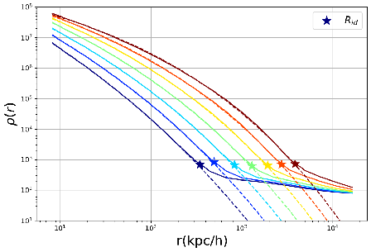
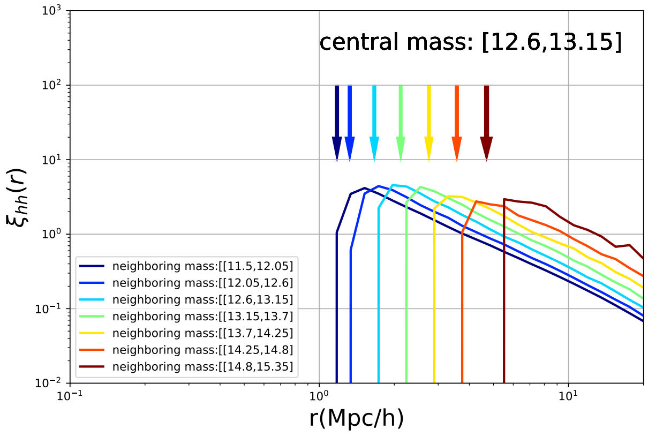
Depletion radius as the exclusion radius
  Define halos according to depletion radius
  First principle model
    Simple/natural model components
    Single free parameter for unresolved halos
  Percent level accuracy across scales
Einasto
(not NFW)
1-halo
R_{ex}
2-halo
Self-similar
Zhou & Han, 2023

Slide 11

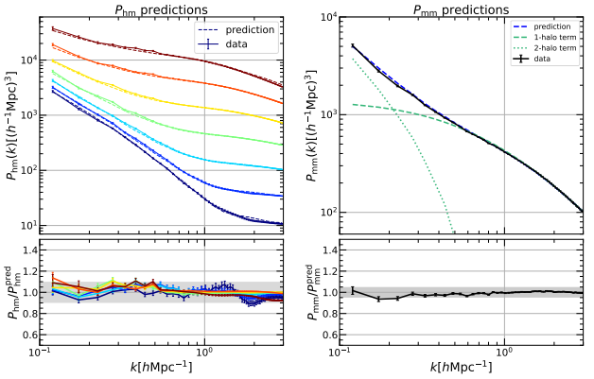
Depletion radius as the exclusion radius
Fourier space: next generation real HaloFit
See Yifeng’s talk
Zhou & Han 2024

Slide 12
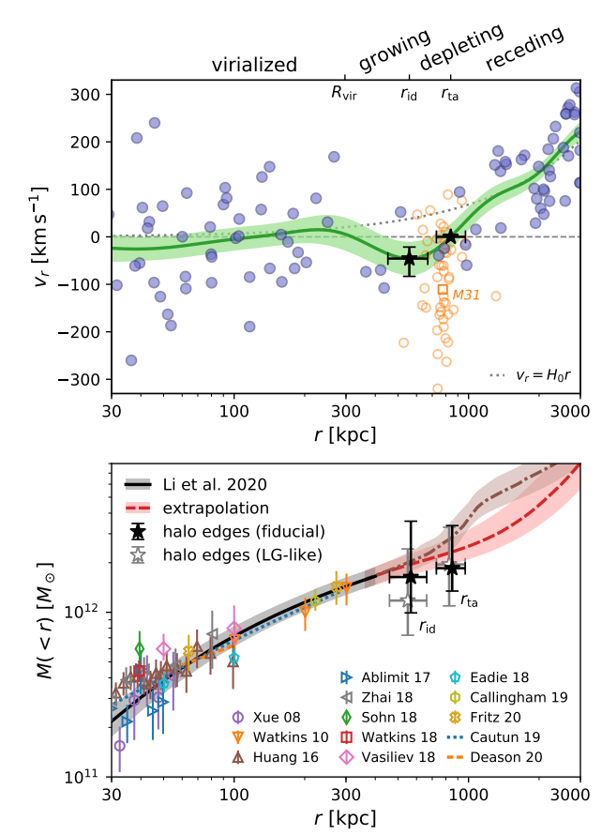

Measuring the depletion radius in our MW
  Radial velocities of dwarf galaxies within 3Mpc of MW
    Exclude satellites within 600kpc from M31
  Iterative Gaussian process
    Velocity Dispersion
    Average radial velocity
  MaxInfall detected at ~2σ for our MW
Outermost edges of MW!
Li & Han 2021, ApJL
See Zhaozhou’s talk

Slide 13
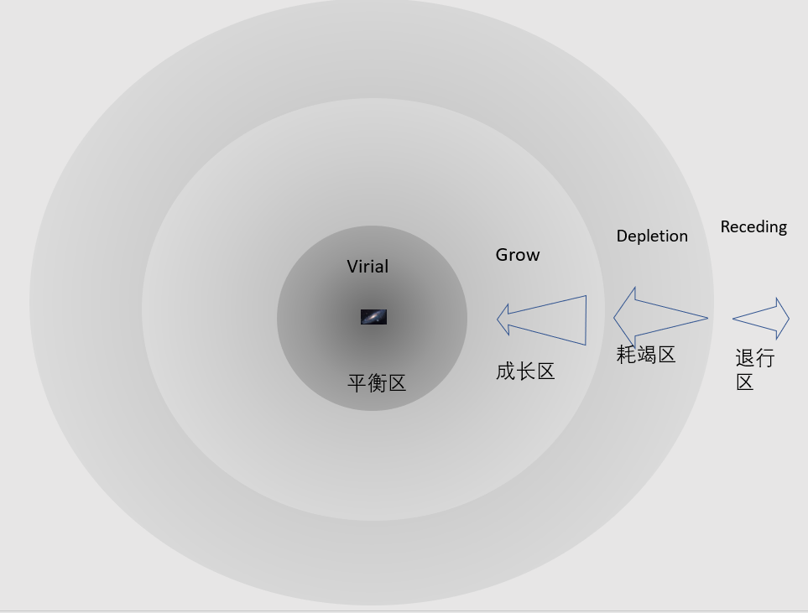

Landscape of our MW
$$r_{vir}=297±16 kpc$$

Slide 14
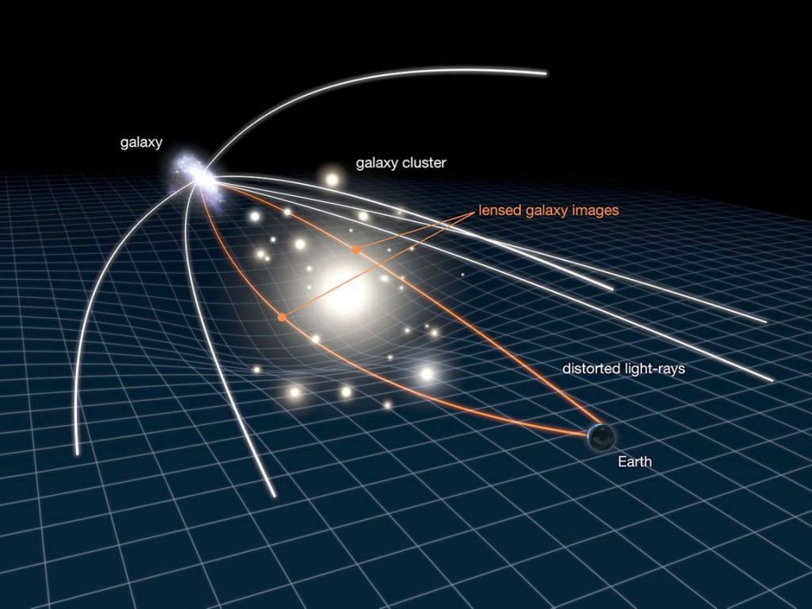
Weak lensing measurement of the depletion radius
DECALS DR8 shear and group catalog
Measure Projected Density Filed
—Fit for 3D density/bias field
Fong, Han+, 2022., MNRAS

Slide 15
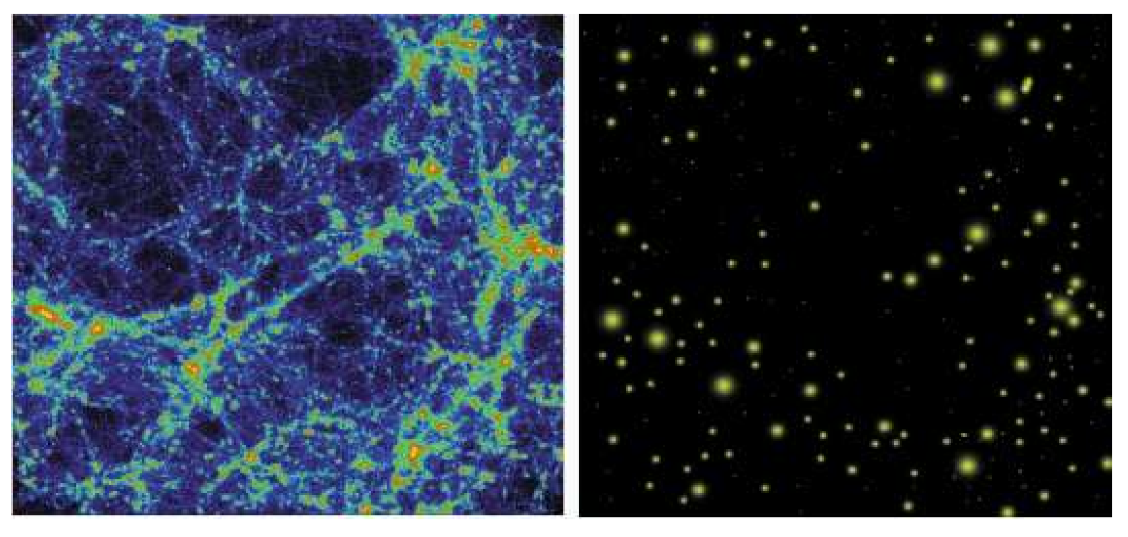

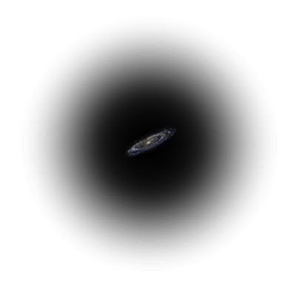
Summary: The extended halo model
Growing multi-layer dark matter condensation
Special largescale locations
Quasi-equilibrium structure
Growing envelope
Depletion radius (Fong &Han 20; Li & Han 21; Fong, Han+22)
Hierarchical buildup
Exclusion radius (Zhou & Han 23,24)
Growth radius (Gao,Han+23)

Slide 16
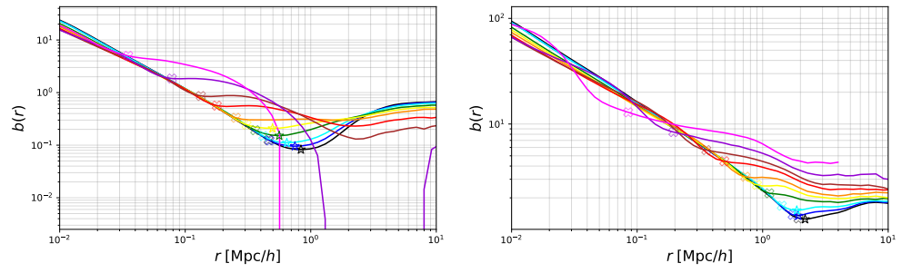
Depletion radius as a halo evolution probe
Galactic halos form/deplete earlier
  Galactic halos have almost exhausted the surrounding material at z=0
  Cluster halos are still actively depleting
depletion rate first increases then decreases
Galactic Halo
Cluster Halo
More depleted
Less depleted

Slide 17
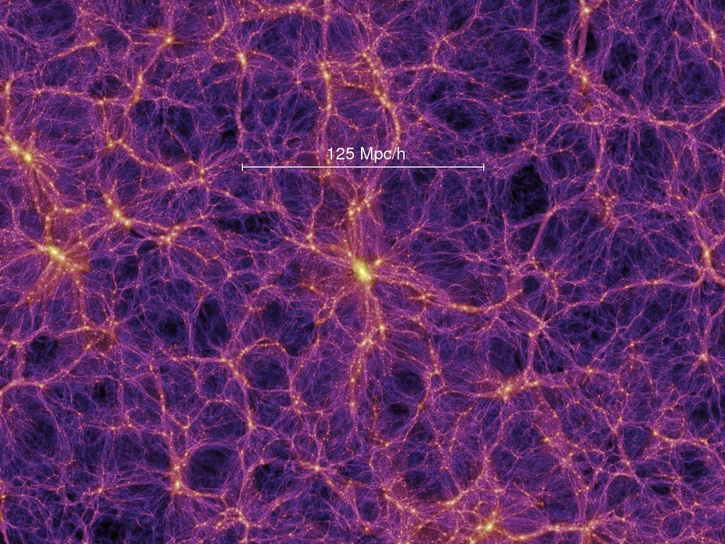
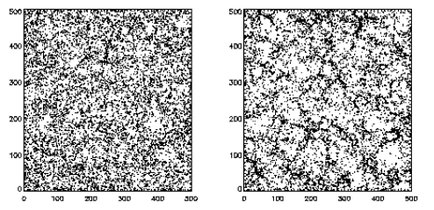

Major problems of the classical halo
NFW+Virial radius
$$ρ_{vir}=Δρ_{b}$$
Pseudo Evolution
Halo Exclusion
Assembly Bias
incomplete
inaccurate
unphysical
young
old
Gao et al. 2005
Halo clustering not fully determined by virial radius
Virial radius keeps evolving when profile stabilize
Halos are not packed by virial radius

Slide 18
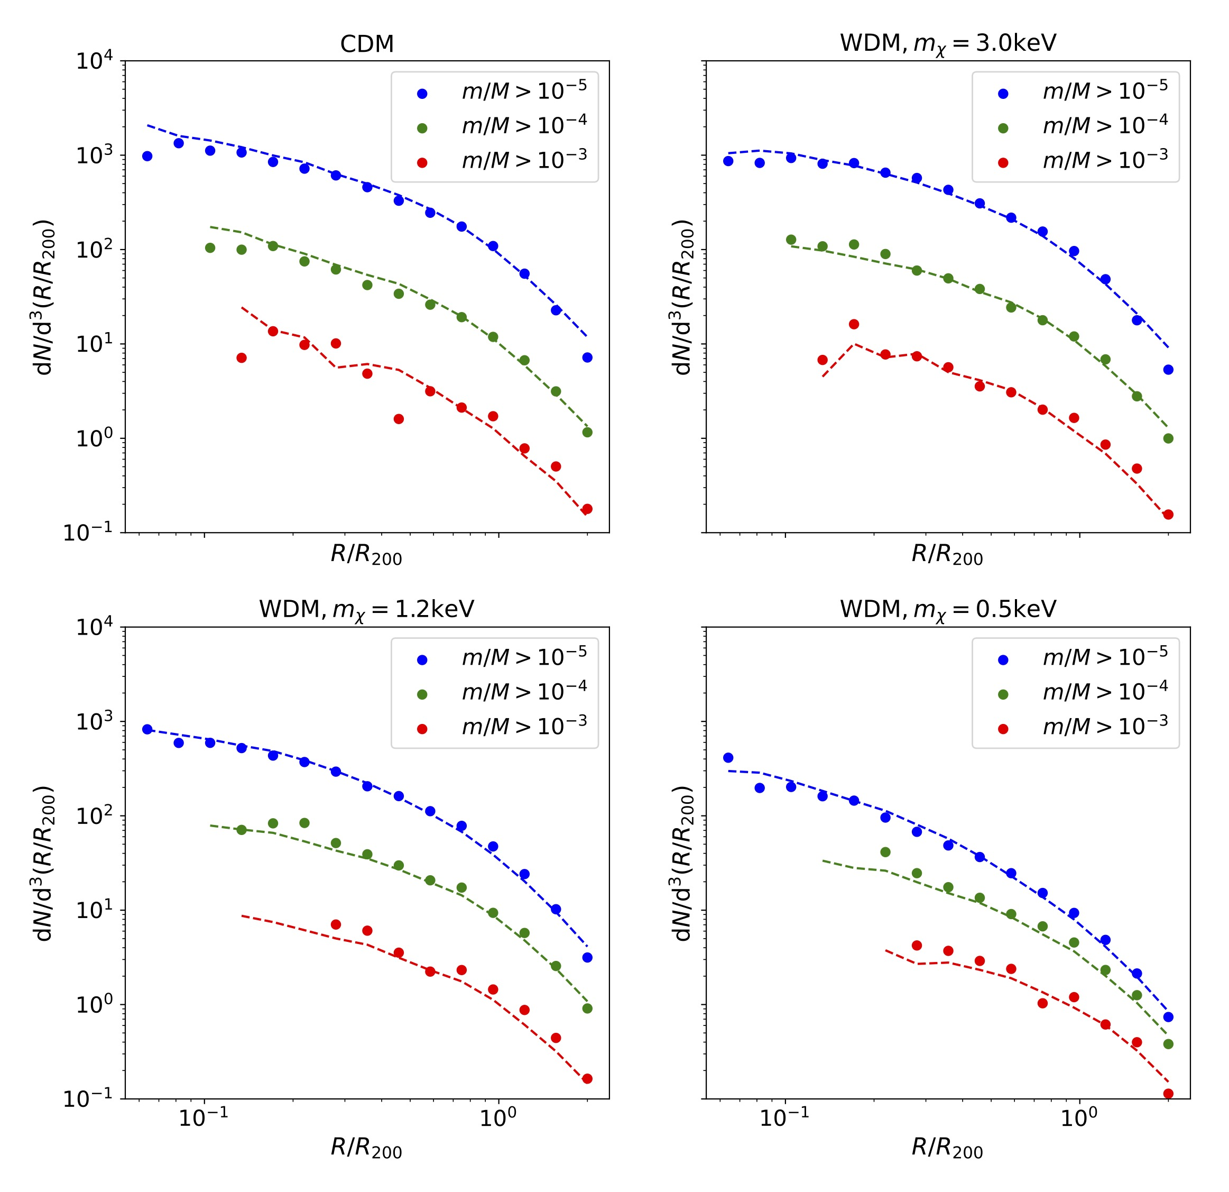
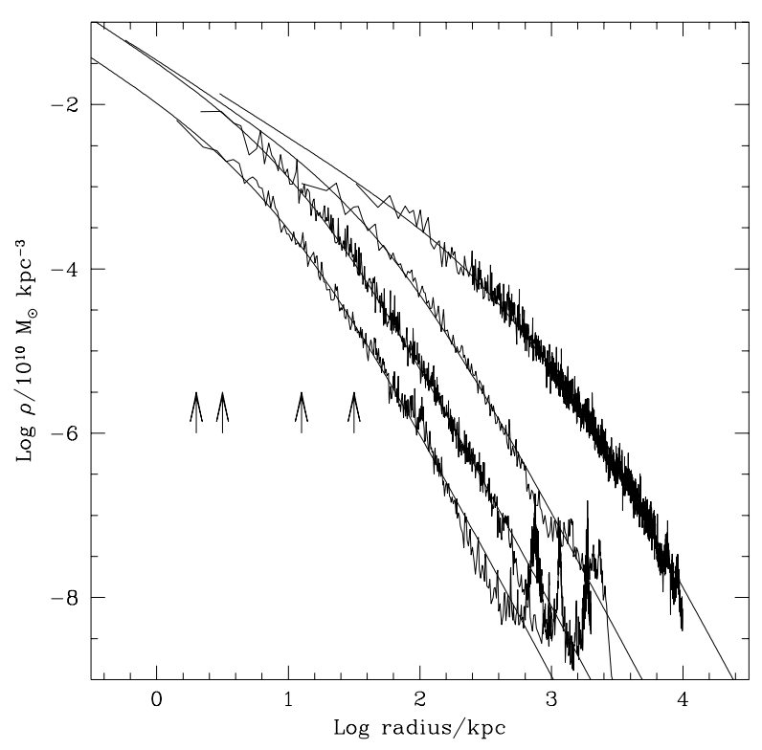
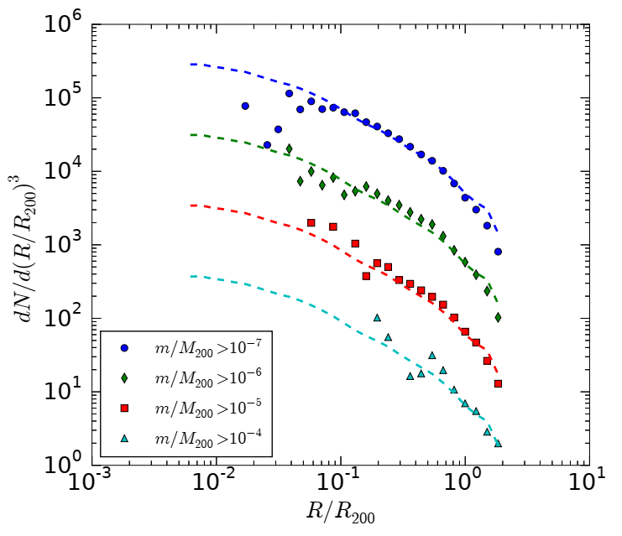
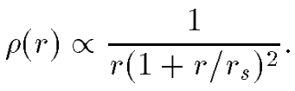



Halo: a fundamental unit
Universal Density Profile
Universal Subhalo Distribution
$$n(m,R)$$
$$n(m,R)$$
Navarro, Frenk, White 1996
Han et al. 2016
He, Han et al. 2023

Slide 19
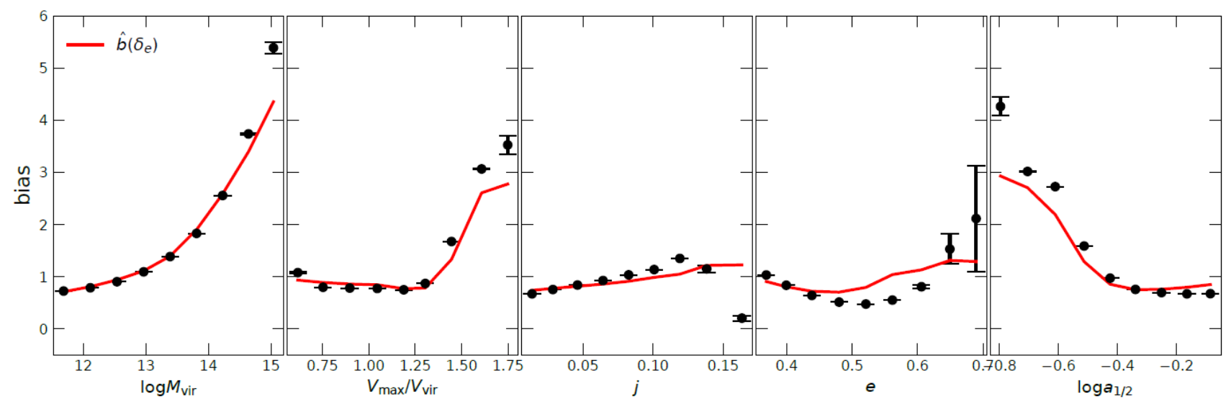
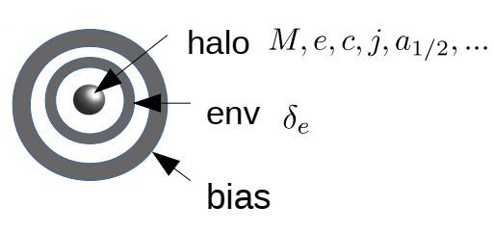
Beyond the virial model
The halo is much more extended
  Connects smoothly to the environment
  Virial radius encloses only the inner part
Environmental density as a powerful halo property to predict assembly bias
Han+ 2019

Slide 20
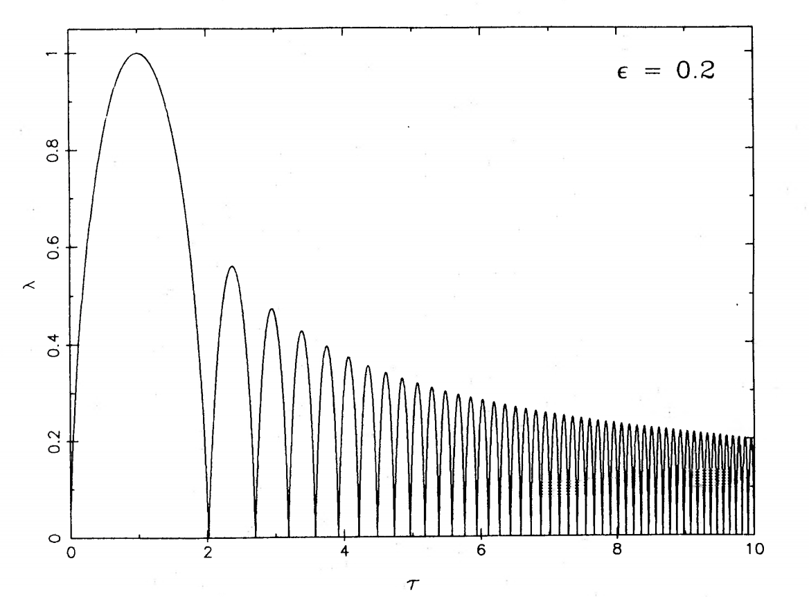


Beyond the virial model
The halo is much more extended
  Connects smoothly to the environment
  Virial radius encloses only the inner part
The halo is growing!
  Virial radius encloses only the quiescent part
  Deepening potential + expanding border
    splashback
Fillmore & Goldreich 1984
$$r/r_{ta}$$
$$t/t_{ta}$$

Slide 21

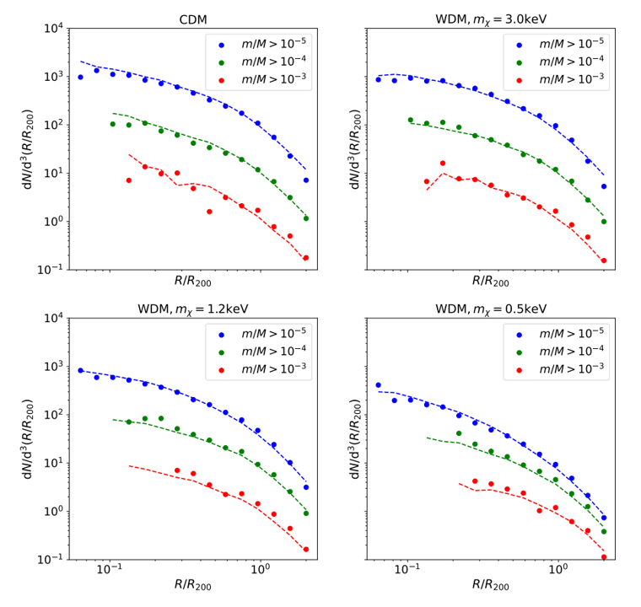
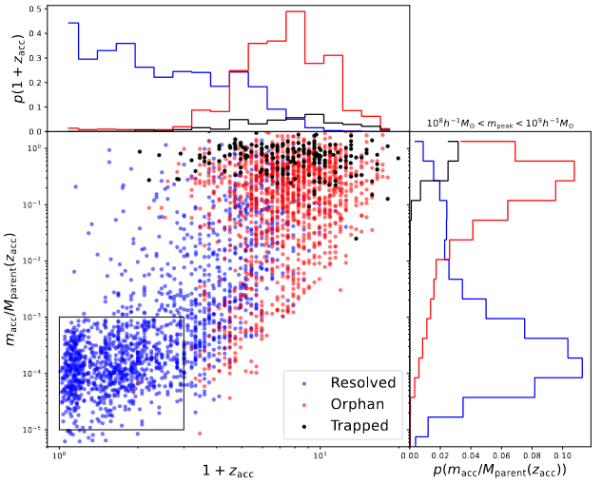
Feihong He
A unified analytical model for CDM/WDM subhalo distribution
Why artificial disruption is not a concern for current cosmological simulations
arxiv: 2309.01109
arxiv: 2408.04470

Slide 22
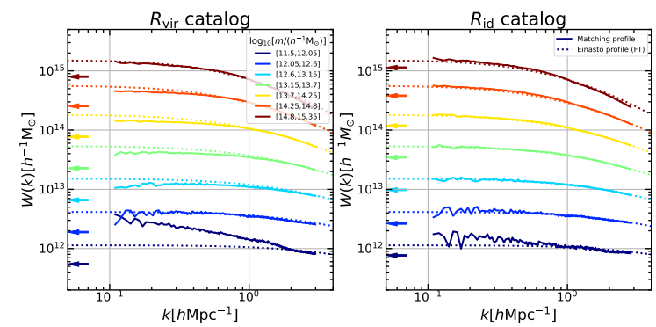

Density profile solution in Fourier space
Matter field=halo field $⊛$ halo profile
  Each halo catalog uniquely determines a matching density profile
Einasto profile matches the depletion radius

Slide 23
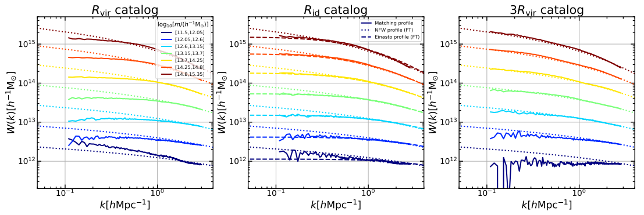
Density profile solution
NFW profile requires much larger halo boundary (and much fewer low mass halos)

Slide 24
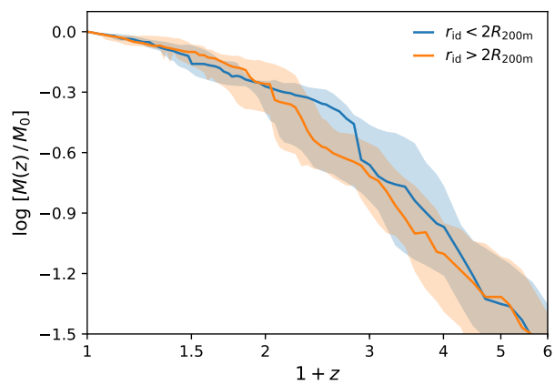
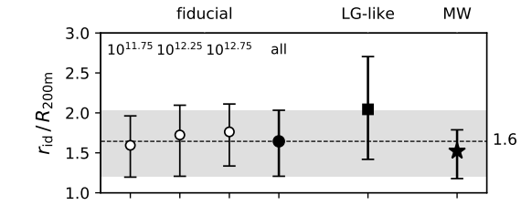
Measuring the depletion radius in our MW
  detected at ~2σ for our MW
  Slight inconsistency with virial radius measurement
  Measured depletion to virial ratio (~1.6）in slight tension with LG-analogies in Illustris
Li & Han 2021, ApJL
  Hints for unique growth history of the MW?

Slide 25
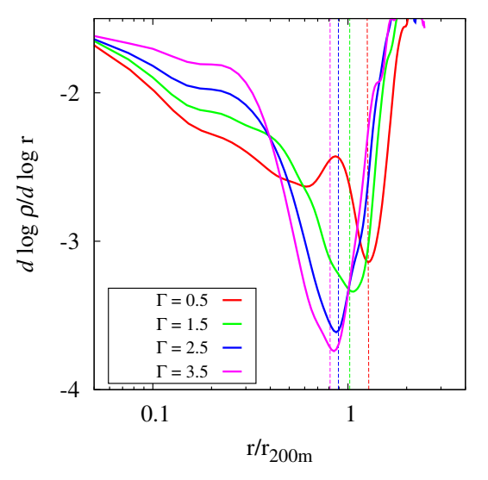
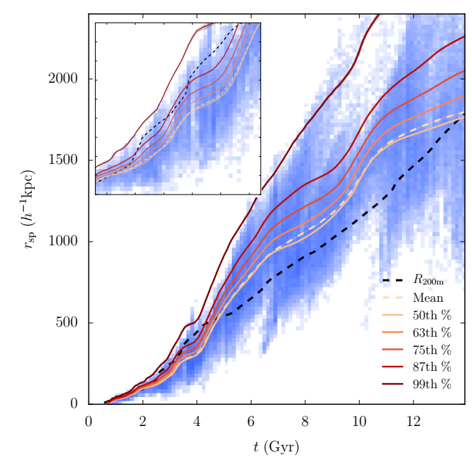
Splashback radius
Pros:
  A dynamical characterization of halo
  Sensitive to halo growth rate: new window to observe halo
Cons:
  Wide distribution in splashback radius of different particles
  Ambiguity in defining the splashback radius
  Density slope difficult to measure
Adhikari et al. 2014
Diemer et al. 2017

