Slide 1
The Dependence of Depletion Radius on Mass Accretion Rate
Jiale Zhou, Shanghai Jiao Tong University
Supervisor: Jiaxin Han
2025.5.26

Slide 2
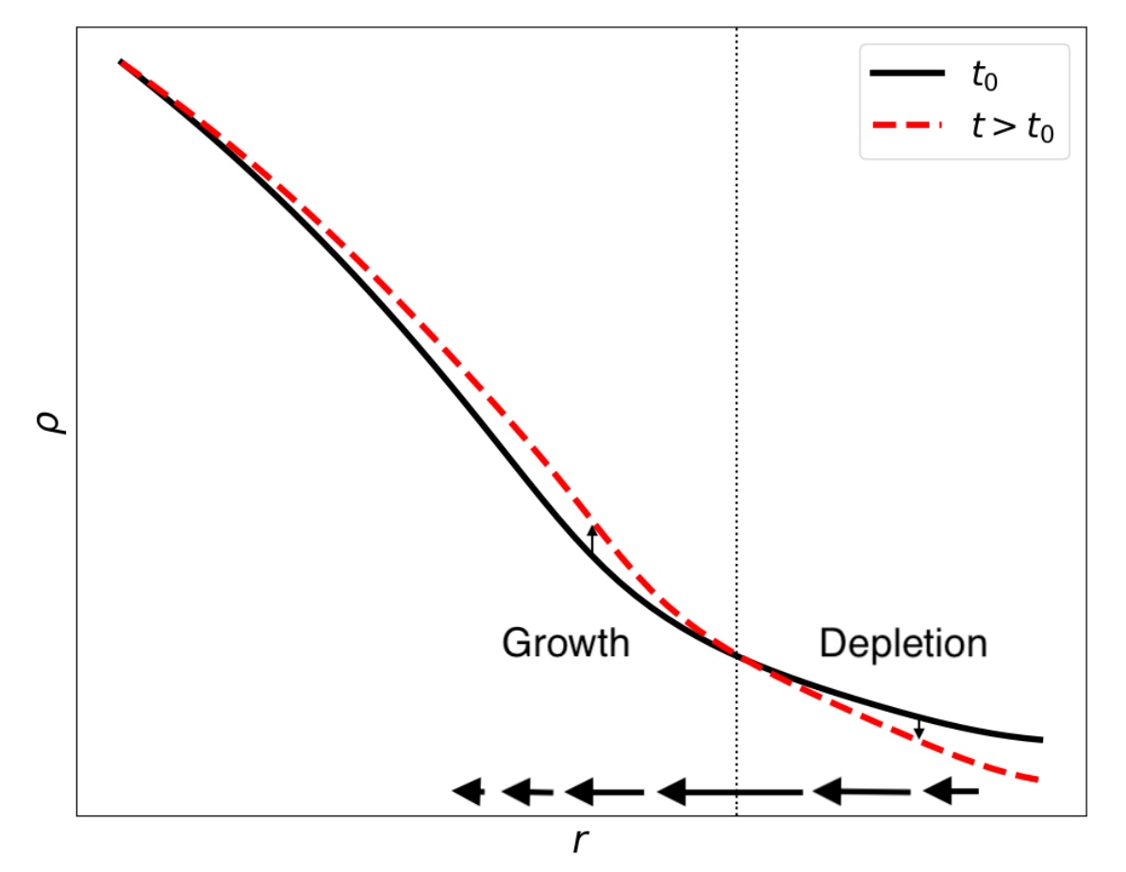
Depletion Radius: Definition
Fong & Han. 2021
Continuity equation:
$$\frac{∂ρ(r,t)}{∂t}=−\frac{1}{4πr^{2}}\frac{∂MFR(r,t)}{∂r}$$
Mass Flow Rate:
$$MFR\left(r\right)≡\frac{dM(<r)}{dt}=4πr^{2}ρ\left(r\right)v_{r}\left(r\right)$$
$$\frac{∂ρ(r,t)}{∂t}=0$$
$$\frac{∂MFR(r,t)}{∂r}=0$$
R_{id}: inner depletion radius,
What determines R_{id}?

Slide 3
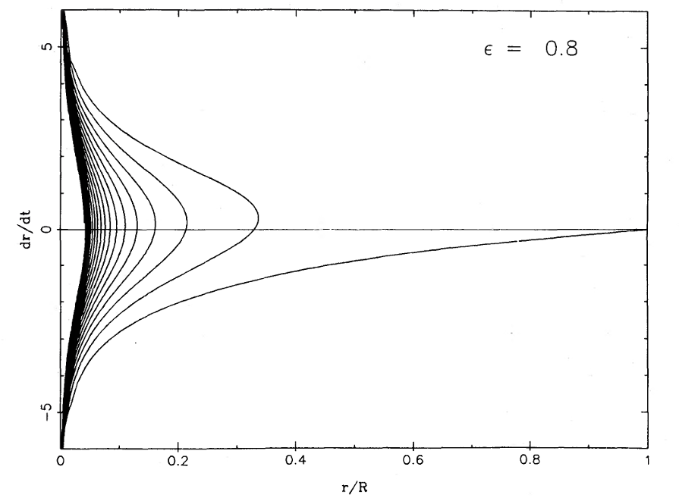
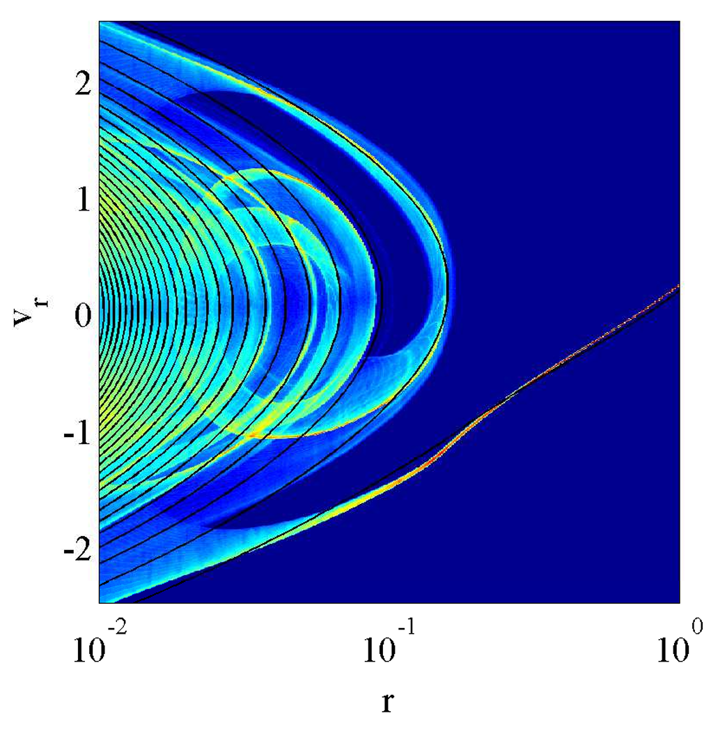
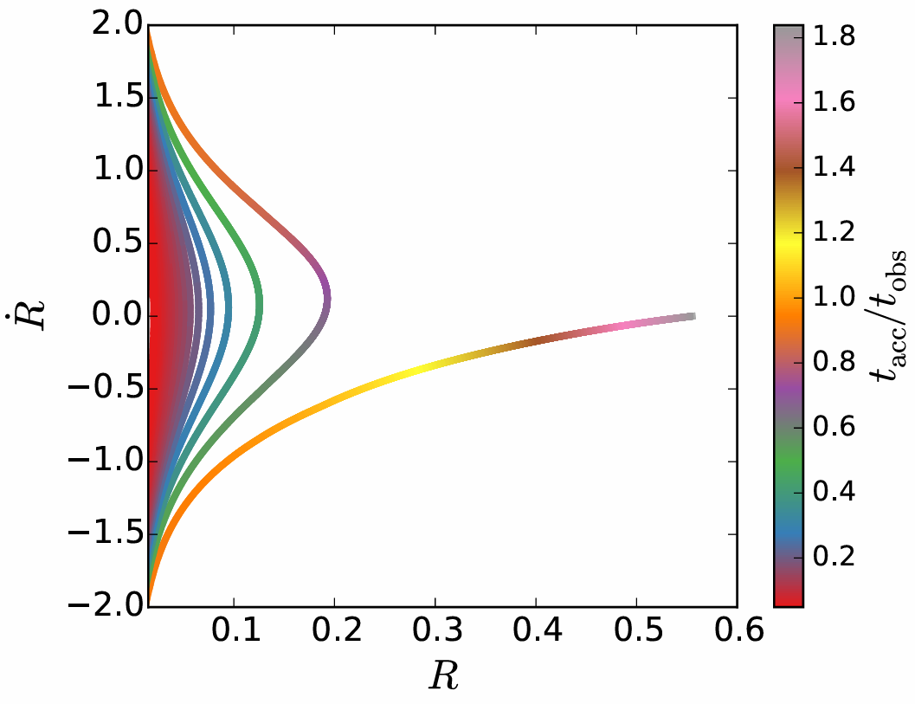
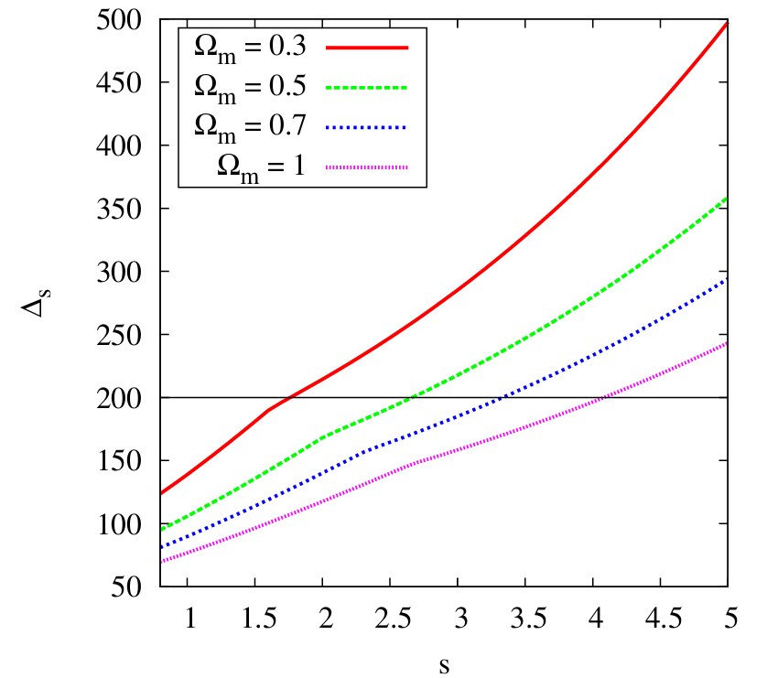
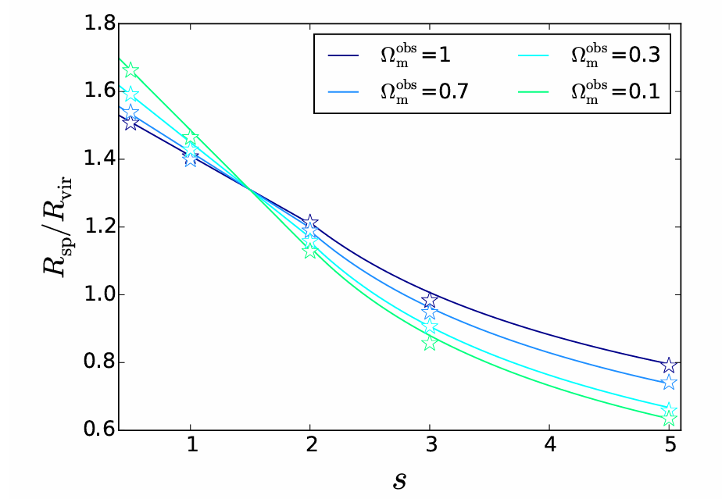
Depletion Radius: Theoretical Expectations
Fillmore & Goldreich 1984 Adhikari et al. 2014 Shi 2016
Self-similar spherical collapse model
R_{caustic}/R_{vir} only depends on s and $Ω_{m}$
s : initial profile → mass accretion rate
$Ω_{m}$: → redshift dependence

Slide 4
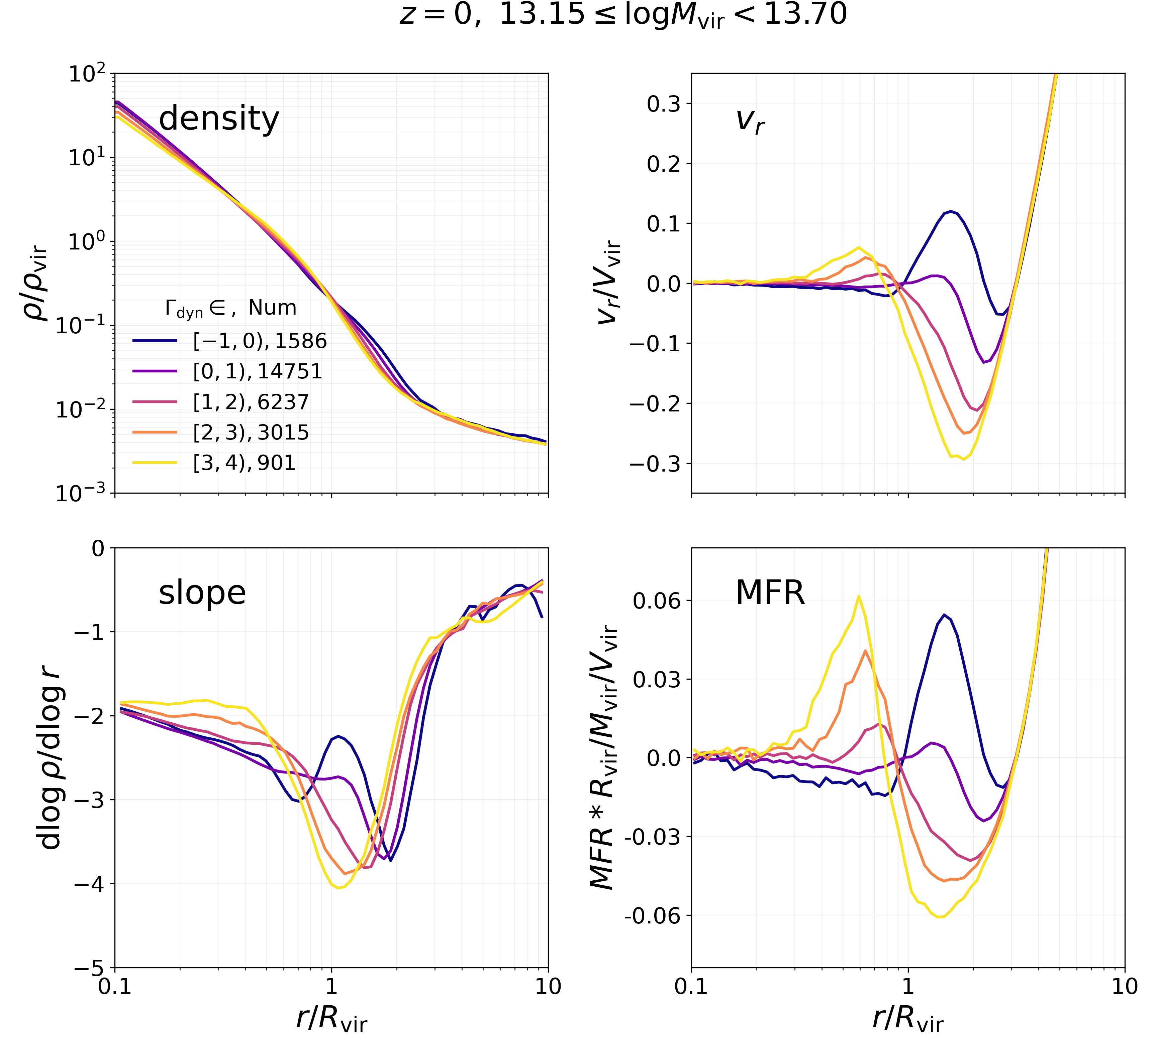
Depletion Radius in Simulation
Data:
Dark matter only simulation
Cosmic Growth, Jing. 2019
Mass accretion rate:
$$Γ=\frac{ΔlogM_{vir}}{Δloga}$$
(Diemer & Kravtsov. 2014)
in a dynamical time interval:
$$t_{dyn}=2\frac{R_{vir}}{V_{vir}}∝\frac{1}{\sqrt{Gρ_{vir}}}$$
higher Γ

Slide 5
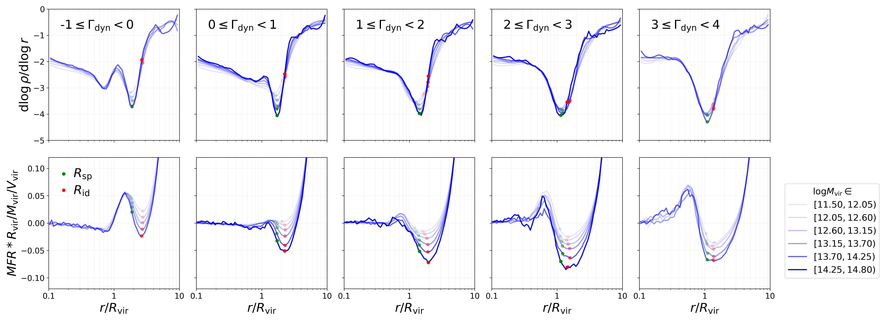
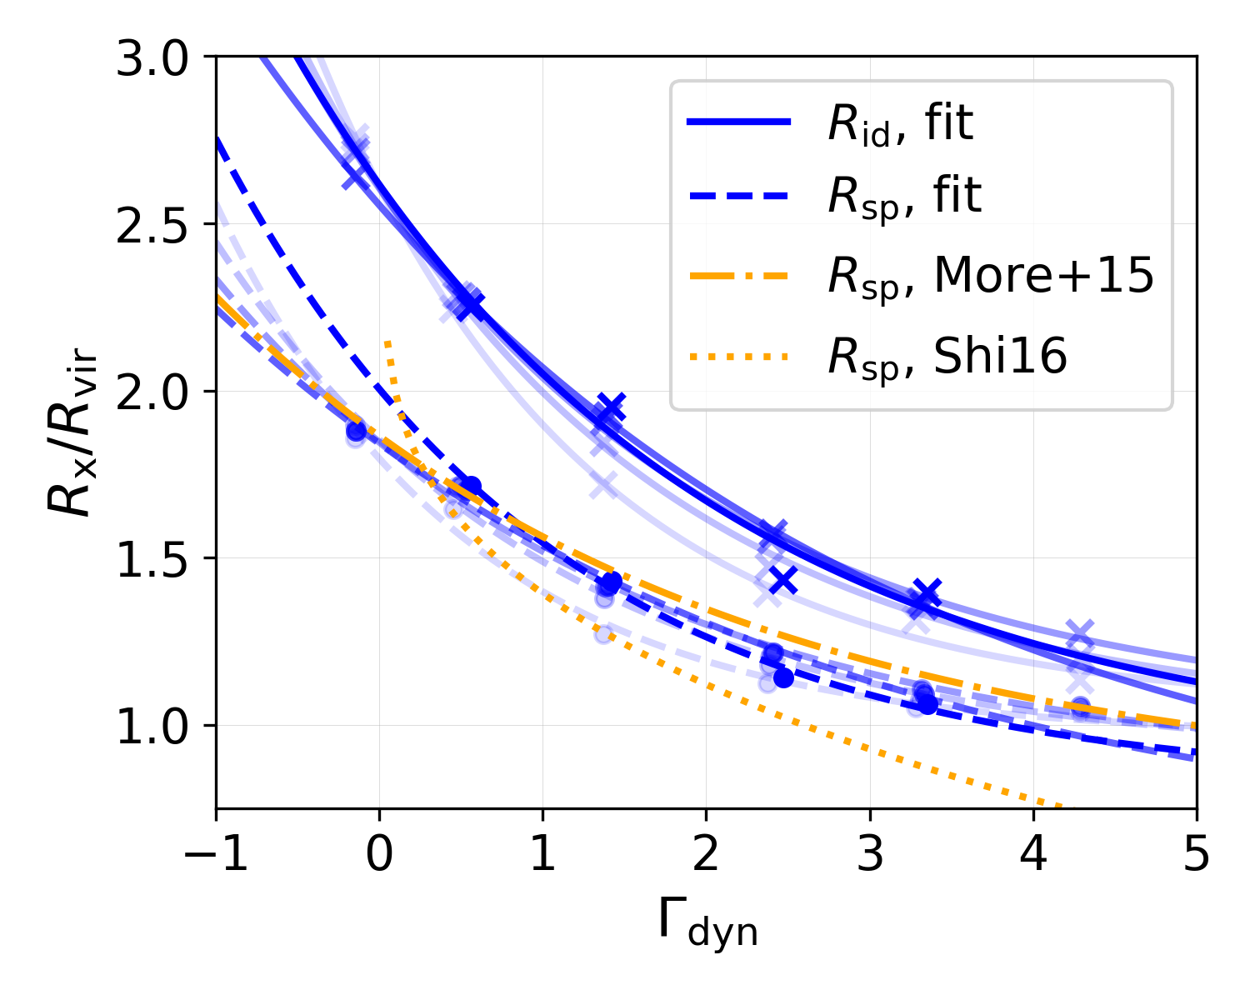
Dependence on Mass
higher Γ
slope
MFR
Fitting function:
No significant dependence on the virial mass
More, Diemer & Kravtsov. 2015

Slide 6
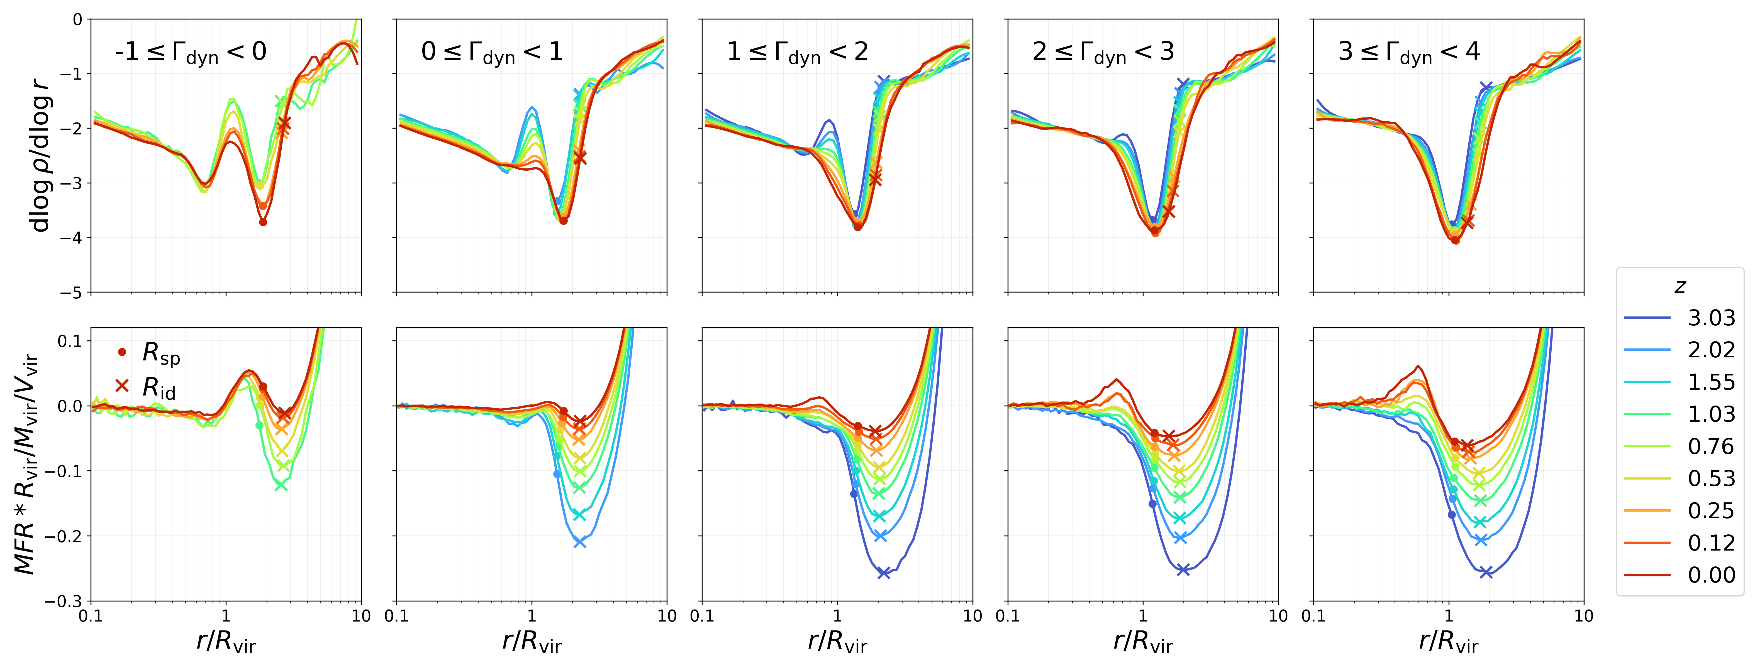
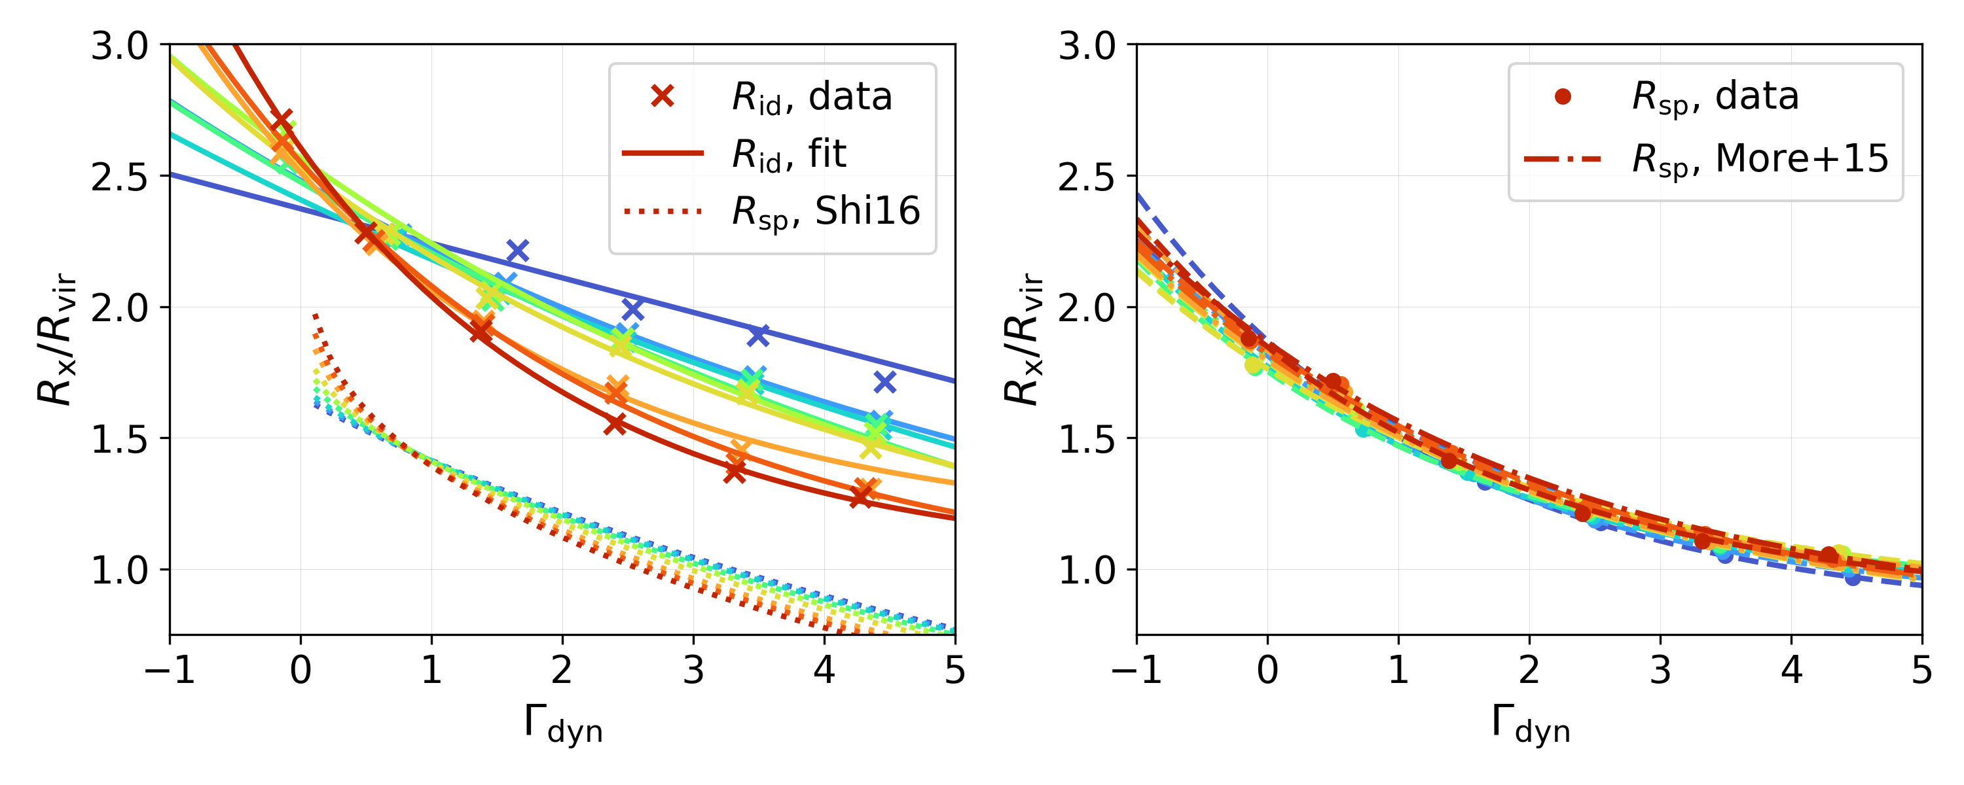
Dependence on Redshift
higher Γ
slope
MFR
R_{id}/R_{vir}: a strong dependence on redshift,
higher redshift → weaker dependence on Γ
the trend is similar to the predictions of Shi 2016.
R_{sp}/R_{vir} : largely independent of redshift

Slide 7
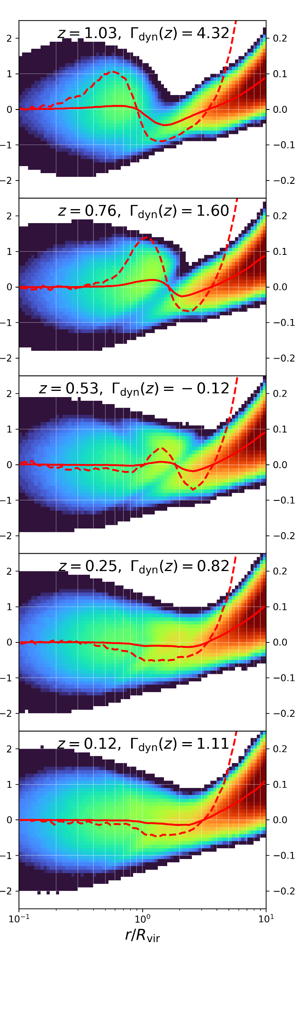
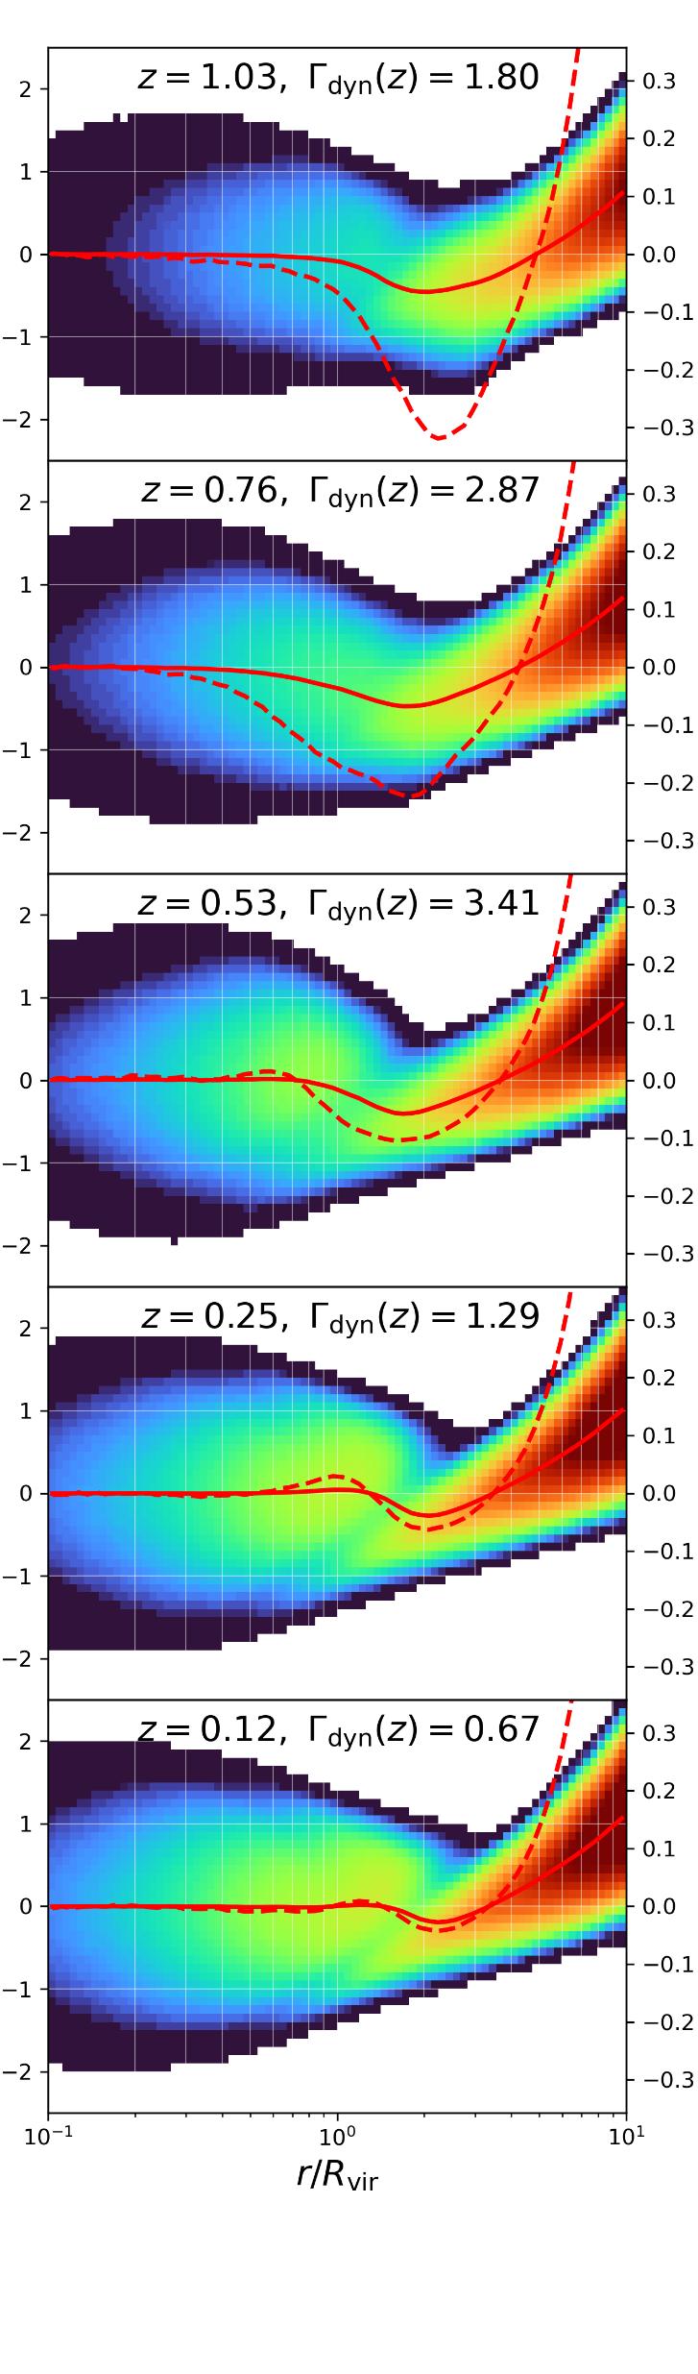
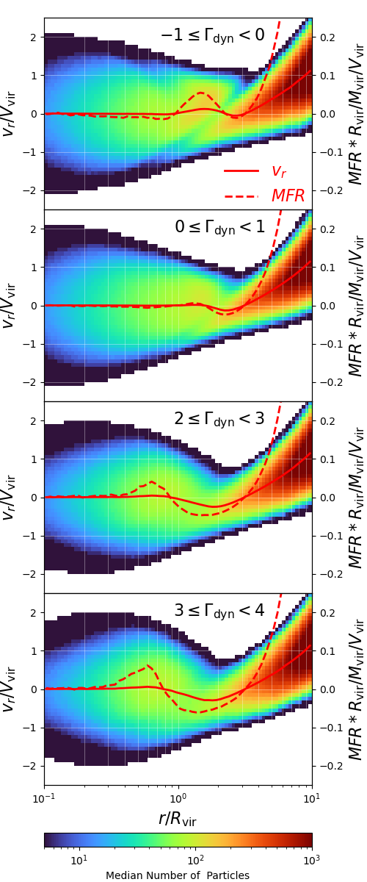
What derives the dependence?
t₀-1t_{dyn}
Evolution in phase-space
higher Γ
t₀
low Γ
high Γ
t₀+1t_{dyn}

Slide 8
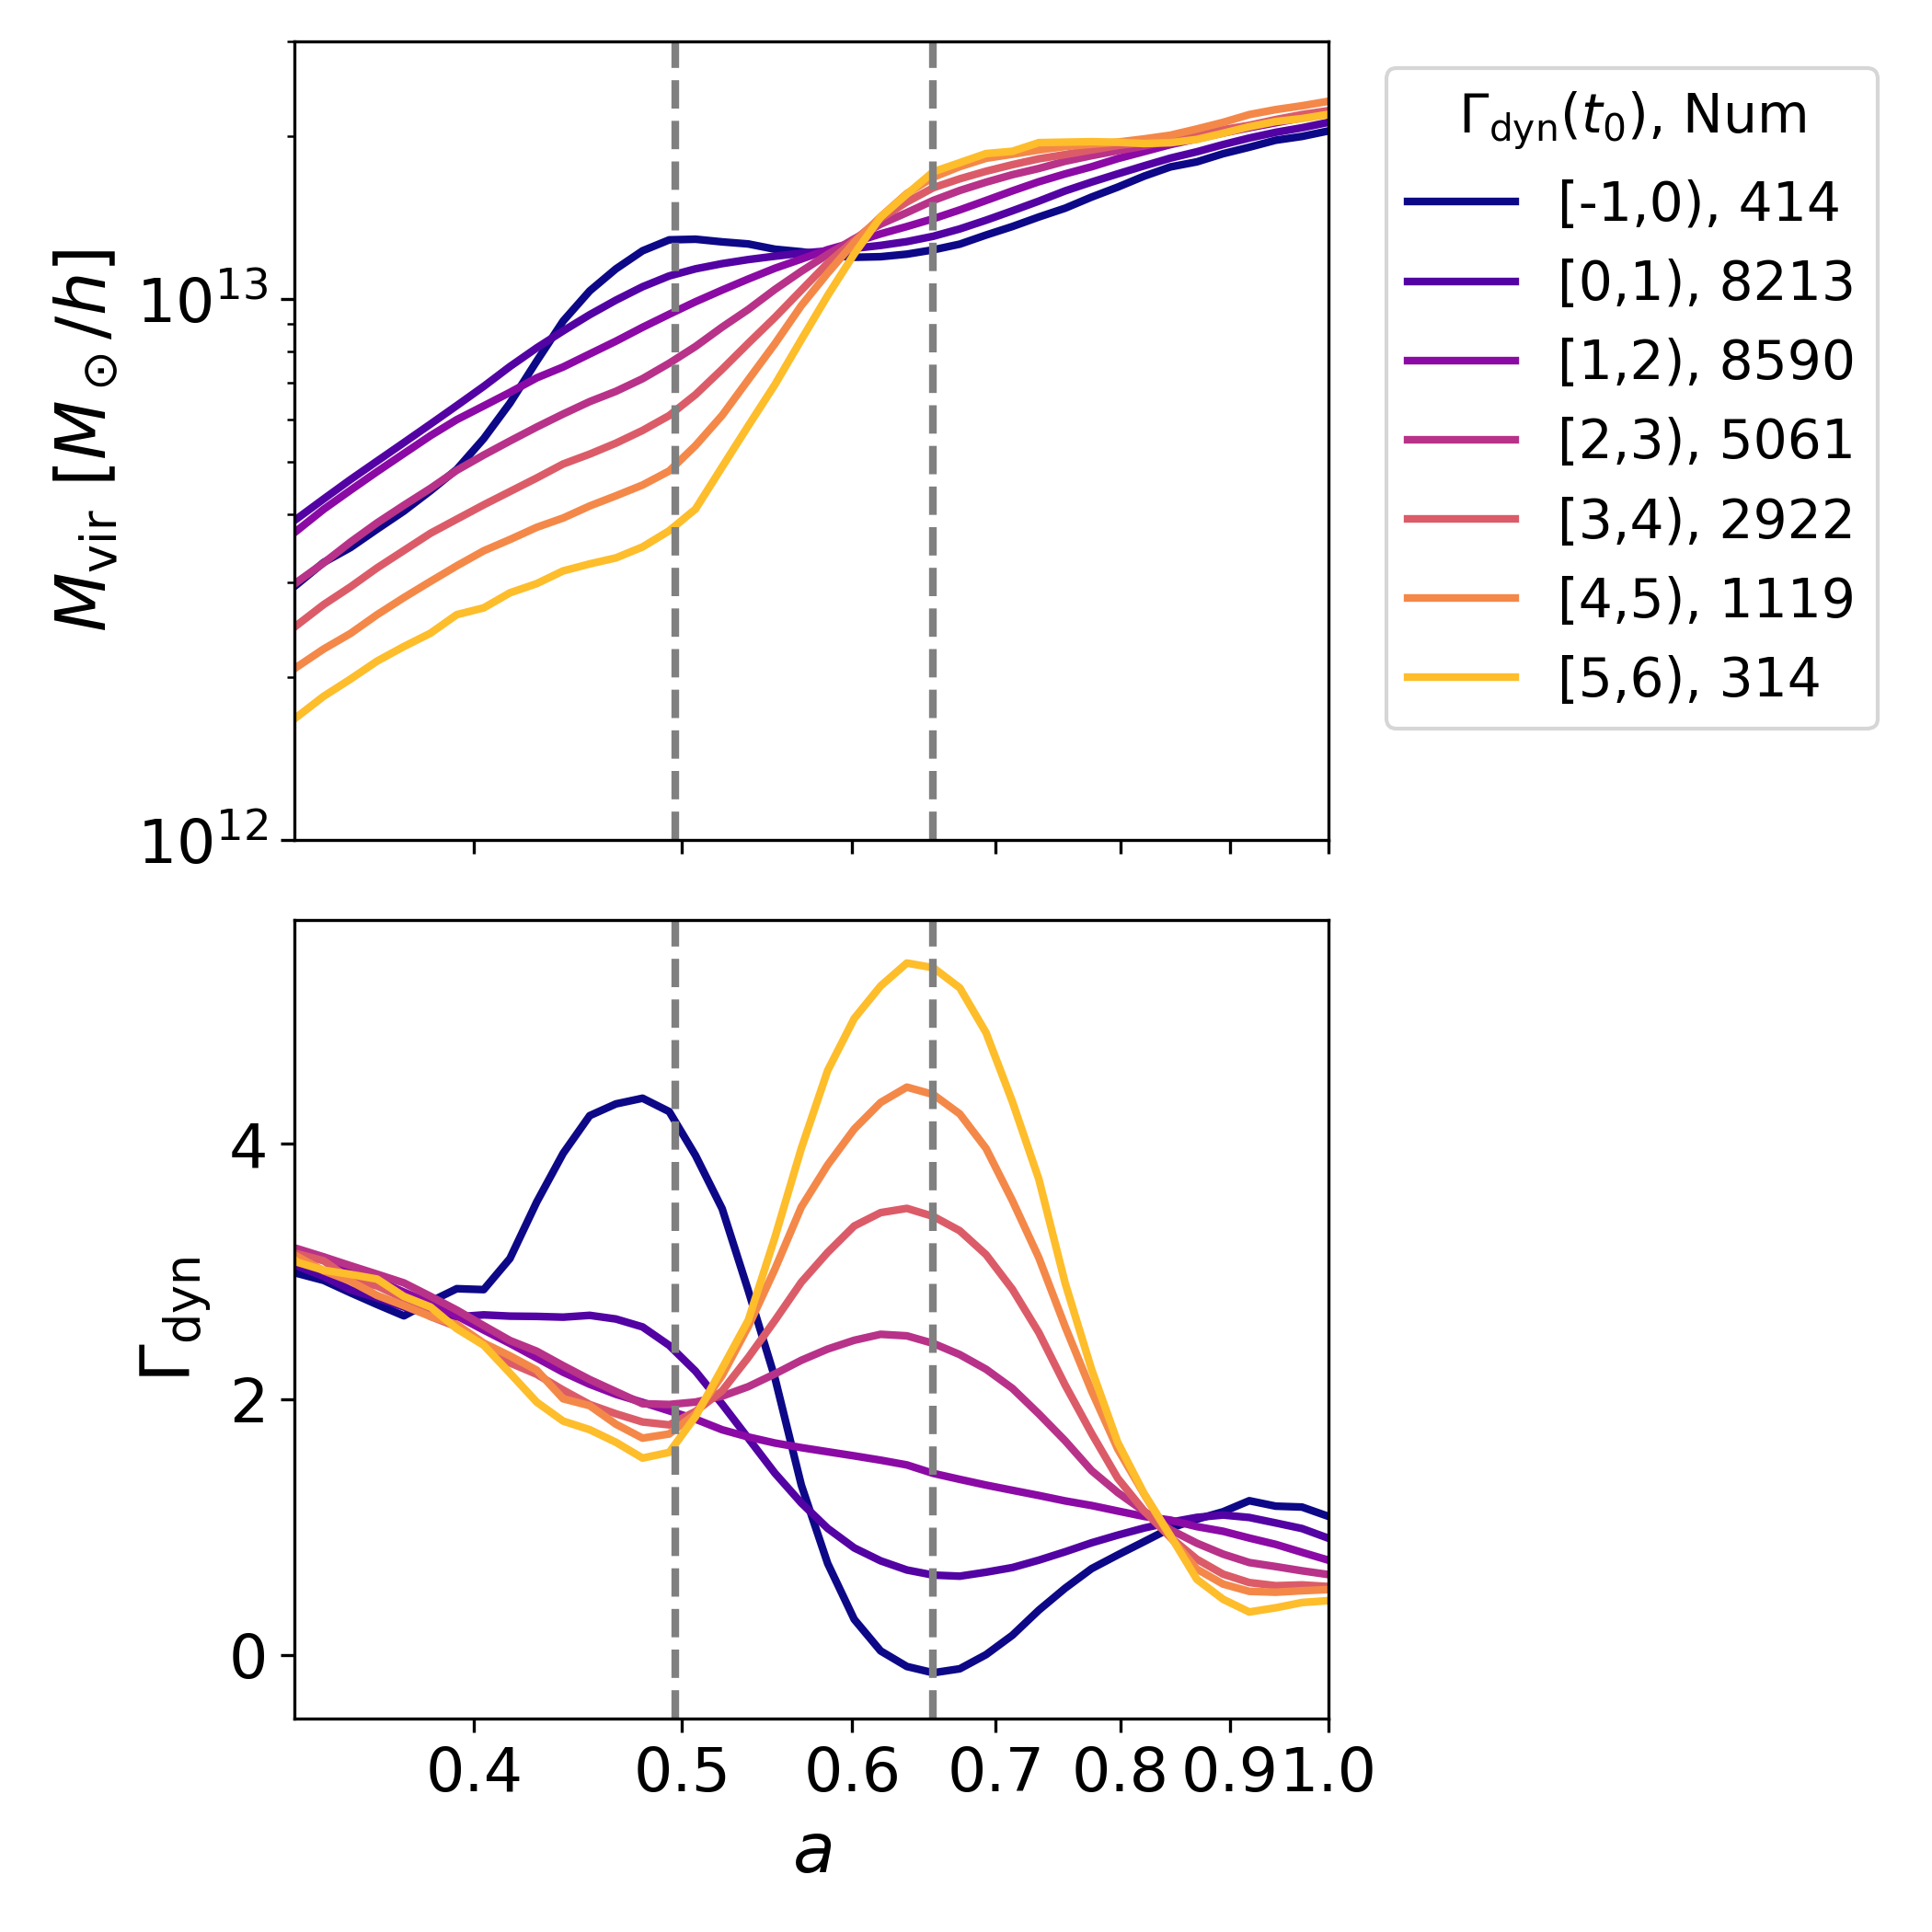
What derives the dependence?
Mass evolution for different Γ bin
t₀-1t_{dyn}
t₀-1t_{dyn} t₀
Evolution in phase-space
t₀
low Γ
high Γ
Dependence on Γ_{vir}
accretion state of halo, transient
M_{vir} is not a good enough proxy for
evaluating accretion rate
t₀+1t_{dyn}

Slide 9
Contribution to the R_{id} Feature -- Low Γ case
R_{vir}
density
radial velocity
smooth particles’ R_{id} ~ R_{vir}
stripped particles
splashing out of R_{vir}

Slide 10
Contribution to the R_{id} Feature -- High Γ case
R_{vir}
density
radial velocity
smooth particles’ R_{id} ~ R_{vir}
stripped particles
have not yet exceeded R_{vir}

Slide 11
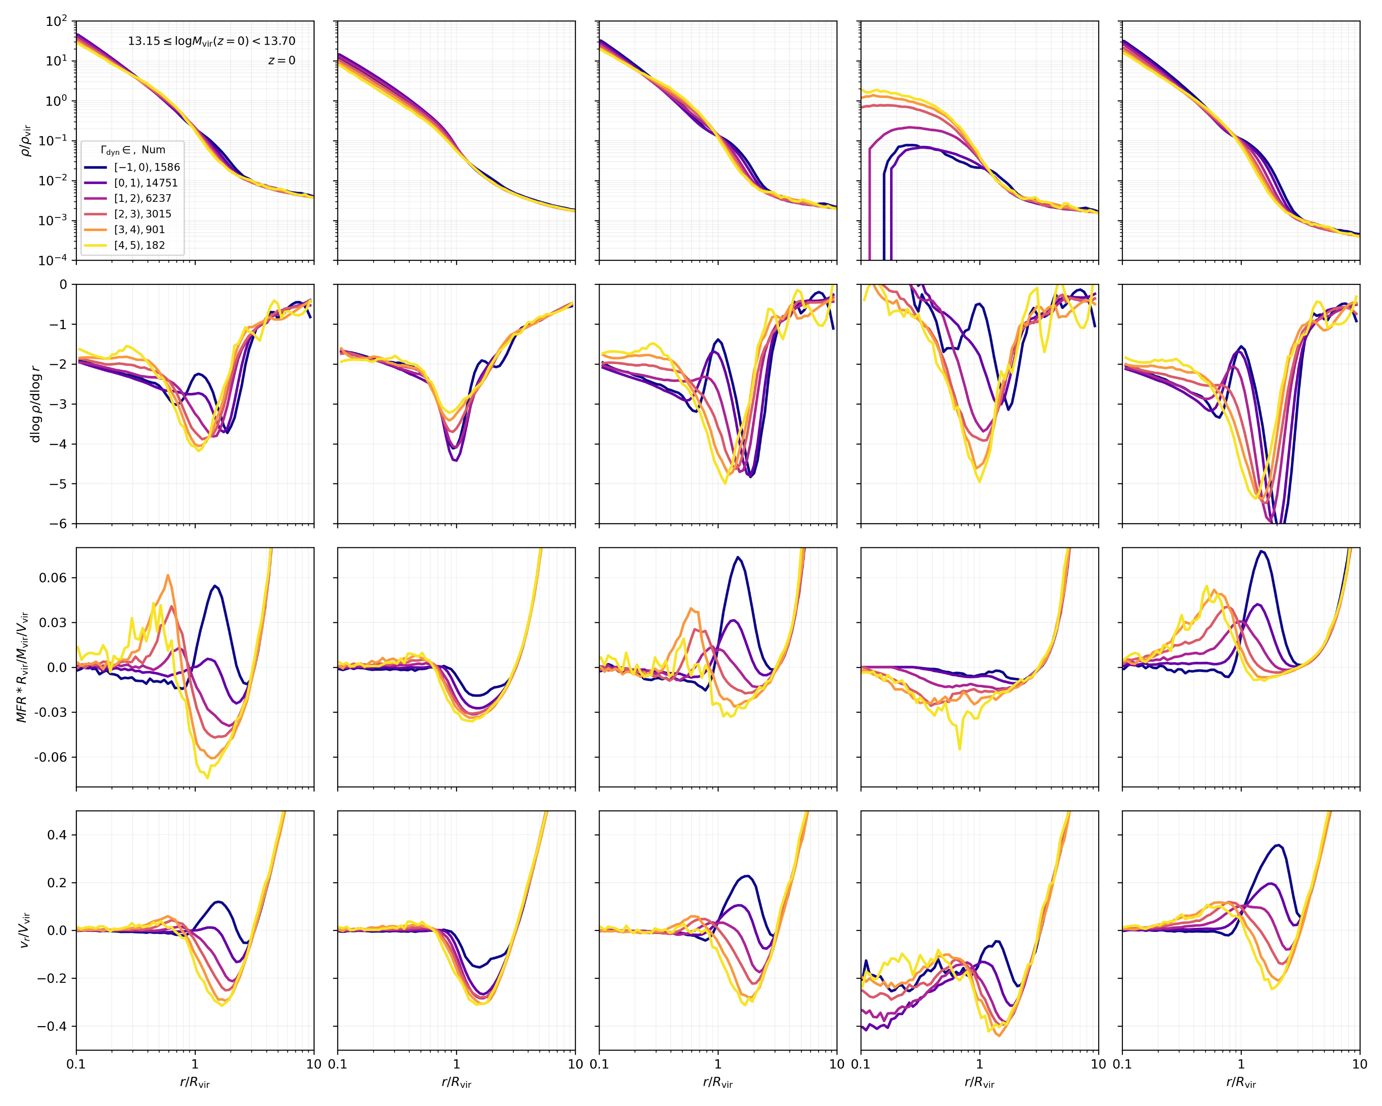
all particles smooth accretion unsmooth accretion bound particles stripped particles
density
slope
Depletion feature mostly
comes from:
unsmooth accretion
→ subhalo merger
MFR
v_{r}

Slide 12
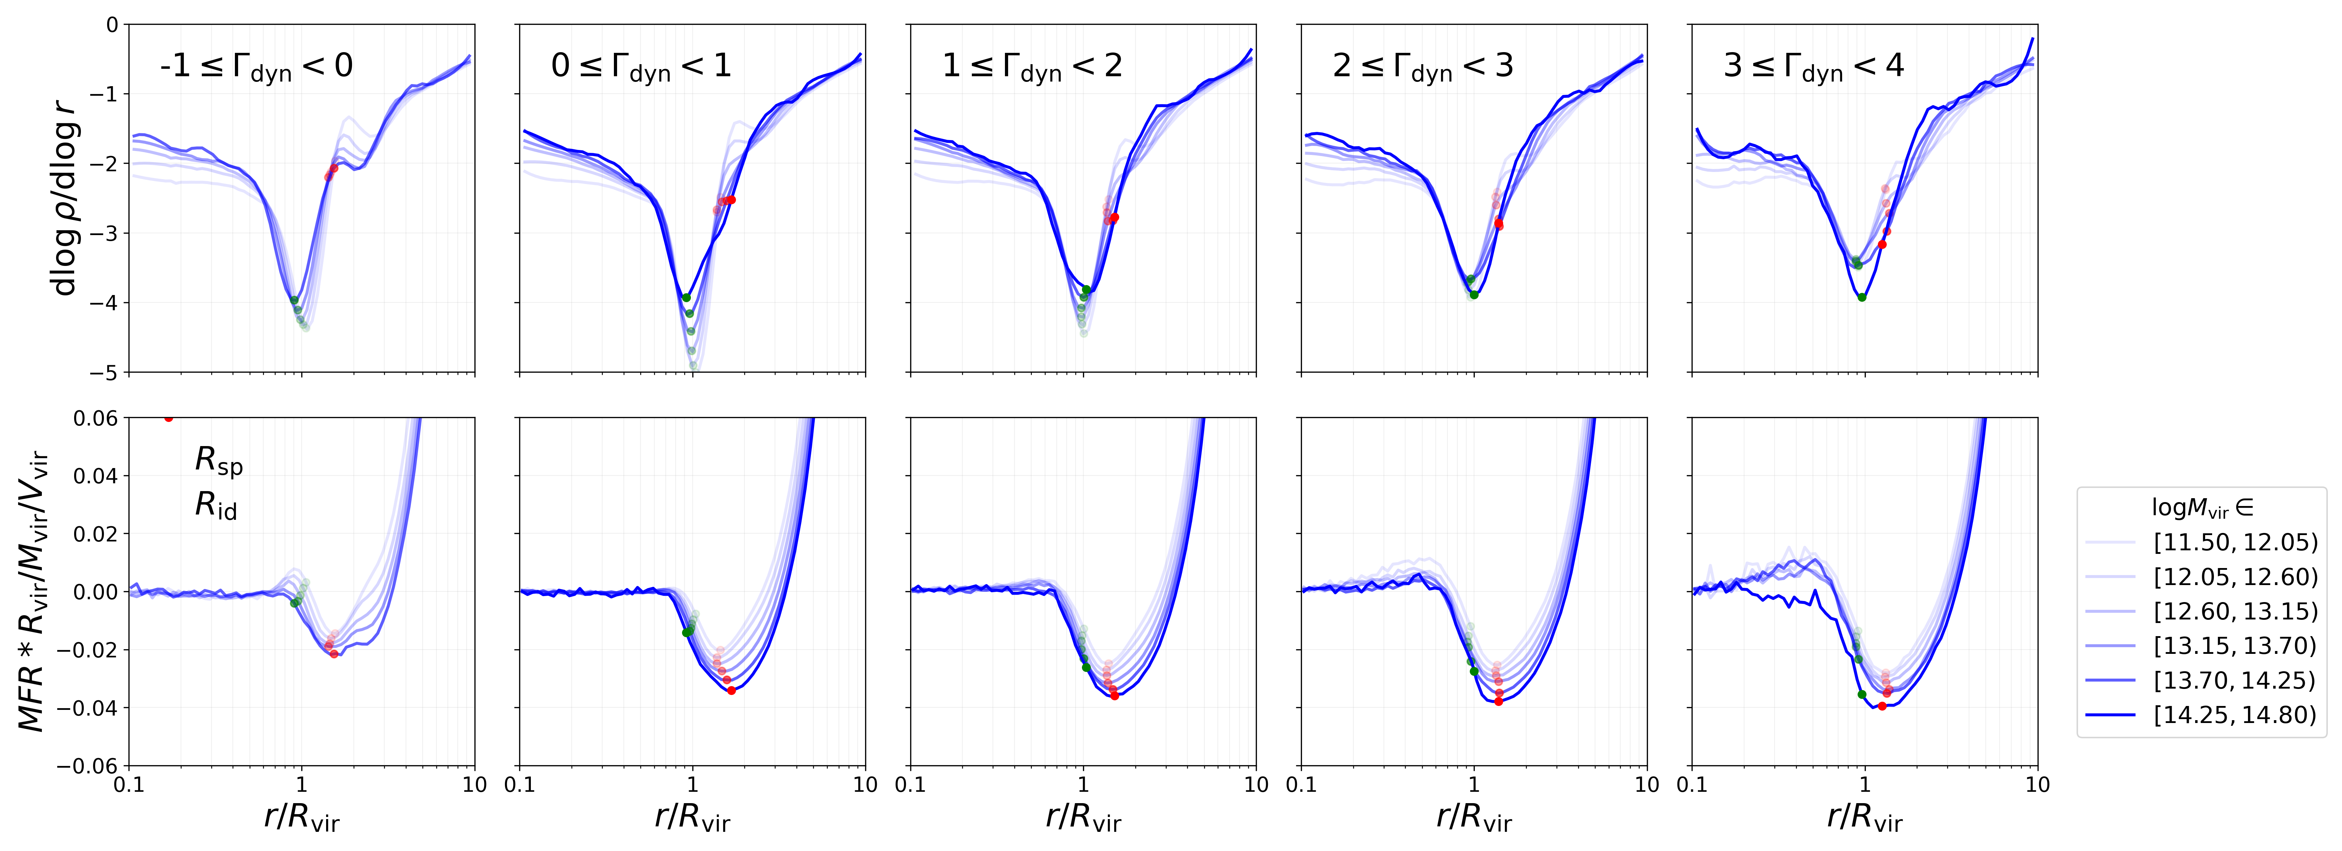
Dependence on Mass
higher Γ
slope
MFR
highly self-similarity

Slide 13
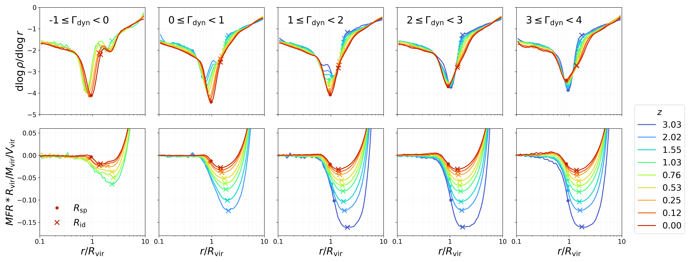
Dependence on Redshift
higher Γ
slope
MFR
R_{id}/R_{vir}: still exhibits a strong dependence on redshift,
R_{sp}/R_{vir} : largely independent of redshift

Slide 14
Summary
The depletion radius depends majorly on $Γ$, independent of halo mass, similar to splashback radius. higher $Γ$ → smaller R_{id}/R_{vir};
The depletion radius also depends on redshift,
higher z → larger R_{id} , weaker dependence on Γ;
The dependence on Γ is actually on the transient accretion state of halo. M_{vir} is not a good proxy for evaluating accretion rate;
The depeletion feature mostly comes from unsmooth accretion.
The smooth accretion component exhibits highly self-similarity.

Slide 15
Thanks!

