Slide 1
Modeling galaxy clustering with modified SHAM
Xiaoju Xu
Shanghai Normal University
Collaborators: Xiaohu Yang, Zhongxu Zhai, Yizhou Gu, Yirong Wang (SJTU)

Slide 2
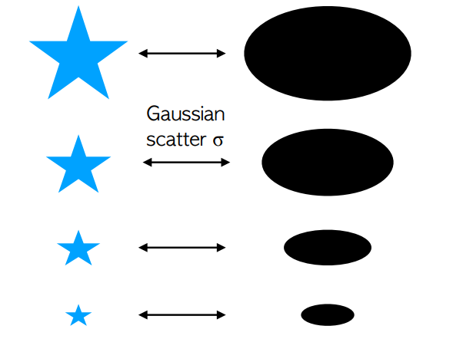
Subhalo abundance matching
Ranking galaxies and subhalos:
more massive/luminous galaxies occupy more massive subhalos
Sample Mstar from the observed cumulative stellar mass/luminosity function by matching to cumulative subhalo mass function:
n(>M*)=n(>M_{sub})
M_{star} or L
M_{peak} or V_{peak}
n(>M*)
n(>M_{sub})
Cumulative stellar mass function
Cumulative subhalo mass function
M*
M_{sub}

Slide 3
Modeling galaxy clustering with modified SHAM
What can SHAM do
Connecting galaxies to subhalos and fit galaxy clustering:
fewer parameters, larger stellar mass range
Produce mock catalog for future observations
Constrain cosmology
Issues
Subhalo mass indicators (Mpeak, Vmax, Vpeak ...)
Underpredict on small scales (orphan galaxies?)
What we propose
Modified SHAM specifying satellite fraction
Constrain SHAM with mock lightcone catalog
Constrain SHAM with SAM and hydrodynamic simulation

Slide 4
Modeling galaxy clustering with modified SHAM
What can SHAM do
Connecting galaxies to subhalos and fit galaxy clustering:
fewer parameters, larger stellar mass range
Produce mock catalog for future observations
Constrain cosmology
Issues
Subhalo mass indicators (Mpeak, Vmax, Vpeak ...)
Underpredict on small scales (orphan galaxies?)
What we propose
Modified SHAM specifying satellite fraction
Constrain SHAM with mock lightcone catalog
Constrain SHAM with SAM and hydrodynamic simulation
depend on halo definition!

Slide 5
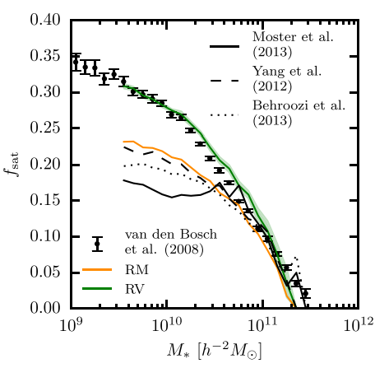
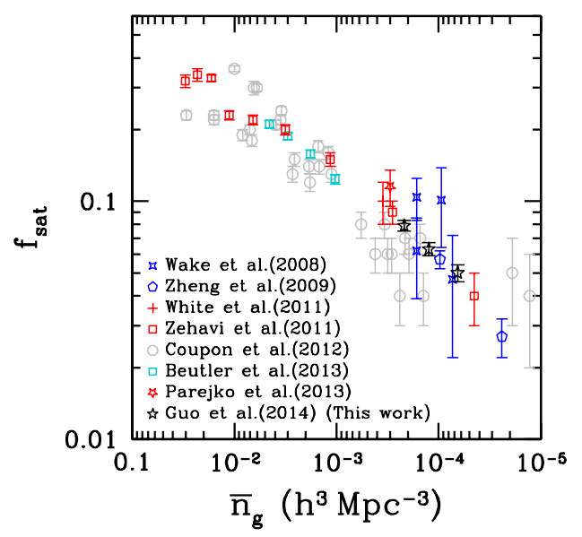
Satellite fraction in observation
Guo 2014
empirical models
satellite fraction
Campbell 2018
Wang et al. 2024
Group catalog (Yang 2021)

Slide 6
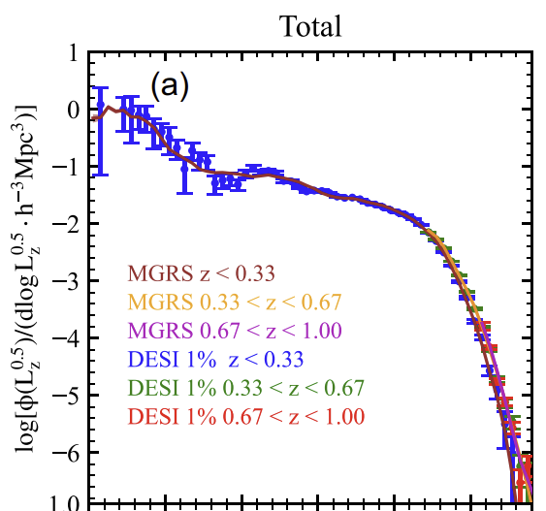
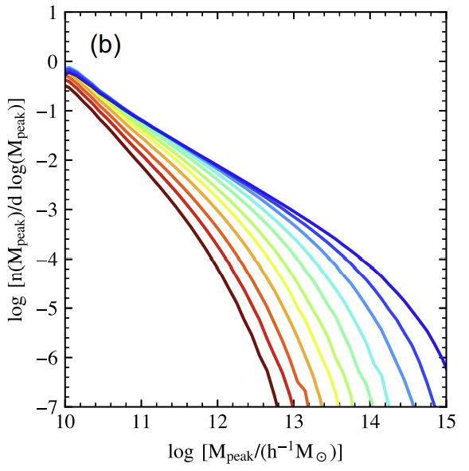
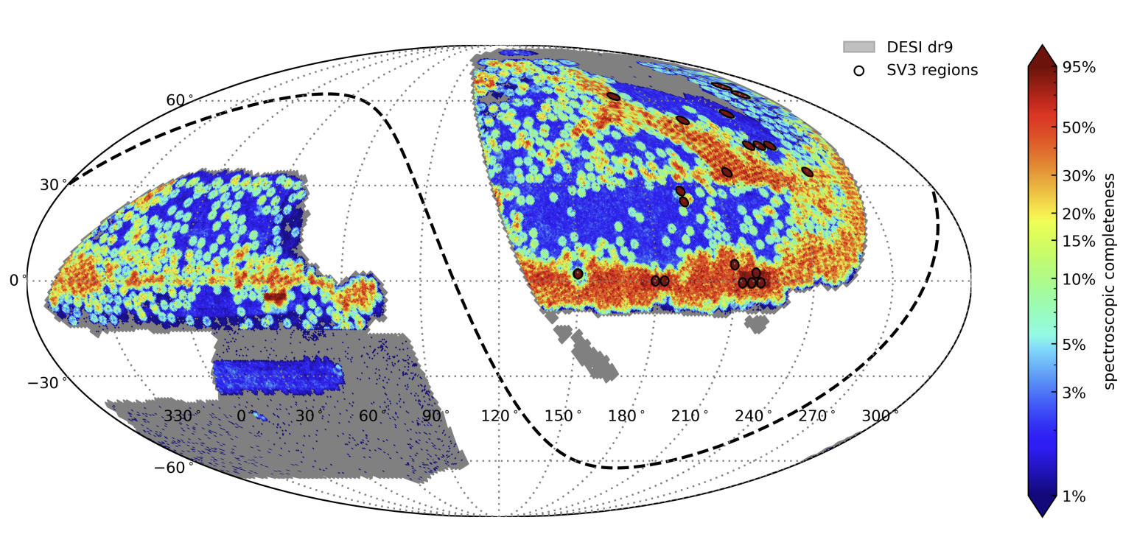
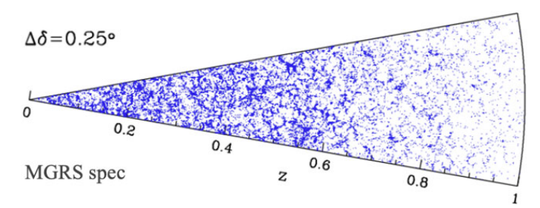
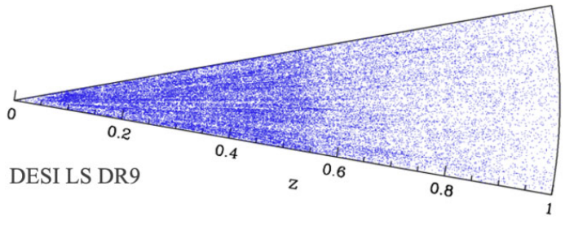
Mock galaxy catalog in lightcone
DESI DR9 and spec data
luminosity function Y1
Jiutian sub mass function
Wang et al 2024
Jiutian N-body simulation (Han et al 2025):
Planck 2018 cosmology
6144³ particles in 0.3, 1, 2 Gpc/h boxes
m_{p} = 3.723 × 10⁸ h⁻¹M_{sun}
Mock galaxy sample: SHAM with σ(logM_{z})
Gu et al 2024

Slide 7
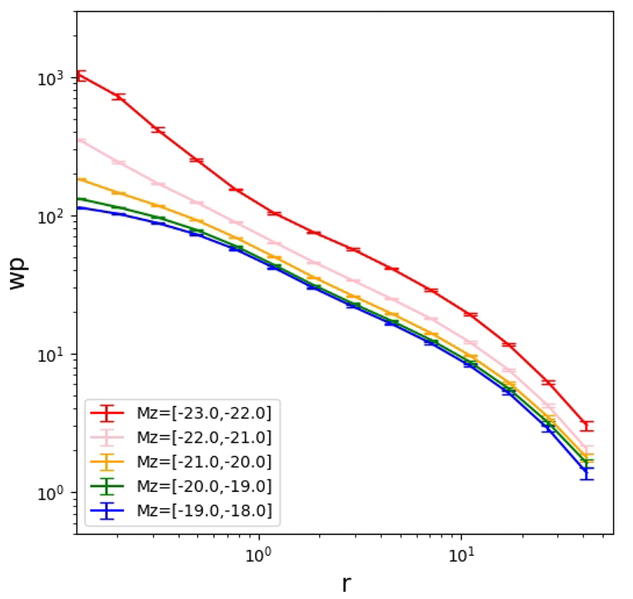
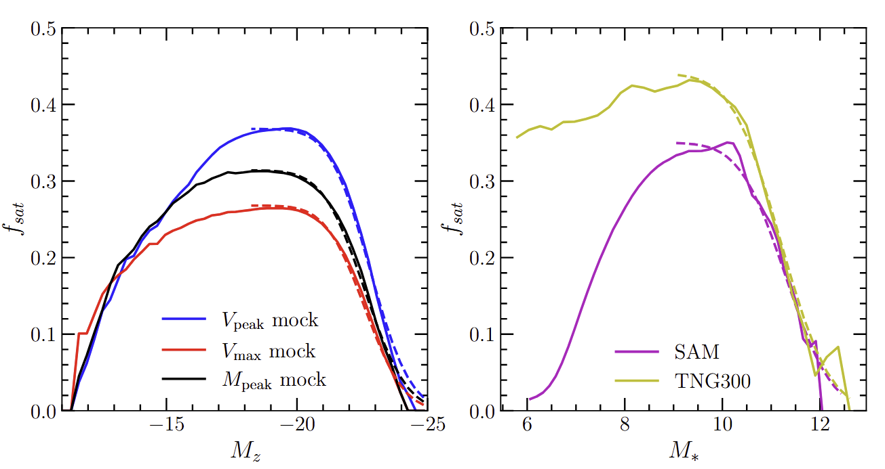
Mock sample clustering and fsat modeling
mock galaxy clustering
fsat parameterization
z=[0.1,0.3]
w_{p}
satellite fraction
Xu et al 2025 in prep.

Slide 8
Mock sample clustering and fsat modeling
mock galaxy clustering
fsat parameterization
z=[0.1,0.3]
f₃
w_{p}
satellite fraction
f₁
f₂
Xu et al 2025 in prep.

Slide 9
Mock sample clustering and fsat modeling
mock galaxy clustering
fsat parameterization
z=[0.1,0.3]
w_{p}
satellite fraction
fsat values as direct parameters
Xu et al 2025 in prep.

Slide 10
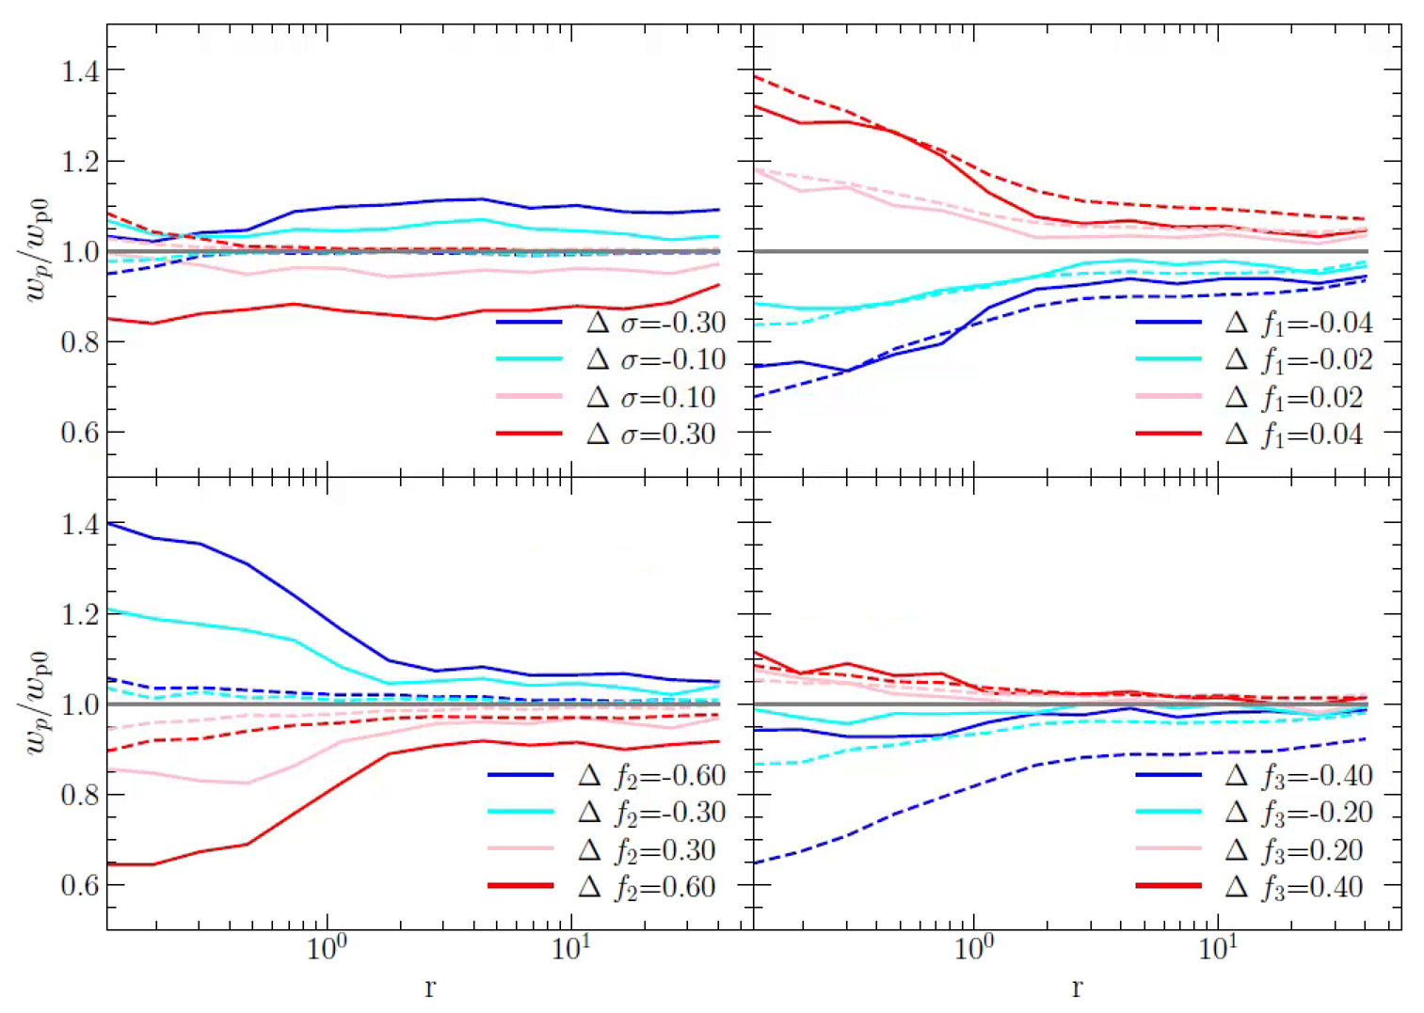
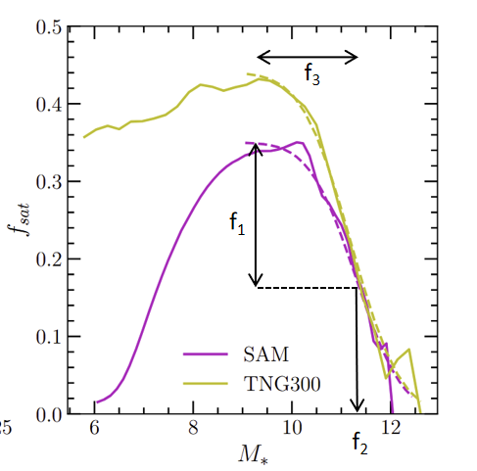
Effect of fsat parameters on galaxy clustering
solid: Mz=[-23,-22]
dashed: Mz=[-21,-20]
Xu et al 2025 in prep.

Slide 11
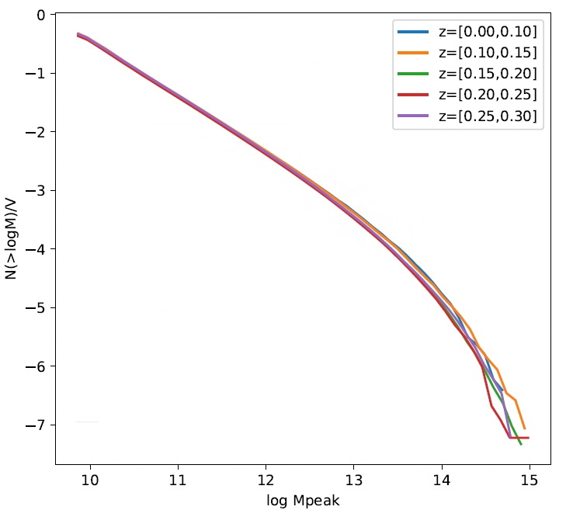
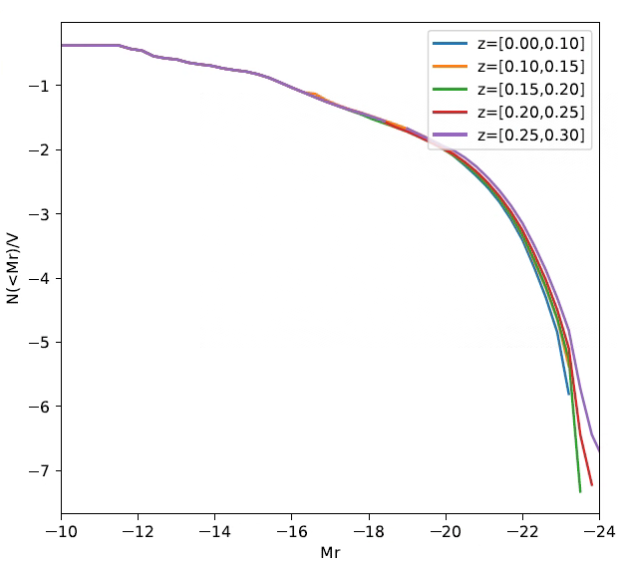
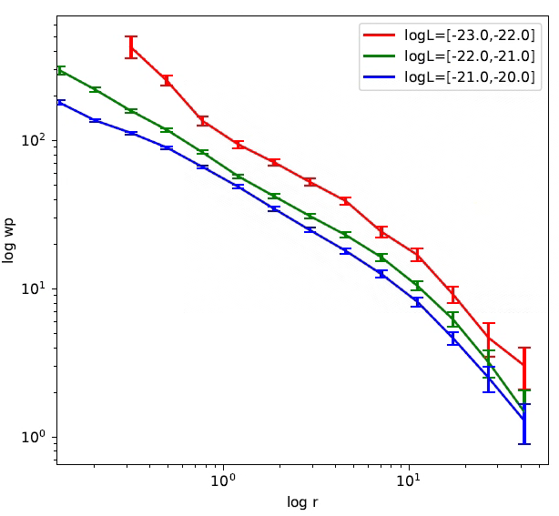
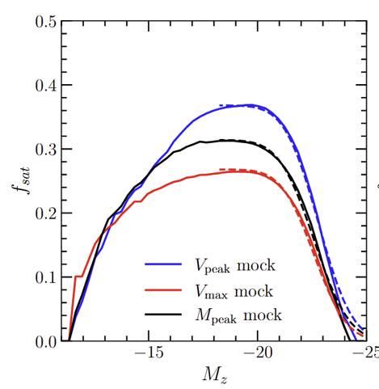
fsat SHAM model
SHAM galaxy catalog
Measure 2PCF wp
wp
Subhalo MF
(jiutian lightcone)
Galaxy LF
(DESI Y1, wang 2024)
central
satellite
r
fsat parameters
σ(M_{z}|M_{h})
accelerate mcmc
MCMC
Gaussian process emulator
512 set of params (4 or 5)
Best fit σ, f1, f2, f3 ……
Xu et al 2025 in prep.

Slide 12
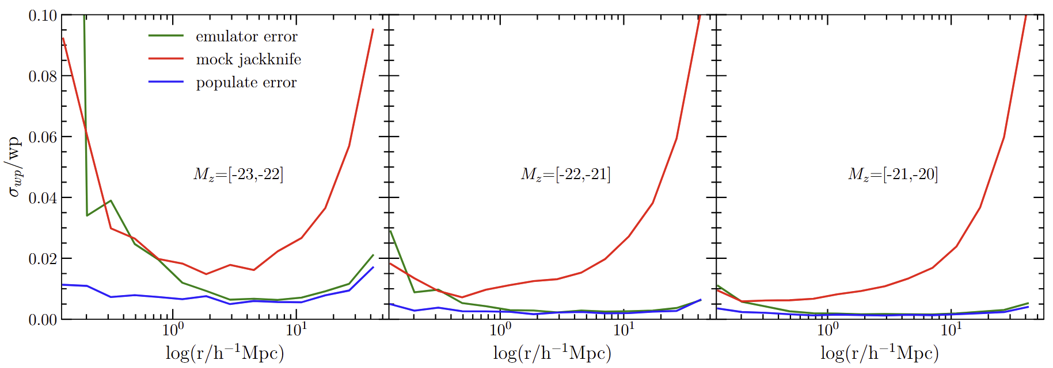
Emulator error
fractional emulator error
Xu et al 2025 in prep.

Slide 13
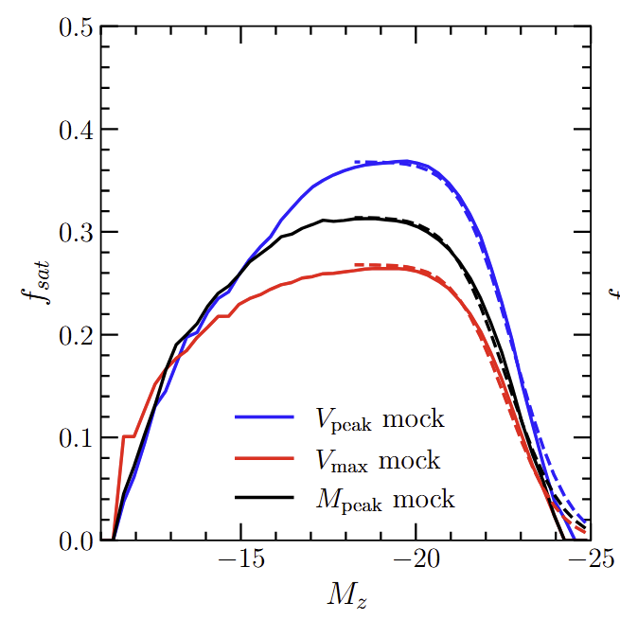
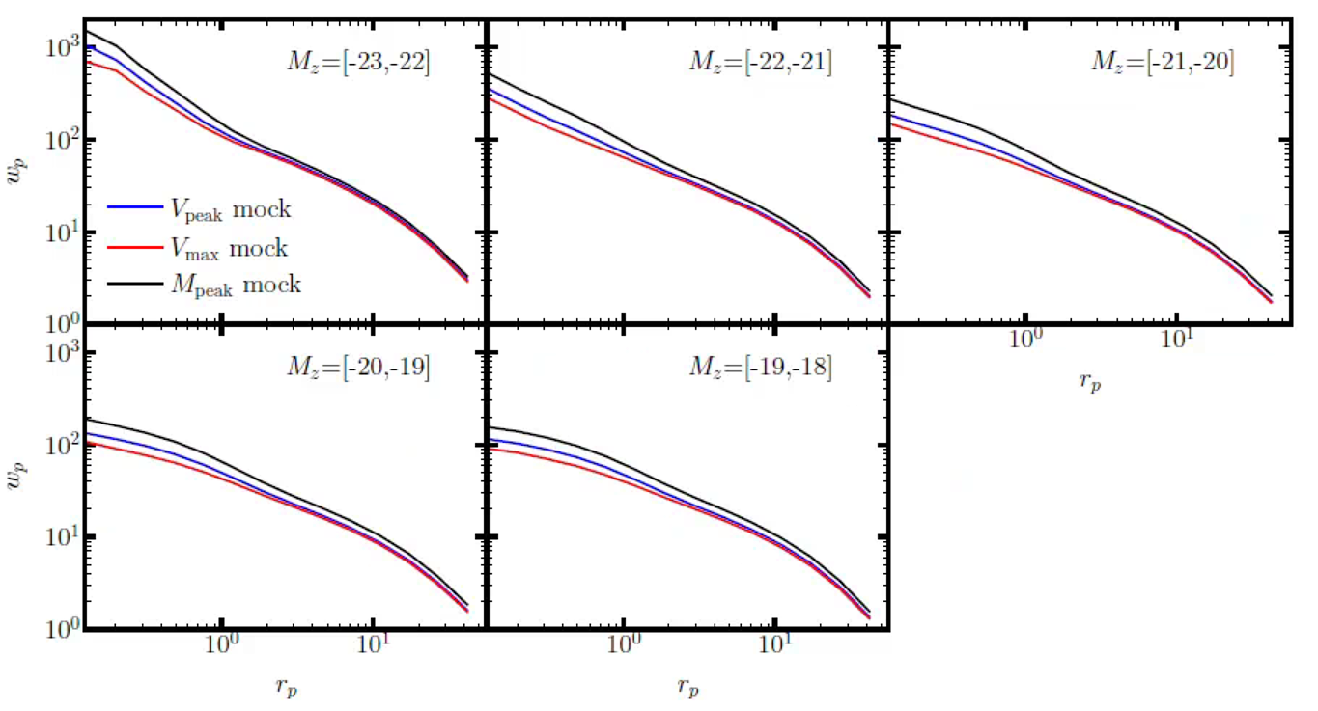
Different halo mass indicators for SHAM
Mpeak model
mock based on Mpeak
Vmax model
mock based on Vmax
Vpeak model
mock based on Vpeak
Xu et al 2025 in prep.

Slide 14
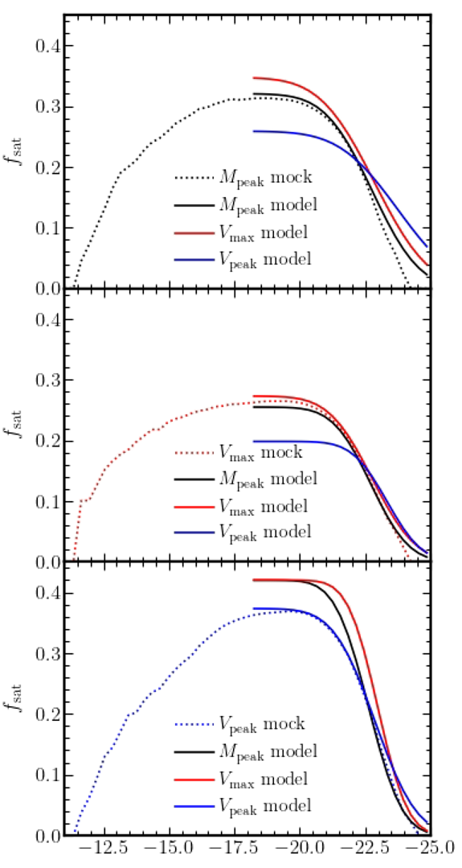
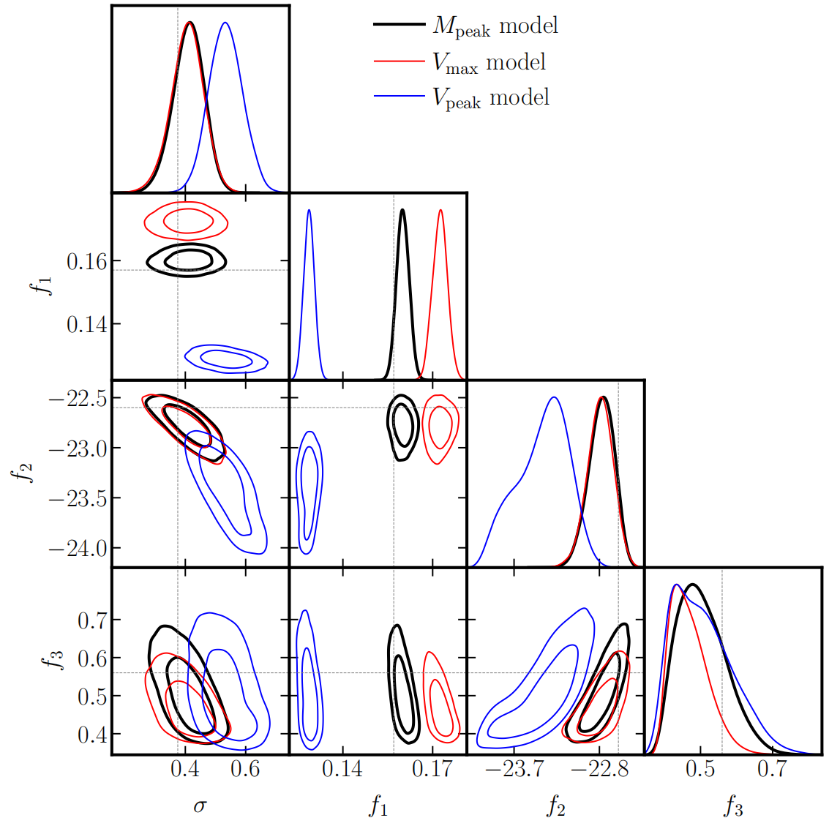
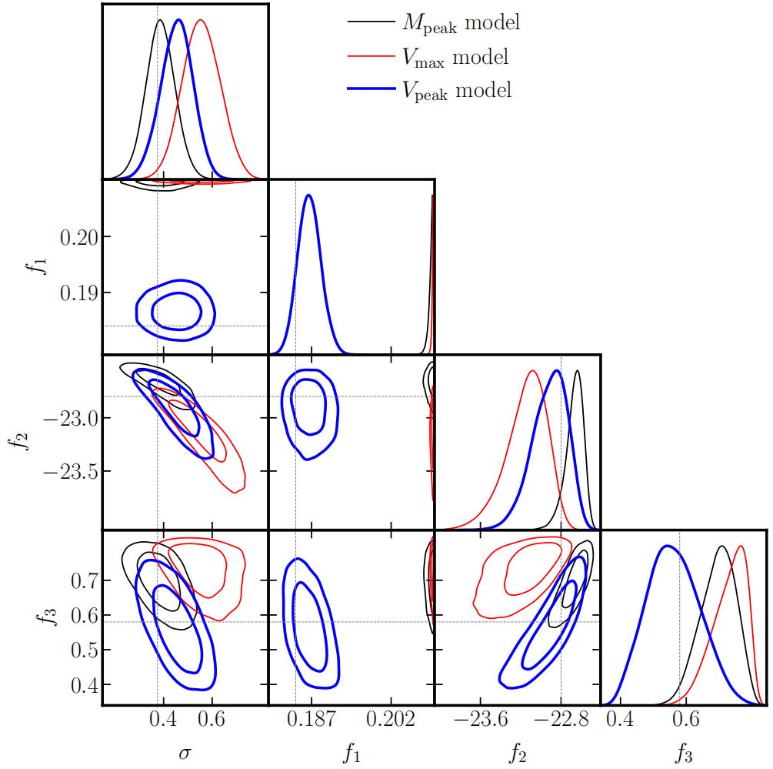
Fitting mock catalogs
fit Mpeak mock
fit Vpeak mock
satellite fraction
Xu et al 2025 in prep.

Slide 15
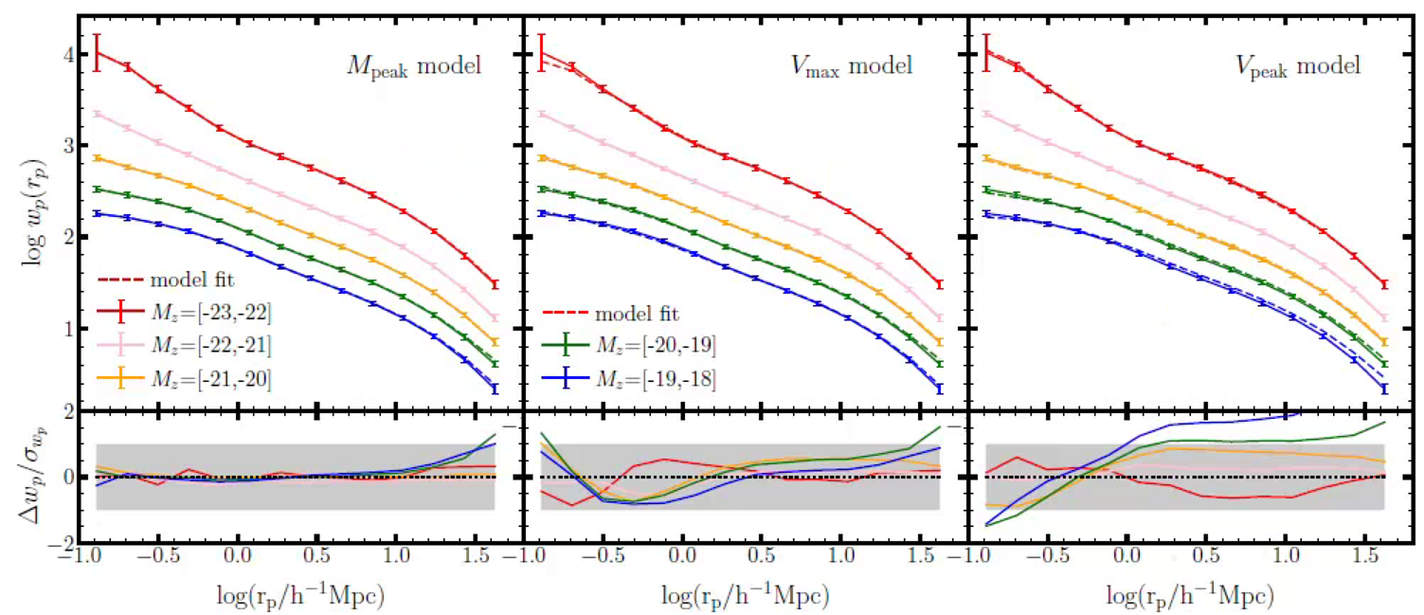
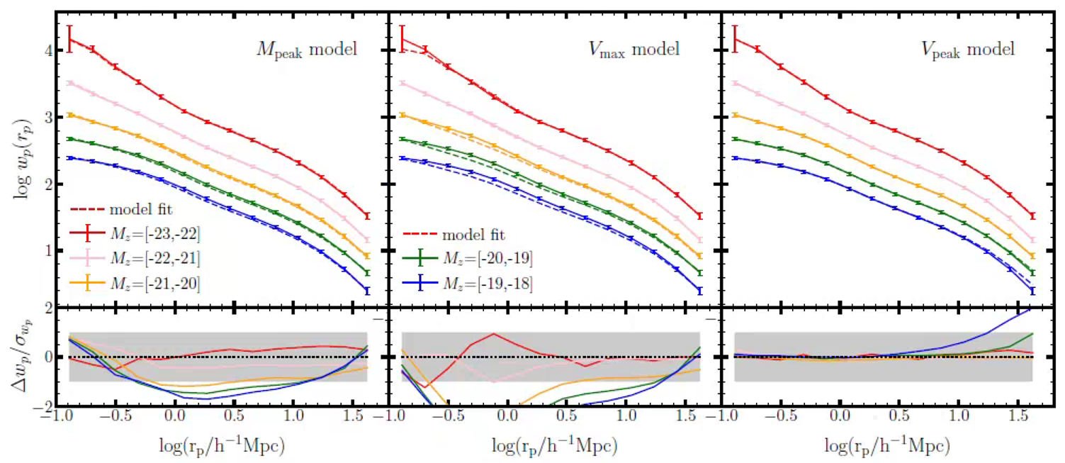
Subhalo abundance matching
Mpeak mock
(0.2*n dex is added to Mz bins except for the faintest)
Vpeak mock
Xu et al 2025 in prep.

Slide 16
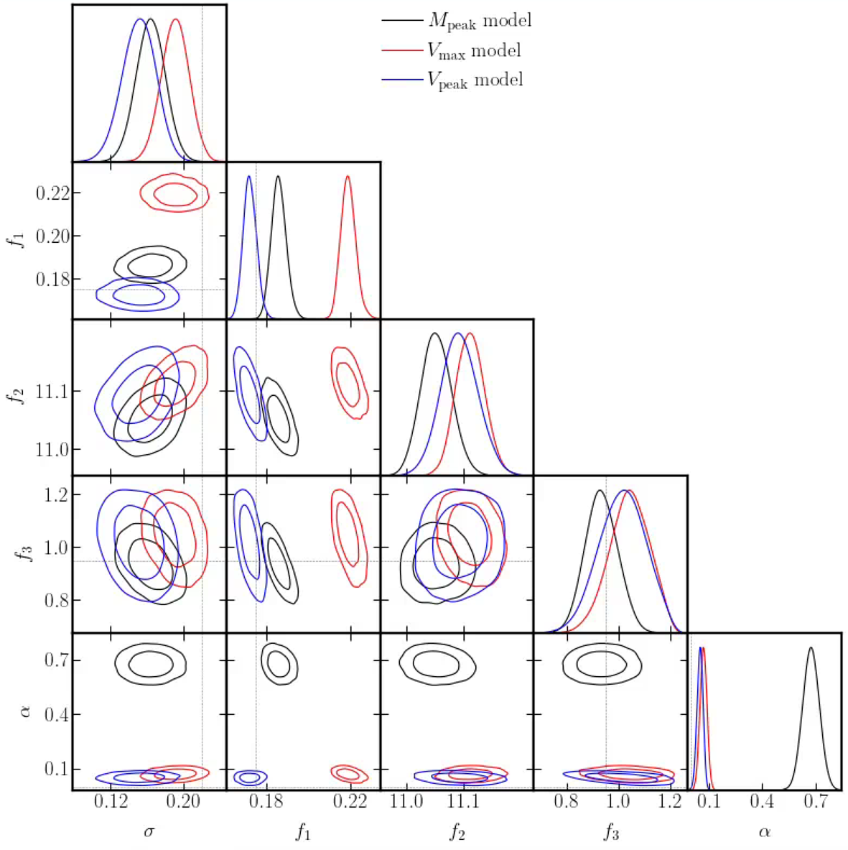
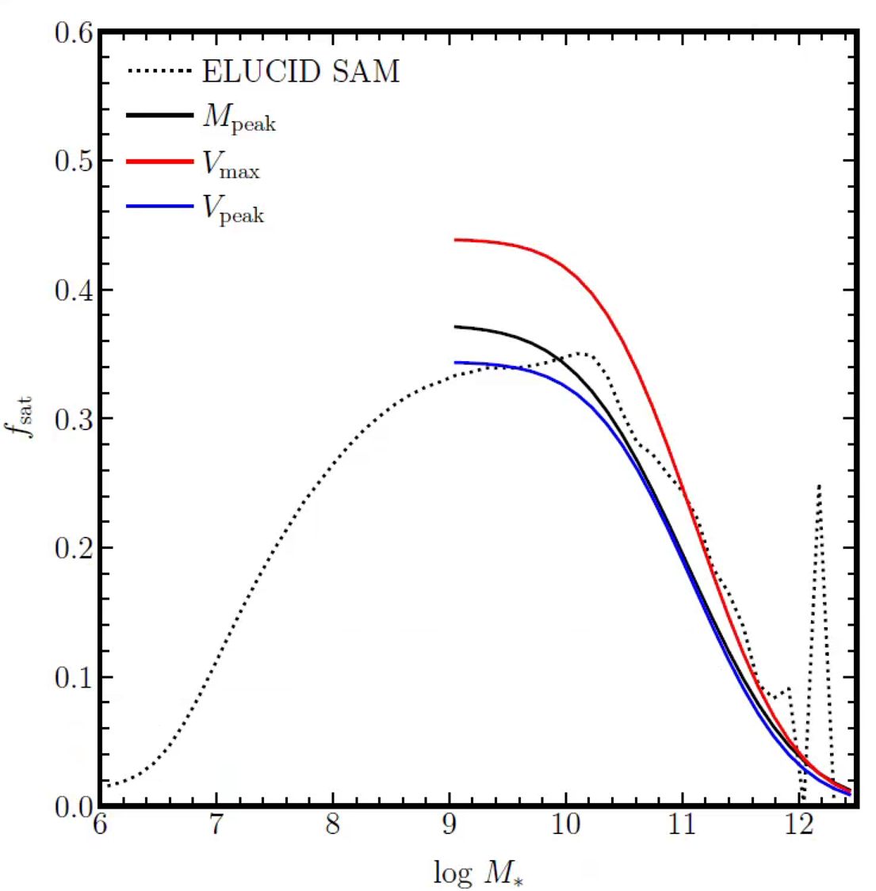
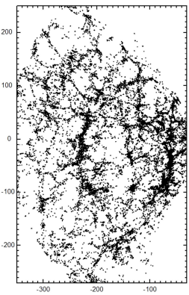
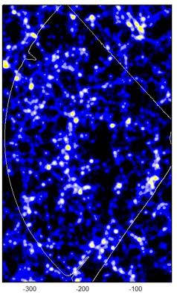
Fitting ELUCID SAM
Vmax model
Mpeak model
satellite fraction
Vpeak model
ELUCID simulation: constrained simulation to reproduce SDSS LSS
(Wang 2016)
SAM: L-Galaxies (Luo 2016)
Vpeak
Mpeak
galaxy assembly bias
Xu et al 2025 in prep.

Slide 17
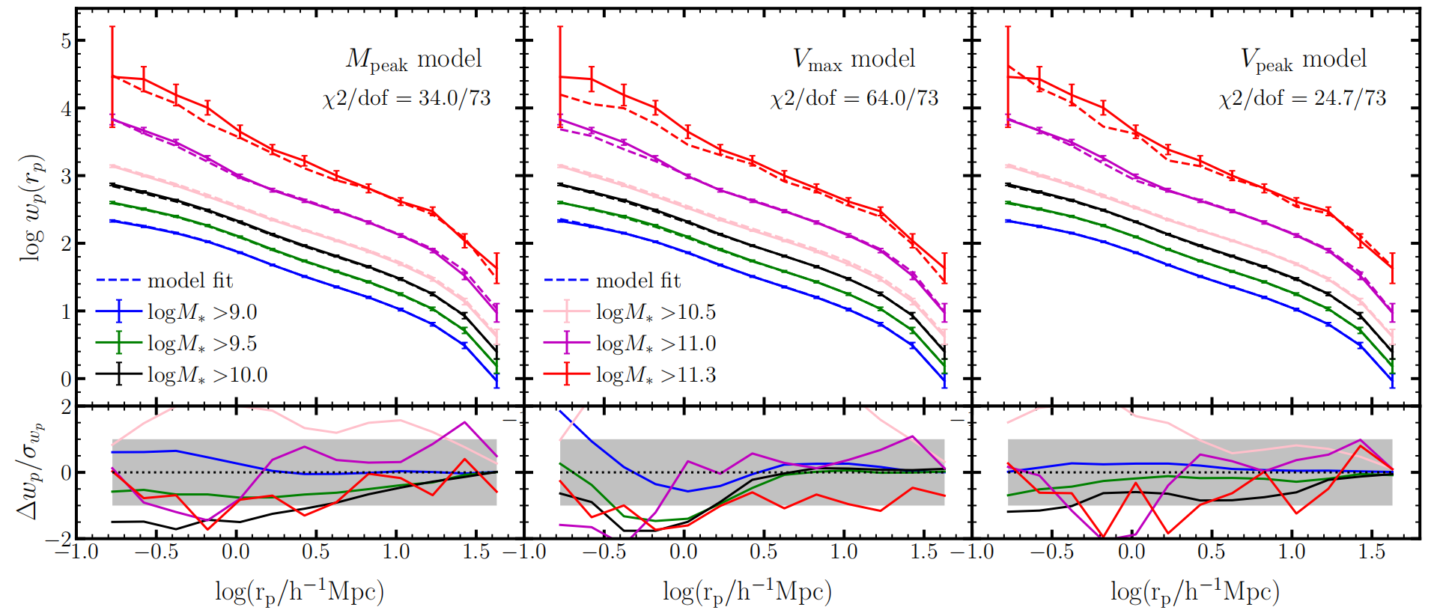
Fitting ELUCID SAM
(0.2*n dex is added to Mz bins except for the faintest)
Xu et al 2025 in prep.

Slide 18
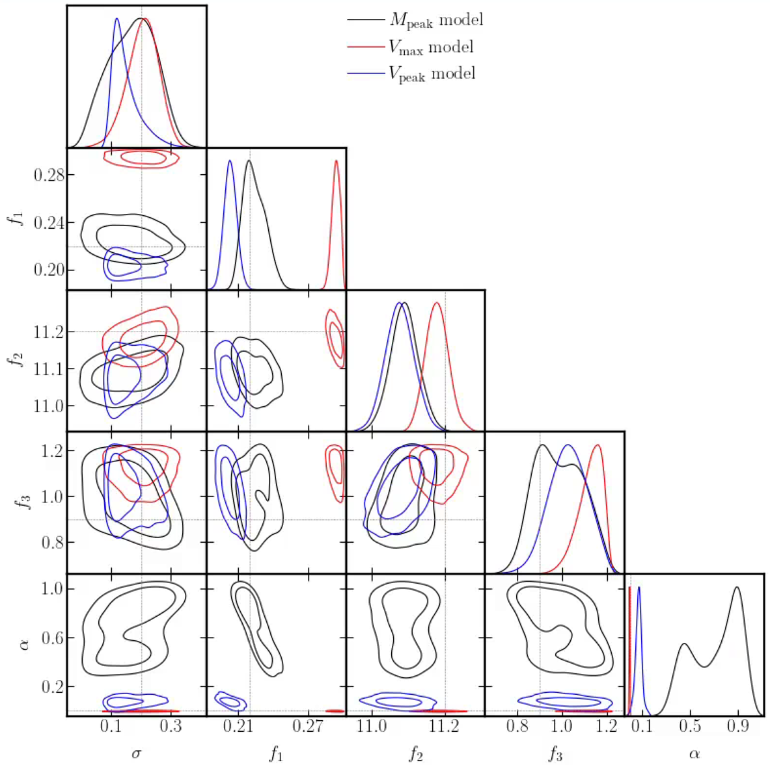
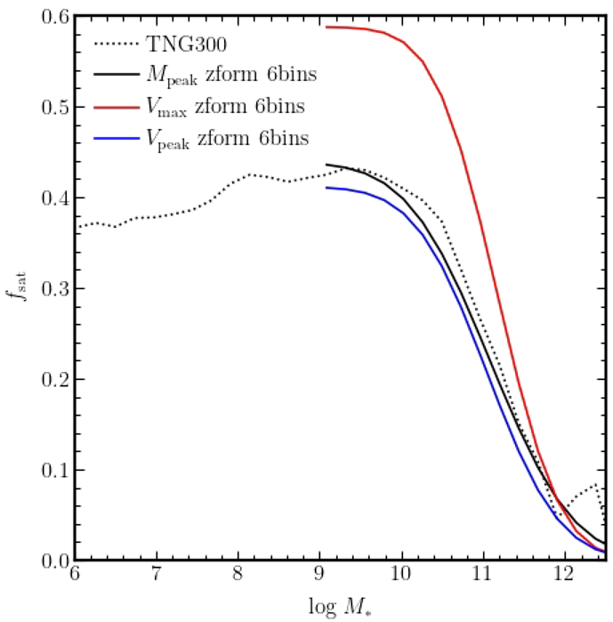
Fitting TNG300
Vmax model
Mpeak model
Vpeak model
satellite fraction
Vpeak
galaxy assembly bias
Mpeak
Xu et al 2025 in prep.

Slide 19
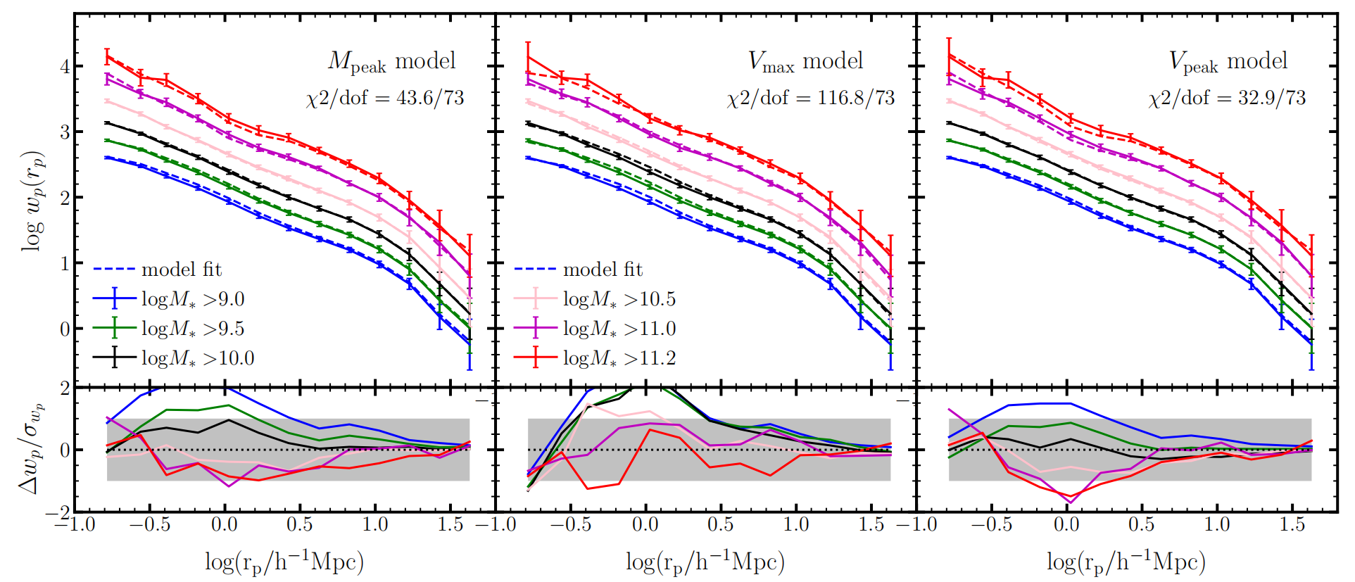
Fitting TNG300
Radial dependence when assigning galaxies to subhalos?
orphan galaxies?
Xu et al 2025 in prep.

Slide 20
Summary
modified SHAM adding satellite fraction as free parameters
constrain SHAM using mock, SAM, and hydrodynamic simulation
reproduce reasonable clustering on large stellar mass range (Mpeak need GAB)
constrain fsat as function of stellar mass or magnitude (Mpeak and Vpeak)
Future
apply the SHAM model to DESI BGS
extend to lower luminosity (Mz or Mr ~ -16)
extend the SHAM to include galaxy assembly bias (environment), satellite radial dependence, orphan galaxies, etc.
dependence on halo definition and halo boundary!

