Slide 1


Can blue-tilted primordial power spectrum save the small scale crisis in MW?
From the perspective of Zoom-In simulation for MW host size dark matter halo
Jianhao WU
MPhil student @ Chinese U of HK, Prof. T. K. Chan’s AstroSim Group
--> Join Wisconsin-Madison as a PhD student in 2025 Fall
Personal website: https://rushingfox.github.io/
Expanding the Boundaries of Dark Matter Halo, SJTU, 2025 May
Based on Paper: Cosmological Zoom-In Simulations of Milky Way Host Size Dark Matter Halos with a Blue-Tilted Primordial Power Spectrum
https://arxiv.org/abs/2412.16072 Under Review by PRD
Jianhao Wu(CUHK), Tsang Keung Chan(CUHK), Victor J. Forouhar Moreno(Leiden).

Slide 2
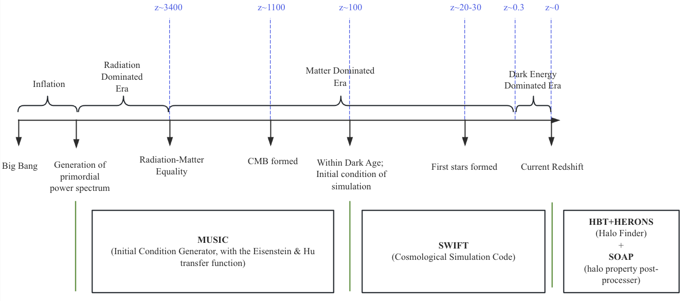
Standard Cosmology Model
The standard cosmology model consists of:
  The single-field slow-roll inflationary model, which would generate a power law primordial power spectrum at very early universe
  The LCDM model, which dominates the later evolution of the universe

Slide 3
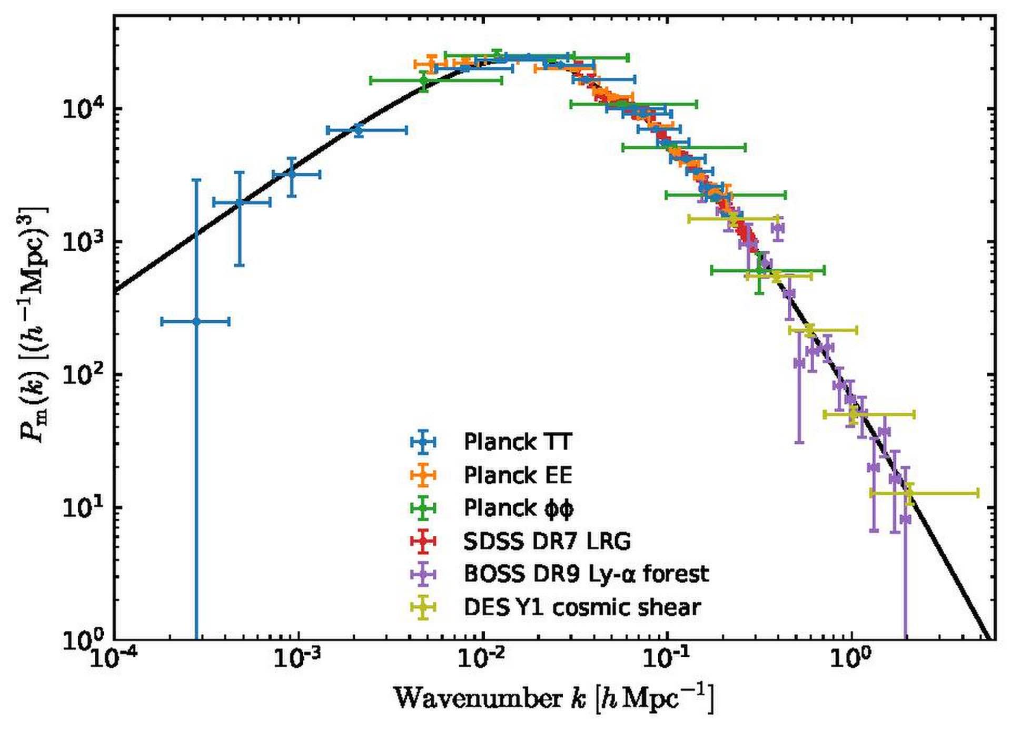
Uncertain at small scales
Standard cosmology model has achieved
great success during the past several
decades, on large scale of universe
However on small scales the primordial power
spectrum is loosely constrained
MW host dark matter halo’s size corresponds to ~2.5 h/Mpc

Slide 4
A small-scale enhanced or suppressed?
There is already paper using a small scale enhanced primordial power spectrum to explain the early formed massive galaxies in JWST
Besides, several other observations are in favor of a small scale enhanced cosmological model—we are trying to address them!
  Even CDM model could not solve the “anomalous” flux ratio problem in strong lensing: a larger fraction mass of substructure is required (arxiv [0903.4559])+ over-concentrated subhalo event is detected (SDSSJ0946+1006, i.e. “Jack Pot” lensing event)
  A too-many-satellite-galaxies problem appeared in nearby galaxy observation (arxiv [1711.06267] [2403.08717])

Slide 5
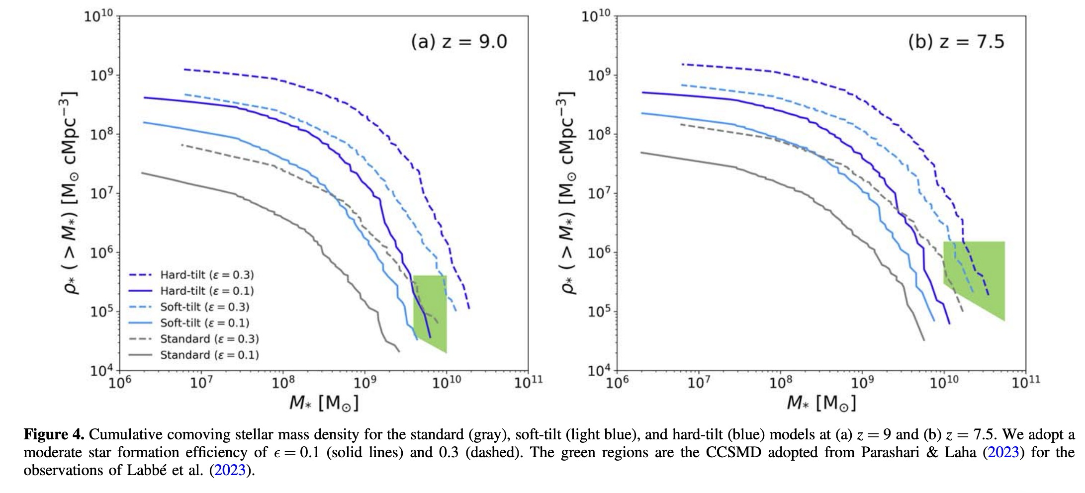
A small scale enhanced primordial power spectrum could explain JWST early structure formation!
Green region is from JWST
Could have more moderate star formation rate than standard cosmology model!
source: 2306.11993

Slide 6
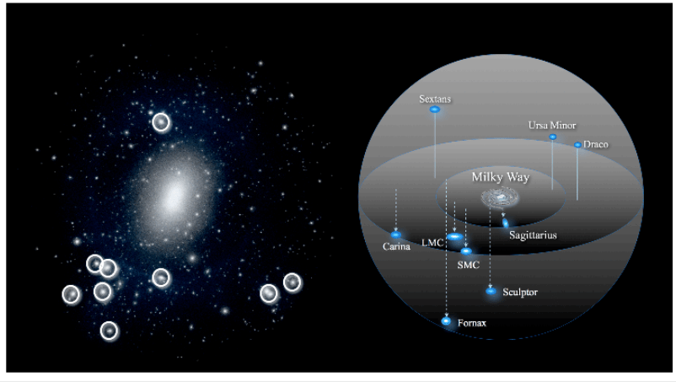
MW satellite galaxies can help constrain small scale！
A satellite galaxy is a smaller galaxy that orbits around a larger galaxy due to gravitational forces
Milky-Way has ≳50 satellite galaxies!

Slide 7
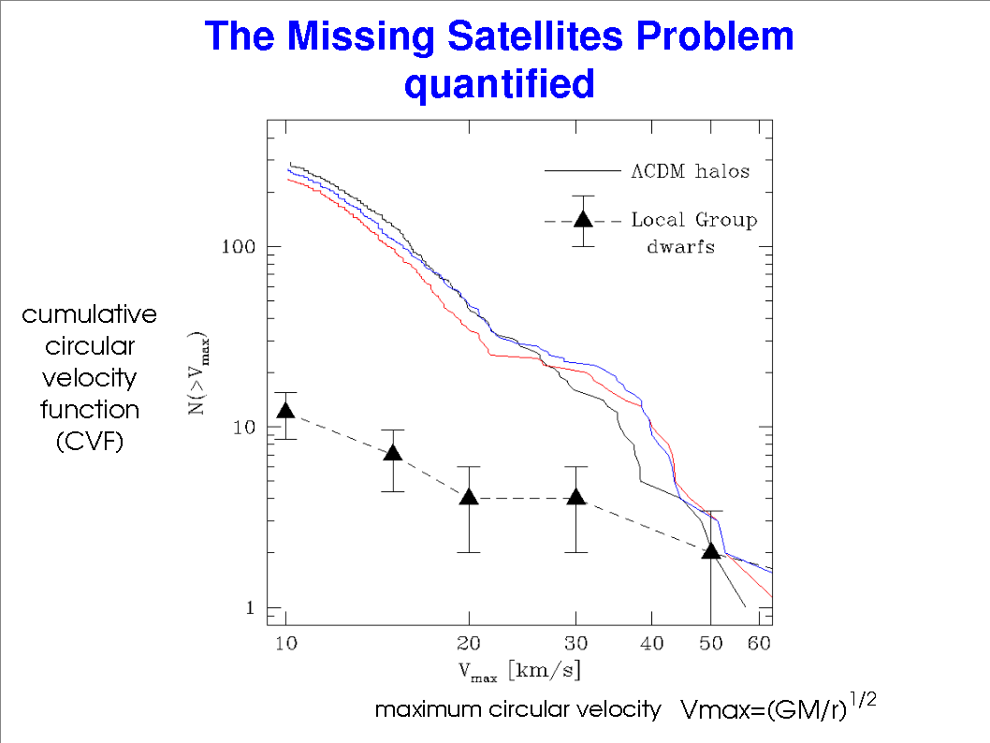
The old Missing Satellite Problem in standard cosmology model
MSP:
observation < theoretical (simulation) prediction
source: astro-ph/0401088

Slide 8
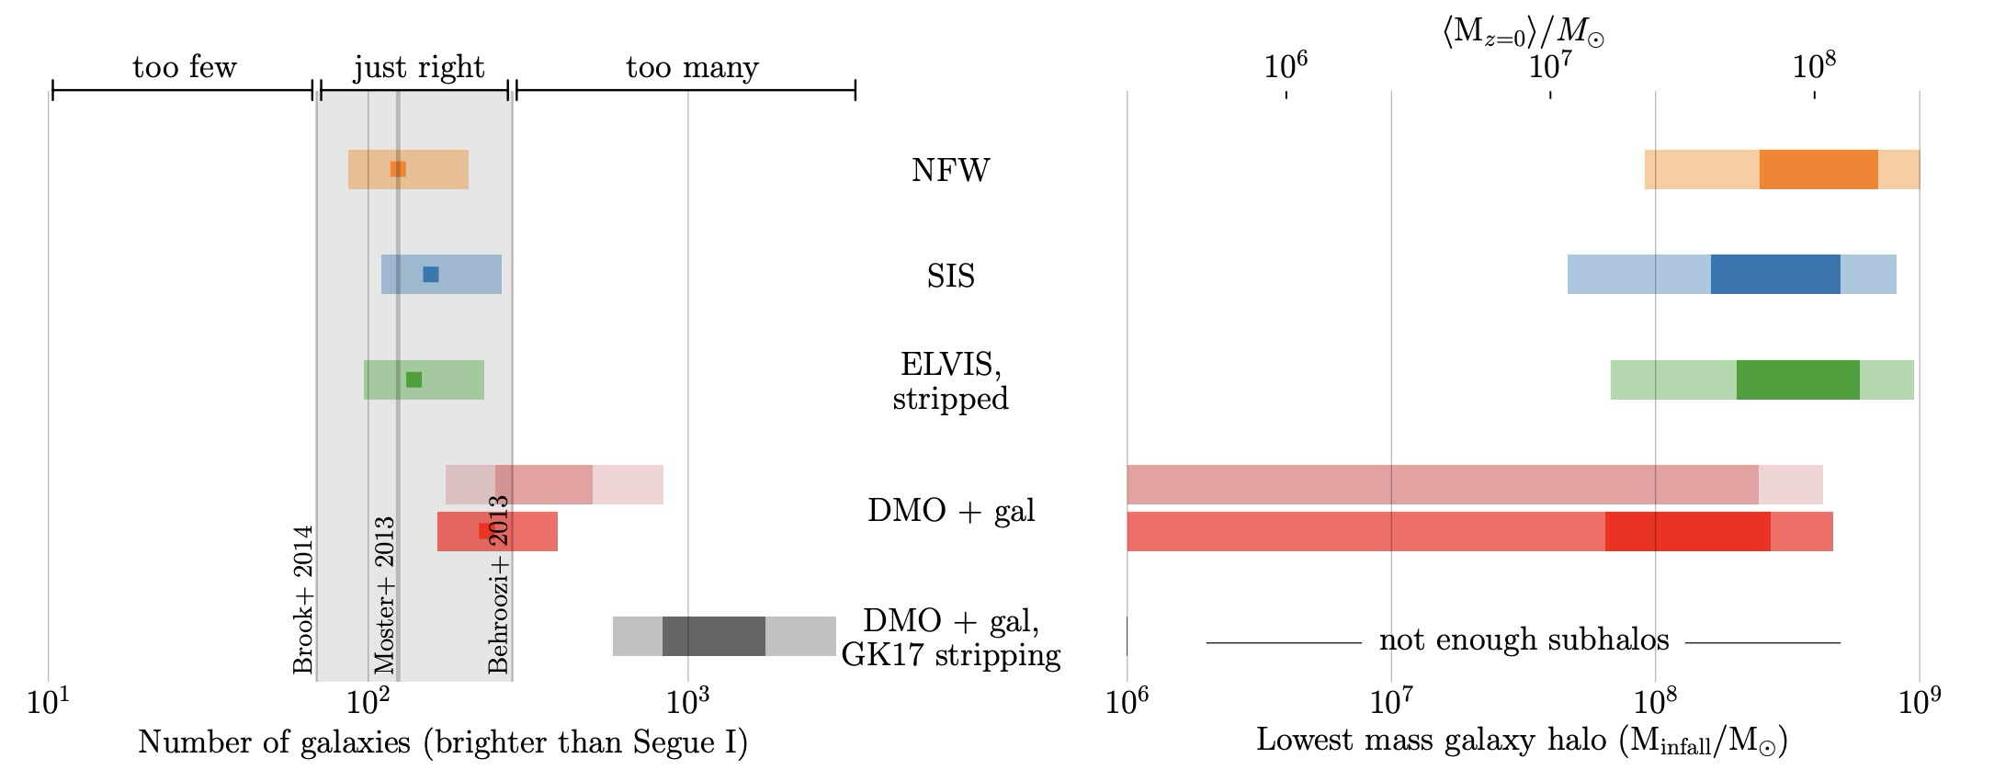
Observation is underestimated!
Then Missing Satellite Problem->Too Many Satellites problem!
Reionization could prevent star formation
Completeness Check: fainter satellite galaxy could only be observed within a much smaller radius/volume
When considering the tidal stripping by central baryonic disk of MW, the satellites would be too many!
source: arxiv [1711.06267]

Slide 9
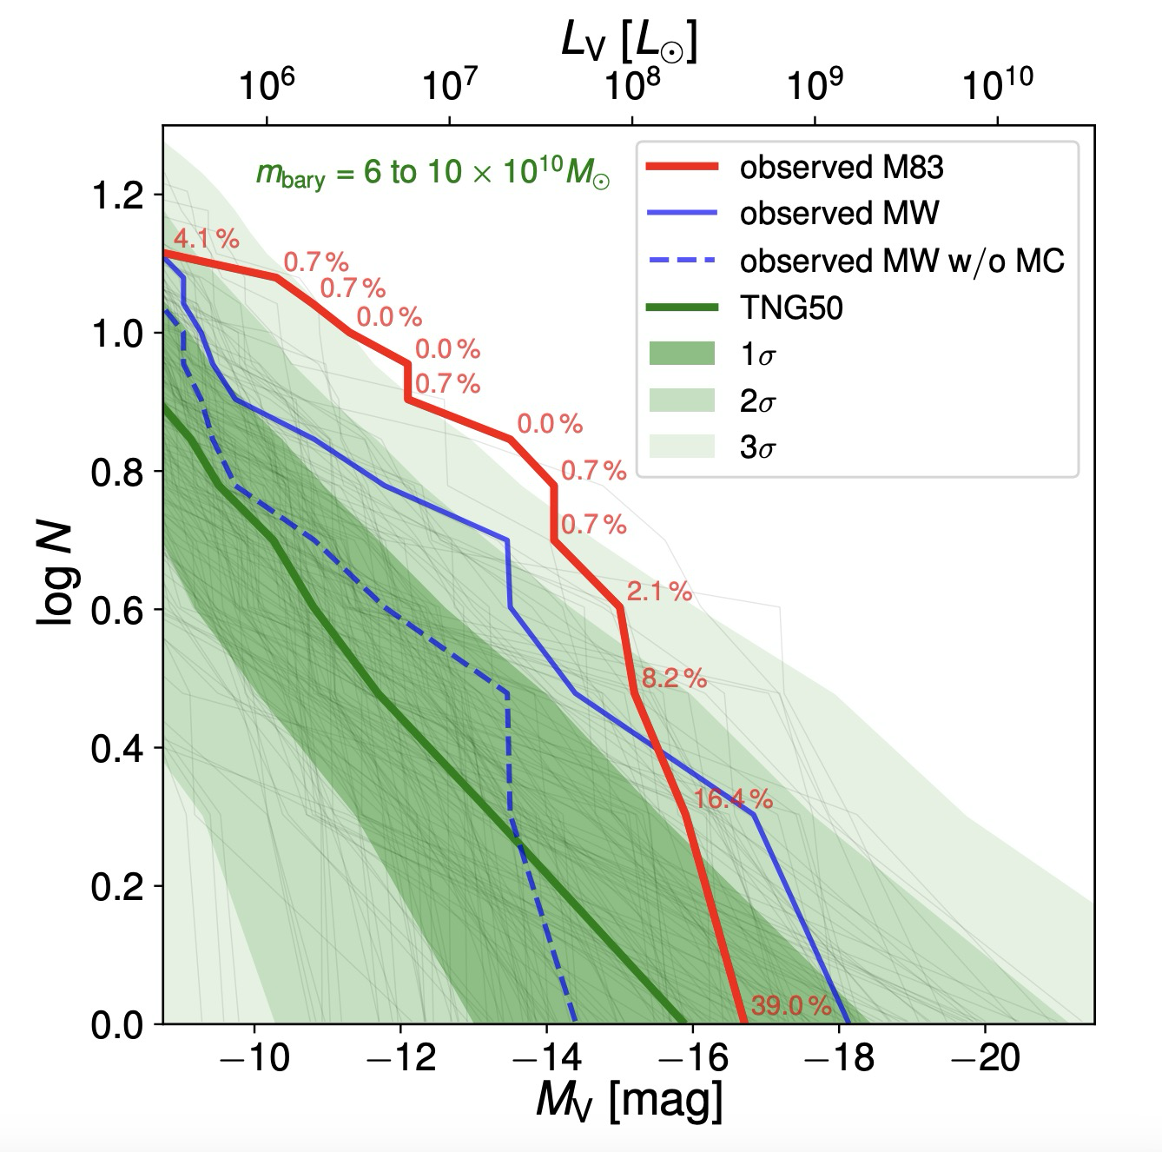
There are also direct observations for more satellite galaxies in nearby MW size galaxies!
M83 host dark matter halo is at the similar mass as MW’s!
Number of subhalos with luminosity higher than L
source: arxiv [2403.08717]

Slide 10
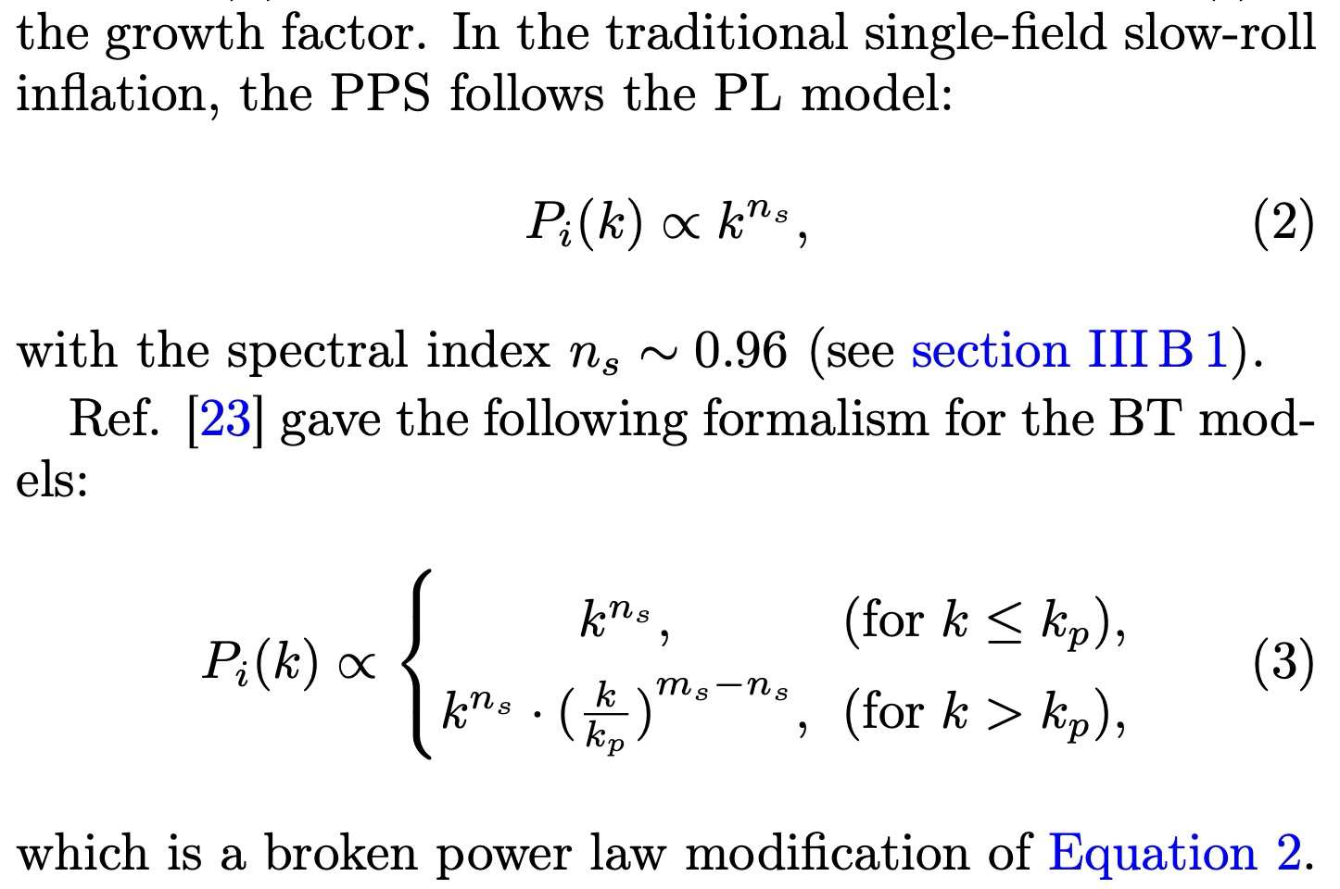
Change Power Law Primordial Power Spectrum->Broken Power Law!
Larger spectral index at small scale end (large k), to give small scale enhancement!
old model
blue-tilted model

Slide 11
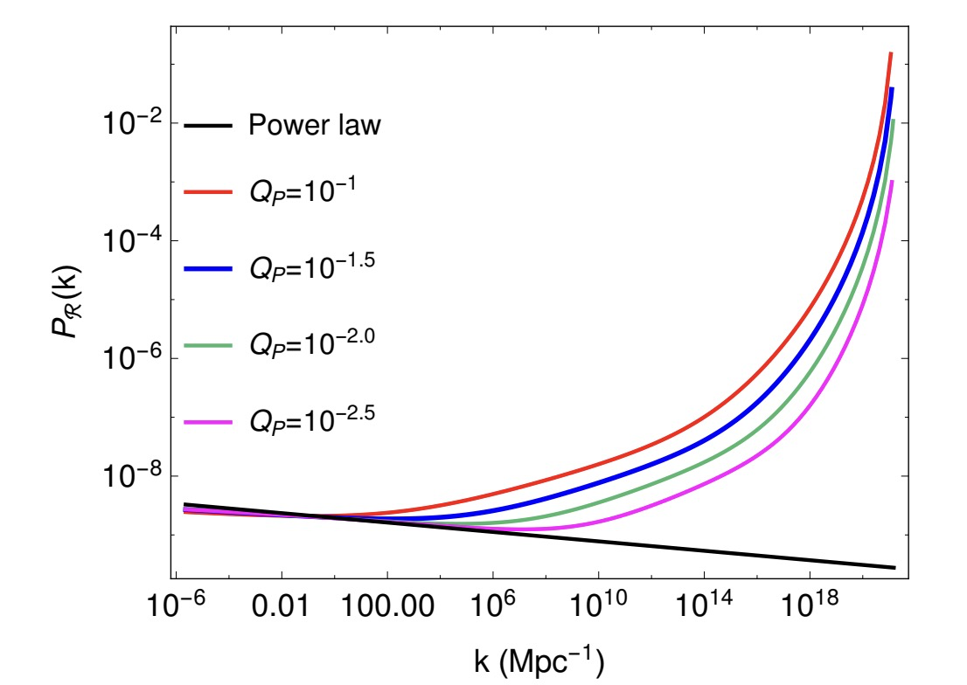
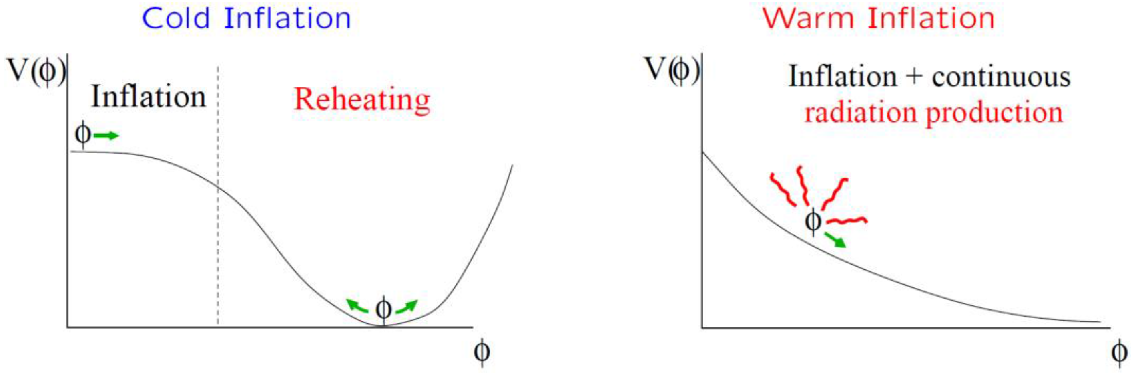
There are already some inflationary scenarios producing small scale enhancement!
Warm Inflation：
  There is a thermal bath which the scalar
  field could interact with
  The power spectrum would have small
  scale enhancement!
(Arya et al, JCAP02 (2018) 043)
(Berera et al. (2009)).

Slide 12
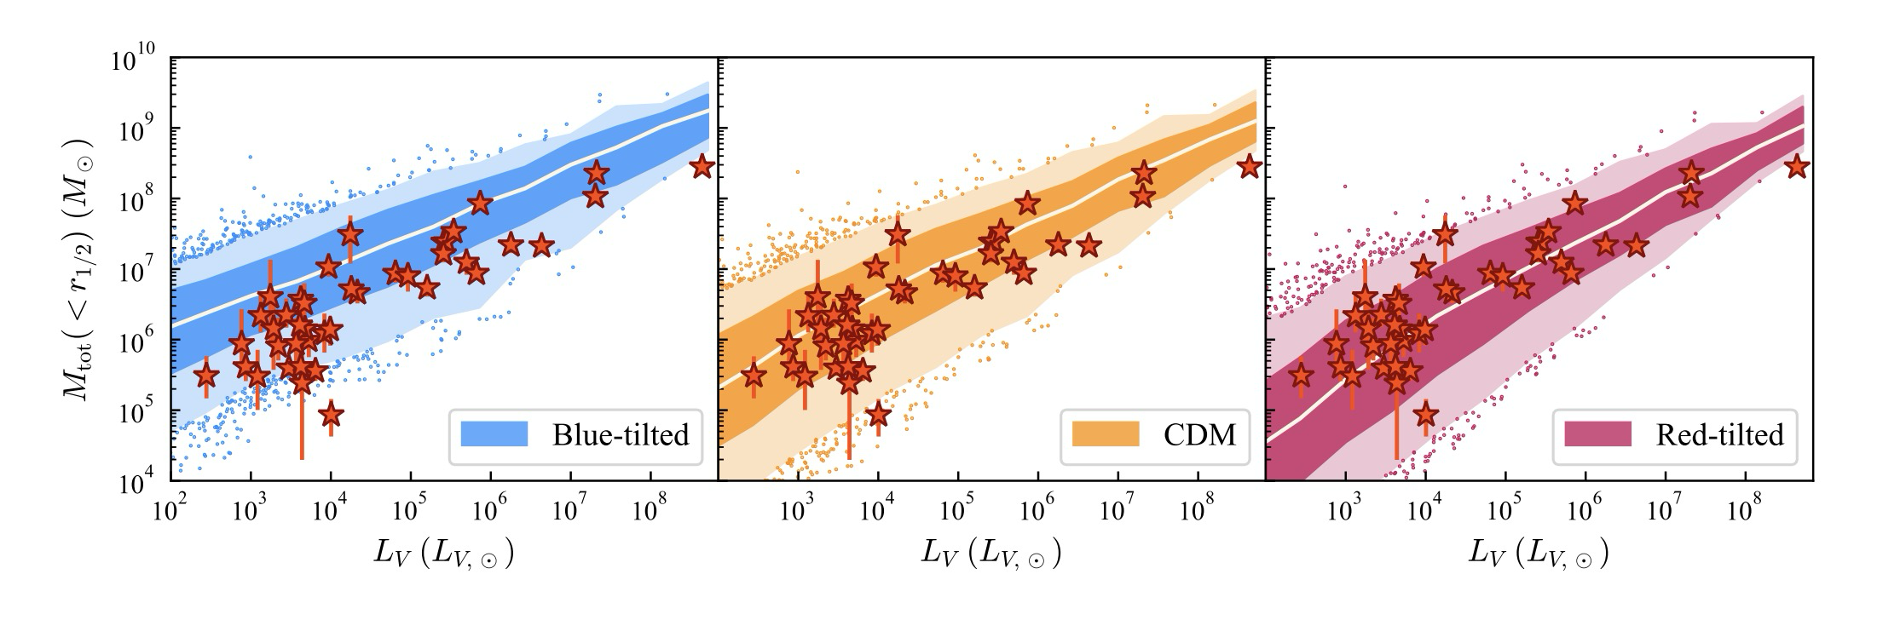
How to choose parameter sets?
Besides JWST, its hosting satellite galaxy’s central density (concentration) could also constrain Primordial Power!
They assume:
“the main effect of the change is on the halo concentration, while galaxy evolution is assumed to be unaffected.”
source: arxiv [2407.04198]

Slide 13
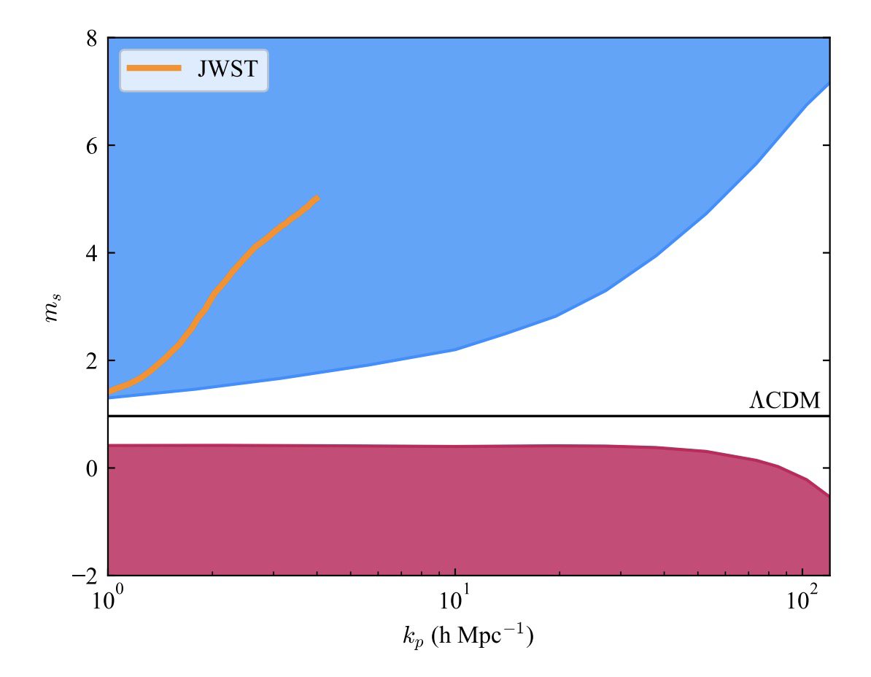
We chose two blue-tilted parameter sets within the allowable parameter space!
One could ease the tension of high star formation rate brought by JWST, while another could not
Both are within (or at least on the border of parameter space :) )
source: arxiv [2407.04198]
Two BT models we chose!

Slide 14
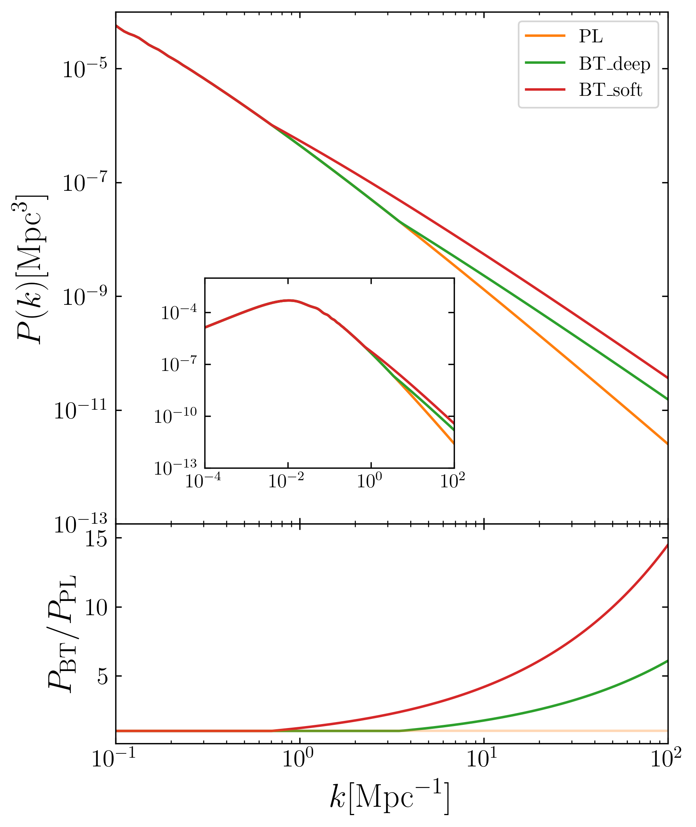
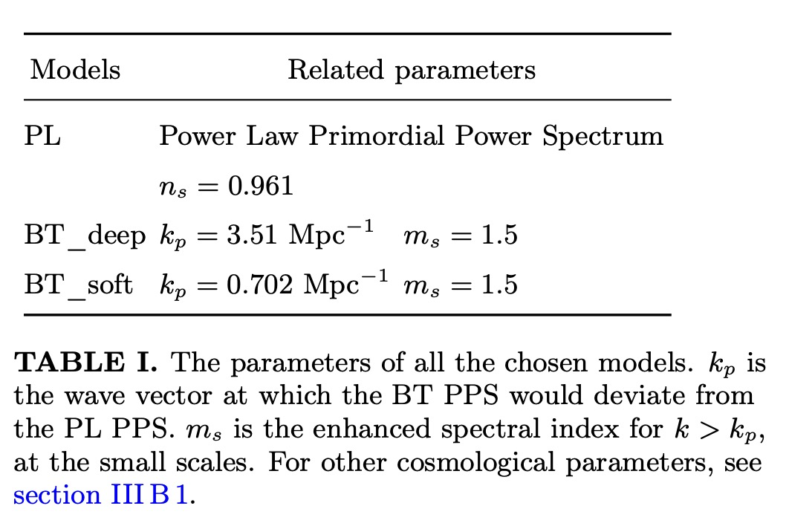
Two blue-tilted models
We chose two sets of parameters for blue-tilted
model (BT model), along with the standard model
(power-law model aka PL model here)

Slide 15
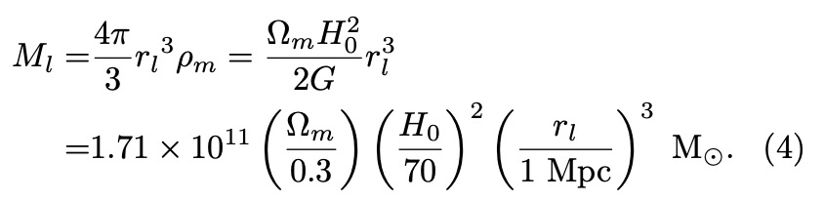

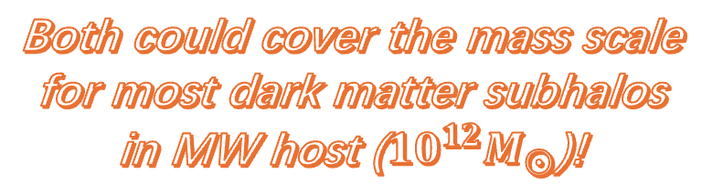

Broken point’s scale corresponds to a cosmic structure mass scale
$k_{p}$ should correspond to a mass scale for cosmic structure, only below which blue-tilted model could affect.
How to get it?
  wave number $k_{p}$ ->
  wave length λ->
  A sphere whose radius $r_{l}=\frac{1}{2}$λ
For BT_deep: $1.1×{10}^{11}M_{⨀}$
For BT_soft: $1.4×{10}^{13}M_{⨀}$
Both could cover the mass scale for most dark matter subhalos in MW host (${10}^{12}M_{⨀}$)!

Slide 16
Numerical pipeline we used
After changing the primordial power spectrum, then use cosmological simulation to evolve to current redshift!
Upper panel: universe history
Bottom panel: numerical codes

Slide 17
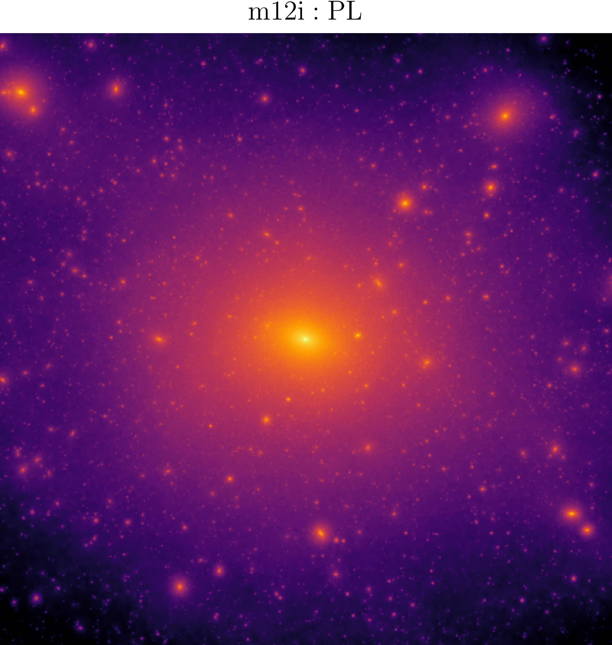
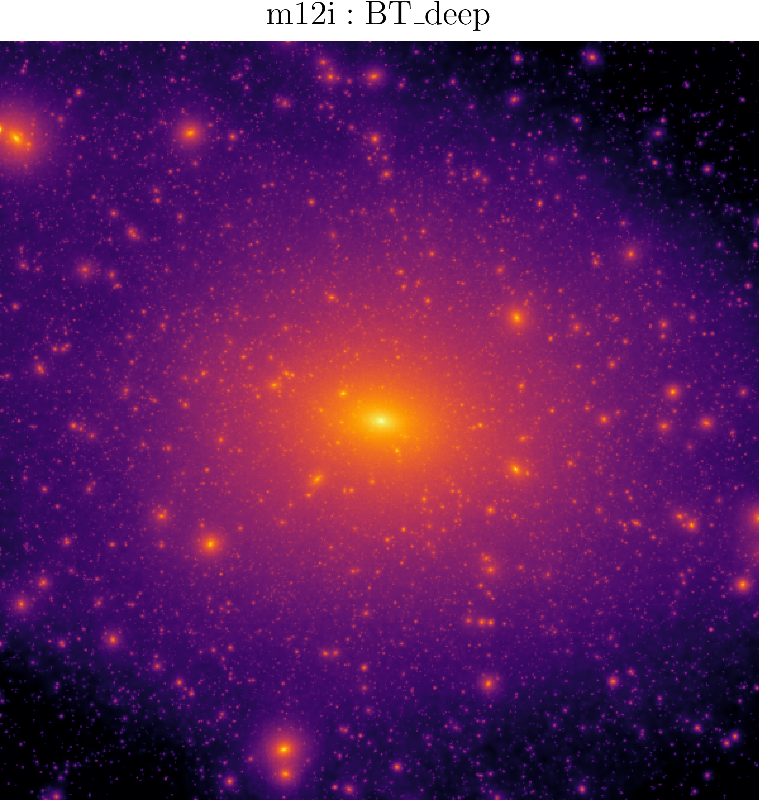
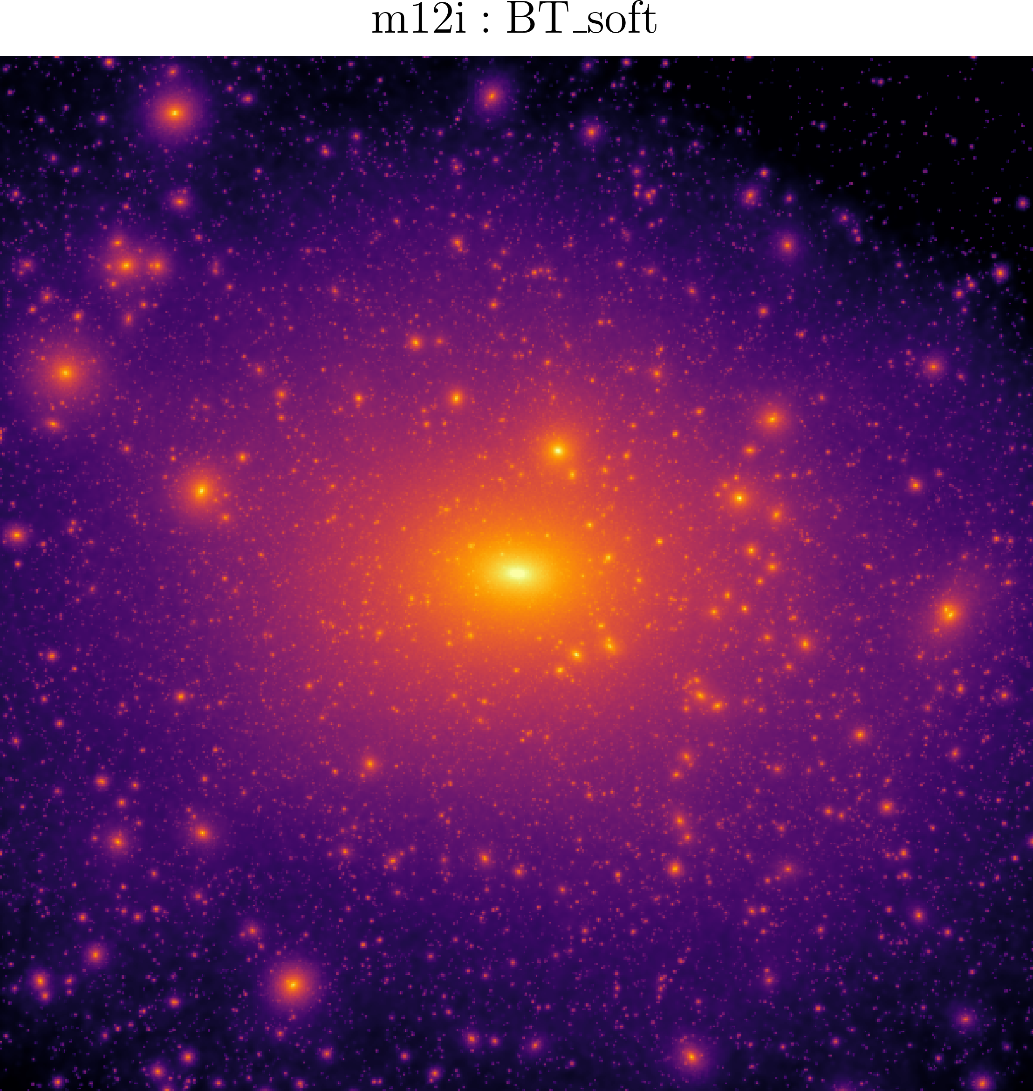
Intuitive look: projection map
dark matter 2D projection map, with side length 400 kpc
Both BT models give more subhalos than power-law!

Slide 18
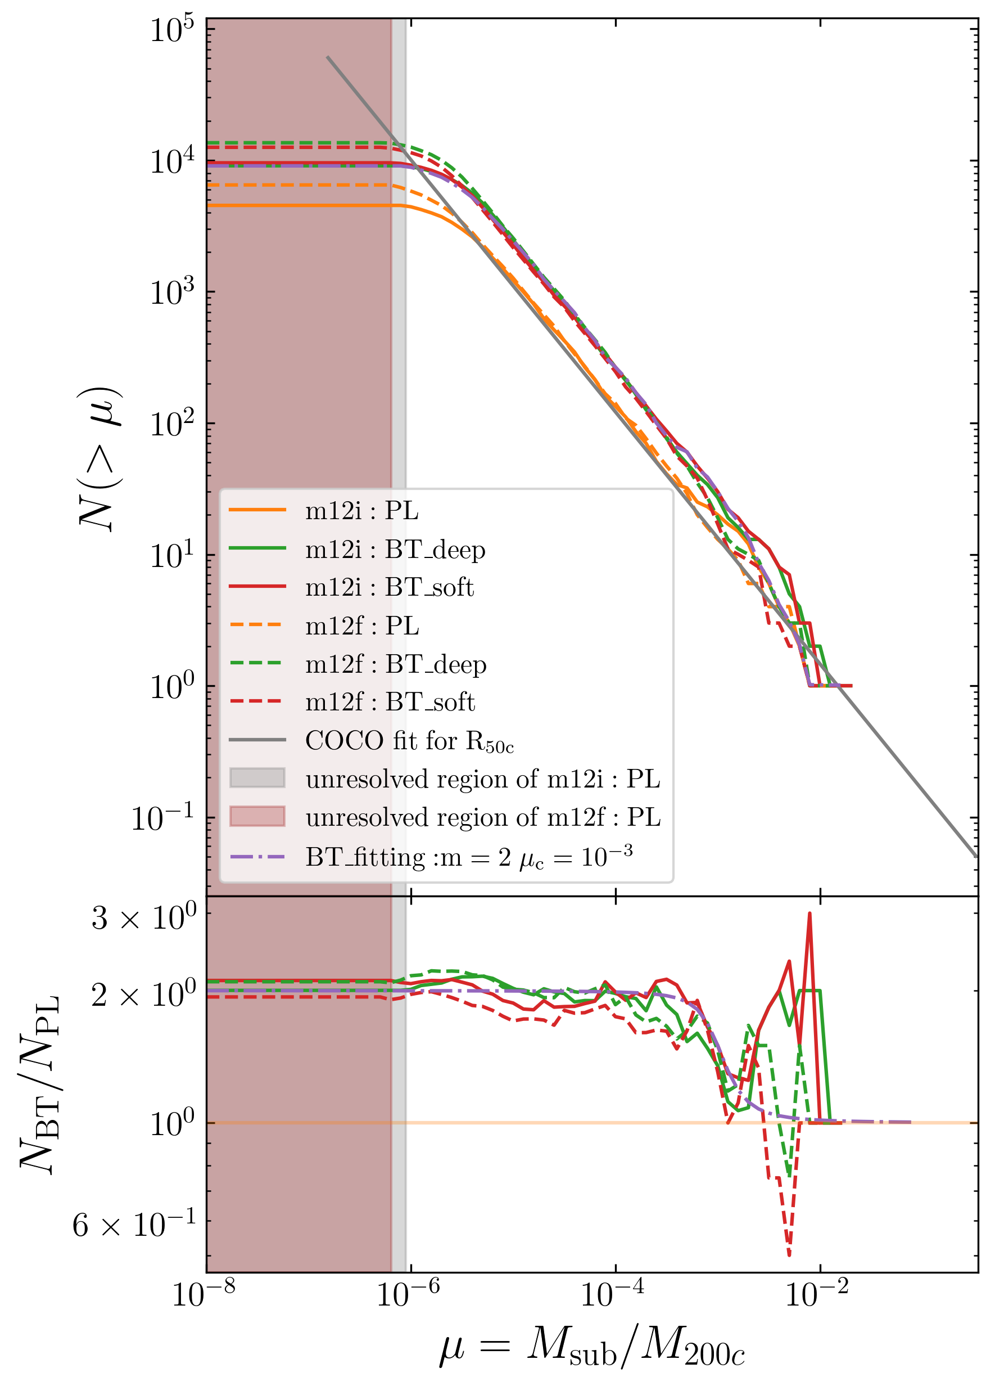
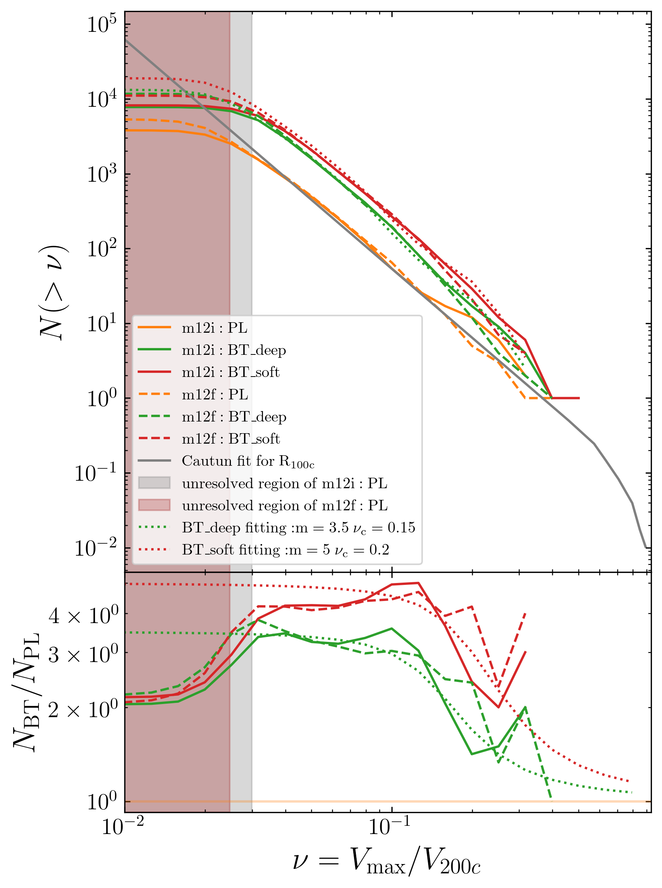
To help the Too-Many-Satellites (Mass/Vmax)
subhalo function(aka subhalo number distribution) by mass or Vmax
  subhalo mass function could
  be enhanced by a factor of two
  at low mass end
  subhalo Vmax function could
  be enhanced by more than 3
  times at low Vmax end
scaled mass
scaled Vmax
Number of subhalos
Ratios between numbers
The ratio for both functions, observes an inverse S shape function!

Slide 19
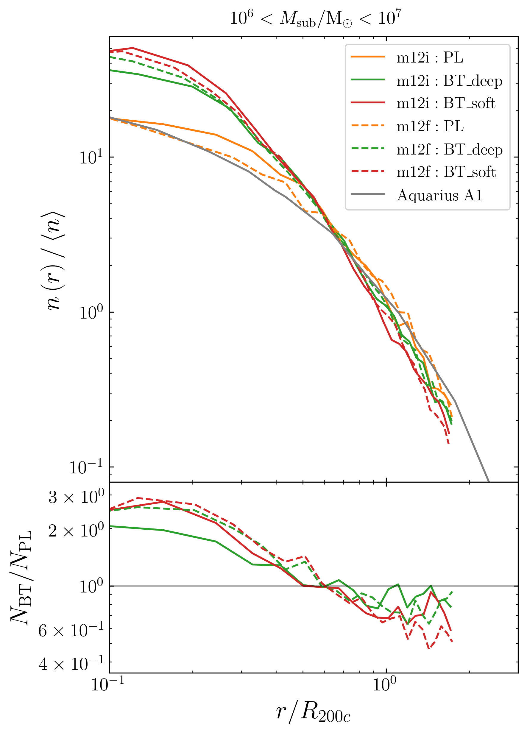
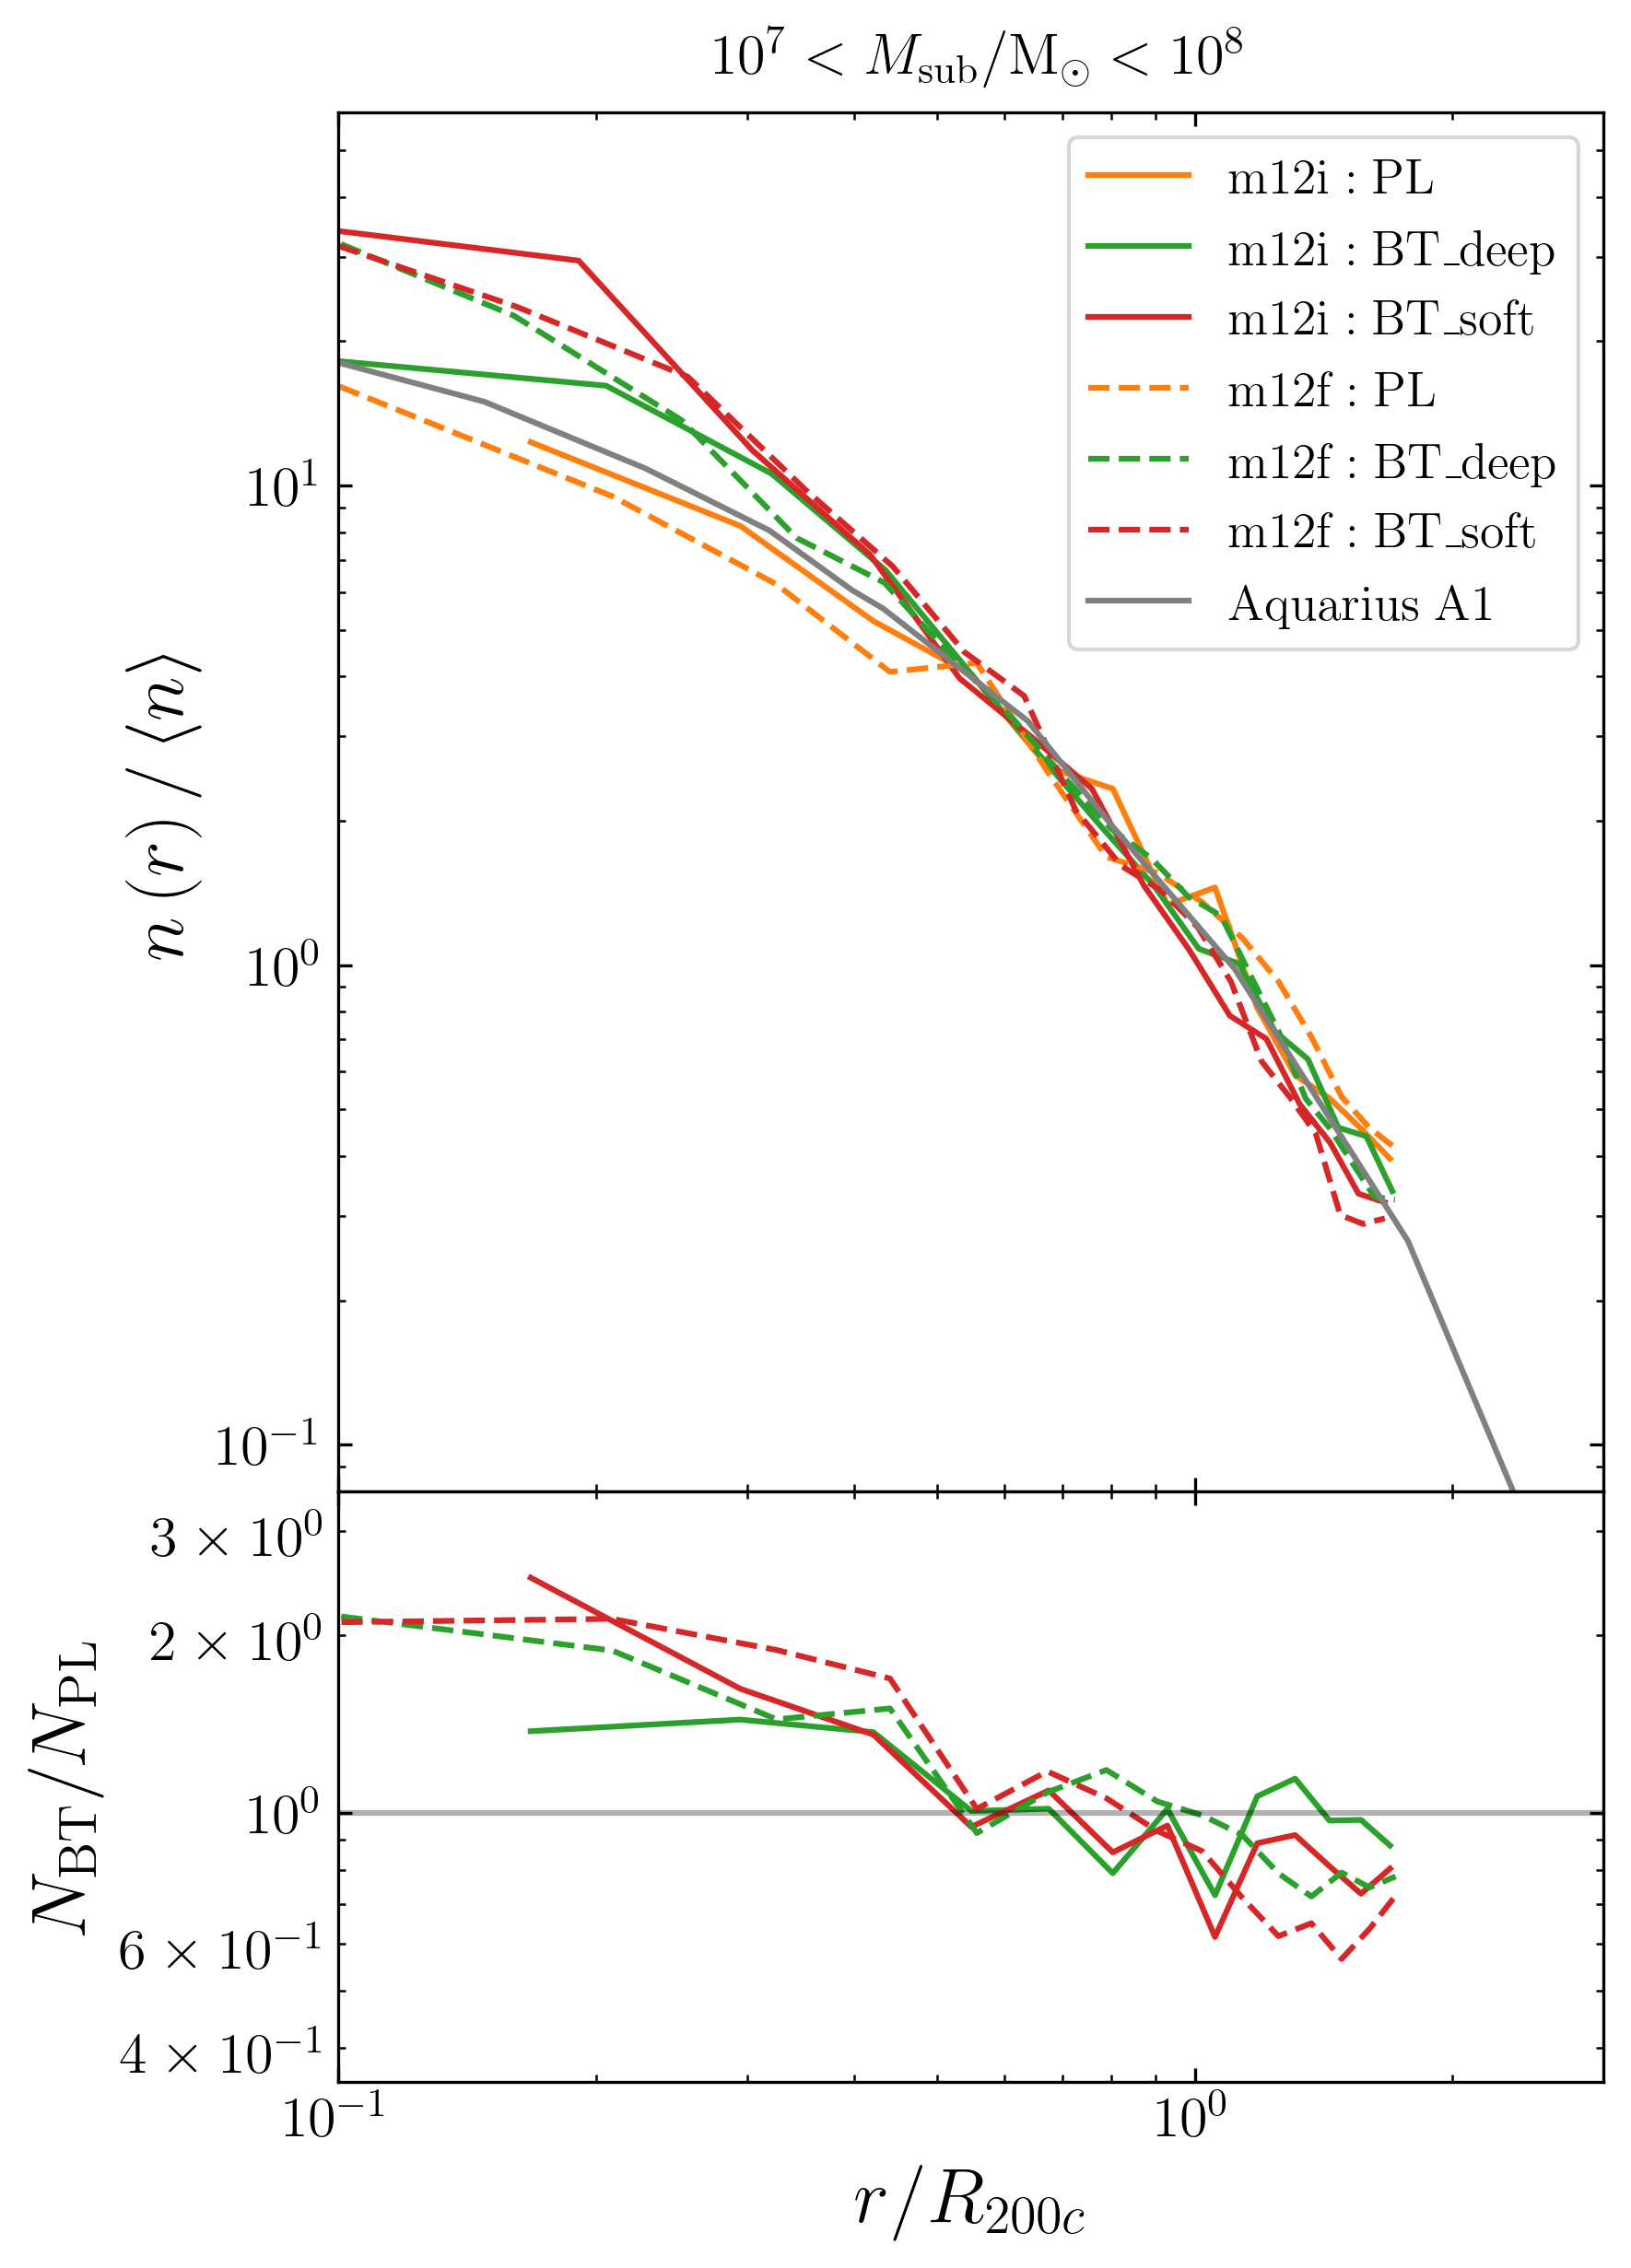
To help the Too-Many-Satellites (radial distance)
radial distance from the center of main halo
  At inner region of main halo,
  normalized number density nearly
  doubled
scaled radial distance
scaled radial distance
Normalized number density
Grey lines are the same for different mass!
(Found by Aquarius simulation [arxiv0809.0898])
Ratio(BT over PL)

Slide 20
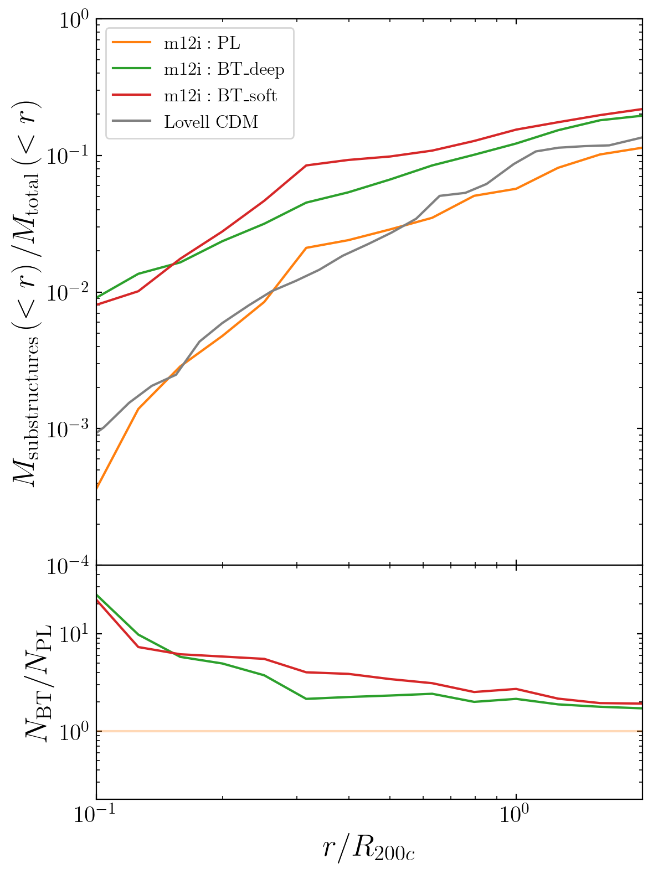
To help Strong Lensing(larger substructure fraction)
scaled radial distance
substructure mass fraction:
  Defined as mass of particles belonging to substructures(within radius r)/total mass(within radius r)
  CDMO simulation is insufficient to explain strong lensing result (arxiv [0903.4559])
  Blue-tilted model could reach an order of magnitude enhancement compared to traditional model
Substructure Mass Fraction
Ratio(BT over PL)

Slide 21
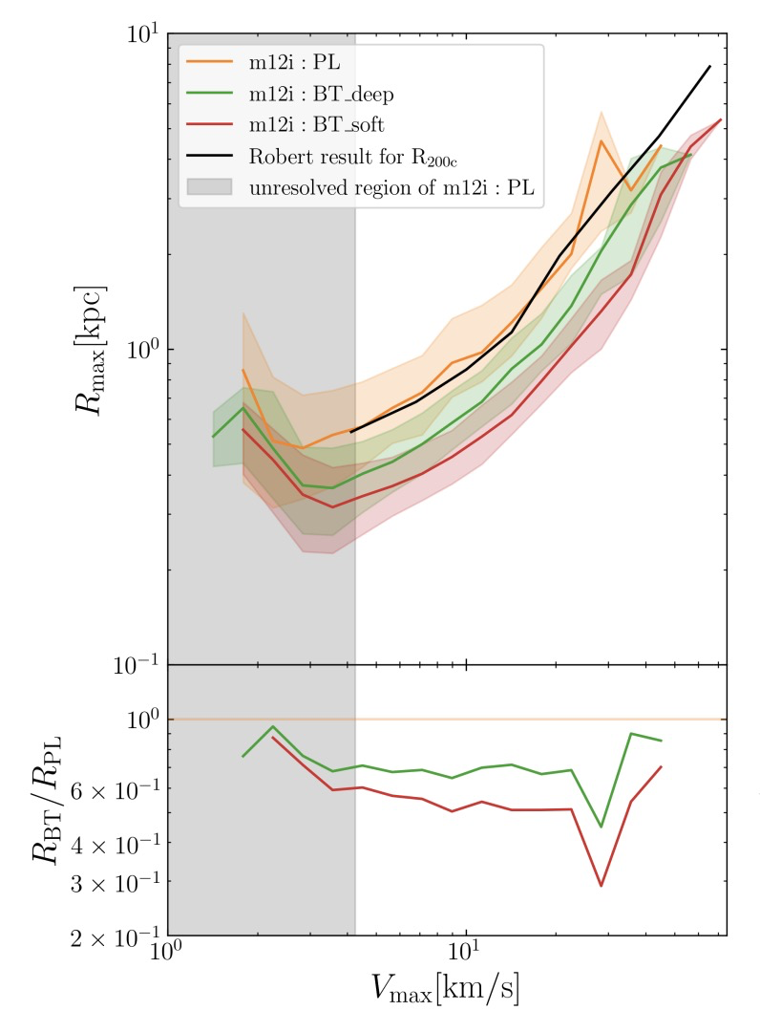
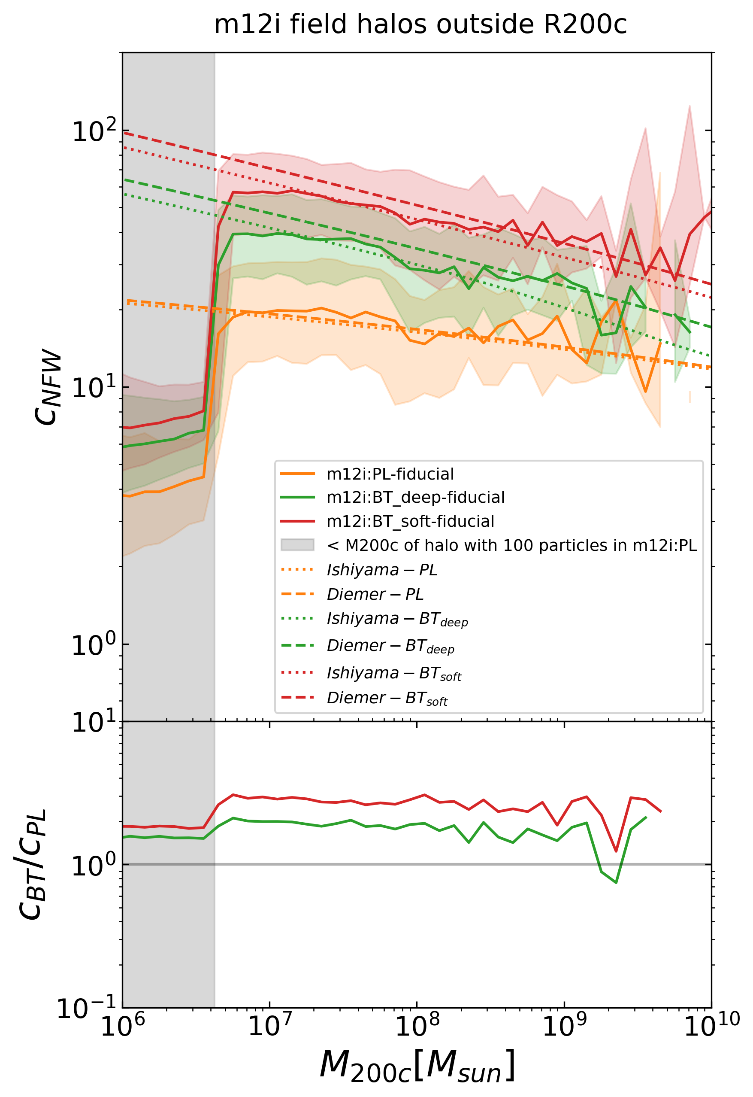
To help Strong Lensing (more concentrated subhalo)
Maximum circular velocity
M200c
Wu, TKC [In prep 2025]
The median Rmax/Cnfw within one Vmax bin
Ratio(BT over PL)

Slide 22
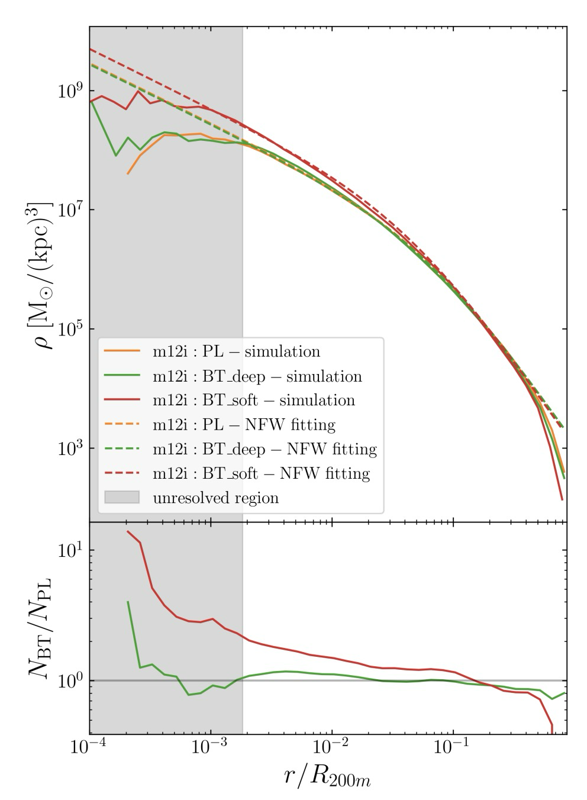
By-Product:Main halo becomes more concentrated
scaled radial distance
But only in BT_soft, BT_deep is very close to standard model!
And That fits well with our prediction!
radial density
Ratio(BT over PL)

Slide 23
Conclusion
We use cosmological simulation to show that a small scale enhanced early universe model could indeed generate more substructure, potentially help to the small scale debate in cosmology:
  More subhalos in terms of mass, Vmax and distance
  Larger fraction of substructure mass & More concentrated subhalo
Currently working on follow-up projects: matching with satellites counts & strong lensing observation

